Slide 1
Solid-State Batteries
Vitor Ferreira Grizzi

Slide 2
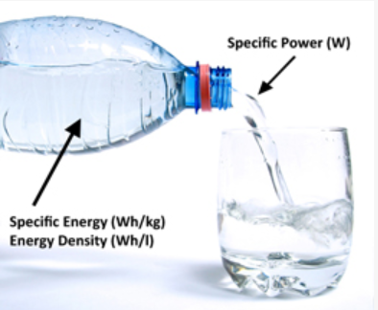
Background Information
Specific Energy (Wh/kg) and Energy Density (Wh/L)
Specific Power (W/kg) and Power Density (W/L)
Battery main components:
Electrolyte
Separator
Cathode (+) and Anode (-)
Source: https://batteryuniversity.com/article/bu-105-battery-definitions-and-what-they-mean
Notes:
In this section I will introduce some concepts that will be used throughout the presentation.
Specific Energy and Energy density tell us how much energy the battery can store per unit mass or unit volume.
As for Specific Power and Power Density, indicates how much of the stored energy can be released per unit mass unit time or per unit volume unit time. In other words, how much power the battery can delivery. A high specific power, for instance, tell us that it can deliver a lot of power per unit mass.
Another point is that both concepts are unrelated, i.e. a high specific energy is not related to a high specific power and vice-versa. A Battery A may be able to store only enough charge to power a lightbulb for 1 minute, while still being able to deliver 1 Ampere if needed (low energy, high power). Battery B may be able to store enough energy to power the exact same bulb for an hour, while only being able to deliver 1 milliampere if needed (high energy, low power).
I will explain the main battery components on the next slide because it has a figure.

Slide 3
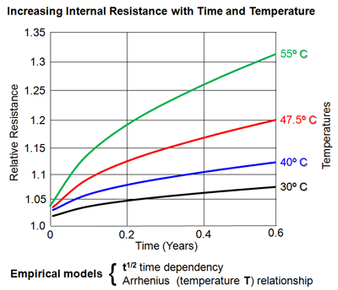
Background Information
Self-Discharge
C-rate
Battery Cycle Life
High temperatures
Overcharging
Deep discharges
High discharge rate
Battery Deterioration
Internal Resistance
Loss of Electrolyte
Source: https://www.upsbatterycenter.com/blog/battery-life-cycle-vs-cycle-life/
Notes:
Self discharge is when a battery releases its energy even though it is not being used.
Batteries are also characterized by their C-rate. It tell us the amount of current a battery can release in one hour. For instance, 1 C-rate means that the battery can be charged in one hour; 2 C-rates mean that it can be charged in half an hour and so on. High C-rate batteries can be charged or discharged very fast and produce a lot of power.
Battery cycle life is measured in charge cycles. Usually, the industry uses as benchmark the number of cycles for the battery to reach 80% of its original capacity. Factors that affect battery cycle life are high temperature, overcharging (keep charging if the battery is 100%), deep discharge (let the battery reach 0%) and high discharge rate (release all the energy of the battery in a short period of time)
As we can see, from the plot, both time and temperature deteriorates a battery. The internal resistance increase as a function of time and temperature from the plot. It depends on the ionic conductivity of the electrolyte, ion mobility, and electrode surface area.

Slide 4
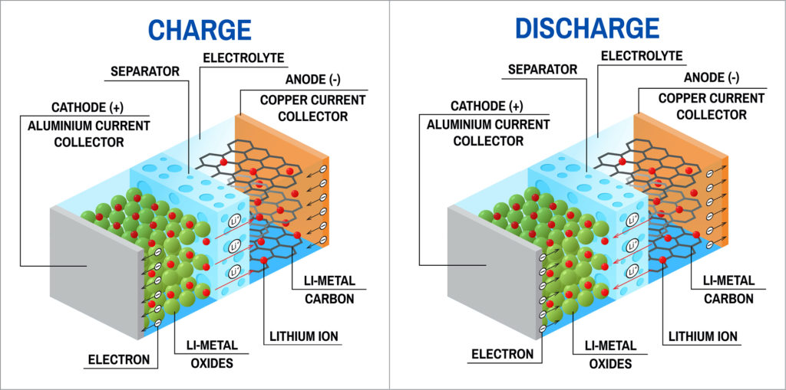
How do batteries work?
Source: https://www.electronicsforu.com/market-verticals/power-electronics/lithium-ion-batteries
Notes:
In this section I will explain how batteries work. I will use the well-known Li-ion as an example because it is in our everyday life and thus it will be easier to understand. Also, solid-state batteries are expected to replace Li-ion batteries, so it will be good to know how Li-ion batteries work to contrast them. Explain battery main components
Electrolyte => Is a medium that contains a solvent that conduct ions. It is usually either a liquid or a gel in most batteries. They also contain other chemical additives
Separator => Is a semiporous membrane, usually made of polymers, that allow the passage of ions but impedes the passage of electrons. If they melt or shrink, the anode and cathode get in direct contact and the cell may shutdown or short-circuit and caught fire in some cases
Cathode / Anode => Is where the electrons from the redox reaction are collected or the contact between the interior of the cell and the external wire
For how the battery works, check the explanation on fis.txt.

Slide 5

The problem with Li-ion batteries
Environmental Impacts:
Solid Waste & Recycling
Mining
Decreasing capacity at each charge/discharge cycle
Safety Issues:
Fire Hazard
Poor cooling, overcharge, mechanical damage, internal short-circuit
Damaging and overloading
Voltage limits
Transportation
Thermal Runaway
Source: https://miningdigital.com/top10/5-largest-lithium-mining-companies-world
Notes:
In this section I will discuss the problem with Li-ion batteries for us to understand why the industry want to replace it by solid-state batteries.
Solid-State battery will nullify or mitigate all these issues. In environmental impacts, although Li-metal solid-state batteries still need lithium, they are much more efficient so the lithium will find better use. In that sense, the environmental issues associated with lithium mining is mitigated.
Fire Hazard => Flame retardant additives (FRA) is an effective strategy to reduce flammability in electrolytes. Fire can happen as a result of poor cooling, overcharge, mechanical damage, internal short-circuit (separator may melt or shrink/deform). The electrolyte in Li-ion batteries cannot be exposed to air.
Thermal runaway => It occurs when the temperature inside a battery reaches the point that causes a chemical reaction to occur inside the battery. This chemical reaction produces even more heat, which drives the temperature higher, causing further chemical reactions that create more heat.
The capacity of Li-ion batteries deteriorate in time. To avoid that, they should be kept in a cool environment (manufactures recommend around 15 C) and don’t fully charge or discharge the battery. The optimum range is to keep them between 20-80 (although 20-50 would be better for the battery life but it is a waste). Battery management systems are used to control that.
In EV up to 1 hour of recharger time and battery needs to be replaced every 10 years.

Slide 6
Historical Perspective of Solid-State Batteries
Michael Faraday discovered solid electrolytes made of silver sulfide (Ag₂S) and lead fluoride (Pb₂F)
By the end of 1950s, a lot of electrochemical systems used solid-state batteries
In the 1990s, Oak Ridge National Lab developed a new type of solid-state battery, which was later incorporated into thin film lithium-ion batteries
Since 2015, as grid-scale level energy storage and EV’s gained momentum, a lot of companies started to invest into solid-state battery technology
Notes:
At the UIUC there is a group lead by Professor Paul Braum at the Materials Science and Engineering department. He recently published a paper in Nature about how the control over the atomic alignment of solid materials can improve the cathode-solid electrolyte interface and stability in solid-state batteries

Slide 7
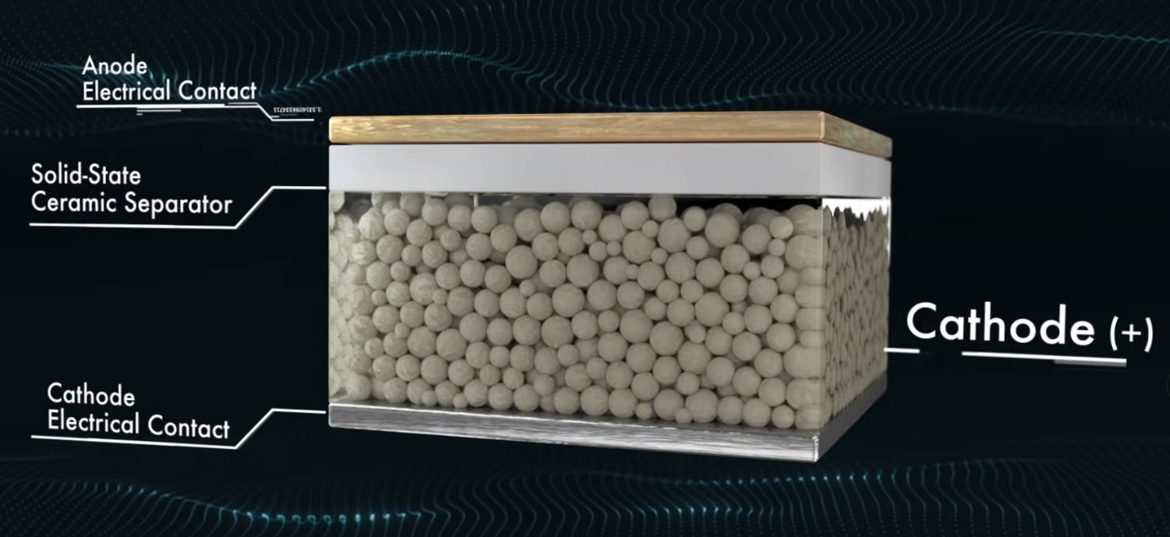
How do Solid-State Batteries work?
QuantumScape Li-Metal batteries
Notes:
As we can see, the polymer separator is substituted by a non-porous solid ceramic separator. But the most surprising feature is the fact that the cell is manufactured without an anode.
As the battery charges the lithium ions migrates from the cathode, diffuses through the atomic lattice of the solid ceramic separator, and get deposited between the separator and the anode electrical contact .
This lack of anode allows a higher energy density, fast charge (around 15 minutes), and safer operation by eliminating the organic polymer separator.
A solid-state separator is necessary in Lithium-metal batteries because it reduces dendrite formation. Dendrites forms in the surface of the anode and they reduce the energy density and can cause short-circuits in the battery by piercing through the separator.

Slide 8
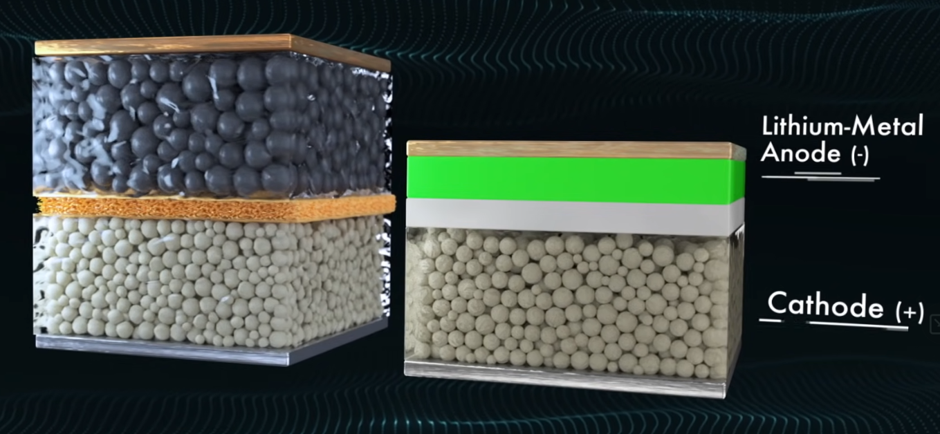
How do Solid-State Batteries work?
Comparison between lithium-ion batteries (left) and lithium-metal batteries (right) Source: QuantumScape
Notes:
Comparison between a Li-ion battery and a solid-state battery. As we can see, the anode is formed of pure lithium-metal.

Slide 9
Types of Solid-State Batteries
Solid Power
Lithium Metal Battery
Specific Energy = 440 Wh/kg, Energy Density = 930 Wh/L, 1000+ cycle life, <20min charge
Lithium Metal anode
Sulfide Solid Electrolyte
NCM Cathode (LiNiMnCoO₂)
Silicon EV Cells:
Specific Energy = 390 Wh/kg, Energy Density = 930 Wh/L, 1000+ cycle life, <15 min charge
High-content Silicon Anode
Sulfide Solid Electrolyte
NCM Cathode (LiNiMnCoO₂)
Conversion Reaction Cells:
Specific Energy = 560 Wh/kg, Energy Density = 785 Wh/L, 1000+ cycle life, <30 min charge
Lithium Metal Anode
Sulfide Solid Electrolyte
Conversion Type Cathode
Notes:
According to Solid Power, they use sulfide-based solid electrolyte because they have the best-known balance of ion conductivity and processability (i.e., the ability to be produced defect-free on industry standard roll-to-roll battery manufacturing equipment) out of all solid electrolyte classes.
State of the art lithium-ion batteries have specific energies of ~265 Wh/kg and energy densities of ~730 Wh/L

Slide 10
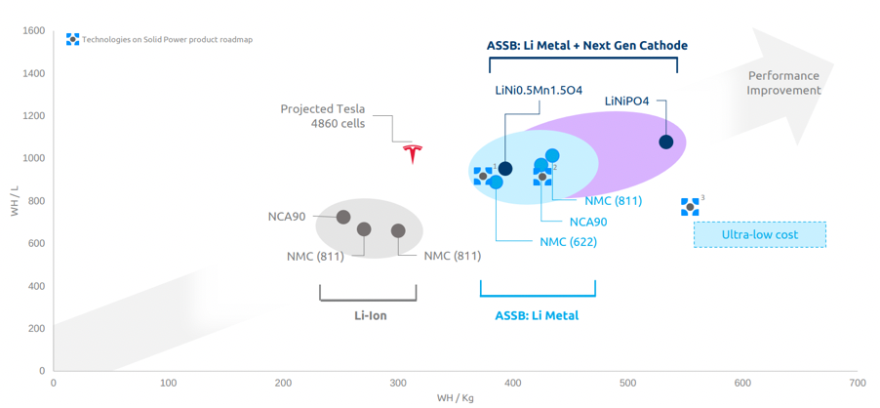
Types of Solid-State Batteries
Source: Solid Power
Notes:
Comparison between solid power batteries and traditional li-ion and tesla pack

Slide 11
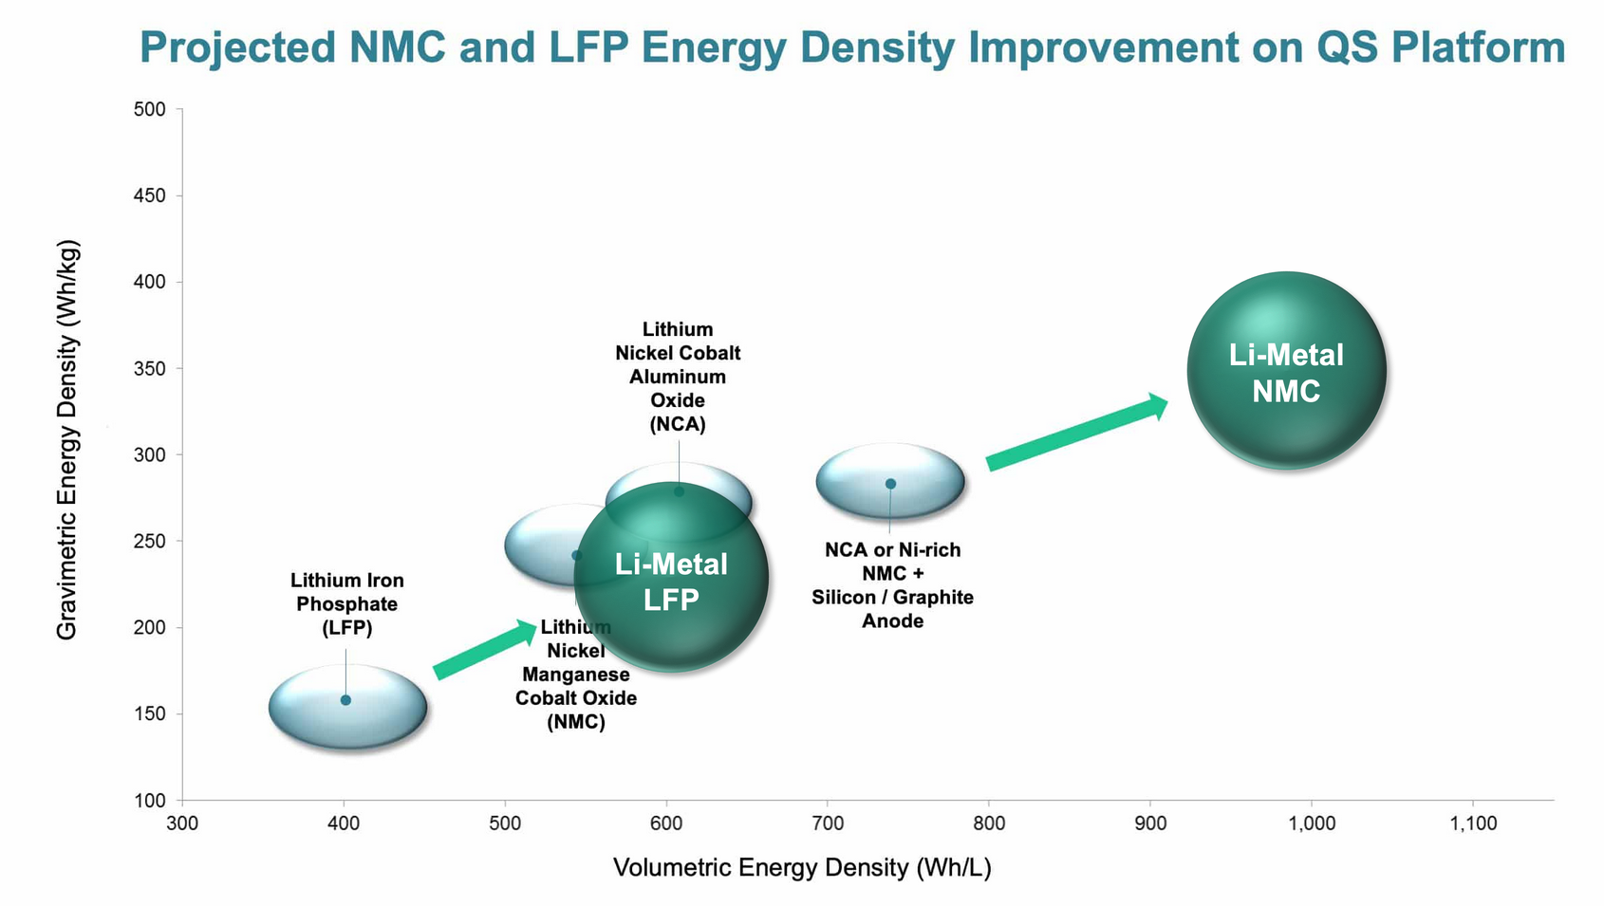
Types of Solid-State Batteries
QuantumScape
Batteries based on Lithium Iron Phosphate (LFP) cathodes cost is roughly 20% lower than NMC or NCA
Anodeless structure
Proprietary ceramic separator
Released data in 2022:
Tests were conducted at a temperature range of 25-45 °C and 3.4 atm of pressure
Battery cycle life of 400+ cycles
15 minutes to charge from 0-80%
Source: QuantumScape

Slide 12
Types of Solid-State Batteries
Toyota
Retain 90% performance over 30 years
Recharge from 0-100% in 10 minutes
Expected to be mass produced in 2025
2 seat prototype EV with 700km range
Samsung
Energy Density = 900 Wh/L, 1000+ Cycle Lifes
Silver Carbon composite anodes
A battery pack from this SSB would enable an EV to drive for 800 km in a single charge and it would last for over 0.8 million km

Slide 13
Types of Solid-State Batteries
Glass Batteries
Pioneered by John Goodenough and Maria Braga in a paper in 2017 titled Alternative strategy for a safe rechargeable battery
Low cost, safe, fast-charging, long lasting (1200+ cycles), first all-solid-state battery that can operate under 60 °C
Self-charging ferroelectric glass electrolyte
Notes:
glass electrolyte is a ferroelectric material—a material that have spontaneous electric polarization that can be reversed by the application of an external electric field. So charge-discharge cycles are effectively jiggling the electrolyte back and forth and perhaps, over time, finding the ideal configuration of each electromagnetic dipole.

Slide 14
Why Solid-State Batteries?
Safe
Can be used in a broader temperature range and thus require less cooling than lithium-ion batteries
More stable
Fast charging times (<15 minutes for 10-80%)
Long usage life (>1000 charge cycles)
High specific energy and energy density
High specific power and power density
Li-metal batteries be manufactured on the same production lines as traditional Li-ion batteries
Notes:
Solid-state batteries have been in use for a long time in small devices such as pacemakers and RFID tags, but it was impossible to recharge. Now, companies designed a way that allows the movement of the ions within the batteries to be reversed. In other words, how to recharge the battery.
Safe => Since the electrolyte in SS batteries is solid,
Energy Density => Solid state batteries have twice the energy density of lithium-ion batteries, allowing EV to reach 1000 km or more in a single charge in contrast with 500 km for lithium-ion EV’s. With ~1000 charge/discharge cycles. A EV would have approximately 0.8 million km of range before the battery needed to be replaced.
This benefits lead to a much wider use of batteries in transportations, from airplanes to heavy road transport and shipping industries. With a higher specific energy, EV’s can be lighter and thus more efficient.

Slide 15
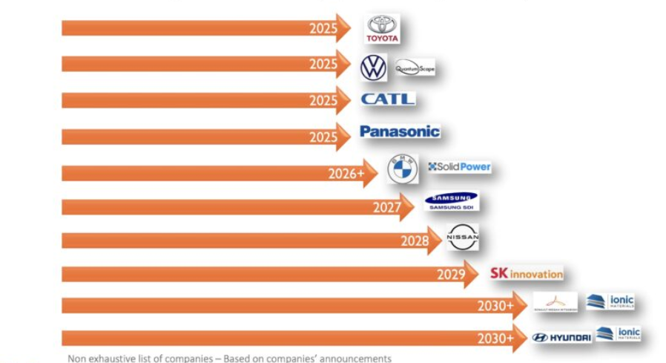
Main Players on Solid-State Batteries Market
Quantum Scape
Partnered with Volkswagen
Samsung
Toyota Motor Corporation
Global leader with over 1000 patents involving SSB
Solid Power
Partnered with BMW and Ford
Announced SSB market entry by battery manufacturer and EV manufacturer
Notes:
The potential market size for SSB is expected to grow over $6 billion by 2030
Toyota is the pioneer in the EV market. It released in 1997 the first mass produced hybrid passenger vehicle called Prius

Slide 16
Challenges to overcome
High cost, with an estimated cost between $800-400/kWh by the year 2026
Dendrites formation in Li-Metal anodes, which reduce the energy density and cause short-circuits
Operation at room temperature and pressure
Scalability
Convert the insertion or deposition of solid electrolytes to processes that are truly drop-in compatible with existing manufacturing infrastructure without affecting the durability or cost of the final product
Notes:
QuantumScape claim that they are the only company that can operate sbb in room temperature. They considered it one of the biggest scientific challenges that they faced.
Usually high temperature

Slide 17
Conclusion
Solid-state batteries are considered the future of batteries due to their superior properties, and they are expected to replace traditional Lithium-ion batteries
The applications of solid-state batteries ranges from electric vehicles and large-scale energy storage systems
The transportation market, especially EV’s, will see huge gains when the solid-state battery technology get ready
Solid-state batteries are expected to start to appear in our everyday life in 2030
There are still some roadblocks to be surpassed, such as cost and scalability, but the perspectives are positive overall

Slide 18
References
Solid-State Batteries, M. Ragheb lecture notes. Available at: https://mragheb.com/NPRE%20498ES%20Energy%20Storage%20Systems/Solid%20State%20Batteries.pdf.
https://www.electronics-notes.com/articles/electronic_components/battery-technology/li-ion-lithium-ion-advantages-disadvantages.php
https://www.upsbatterycenter.com/blog/battery-life-cycle-vs-cycle-life/
https://cleantechnica.com/2016/05/31/battery-lifetime-long-can-electric-vehicle-batteries-last/
https://en.wikipedia.org/wiki/Lithium-ion_battery
https://en.wikipedia.org/wiki/Solid-state_battery
Wu, X. et al. Safety Issues in Lithium-Ion Batteries: Materials and Cell Design. Frontiers in Energy Research (2019). https://doi.org/10.3389/fenrg.2019.00065
Ma, S. et al. Temperature effect and thermal impact in lithium-ion batteries: A review. Progress in Natural Science: Materials International (2018). https://doi.org/10.1016/j.pnsc.2018.11.002

Slide 19
References
Lithium VS Hydrogen VS Solid State | EV Battery Technologies Explained https://www.youtube.com/watch?v=CcRAEAtRlFE
What are Solid-State Batteries? (QuantumScape) https://www.youtube.com/watch?v=azACL3lLMo8
Exploring when solid-state batteries will arrive https://www.youtube.com/watch?v=3PyXQ0UXk9w
https://www.eetasia.com/solid-state-batteries-bid-to-replace-li-ion-in-evs/
https://www.quantumscape.com/technology/
https://solidpowerbattery.com/
https://www.dnv.com/to2030/technology/are-solid-state-batteries-the-holy-grail-for-2030.html
https://www.enpowerinc.com/tesla-battery-day-enpowers-take/
Blocking lithium dendrite growth in solid-state batteries with an ultrathin amorphous Li-La-Zr-O solid electrolyte. Nature (2021). https://www.nature.com/articles/s43246-021-00177-4
https://dragonflyenergy.com/thermal-runaway/

Slide 20
Thank You!

