Slide 1
Structural Batteries as Energy Storage in Electric Vehicles
Tim Wallace
B.S. Nuclear, Plasma and Radiological Engineering
University of Illinois at Urbana-Champaign
twalla20@illinois.edu

Slide 2
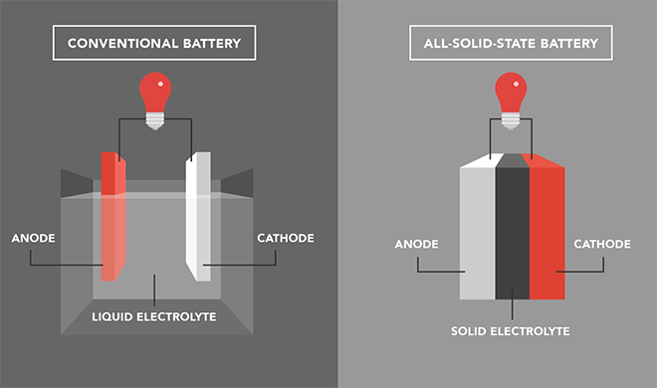
What is a Structural Battery?
Battery incorporated as a structural member
Solid State Battery
  Li-ion based
  Less flammable than liquid Li-ion counterparts
  Can be formed into complex configurations due to solid structure
Multifunctional Component

Slide 3
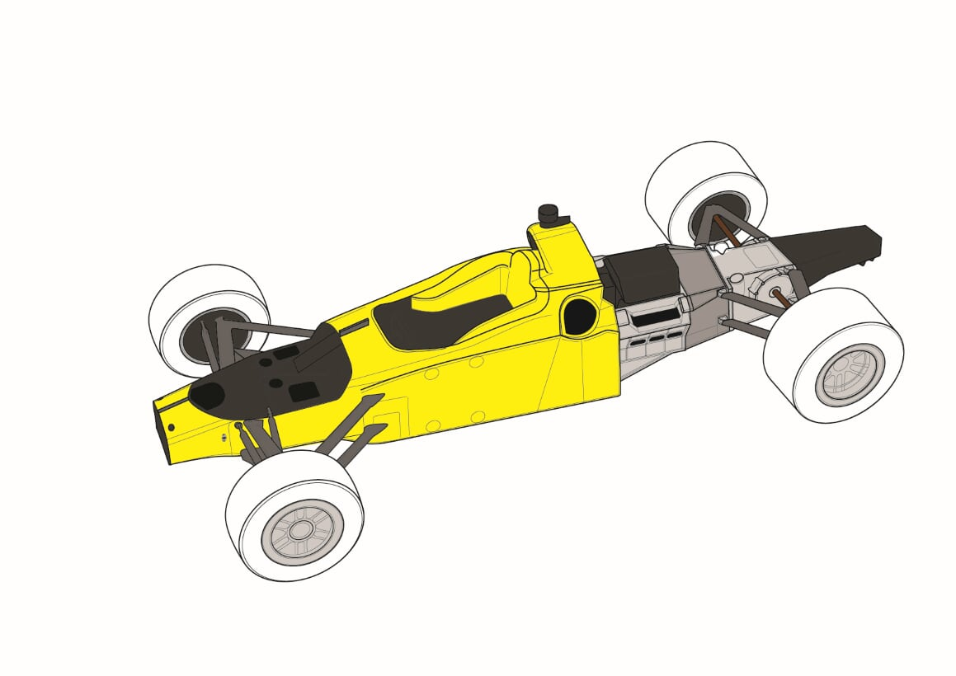
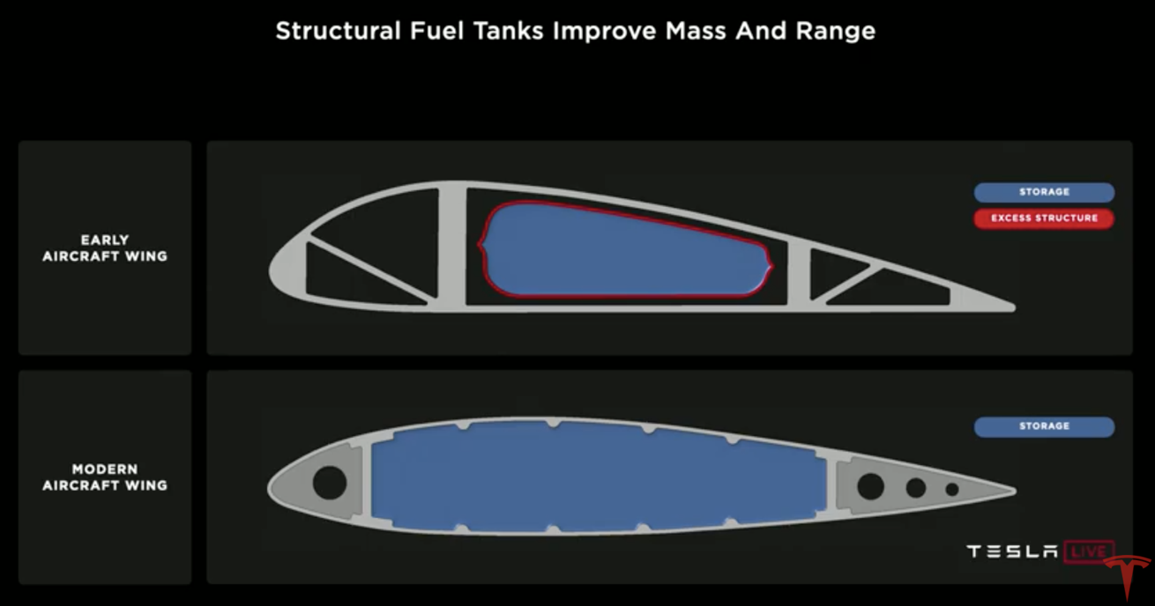
Examples of Multifunctional Components
Modern fully wet wings in aircraft
Engine blocks in high performance cars

Slide 4
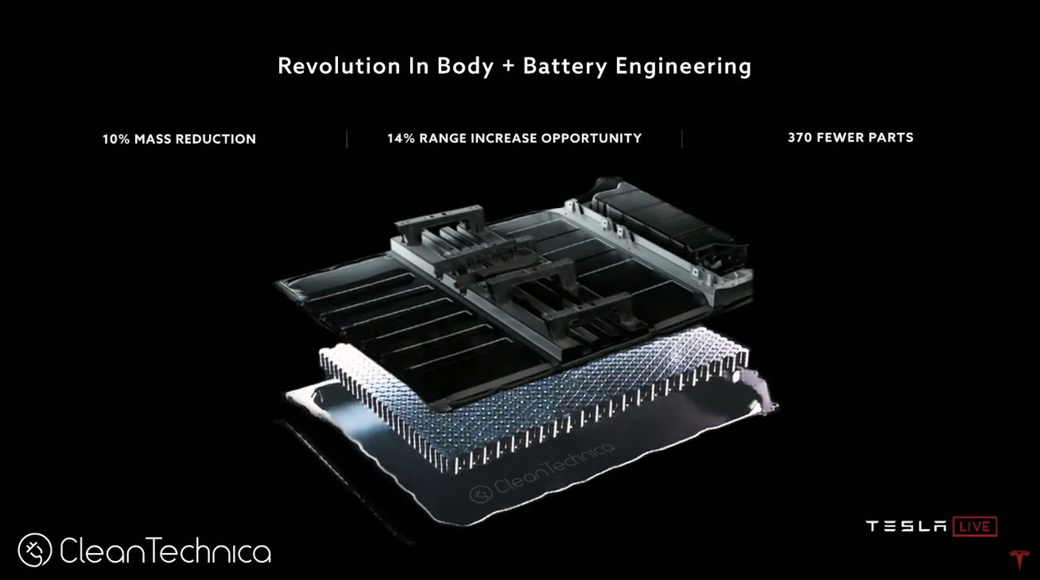
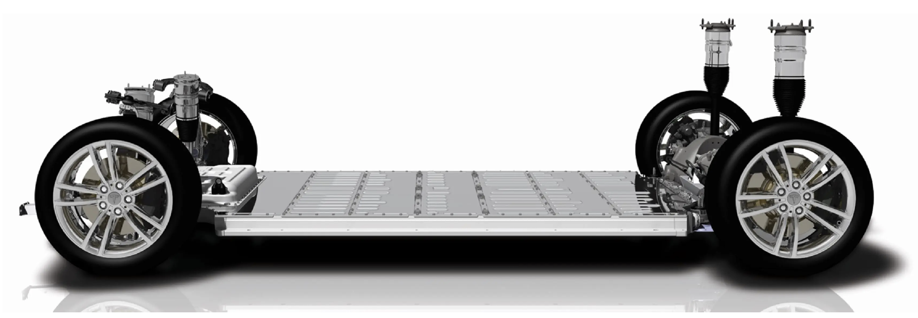
Current Battery Technology in EVs
Large packs of hundreds of Li-ion batteries
  Tesla’s Skateboard chassis design
Embedded batteries
  Bridging the gap between monofunctional and multifunctional
  Li-ion batteries pose cooling challenges
[3]

Slide 5

SORCERER
[4]
Structural pOwer CompositEs foR futurE civil aiRcraft
  Developing multifunctional composite materials for NATO air forces and western aviation industry
  USAF, Horizon 2020 (EU), Airbus
Chalmer University of Technology (Sweden)
  Implementation, structural performance, efficient design
IMDEA (Spain)
  Fabrication, fire retardancy, electrochemical performance
Imperial College London (UK)
  Structural Supercapacitors
KTH Royal Institute of Technology (Sweden)
  Multifunctional Performance Qualification

Slide 6
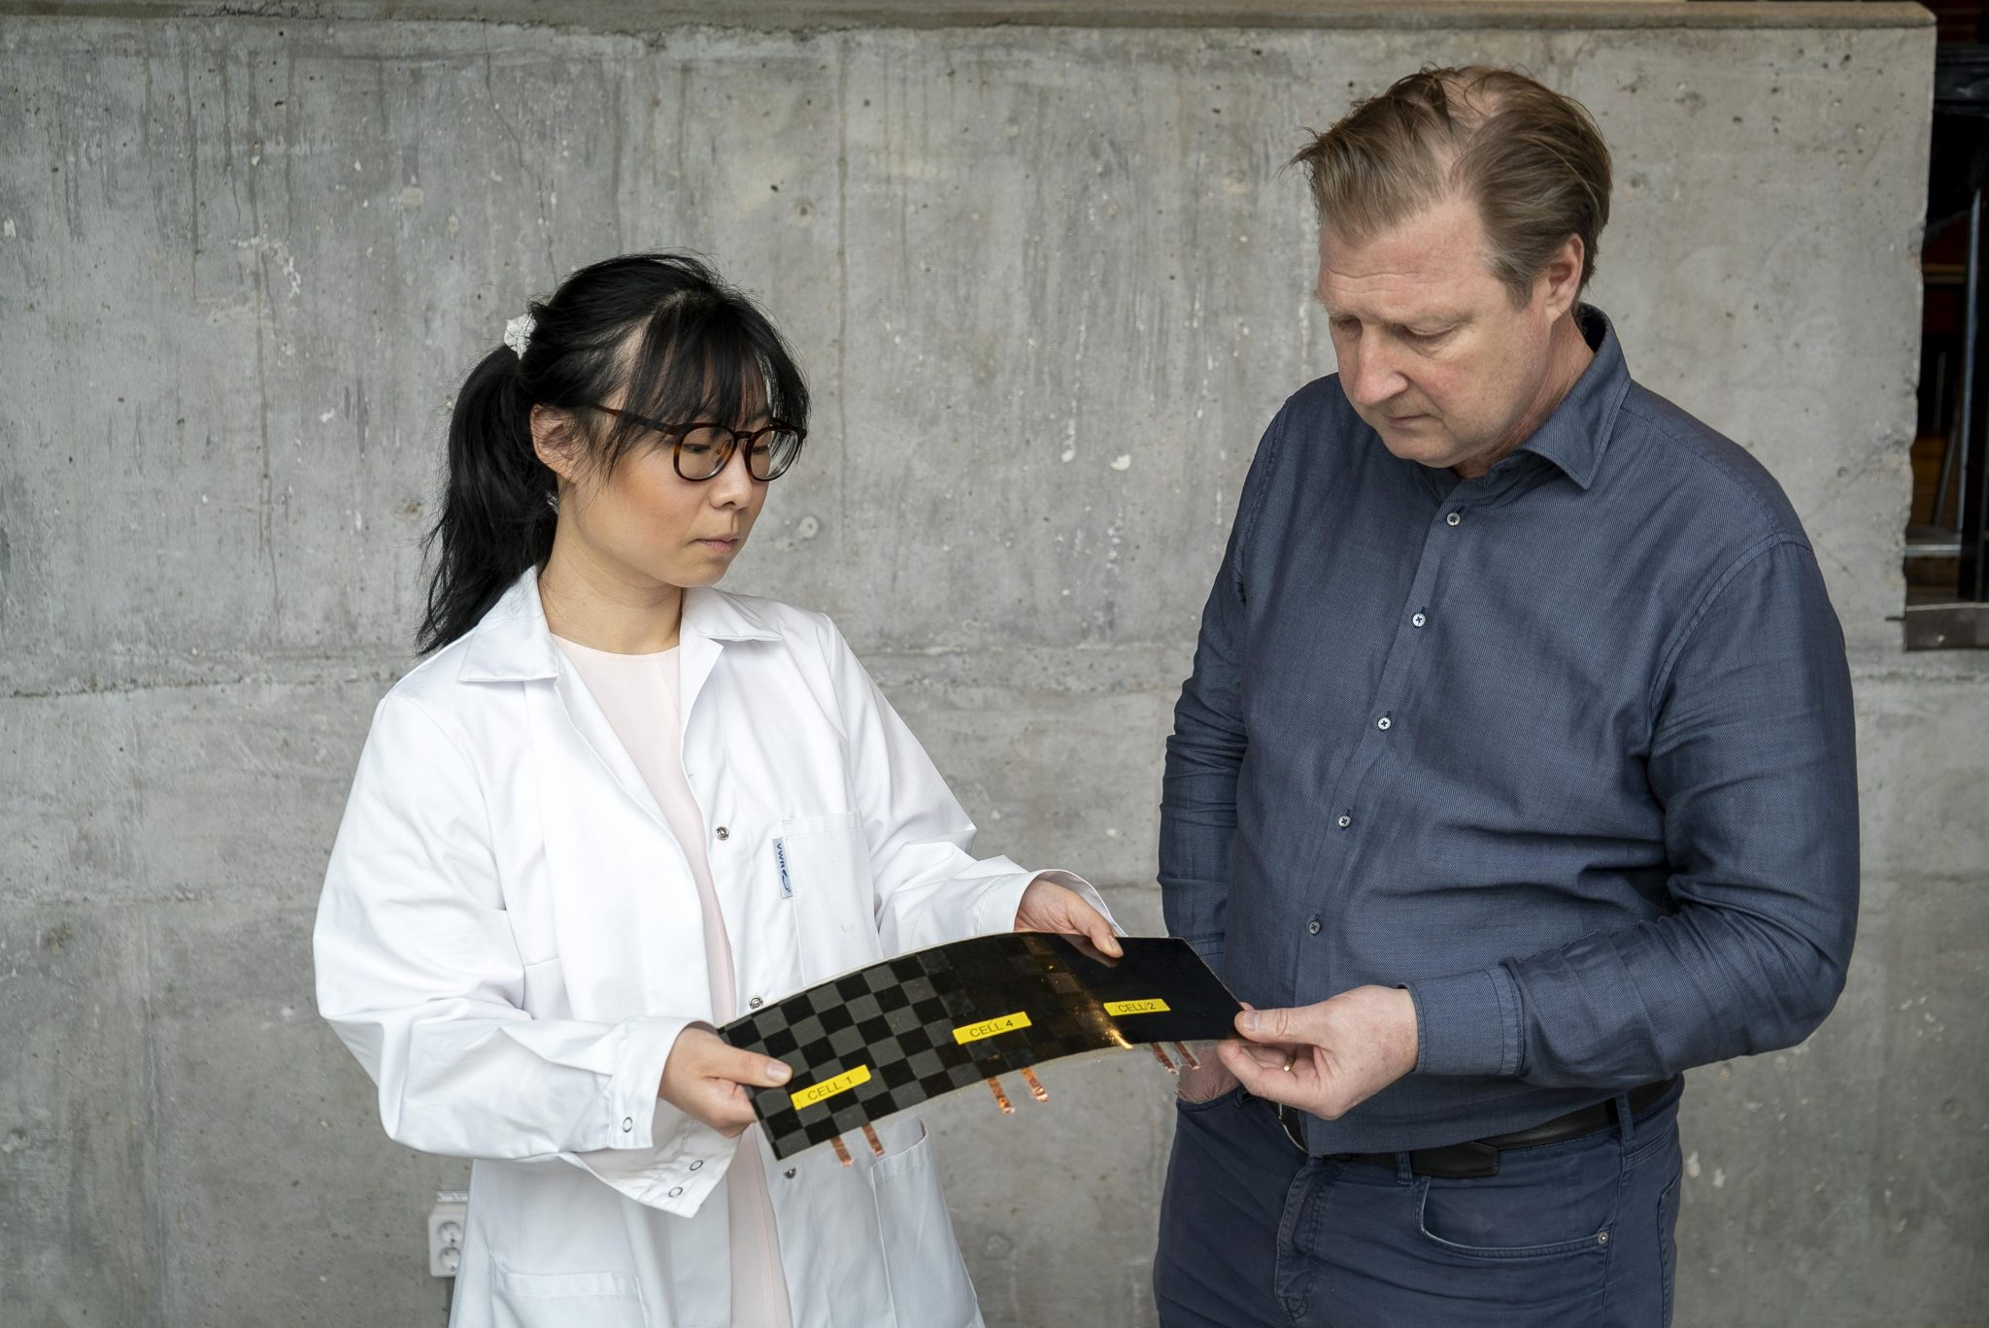
Structural Battery Overview
Anode - Carbon Fiber (CF)
  IMS65 filament yarn [5]
  Copper foil current collector
Cathode - Lithium-Iron-Phosphate (LFP)
  Supported by aluminum foil
Structural Battery Electrolyte (SBE)
  Two types of glass fiber (GF) tested
  Whatman GF/A - commercially available weave
  Plain weave - GF PW
[6]
Dr. Johanna Xu and Dr. Leif Asp

Slide 7
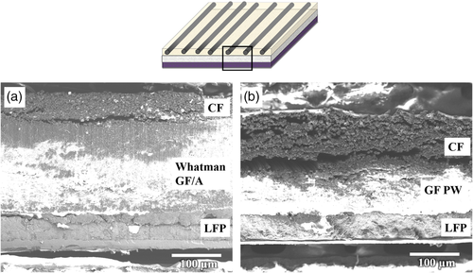
Structural Battery Cross Section
[7]

Slide 8
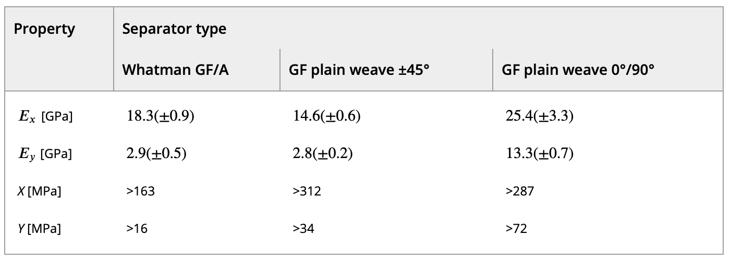
Mechanical Performance
Tensile Test Results
Material | Young's Modulus, [GPa]
7075 Aluminum | 71.7
1045 Steel | 200
IMS65 | 290
Structural Battery (GF) | 25.4
[7]

Slide 9
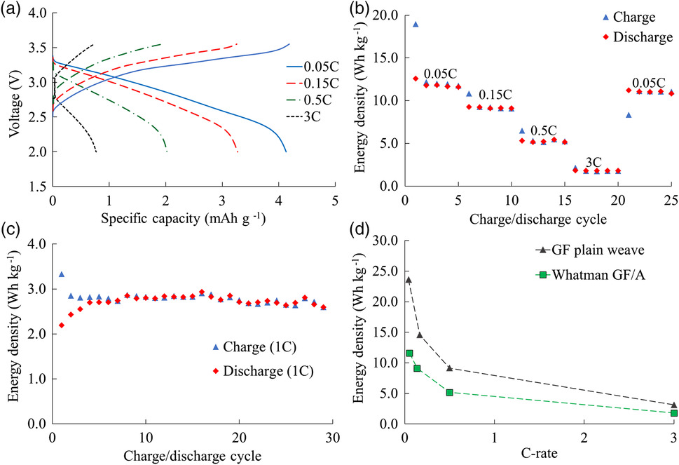
Electrochemical Performance
Nominal specific energy of 24 Wh/kg
Survived cyclic charging cycles
Thinner electrolyte PW preferable
  Less internal resistance with a thinner structure
[7]

Slide 10
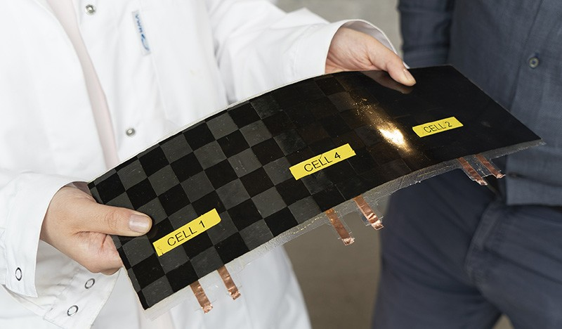
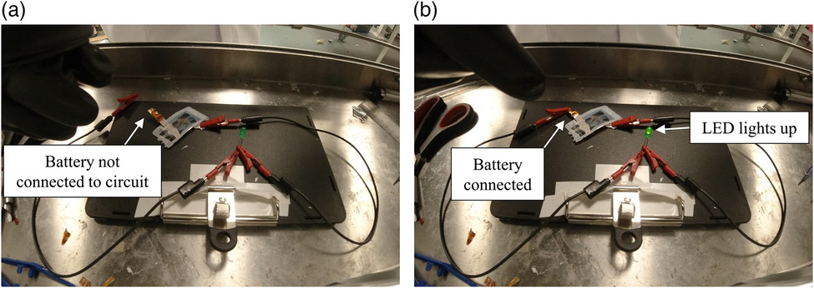
Comparisons with Previous Developments
US Army, 2007 [7]
  Gel electrolyte for electrochemical performance
  3 GPa, 35 Wh/kg
Carlson et al. 2013 [8]
  Developed solid LFP cathode
  Did not report multifunctional performance
Moyer et al. 2020 [9]
  <2 GPa, 40+ Wh/kg
[6]
[7]

Slide 11
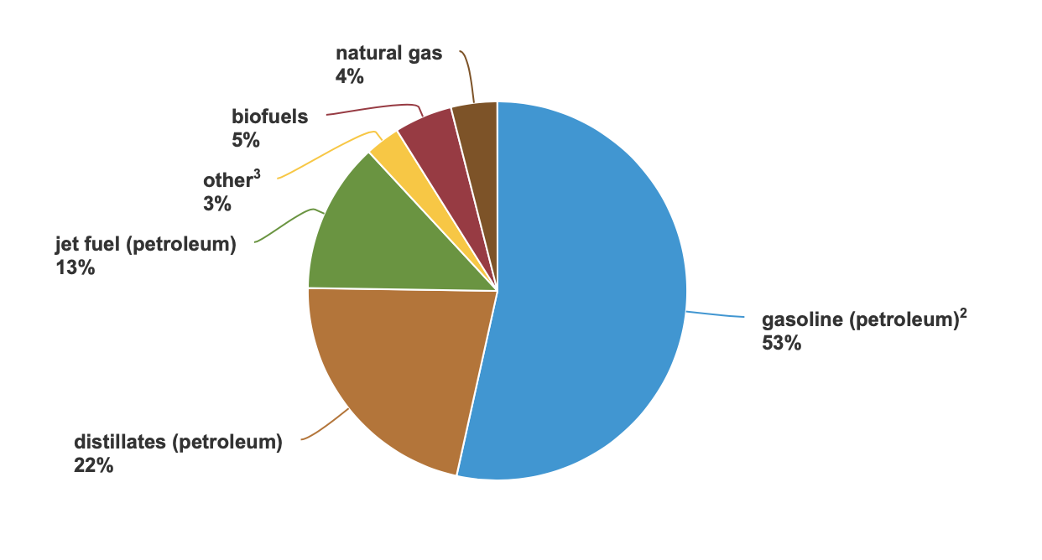
Energy Storage Comparisons
93 % of energy used in the transportation sector come from chemical fuel
Energy density
  lithium ion batteries is ~150x less than fuel
  83.3 Wh/kg vs. 13 kWh/kg [2]
  Structural batteries have ~30% of liquid batteries
[1]

Slide 12
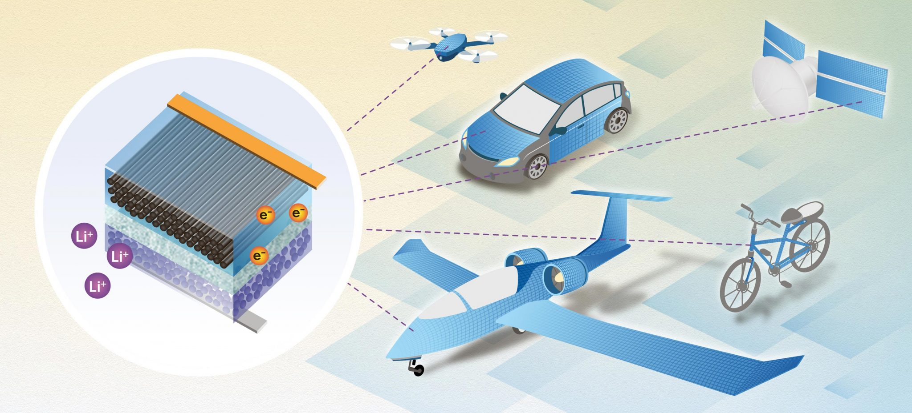
Future Development
Solid state battery technology must continually improve
  Vulnerable to temperature degradation
Thinner electrolyte is necessary for better multifunctional properties
  Moves mass bias toward stronger CF
Stiffer, more consistent CF lamina
  Improves directional PW performance
Carbon Aerogel (CAG) infusion
Technology is still very young
  Much room for growth
[6]

Slide 13
Questions?

Slide 14
References
https://www.eia.gov/energyexplained/use-of-energy/transportation.php
https://www.aps.org/publications/apsnews/201208/backpage.cfm/
https://cleantechnica.com/2020/10/10/teslas-new-structural-battery-pack-its-not-cell-to-pack-its-cell-to-body/
https://www.sorcerer.eu/pages/about.html
http://www.asprotec.ru/pub/IMS65_E23.pdf
https://scitechdaily.com/big-breakthrough-for-massless-energy-storage-structural-battery-that-performs-10x-better-than-all-previous-versions/
https://onlinelibrary.wiley.com/doi/10.1002/aesr.202000093
https://www.diva-portal.org/smash/record.jsf?pid=diva2%3A999197&dswid=-8951
https://www.sciencedirect.com/science/article/pii/S240582971930916X?casa_token=_IHVAHvjtnYAAAAA:A6bsfk1YVrECi9i-rhTBxsuDUZeIPRgnMFaNgEtfytDYE7qcrC_pSQdvsQ2HhMfXWYkzkqJjMw

