Slide 1
Liquid Air Energy Storage
NPRE 498 – Energy Storage and Conveyance
Thomaz Perilli
MS in Bioenergy
Professional Science Master’s concentration

Slide 2
Outline
Cryogenic Energy Storage
Liquid Air Energy Storage
  Advantages
  Disadvantages
Options
Current Plant
Future Projects
Conclusions
References

Slide 3
Cryogenic Energy Storage (CES)
Large energy storage method that uses a cryogen as an energy vector
Excess energy from off peak hours or energy from intermittent renewable sources, such as wind and solar, is used to liquefy a gaseous substance
Cryogen is stored
Power is recovered through a thermodynamic cycle

Slide 4
Liquid Air Energy Storage (LAES)
Feedstock: air – free and abundant
Air liquefies at -196°C
Air to liquid air: 700 fold decrease in volume
Specific energy: around 100-200 Wh/kg
Three-stage process:
Round-trip efficiency: up to 60%
Charge
Storage
Discharge

Slide 5
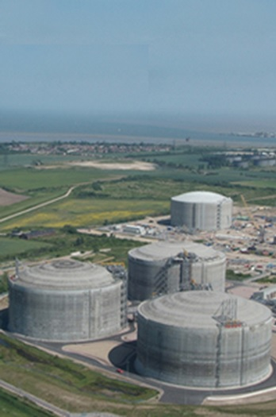
Advantages
Existing global, industrial gases infrastructure and mature components with proven lifetime (25 years+) and performance
Storage at low pressure
LAES does not require scarce materials
Low capital cost
No geological constraints
Synergy with other processes:
  Integration/recycling of waste heat
  Integration/recycling of waste cold

Slide 6
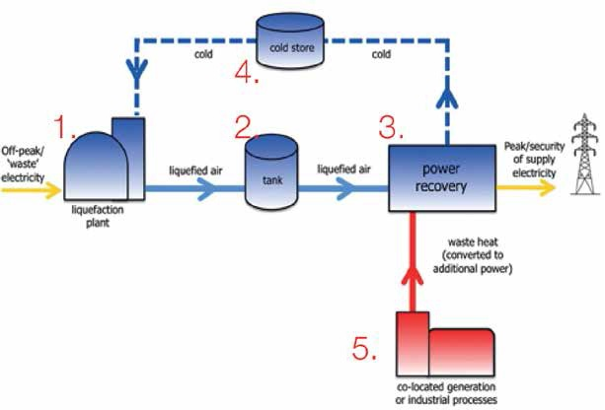
LAES: cold recycle and waste heat

Slide 7
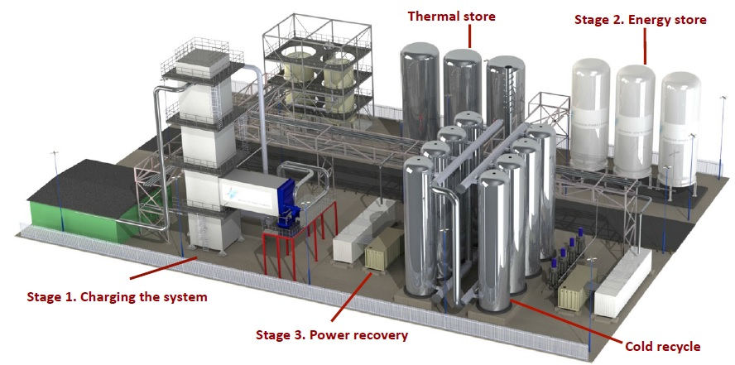
LAES facility model

Slide 8
Disadvantages
Lower efficiency
Safety issues: nitrogen leakage (boiling point lower than oxygen)
  Oxygen deficiency: outside tank
  Oxygen enrichment: inside tank
Shorter storage time: hours to days

Slide 9
Options
Oxy-combustion
  Oxygen and nitrogen are separated
  Nitrogen is used as the storage media
  Oxygen is used in combustion processes: increases efficiency, reduces NO_{x} pollution, eases CO₂ recovery
Nuclear Power Plant
  Excess electricity used to liquefy air
  Heat from NPP is used in the recover stage
  Round-trip efficiency: 71%
Liquid nitrogen industry

Slide 10
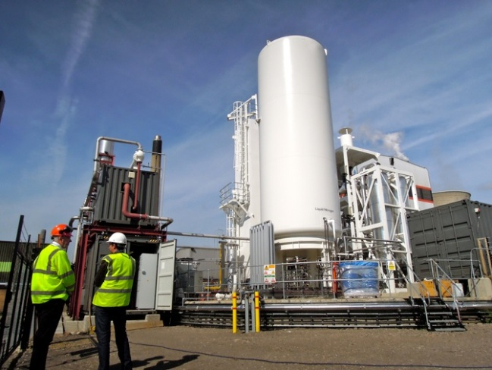
Current Plant
Highview pilot plant
  Location: Slough, Greater London, England
  Operational since 2011
  Power: 350 kW
  Efficiency: 8%
    Only half of the cold recycled
    Small size facility
  Next to a power station: waste heat synergy

Slide 11
Future Projects
Highview pre-demonstration unit
  Location: Pilsworth, Greater Manchester, England
  Expected to be operational by early 2015
  Power: 5 MW
  Funding: $13.5 M – Department of Energy and Climate Change, UK
  Next to a landfill: waste heat synergy
Partnership with GE

Slide 12
Conclusion
LAES has some interesting advantages and can play a minor role in energy storage if actual efficiency is brought closer to the theoretical efficiency
“While in no way claiming to be a panacea to all our energy challenges, liquid air as an energy store has different attributes for which there is a real demand in a robust low carbon power and transport infrastructure.”

Slide 13
References
http://www.highview-power.com/wp-content/uploads/Highview-Brochure.pdf
http://www.liquidair.org.uk/about-liquid-air#ql-intro
Chai L, Liu J, Wang L, Yue L, Yang L, Sheng Y, Chen H, Tan C. Cryogenic energy storage characteristics of a packed bed at different pressures. Applied thermal engineering 2014;63(1):439-446.
Stöver, B., Rehfeldt, S., Alekseev, A., Stiller, Ch. (2013): Process engineering and thermodynamic evaluation of concepts for liquid air energy storage. Vienna: Power Gen.
Li Y, Cao H, Wang S, Jin Yi, Li D, Wang X, Ding Y. Load shifting of nuclear power plants using cryogenic energy storage technology. Applied Energy 2014;113:1710-1716.
http://www.highview-power.com/tour/

