Slide 1
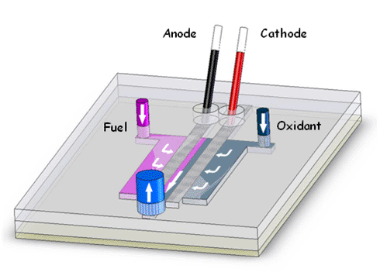
Laminar Flow (Membraneless) Fuel cells (LFFC’s)
Tapan Patel
NPRE 498
University of Illinois at Urbana-Champaign

Slide 2
Agenda
Overview
Why use fuel cells
Disadvantages of current fuel cells
Laminar Flow Fuel Cells
Self Pumping
Applications

Slide 3
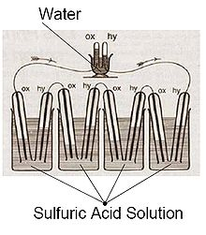
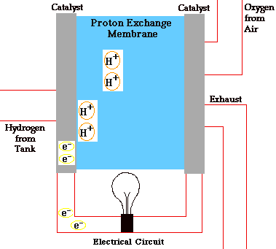
Overview
The first fuel cell was developed by Sir Robert Grove (1839)
Modern fuel cell
  Two types (PEMFC and SOFC)

Slide 4
Why use fuel cells?
Alternative to batteries
  Li-Ion- 250-360 Wh/L
  Hydrogen - 2800 Wh/L
  Borohydride - 2200 Wh/L
  Methanol - 4416 Wh/L
Environmental concerns
  Generally cleaner (H/C ratio)
    Coal – .5-1.0
    Ethanol – 3.0
    Sodium Borohydride – 4.0
    Methane, Methanol- 4.0
    Hydrogen – Inf

Slide 5
Disadvantages of current fuel cells
PEMFC
  Low Temperature
  Expensive catalysts (Platinum/Palladium/Ruthenium)
  Expensive Membrane (Nafion $15/cm^2-low loading)
    MEA can account for 50% cost
SOFC
  High Temperature
  No catalysts required
  Can run on butane, methane etc.
Cross Over
Diffusion of reactants at anode and cathode can be rate limiting
Hydrogen/Oxygen cells bulky due to hydrogen storage issues

Slide 6
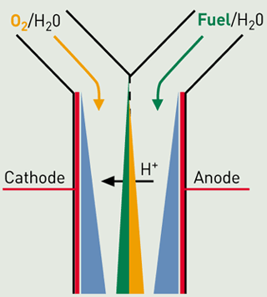

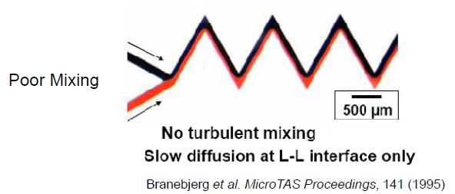
Laminar Flow Fuel Cells
Direct Methanol Fuel cells
  High Crossover/Low Efficiency
  Very common fuel for FC’s
LFFC’s
  Diffusion Based
  Reynolds Number = .01
  Still have some issues with crossover

Slide 7
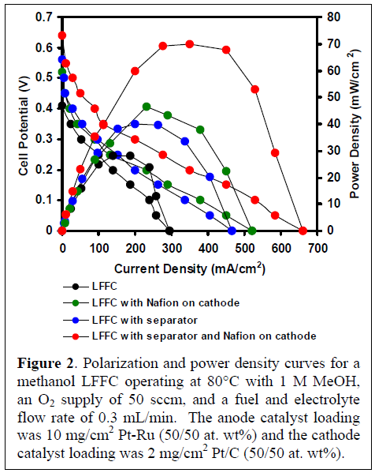
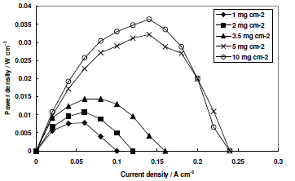
Laminar Flow Fuel Cells (cont.)
85% Anode - 60% Cathode wt% Pt loading
Even with separator and Nafion, LFFC’s outperform by 2 times!
2. Lower catalyst loading

Slide 8
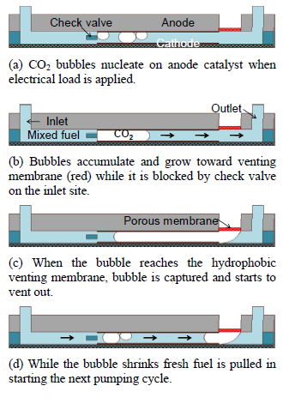
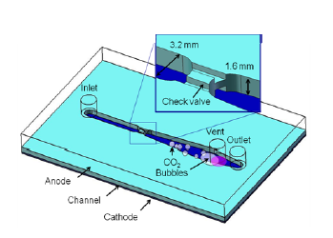
Other Fuels/Self Pumping
Ancillary Mechanisms needed (eg. Pump)
  Can make system complex and expensive
Formic acid/Sulfuric acid also widely researched
Self Pumping Mechanism
  UCLA and MTU

Slide 9
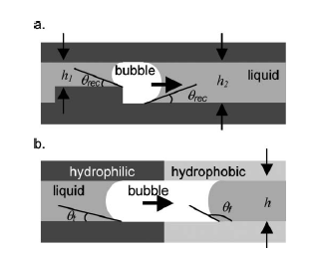
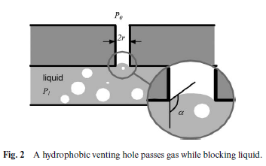
Self Pumping Concept
Contact angle of water > 90
Contact angle of gas <90

Slide 10
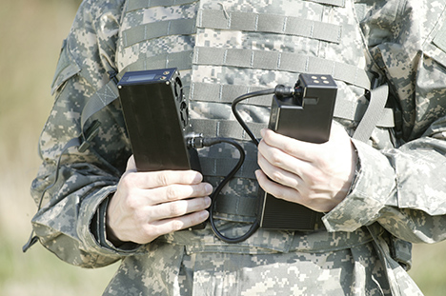
APPLICATIONS
Battery packs for soldiers (currently weight up to 20 pounds)
Portable power (cell phones, laptops etc.)
  INI Power Systems, of North Carolina (www.inipower.com), says it delivered a beta 15W system to a military customer in August and signed a joint development agreement with a major Asian battery and laptop OEM to integrate its stacks into a consumer platform. It is also working on a telecommunications power supply with partner Advanced Power Systems, targeted for the first half of 2008. Anthony Atti, VP of business development, reports the military test unit is running more than nine hours on 200cc of neat methanol, and a 72-hour military mission would require total system and fuel weight of less than 9lb.

Slide 11
References
http://en.wikipedia.org/wiki/Fuel_cell
http://en.wikipedia.org/wiki/Lithium-ion_battery
http://hypertextbook.com/facts/2005/JennyHua.shtml
http://www.newscientist.com/article/dn10066-new-type-of-hydrogen-fuel-cell-powers-up.html
http://www.fuelcellsforpower.com/index.php?option=com_content&view=article&id=47&Itemid=56
http://www.electrochem.org/meetings/scheduler/abstracts/214/0701.pdf
http://www.understandingnano.com/fuel-cells.html
http://www.gizmag.com/go/5325/picture/21130/

Slide 12
References
Baglio, V. "Electrochemical Analysis of Direct Methanol Fuel Cells for Low Temperature Operation." International Journal of Chemical Science (2006). Print.
IEEE Workshop on Micro Electro Mechanical Systems., IEEE Robotics and Automation Society., American Society of Mechanical Engineers., Denki Gakkai (1888), & Institute of Electrical and Electronics Engineers. (1989). Proceedings, IEEE micro electro mechanical systems. New York, NY: IEEE.
Choban, E. "Microfluidic Fuel Cell Based on Laminar Flow." Journal of Power Sources 128.1 (2004): 54-60. Print.
Meng, Dennis Desheng, and Chang-Jin “CJ” Kim. "Micropumping of Liquid by Directional Growth and Selective Venting of Gas Bubbles." Lab on a Chip 8.6 (2008): 958. Print.
Hollinger, Adam, Ryan Maloney, Larry Markoski, and Paul Kenis. "Nanoporous Separator to Minimize Fuel Crossover in a Direct Methanol Laminar Flow Fuel Cell." Print.
R.S. Jayashree, L. Gancs, E.R. Choban, A. Primak, D. Natarajan, L.J. Markoski, P.J.A. Kenis, J. Am. Chem. Soc. 48 (2005) 16758–16759.

Slide 13

QUESTIONS

