Slide 1
Flow batteries for energy storage
Stephen Pety
NPRE 498 11/16/11

Slide 2
Interest from the President
http://www.youtube.com/watch?v=Efk2sLLHVpc

Slide 3
Outline
How a flow battery operates
Components of a flow battery
Different kinds of flow batteries
  Zinc-Bromine
  All Vanadium
  Polysulphide-Bromine
Modeling
Applications
New “semi-solid flow battery” fresh out of MIT
Conclusions

Slide 4
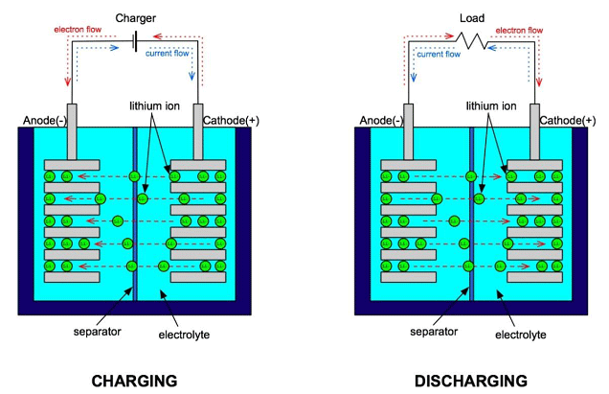
How a standard battery operates¹
Li-ion battery (charging)

Slide 5
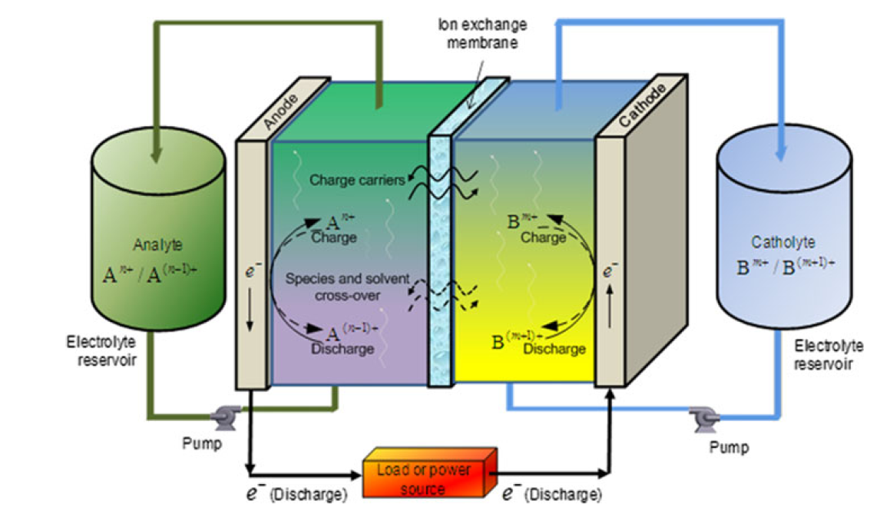
How a flow battery operates²
Flow battery
Notes:
Mention anode/cathode role

Slide 6
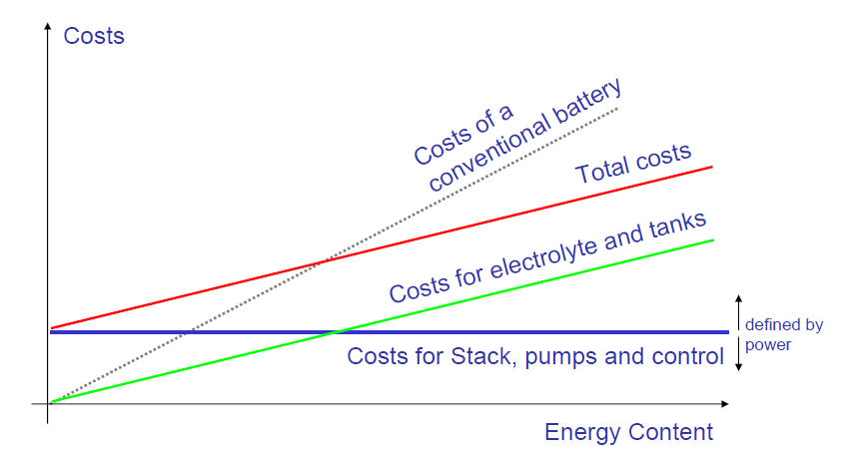
Advantages of flow batteries³
Decoupling of power and storage
Energy can be stored in liquid form
Modularity allows quick upgrades
Less expensive materials: $300/kW vs $1000/kW for Li-ion
Can fully charge/discharge with little electrode damage
Can be “instantly recharged” if desired by pumping in fresh fluid

Slide 7
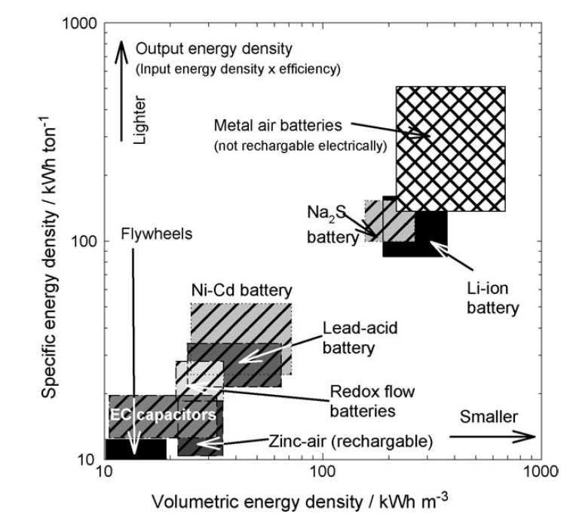
Disadvantages of flow batteries⁴
Specific capacity is ~10 x less than standard batteries due to solubility limits
Generally low voltages (<1.5 V vs. >3 V for Li-ion)
Pumps required to circulate electrolyte
Technology not as developed as standard batteries

Slide 8
Components of a flow battery

Slide 9
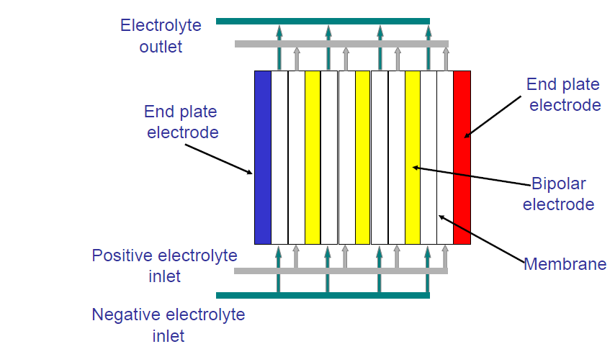
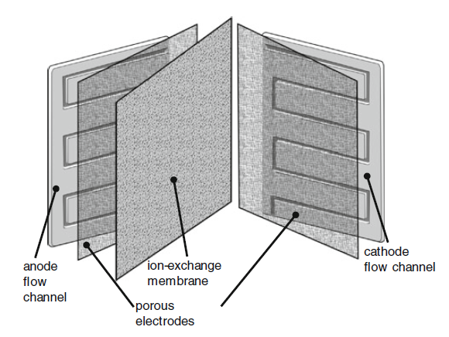
Cell setup^{2,5}
Channels carry solutions through porous electrodes and are separated with an ion-permeable membrane
Solutions can be pumped continuously or intermittently
Cells can be stacked in series of parallel to increase voltage, current
Four cells in series
One flow cell

Slide 10
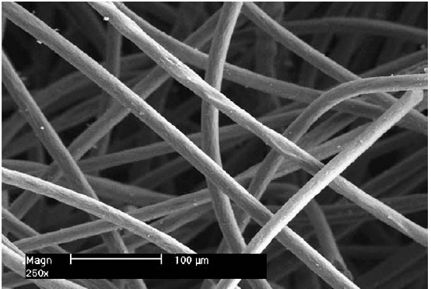
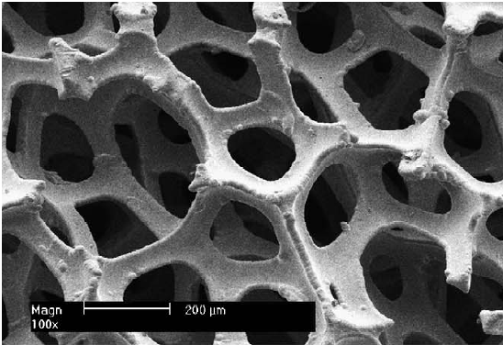
Electrode materials⁶
High surface area materials used such as
  Graphite
  Carbon fiber
  Carbon-polymer composites
  Carbon nanotubes
  Graphene-oxide nanoplatelets
  Metal foams and meshes
Carbon felt electrode
Nickel foam electrode

Slide 11
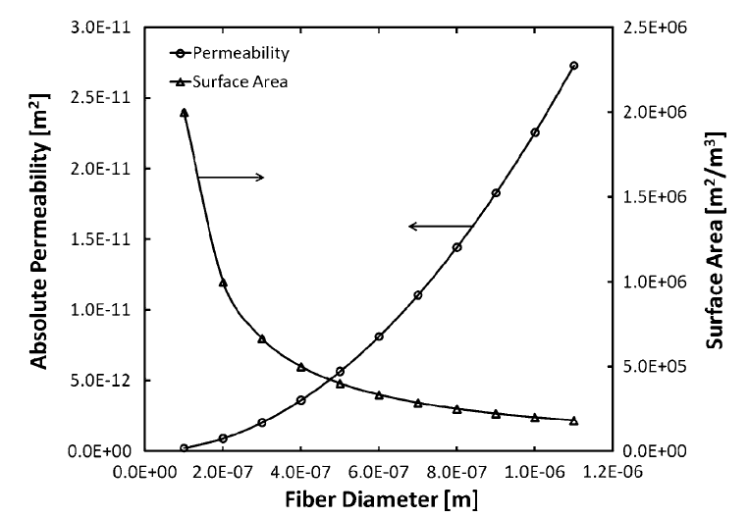
Electrode design considerations²
Catalytic activity: Can be raised with techniques such as
  Chemical etching
  Thermal treatment
Wetting: Can be improved through treatments such as
  Oxidation
  Aryl sulfonation
Constituent size: Smaller means
  Higher surface area, so
  more power generated
  Lower permeability, so
  more pressure needed
  Addition of CNTs
  Addition of metal particles

Slide 12
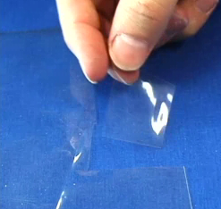
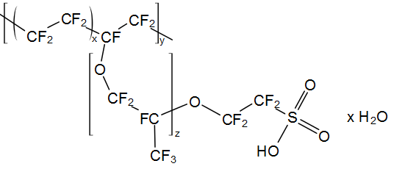
Separator materials⁷
Cationic or anionic exchange membranes
Most common is Nafion (cationic exchange)
Important considerations are
  Speed of ion diffusion
  Mechanical properties
  Ion selectivity
Can improve ion selectivity with inorganic materials such as SiO₂
Nafion
Nafion structure

Slide 13
Different kinds of flow batteries

Slide 14


Flow battery history^{8,9}
1884: French engineer Charles Renard pioneered “La France”
“La France” ran on a Zn-Cl flow battery system where Cl was generated onboard with CrO₃ and HCl
1970s: Modern flow battery research starts at NASA with Fe-Cr system

Slide 15
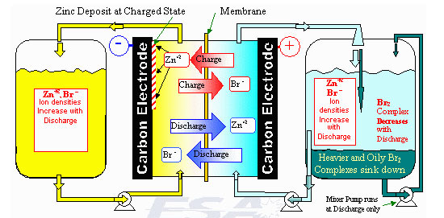
Zn-Br flow batteries¹⁰
Developed by Exxon in early 1970s
Charging involves Br ions and electroplating of Zn:
  3Br ⁻ − 2e ̶ → Br₃ ̶
  Br₃ ̶ → Br₂ + Br ⁻
  E⁰ = +1.09 V vs SHE
Zn and Br ions move across separator
  Zn²⁺ + 2e⁻ → Zn
  E⁰ = − 0.76 V vs SHE

Slide 16
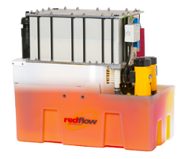
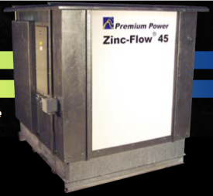
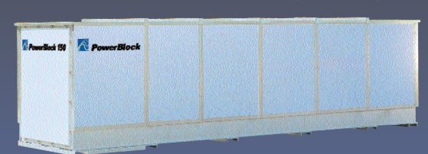
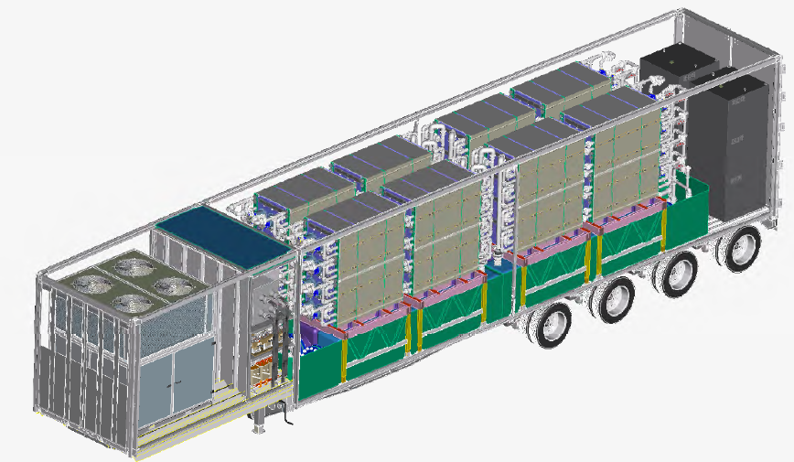
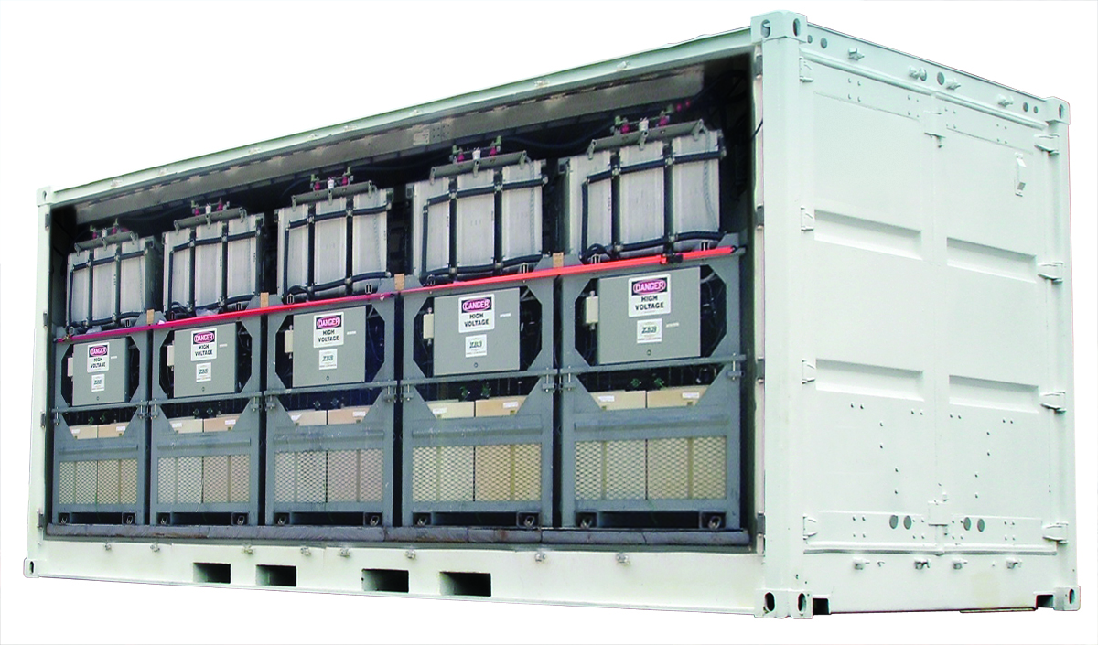
Zn-Br batteries in the market¹¹⁻¹³
RedFlow makes 10 kWh cells for light use
Premium Powers makes
  Zincflow – 45 kWh, 15 kW
  Powerblock – 150 kWh, 100 kW, 415 V
  Transflow – 2.8 MWh, 500 kW, 480 V
ZBB has entered Chinese energy storage market
Transflow
ZBB cells

Slide 17
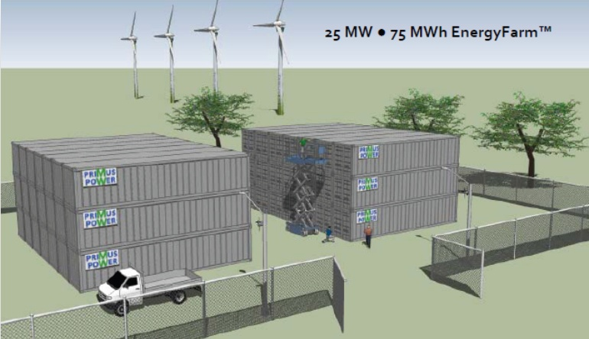
75 MWh Zn-Br plant¹⁴
Primus Power recently started a 75 MWh plant in Modesto, CA
“EnergyFarm” is set to be completed in 2013

Slide 18
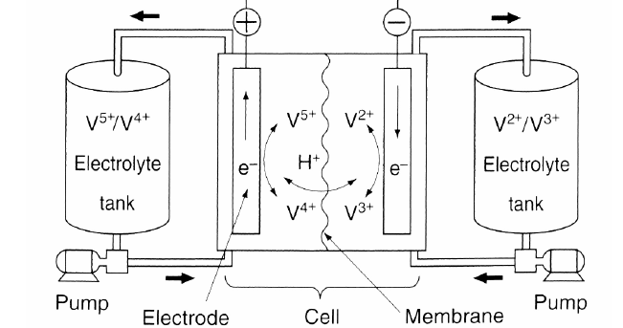
All Vanadium battery¹⁵
  V³⁺ + e⁻ → V²⁺
  E⁰ = − 0.26 V versus SHE
Developed in 1985 by Professor Maria Skylla-Kazacos at the University of New South Wales
All Vanadium ions reduces troublesome ion crossover:
  VO²⁺ + H₂O − e⁻→ VO₂⁺ + 2H⁺
  E⁰= +1.00 V versus SHE
H⁺ ions move
across separator

Slide 19
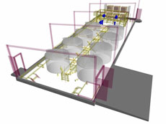
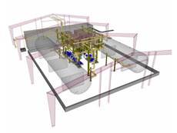
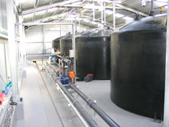
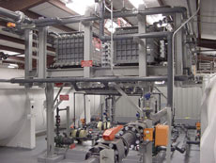


Commercial Vanadium batteries¹⁶
Prudent Energy (China) is main supplier
  Acquired VRB Power Systems in 2009
  Line ranges from 5 kW packs to 2MWh systems
1 MWh unit in King Island, Australia
2 MWh unit in Moab, Utah

Slide 20
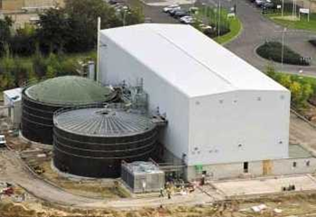
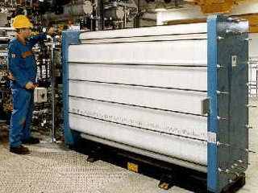
Polysulfide/Bromine battery^{17,18}
Patented in 1987, studied by Regenesys then VRB
High-solubility, low-cost reactants
  3Br ̶ − 2e ̶ → Br₃ ̶
  E⁰ = +1.09 V vs SHE
Na⁺ ions cross separator
120 MW unit started in England but not completed
  S₄²⁻ + 2e ̶ → 2S₂^{2 ̶}
  E⁰ = -0.265 V vs SHE

Slide 21
Other flow battery systems
Soluble lead-acid
  Same chemistry as standard lead-acid battery
  No separator needed
V-Br
  Higher solubility than all-vanadium
Zn-Ce
  High voltage of 2 – 2.5 V through use of sulfonic acid solvent
Notes:
Soluble lead acid same chemistry
Fe-Cr like Fe-Br
V-Br has more solubility
Zn-Ce like Zn-Br but higher V because sulfonic acid solvent

Slide 22
Modeling of flow batteries

Slide 23
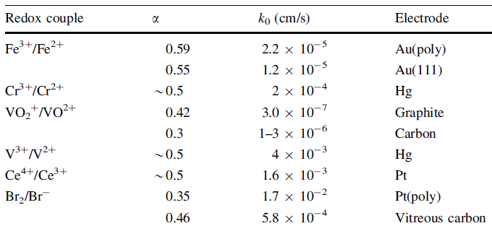
Kinetics²
Kinetics of redox chemistry described with k₀
  i₀ – exchange current/area F – Faraday’s constant k₀ – rate constant
  c₀ – concentration of oxidizing species c_{r} – concentration of reducing species
  α – transfer coefficient
i₀ is important to verify
experimentally
k₀ should be ~10⁻⁵ cm/s
or more for an efficient cell

Slide 24
Transport²
Flux of ion species governed by
N_{i} – flux of ion species z_{i} – charge number u_{i} – mobility
c_{i} – ion concentration ϕ₂ – Voltage D_{i} – Diffusivity v - velocity
Velocity through porous electrode can be modeled with Darcy’s Law
k – permeability µ - viscosity p - pressure
Voltage-driven
Diffusion
Bulk flow

Slide 25
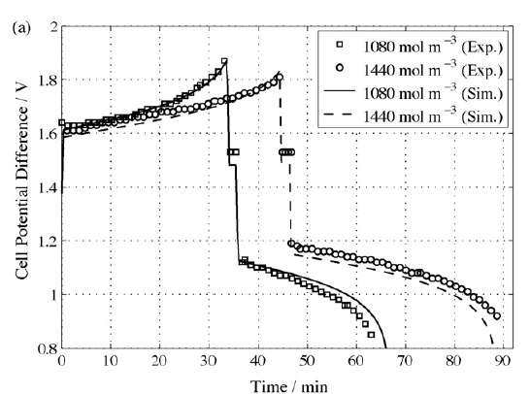
VRB modeling example¹⁹
Model developed to study effect of variables such as
  Ion concentration
  Flow rate
  Electrode porosity
Good agreement
between experiment
and modeling

Slide 26
Applications of flow batteries

Slide 27
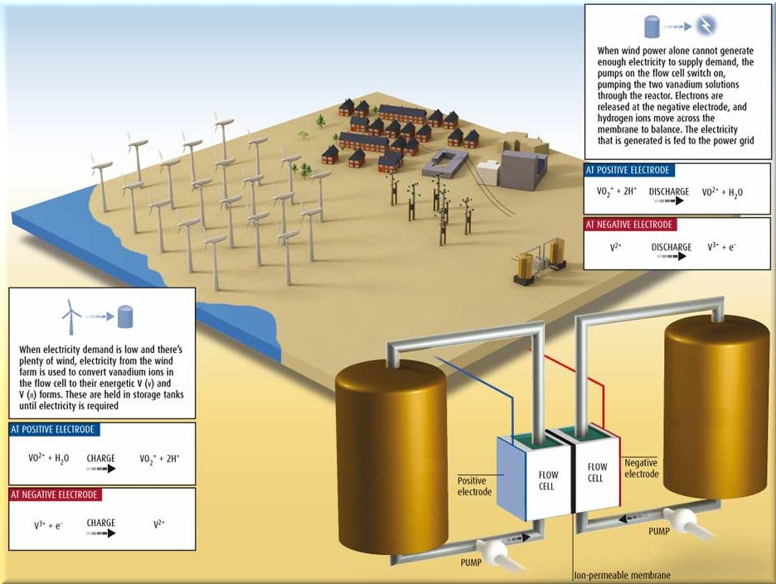
Applications: Grid storage²⁵
Grid storage is major current application and target market

Slide 28
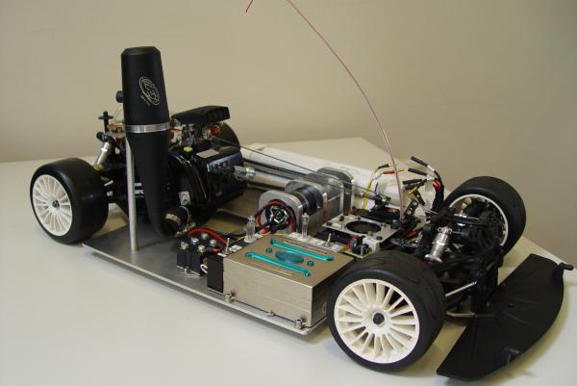
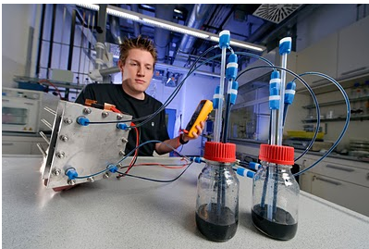
Applications: Vehicles^{21,22}
Vehicles would be interesting application since batteries could be instantly “refueled”
Research at Fraunhofer has looked at improving flow batteries for this purpose

Slide 29
New “semi-solid flow battery”

Slide 30
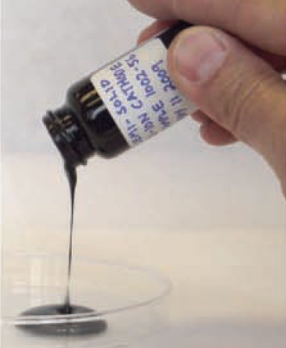
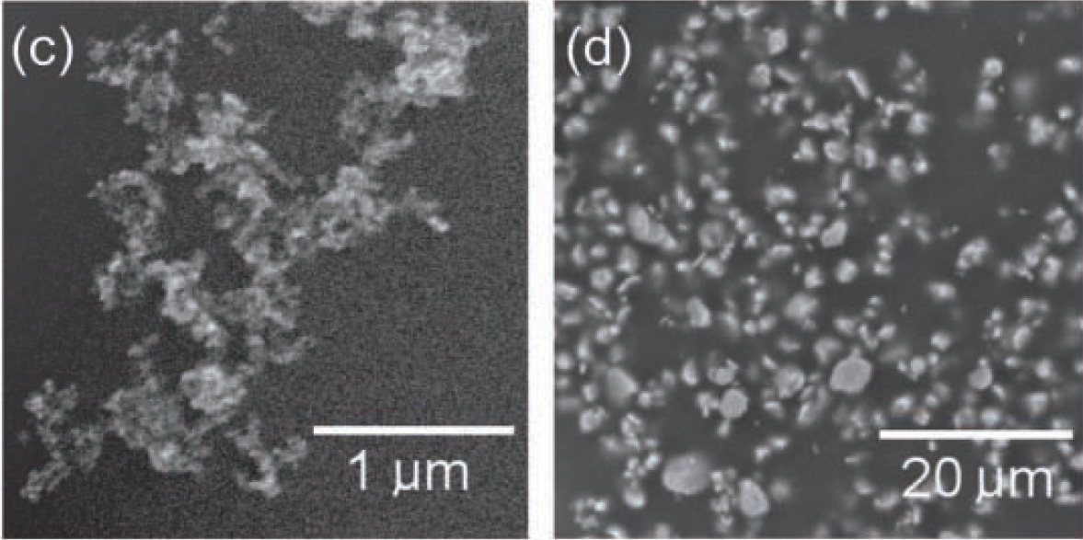
Semi-solid electrode suspensions²³
Yet-Ming Chiang’s group at MIT made semi-solid anode and cathode suspensions based on Li-ion chemistry
  Standard Li-ion electrolyte as base material (alkyl carbonates + LiPF₆ salt)
  Micron-scale anode/cathode particles, e.g. LiCoO₂ and Li₄Ti₅O₁₂ (LCO and LTO)
  Nano-scale carbon black to stabilize suspension and provide conductivity
Anode/cathode loadings up to 40% obtained, ~10 x greater than a
standard flow battery
Semi-solid cathode
Micron-scale LCO
Ketjen black nanoparticles

Slide 31
Semi-solid battery operation
Standard Li-ion battery (charging)

Slide 32
Semi-solid flow battery operation
e⁻
e⁻
Load
Separator
Li⁺ ions
Anode suspension tank
Cathode
suspension tank
Current Collector
Current Collector
Anode particles
Cathode
particles

Slide 33
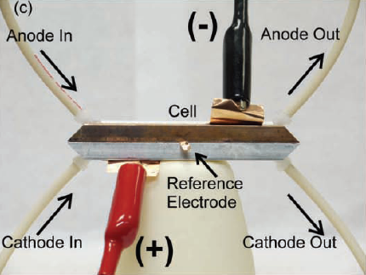
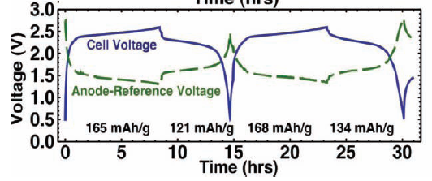
Semi-solid flow cell results
Full flow cell made with LCO cathode and LTO anode
  Charging approached LTO theoretical capacity, 170 mAh/g
  Discharging was ~75% efficient, could be improved with better anode/cathode matching
Scaling suggests energy densities of 300 – 500 kWh/m³ should be possible
  High enough for EVs!

Slide 34
Conclusions
Flow batteries are an up-and-coming mode of energy storage that offer several benefits over traditional battery systems
A variety of options exist for electrodes, separators, and active materials in flow batteries and there is much research on this topic
Flow batteries are currently mainly used in grid-storage applications due to their low cost and modularity
Recent “semi-solid” flow battery may be set to revolutionize field

Slide 35
References
www.greenmanufacturer.net
Weber, A.; Mench, M.; Meyers, J.; Ross, P.; Gostick, J.; Liu, Q., Redox flow batteries: a review. Journal of Applied Electrochemistry 2011, 41 (10), 1137-1164.
http://www.eurosolar.org/new/pdfs_neu/electric/IRES2006_Jossen.pdf
Ponce de León, C.; Frías-Ferrer, A.; González-García, J.; Szánto, D. A.; Walsh, F. C., Redox flow cells for energy conversion. Journal of Power Sources 2006, 160 (1), 716-732.
http://www.eurosolar.org/new/pdfs_neu/electric/IRES2006_Jossen.pdf
Zhao, P.; Zhang, H.; Zhou, H.; Yi, B., Nickel foam and carbon felt applications for sodium polysulfide/bromine redox flow battery electrodes. Electrochimica Acta 2005, 51 (6), 1091-1098.
http://mrsec.wisc.edu/Edetc/nanolab/fuelcell/
http://www.sciencephoto.com/media/228193/enlarge
http://hist.olieu.net/meauXfiles/Charles-Renard.html
http://www.electricitystorage.org/technology/storage_technologies/technology_comparison
http://www.redflow.com/
http://www.premiumpower.com/
http://gigaom.com/cleantech/china-the-next-big-grid-storage-market/
http://www.smartgrid.gov/sites/default/files/primus-power-oe0000228-final.pdf
Steeley, W. VRB Energy Storage for Voltage Stabilization; Electric Power Research Institute: Palo Alto, CA, 2005.
http://www.vrbeasteurope.hu/?level=fotogaleria&lang=en\
http://www.bubbleautomation.com/siemens-s7400-plc-programmers-n1.htm
http://homework.uoregon.edu/pub/class/hc441/bstorage.html
Shah, A. A.; Al-Fetlawi, H.; Walsh, F. C., Dynamic modelling of hydrogen evolution effects in the all-vanadium redox flow battery. Electrochimica Acta 2010, 55 (3), 1125-1139.
http://homework.uoregon.edu/pub/class/hc441/bstorage.html
http://nanopatentsandinnovations.blogspot.com/2010/04/fraunhofer-to-showcase-redox-flow.html
http://www.sciencedaily.com/releases/2009/10/091012135506.htm
Duduta, M.; Ho, B.; Wood, V. C.; Limthongkul, P.; Brunini, V. E.; Carter, W. C.; Chiang, Y.-M., Flow Batteries: Semi-Solid Lithium Rechargeable Flow Battery. Advanced Energy Materials 2011, 1 (4), 458-458.

Slide 36
Questions?

