Slide 1


Feasibility of 100% Zero Emission Vehicles by 2035 in Illinois Powered by Renewable Energy Sources Only
Sonia Chandra
UIUC M.Eng in Energy Systems
schand58@illinois.edu
NPRE 498

Slide 2
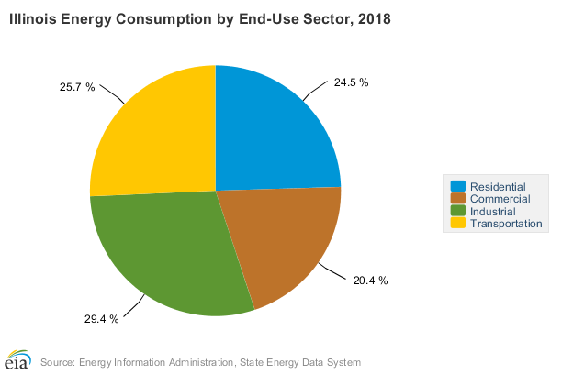
Background
5th largest energy-consuming state in the nation
6th largest petroleum-consuming state in the nation
^{1,014 trillion BTU annually}
^{$21,260 million annually}

Slide 3

Background
Destination: Zero Carbon
Make all new cars electric by 2035.
Make all buses electric by 2030.
Double the number of people who travel on foot, bike or public transit by 2030.

Slide 4
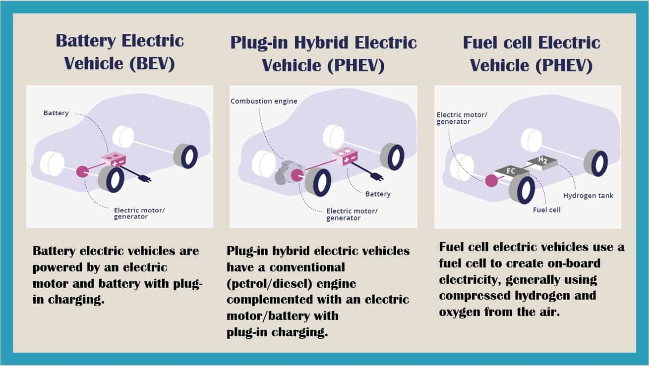
Types of Electric Vehicles’s (EVs)
Plug-in hybrid
Battery electric
Hydrogen fuel cell

Slide 5
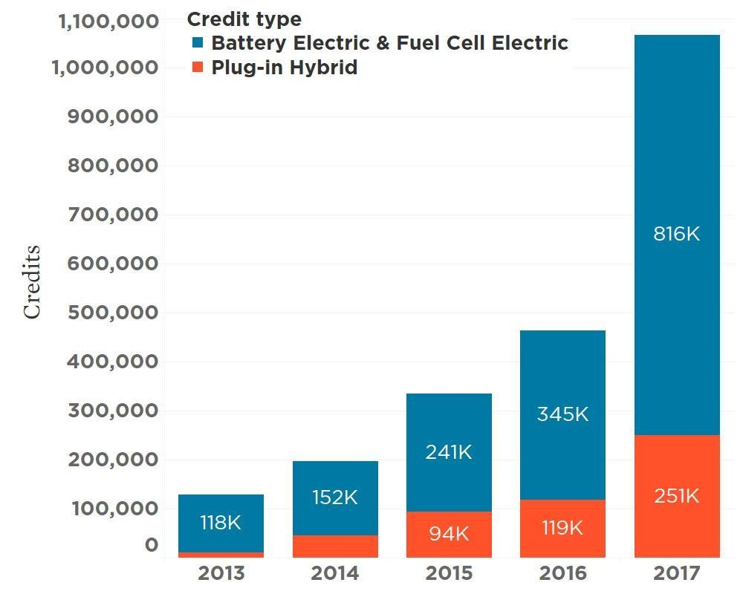
Zero Emission Vehicle (ZEV) program
Managed by California Air Resources Board (CARB)
Adopted by 10 states: Colorado, Connecticut, Maine, Maryland, Massachusetts, New Jersey, New York, Oregon, Rhode Island, and Vermont
Each automaker is assigned ZEV credits
Tesla Model S : 3.3 credits
Nissan Leaf: 1.8 credits
PHEVs → 43% of credits
BEVs & FCEVs→ 57% of credits

Slide 6
Constraints
Total Energy Demand: 100% EV’s
Renewable Energy Sources: Nuclear, Wind and Solar
Business As Usual (BAU) Projections
Feasibility:
Growth in Renewable Energy > Total Energy Demand
Current grid system can supply and transmit total energy demand
Savings from petroleum > Cost of infrastructure (4 charging ports to80% current gas stations)

Slide 7

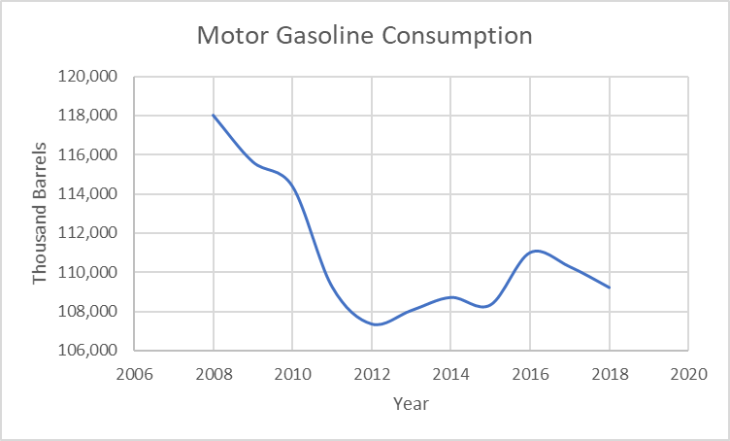
Energy Demand from 100% EV’s
Total Miles Driven in IL / Year
Average car (ICE) fuel consumption= 25mpg
Illinois motor gasoline consumption (2019) = 105,720,000 Barrels
Total miles travelled in IL/ year (2019) =1.1 x10^11 miles (110 Billion Miles)
Average miles per driver = 12,581 miles
Current % of EV’s in IL = 0.3 % (12400)
Total Energy Demand
Average EV energy consumption=314Wh/mile
Total Energy Demand (100%)= 1.1 x 10^11 miles x 314Wh/mile
35 TWh

Slide 8
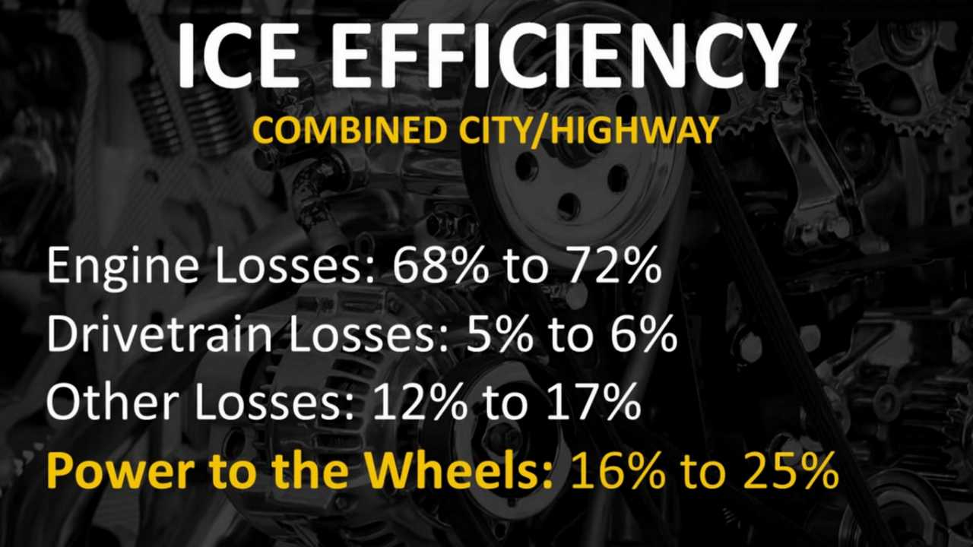
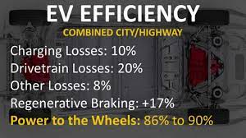
Energy Savings from 100% EV’s
Current Energy Demand (gasoline) = 180 TWh
145 TWh savings
Energy Savings 180TWh → 35TWh = 80%

Slide 9
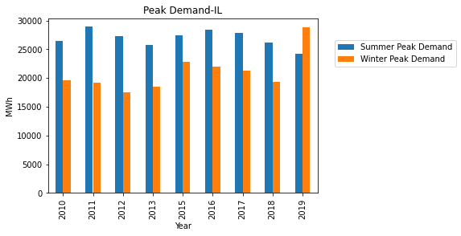
Feasibility on IL Grid System
Current net electricity generation = 184TWh
Total Retail Sales = 138TWh
Energy not consumed = 46TWh (25%)
Additional energy needed = 35 TWh

Slide 10
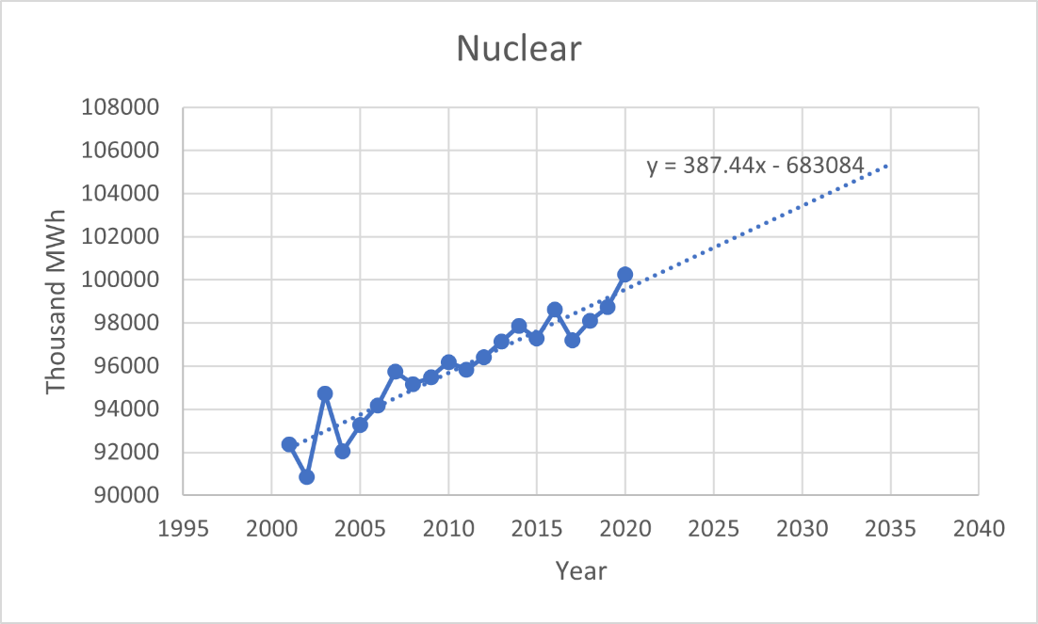
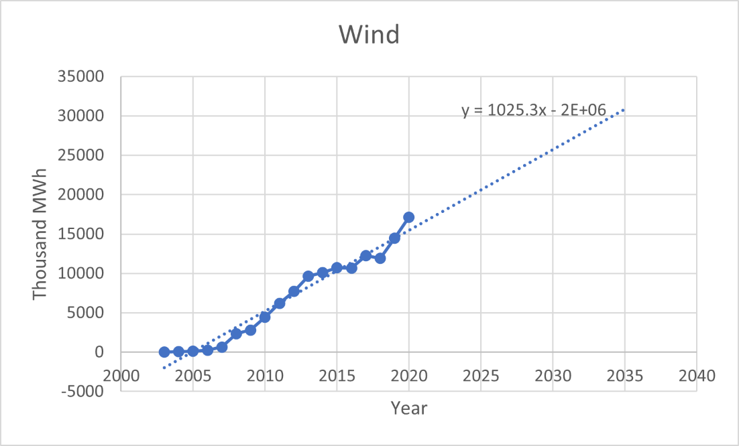
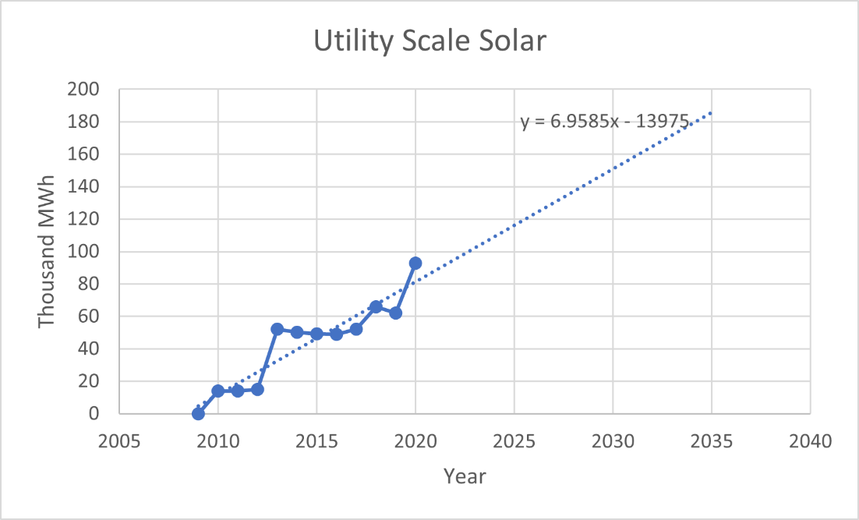
Anticipated Renewable Energy Generation in 2035
Source (Thousand MWh) | Nuclear | Wind | Solar | Total
Current Generation (2020) | 100246 | 17111 | 92.85
Expected Generation (2035) | 105356 | 86486 | 185.5
Additional Energy | 5110 | 69375 | 92.65 | 74577.65
74 TWh
47% → Powering EV’s

Slide 11
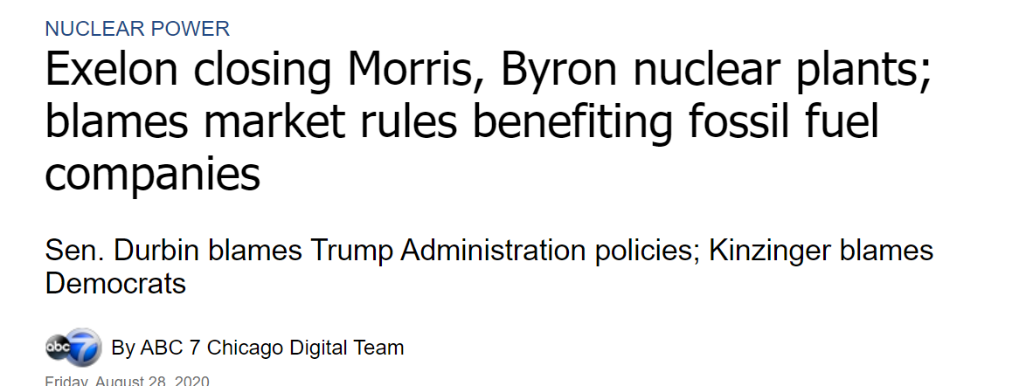
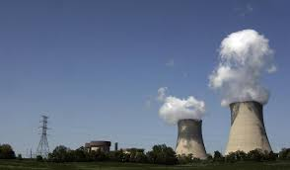
Nuclear Power in Illinois
Without nuclear energy: 69TWh
51% → Powering EV’s

Slide 12
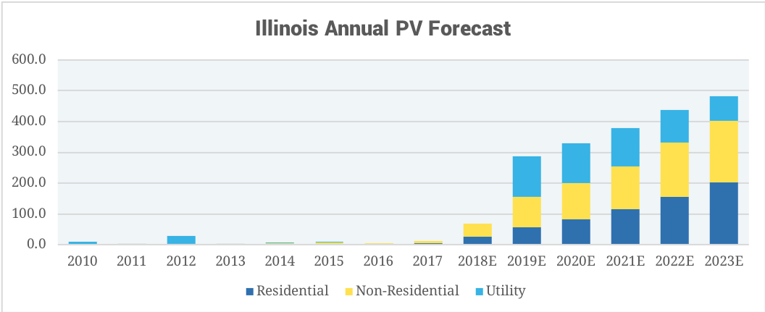
Solar Energy in IL
SEIA: Path to 100
RPS: 25% by 2025 to 40% by 2030
REC procurement from 10 million by 2020 to 45 million by 2030
50/50 split from solar and wind.

Slide 13
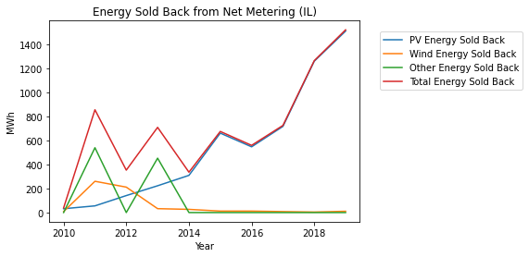
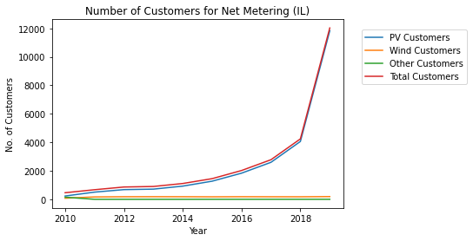
Residential PV
Expected to grow 1700% in next decade
Residential PV 1400 MWh → 2TWh

Slide 14
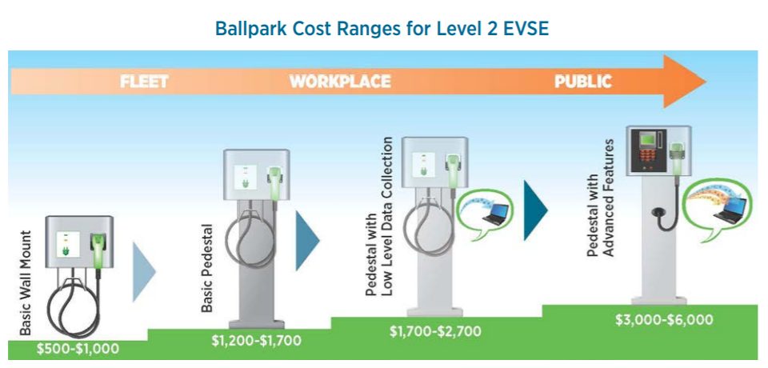
Cost of Infrastructure
AC Level 2 Vehicle Range Added per Charging Time and Power
10 mi/hour @ 3.4kW
20 mi/hour @ 6.6kW
60 mi/hour @ 19.2 kW
208/240VAC/20-100A (16-80A continuous)
EVSE | Cost
Installation | $4200
Pedestal Equipment | $4500
Operation & Maintenance | $686
Total | $9386

Slide 15
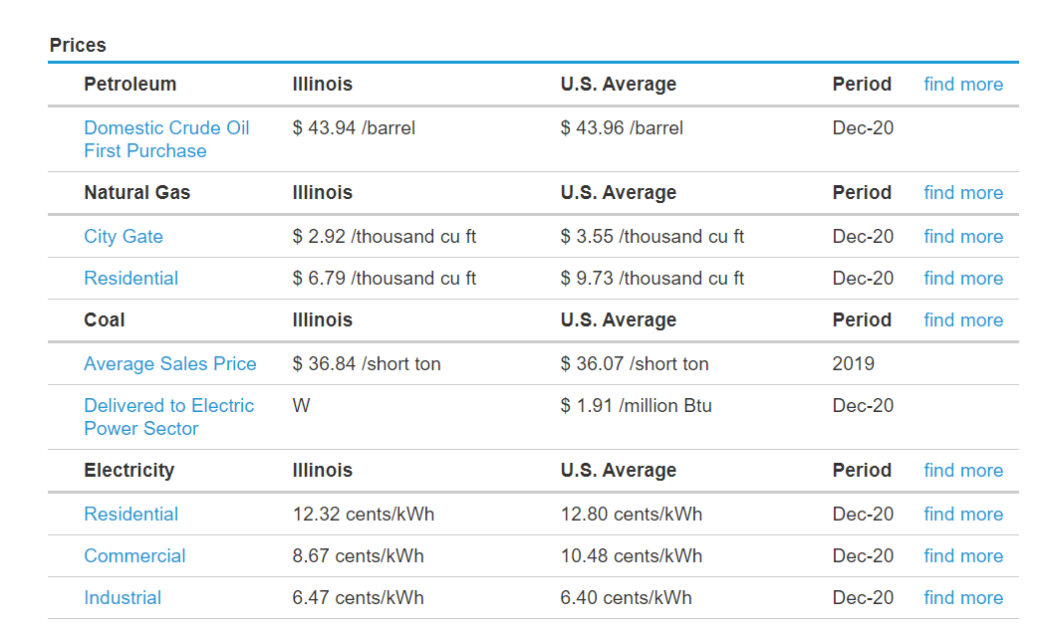
Cost of Infrastructure
Number of charging ports =12,212
Total Cost = $114.6 Million
Cost of petroleum/year =$4.6 Billion

Slide 16
Benefits of EV Market Expansion on Energy Storage Systems
Allows EV’s to be used in lieu or in conjunction with electricity storage in emergencies/supply shortages
As EV increases amount of energy purchased at night, it reduces energy-time shift and time-off use energy cost management
Leads to economies of scale and lower prices for advanced battery systems
Increases grid integration and system management

Slide 17
Current EV Incentives
EV exemption from state emissions testing
ComEd offers 3 EV rate plans for residential customers
Illinois Electric Co-op members may be eligible to finance their EV at 0.5% interest
City of Naperville offers $30 per kW up to $3,000 (filed on behalf of customer)

Slide 18
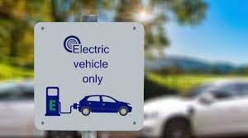
EU Electric Vehicle Targets
30 million electric cars by 2030
Currently: 1.8 million electric and plug-in hybrid vehicles registered in Europe
High-speed rail traffic to double by 2030
Scheduled travel between cities of under 300 kilometers (186 miles) to become carbon-neutral
Zero-emission large aircraft and vessels should be “ready for market” by 2035

Slide 19

Questions?
Thank You

Slide 20
References
https://ev-database.org/cheatsheet/energy-consumption-electric-car
https://www.iea.org/reports/fuel-consumption-of-cars-and-vans
https://www.epa.gov/automotive-trends/highlights-automotive-trends-report
https://afdc.energy.gov/data/10962
https://www.thezebra.com/resources/driving/average-miles-driven-per-year/#average-miles-driven-per-year-by-state
https://www.valuepenguin.com/auto-insurance/car-ownership-statistics
https://www.solarpowerworldonline.com/2019/06/illinois-agency-says-state-wont-reach-rps-of-25-by-2025-unless-legislation-changes/
https://ilenviro.org/energy/renewable-energy/
https://afdc.energy.gov/files/u/publication/evse_cost_report_2015.pdf

