Slide 1

Seasonal Thermal
Energy Storage
Chris Kuprianczyk
NPRE 498 – Energy Storage and Conveyance

Slide 2
Overview
What is STES?
How is energy captured?
How is energy stored?
How much energy can be stored?
Is it being done already?
Conclusions/Questions

Slide 3
What is STES?
In general, STES is using thermal energy captured in warm seasons for heat in cool seasons.
Thermal energy can come from the sun, or from other industrial process waste heat.
STES attempts to solve the problem of energy storage for thermal energy sources.

Slide 4
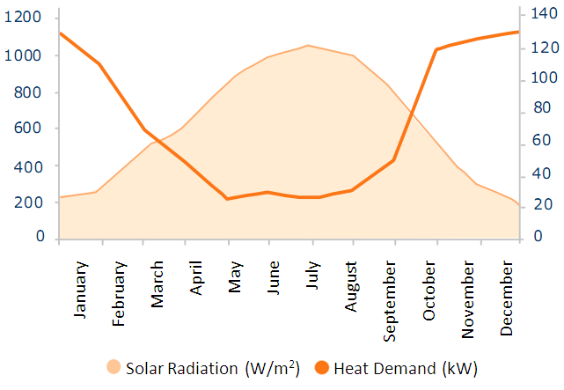
Solar Radiation vs. Heat Demand

Slide 5
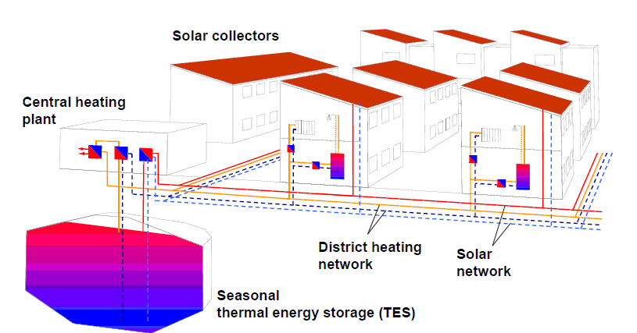
How is energy captured?
Solar Collectors:
Heat is captured via solar thermal panels and is pumped to an underground reservoir

Slide 6
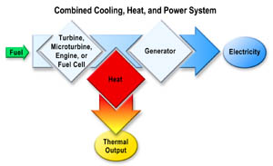
How is energy captured?
Heat Exchangers:
Convert the waste thermal output from industrial processes into usable heat in a different part of the year.

Slide 7
How is energy stored?
Thermal Reservoirs:
  Natural aquifers hold heated water throughout the year for reuse when needed (ATES)
  Earth deep in the ground (borehole) is heated, and the heat is extracted when needed (BTES)
  Water is stored in an insulated tank or pit after being heated for later use (TTES and PTES)

Slide 8
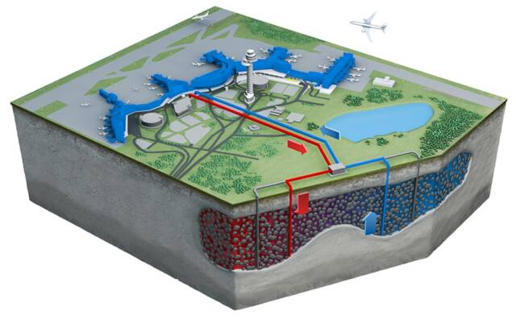
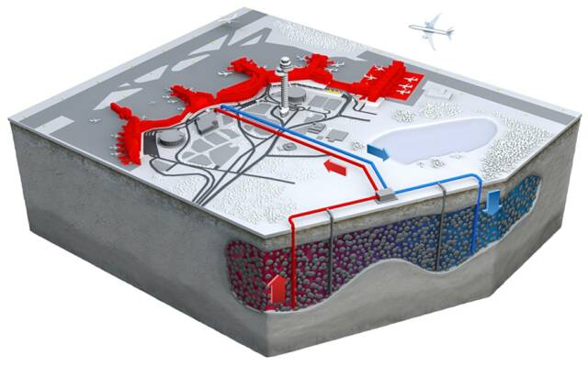
How is energy stored?

Slide 9
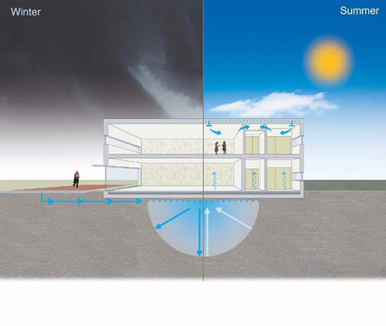
How is energy stored?

Slide 10
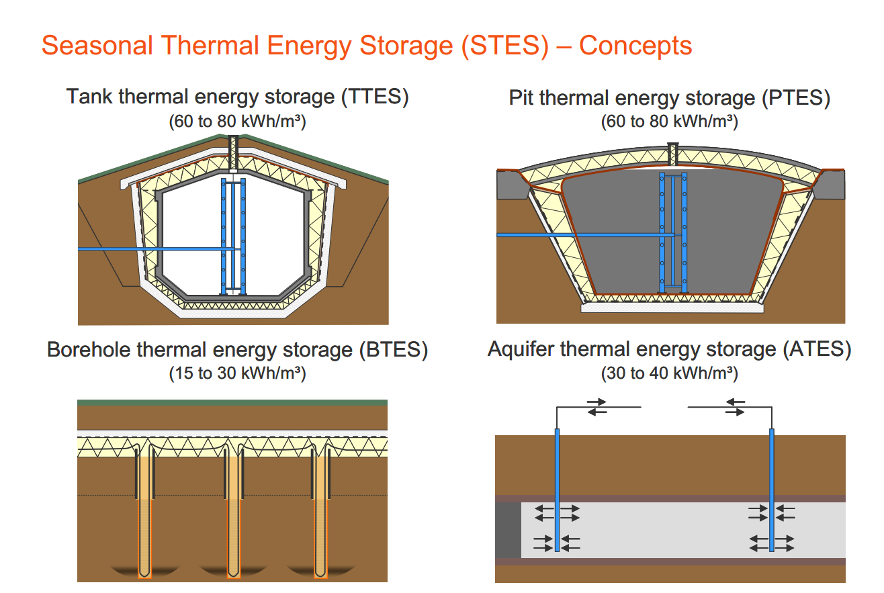
How is energy stored?

Slide 11

How much energy can be stored?
$Q=mc_{p}∆T$
Q: Thermal Energy Stored
m: Mass of substance that is storing heat
C_{p} : Specific heat capacity of storing material
ΔT: Change in temperature of substance before and after storage

Slide 12

How much energy can be stored?
Example Problem: The sun heats 100,000L of water from 22C to 39.2C, which is stored in an insulated storage tank. How much energy is stored in the water?
$Q=mc_{p}∆T$
C_{p} = 4.18 J/ (gK)
ΔT=17.2 K
m=ρV=100000kg=1e8 grams
Q= (1e8) (4.18) (8.6) J = 7200 MJ = 2 MWh

Slide 13
Limitations:
Need a nearby aquifer, or else earth excavation is required to install thermal storage and extraction.
Need efficient insulation, or water will not stay warm year round
Need efficient pumps to move water to where it is needed
Need efficient heat exchangers to provide and extract heat to and from the water, if applicable

Slide 14
Is this being done already?
Drake Landing Solar Community, Alberta, Canada
  52 homes with 800 solar collectors on garage roofs
  Glycol solution is heated, then heat is transferred to water for short term storage
  Heat is then stored for long term periods using BTES (144 6-inch boreholes)
  They get 97% of their year-round heat from STES

Slide 15
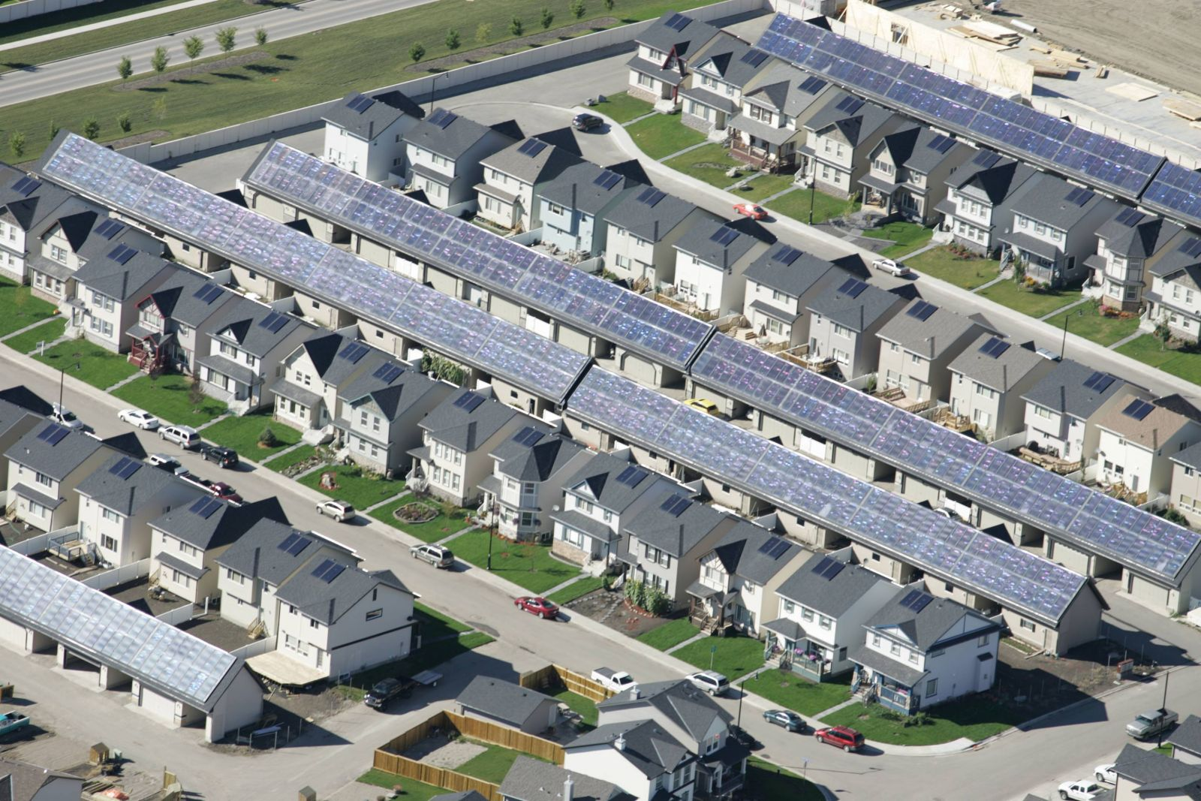
Is this being done already?
Drake Landing Solar Community

Slide 16
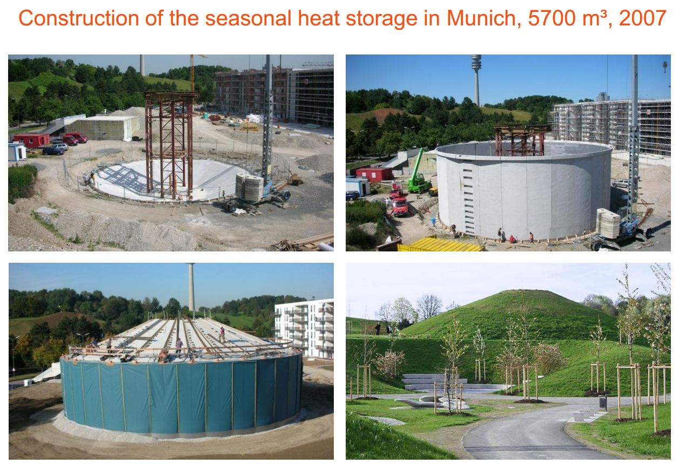
Is this being done already?
Munich STES

Slide 17
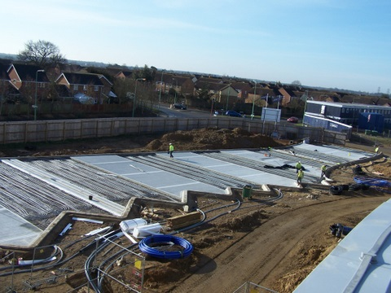
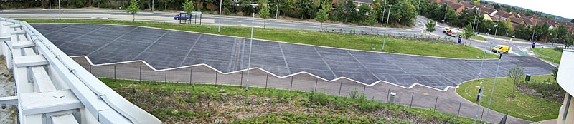
Is this being done already?
One College, near Ipswich, England
Uses Asphalt solar collectors, stores heat for winter

Slide 18
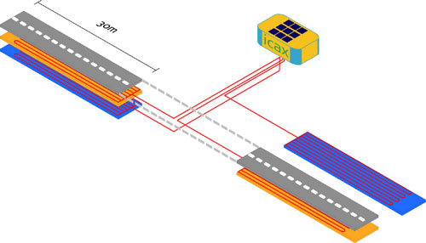
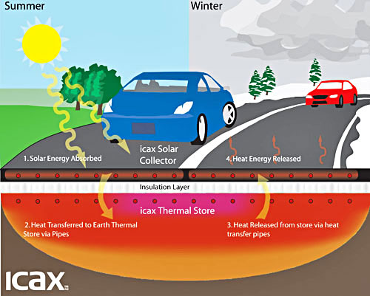
Is this being done already?
Toddington Motorway Service station

Slide 19
Conclusions
STES stores thermal energy for when it is most needed, usually from summer to winter
Energy is stored in aquifers, boreholes, tanks, or pits
It is being done in several places already, including in Canada, Germany, and the UK

Slide 20
References:
http://www.icax.co.uk/images/SolarRadiation_HeatDemand.png
http://www.einstein-project.eu/fckeditor_files/image/Homepage_haundi.jpg
http://www.in.gov/oed/images/heat_power2.jpg
http://www.underground-energy.com/ATES.html
http://www.icax.co.uk/renewable_cooling2.html
http://www.nrcan.gc.ca/sites/www.nrcan.gc.ca/files/www/images/science/articles/2/image2.jpg
Solar district heating with seasonal thermal energy storage in Germany
  120619_EUSEW_5+-+Pauschinger+Solites_SDHGermany_120618.pdf

