Slide 1


CSP plant with TES storage & Cost analysis
Saurav Subhash

Slide 2
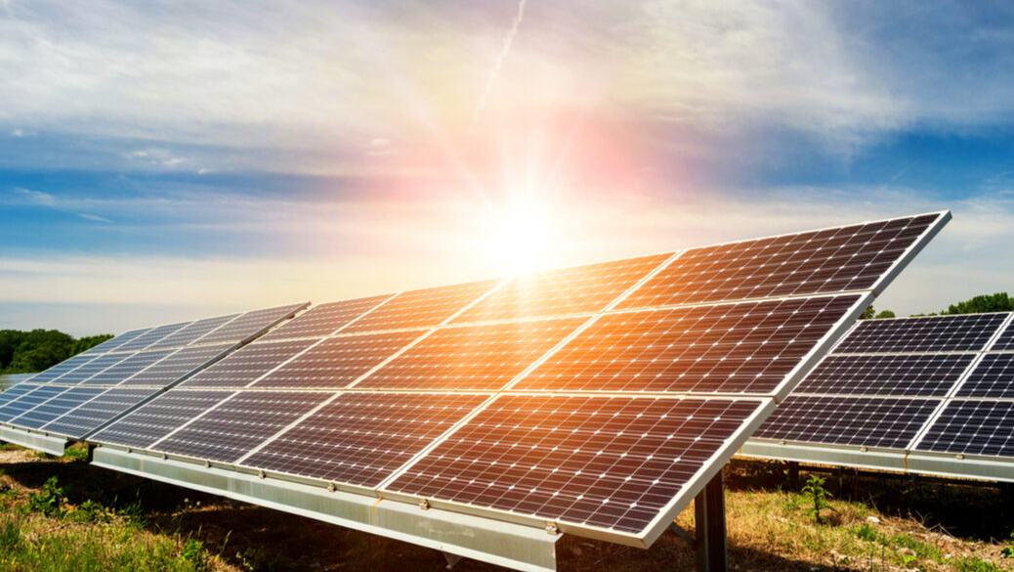
Alternatives to Photovoltaics?
Collecting Solar Power is favorable
PhotoVoltaics have practically peaked in efficiency
The more advanced technologies are incredibly expensive
NO STORAGE

Slide 3
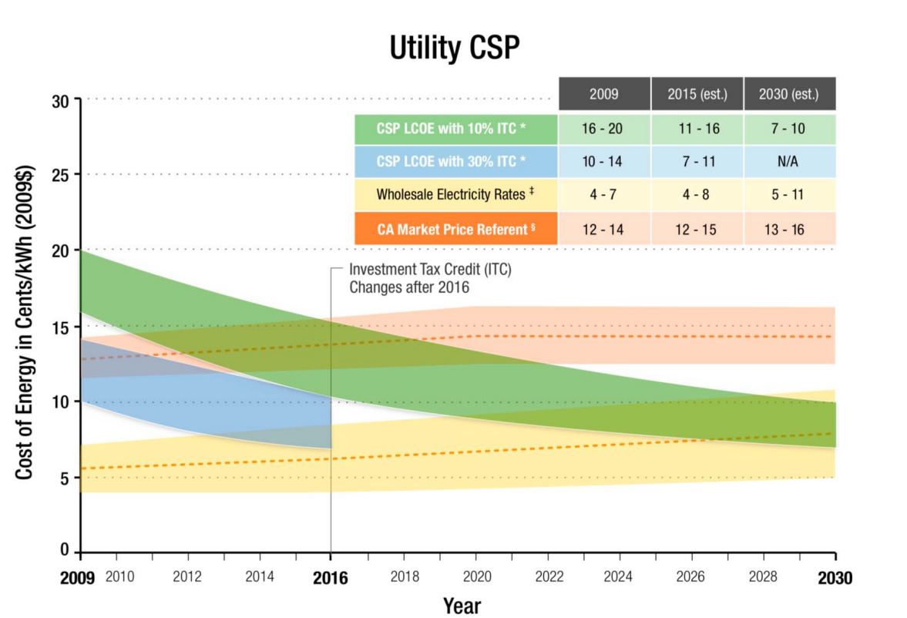
Utility CSP: DOE Analysis

Slide 4
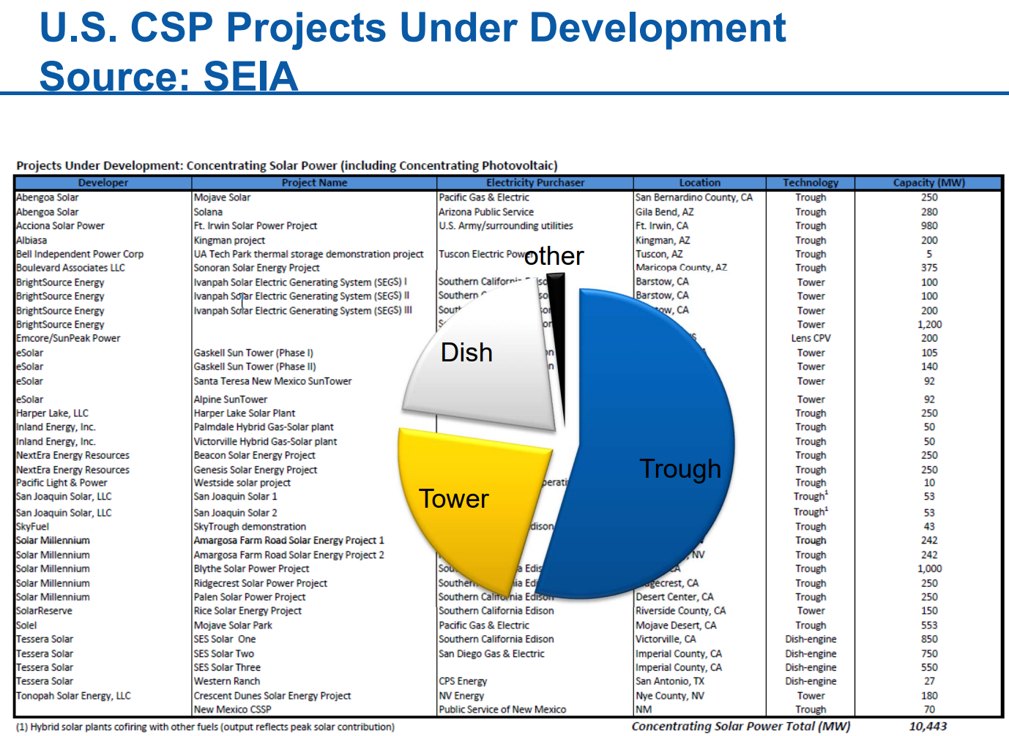

Slide 5
Largest CSP Capacities (2014)
1. Ivanpah Solar Electric Generating System in the Mojave Desert of California, United States—392MW
2. Solar Energy Generating Systems in California, United States—354MW
3. Solana Generating Station in Arizona, United States—280MW
4. Solaben Solar Power Station in Logrosán, Spain—200MW
5. Solnova Solar Power Station in Seville, Spain—150MW
6. Andasol Solar Power Station in Granada, Spain—150MW
7. Extresol Solar Power Station in Torre de Miguel Sesmero, Spain—150MW
8. Shams-1 in Abu Dhabi, UAE—100MW (largest single-unit solar power plant in the world)
9. Palma del Río Solar Power Station in Córdoba, Spain—100MW
10. Manchasol Solar Power Station in Ciudad Real, Spain—100MW
11. Valle Solar Power Station in San José del Valle, Spain—100MW

Slide 6
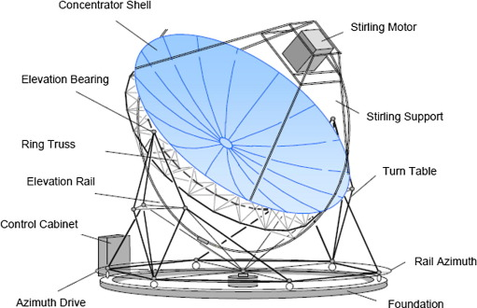
Dish Engine Systems
Notes:
Dish/engine systems use mirrored dishes (about 10 times larger than a backyard satellite dish) to focus and concentrate sunlight onto a receiver. As shown in Figure 5, the receiver is mounted at the focal point of the dish. To capture the maximum amount of solar energy, the dish assembly tracks the sun across the sky. The receiver is integrated into a high-efficiency "external" combustion engine. The engine has thin tubes containing hydrogen or helium gas that run along the outside of the engine's four piston cylinders and open into the cylinders. As concentrated sunlight falls on the receiver, it heats the gas in the tubes to very high temperatures, which causes hot gas to expand inside the cylinders. The expanding gas drives the pistons. The pistons turn a crankshaft, which drives an electric generator. The receiver, engine, and generator comprise a single, integrated assembly mounted at the focus of the mirrored dish.
Unlike other CSP systems, parabolic dish systems are smaller in size, more efficient, and uses gas as the working fluid to generate electricity by running a heat engine. These systems can produce electricity between 3 and 25kW at 30% conversion efficiency, which is higher than other CSP technologies. Due to its size and ruggedness it can be used as a standalone system for supplying power to remote areas and in the aftermath of disasters.

Slide 7
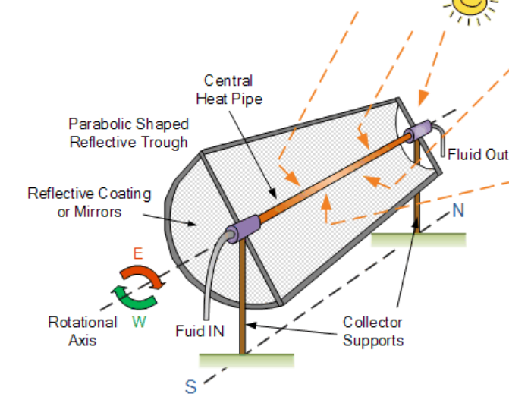
Trough Systems
Notes:
This system consists of a long parabolic-shaped collector with curved mirrors that focuses the sun’s rays on a receiver pipe (absorber tube) located at the focal point of parabolic troughs. These troughs can be more than 600m in length and the metal absorber tube is usually embedded into an evacuated glass tube to reduce heat losses. The troughs are rotated throughout the day as the sun moves from east to west to maximize the received solar energy.
The metal absorber tube is filled with fluid, typically synthetic oil, which can be heated up to 400°C. Because of the parabolic shape, the troughs can focus the sun at 30–100 times its normal intensity. The fluid is then pumped through a heat exchanger that transfers heat to water which produces steam on boiling the water. The steam is used to run a turbine which generates electricity.
The use of other heat transfer fluids like molten salts or direct steam allows the operation up to 550°C, hence improving the plant efficiency. These systems can also be designed as hybrids by using fossil fuel to back the solar thermal output during night time or during periods of cloudy days.

Slide 8
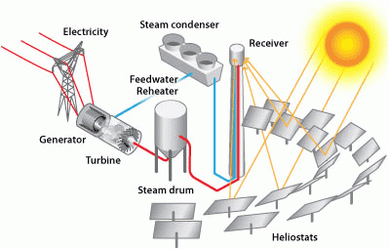
Power tower systems
Notes:
Power towers system as shown in Fig. 7.5 is a newer technology compared to the parabolic solar trough and is more suited for large-scale grid connected power plants to be economical. A power tower system consists of many large sun tracking flat mirrors that focus sunlight on a receiver at the top of a tower.
These tracking mirrors, numbering in hundreds to thousands, called heliostats can concentrate as much as 1500 times that of energy coming from the sun. This enormous amount of energy produces high temperature of 500–1500°C which can then be used to heat a fluid such as water or molten salt. The heated fluid in the receiver is used to generate steam which in turn is used to move the turbine generator for producing electricity. Solar tower technology is among one of the solar thermal technologies that has the ability to store energy which enables it to supply electricity to the grid when needed and during cloudy weather or nights when there is no sun.
It is a good source of providing large-scale distributed power to the nonproductive land like a desert without producing any greenhouse gases. It is estimated that a single 100-MW power tower with 12hours of storage requires only 1000 acres of land for supplying electricity to 50,000 homes.
The hot fluid can be used immediately to make steam for electricity generation or stored for later use. Molten salt retains heat efficiently, so it can be stored for days before being converted into electricity. That means electricity can be produced during periods of peak need on cloudy days or even several hours after sunset.

Slide 9
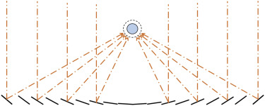
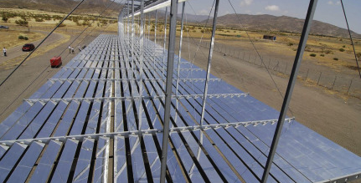
Linear Fresnel
Notes:
The linear Fresnel reflector technology received its name from the Fresnel lens which has multiple refracting planes designed to improve the concentration of light coming from many different angles onto a single point or line. This lens was developed by Augustin-Jean Fresnel in the 18th century, and allows a substantial reduction in the thickness, volume and weight of the lens but also reduces the quality of imaging. Giovanni Francia of Italy first applied it in 1960 for development of linear and a two-axis tracking
Fresnel steam-generating system. A linear Fresnel reflector’s design is based on a principle between the power tower and parabolic trough concentrator systems. It is similar to parabolic trough system but contains fixed receiver pipe while mirrors track.
The trough shape is split into multiple mirror facets. This mirror based system uses the same principle as a Fresnel lens uses for flat plane mirrors that track the sun to reflect light onto a tube. An additional secondary mirror is used in some systems behind the focal plane which directs the sunlight into the absorber pipe. The linear Fresnel reflector system shown in Fig. 7.8 uses long rows of flat or slightly curved mirrors to reflect sunlight onto a downward facing raised linear collector containing two stainless steel absorber tubes.
The collector in this system is a fixed absorber tube located at the common focal line of the mirror reflectors equipped with single or dual axis tracker to maximize the amount of sun energy collected throughout the day. A secondary concentrator is used to reflect the rays within the accepting angle. The Fresnel reflectors concentrate beam radiation to a stationary receiver. The receiver consists of two stainless steel absorber tubes. Each receiver has a secondary CPC as well
The thermal storage system draws molten salt from a 290° C tank and is heated to 550° C by the mirror’s heat. The heated molten salt is passed to a separate tank for storage and is pumped through a heat exchanger that can be used later to produce electricity.

Slide 10

Advantages
Linear Fresnel
Direct generation of steam without the use of the intermediate HTF
Less stringent requirements for the optical accuracy
A construction design geared toward factory assembly leading to reduced field installation activities
Use of conventional ‘off-the-shelf’ materials & Less impact of wind on the structural design.

Slide 11
Disadvantages
Linear Fresnel
•The technology is less mature than troughs, with only recent relatively small-scale commercial developments
•Lower power cycle efficiency due to lower steam temperature
•Lower optical efficiency and increased heat losses due to absence of insulation around the receiver tubes.
The steam cycle efficiency may be significantly higher than with trough technology if the temperature can be increased up to 450°C, which some technology suppliers are seeking to achieve

Slide 12
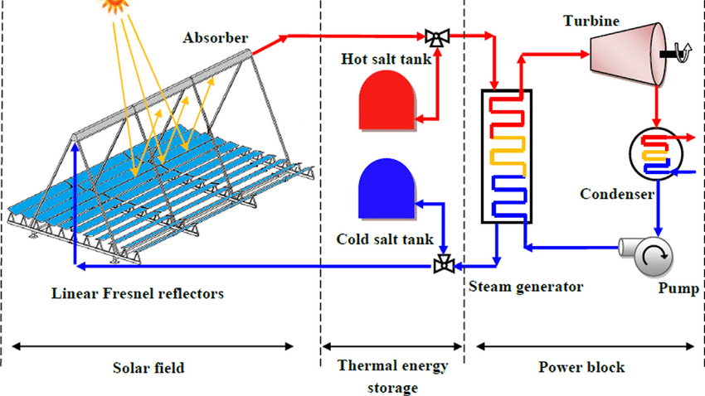
Notes:
Molten salt is a mixture of nitrate sodium nitrate (NaNO3) and potassium nitrate (KNO3) at a 60:40 ratio which melts when heated above 230°C. In the two-tank system, also called a direct system, the heat transfer fluid in the form of molten salt is placed in two separate tanks, one at a high temperature and other at a low temperature. Molten salt fluid from low temperature tank flows through the solar collector where it is heated by sunlight to a high temperature.
The heated fluid then flows to the high temperature tank for storage. Fluid from the high temperature tank flows through a heat exchanger where it generates steam for producing electricity. The fluid exits the heat exchanger at a low temperature and returns to the low-temperature tank.
This system, although simple and cost effective, involves significant physical and cost redundancy in its construction. The Solana CSP plant which started operation in 2013, at Phoenix, Arizona, uses molten salt storage that can deliver power for nearly 6 hours after sunset.

Slide 13
Thermal Energy Storage
Extended beyond non solar hours
Avoids supply-demand mismatch
Sensible heat storage
Latent heat storage
High storage density
Reduce storage volume
Small temperature variation
Disadvantage?
higher thermal resistance +
Low thermal conductivity of PCM
More expensive
Notes:
The operation of a CSP plant can be extended beyond periods of no solar radiation by the addition of thermal energy storage (TES). This will make the system not only more dispatchable but it will also make it more cost effective and improve its performance by reducing the mismatch between supply and demand. There are two kinds of TES commonly used for CSP plants. The first TES system is called sensible heat storage, and is based on storing thermal energy by heating or cooling a liquid or solid storage medium such as water, molten salt, sand and rocks. When a substance used as the TES is heated, its internal energy increases and when it cools, that thermal energy is released to the neighboring locations. This is an indirect method of heating a large volume of material for storing a certain amount of energy required by the CSP plants. Sensible heat storage system although is relatively cheaper than latent heat storage, it requires proper design to discharge thermal energy at constant temperatures.
The second method of thermal storage for CSP plants is latent heat storage which uses phase change materials (PCMs) for a shift in phase when the material changes from solid to liquid and vice versa. The heat stored and retrieved during the phase change process of material is called latent heat and can be used to reduce the size and cost of the storage system. Latent heat storage is a direct storage system which has the advantage of high storage density and ability to store energy with only a small temperature variation.
TES through PCM is capable of storing and releasing large amount of energy in a wide range of temperature applications. However, the higher thermal resistance provided by intrinsically low thermal conductivity by the use of PCM is presenting a major technology barrier for its implementation. Because of high temperatures and the pressure involved, it is costly and is used as a buffer storage for peak power. Most of the current CSP plants use sensible energy storage in molten salt to store energy which requires large volume of salt for two-tank storage systems.

Slide 14
Sensible Heat Storage
Two-tank direct system
Two-tank indirect system
Single tank thermocline system(Temp gradient)
Notes:
Solar thermal energy in this system is stored in the same fluid used to collect it. The fluid is stored in two tanks—one at high temperature and the other at low temperature. Fluid from the low-temperature tank flows through the solar collector or receiver, where solar energy heats it to a high temperature, and it then flows to the high-temperature tank for storage. Fluid from the high-temperature tank flows through a heat exchanger, where it generates steam for electricity production. The fluid exits the heat exchanger at a low temperature and returns to the low-temperature tank.
Two-tank direct storage was used in early parabolic trough power plants (such as Solar Electric Generating Station I) and at the Solar Two power tower in California. The trough plants used mineral oil as the heat-transfer and storage fluid; Solar Two used molten salt.
TWO-TANK INDIRECT SYSTEM
Two-tank indirect systems function in the same way as two-tank direct systems, except different fluids are used as the heat-transfer and storage fluids. This system is used in plants in which the heat-transfer fluid is too expensive or not suited for use as the storage fluid.
The storage fluid from the low-temperature tank flows through an extra heat exchanger, where it is heated by the high-temperature heat-transfer fluid. The high-temperature storage fluid then flows back to the high-temperature storage tank. The fluid exits this heat exchanger at a low temperature and returns to the solar collector or receiver, where it is heated back to a high temperature. Storage fluid from the high-temperature tank is used to generate steam in the same manner as the two-tank direct system. The indirect system requires an extra heat exchanger, which adds cost to the system.
This system will be used in many of the parabolic power plants in Spain and has also been proposed for several U.S. parabolic plants. The plants will use organic oil as the heat-transfer fluid and molten salt as the storage fluid.
SINGLE-TANK THERMOCLINE SYSTEM
Single-tank thermocline systems store thermal energy in a solid medium—most commonly, silica sand—located in a single tank. At any time during operation, a portion of the medium is at high temperature, and a portion is at low temperature. The hot- and cold-temperature regions are separated by a temperature gradient or thermocline. High-temperature heat-transfer fluid flows into the top of the thermocline and exits the bottom at low temperature. This process moves the thermocline downward and adds thermal energy to the system for storage. Reversing the flow moves the thermocline upward and removes thermal energy from the system to generate steam and electricity. Buoyancy effects create thermal stratification of the fluid within the tank, which helps to stabilize and maintain the thermocline.
Using a solid storage medium and only needing one tank reduces the cost of this system relative to two-tank systems. This system was demonstrated at the Solar One power tower, where steam was used as the heat-transfer fluid and mineral oil was used as the storage fluid.

Slide 15
Latent Heat Storage
Expensive
Reduced Thermal Conductivity
Notes:
In latent heat storage, the heat energy is stored/extracted when the storage material undergoes a phase changes at constant temperature. Simply put, when the material melts/solidifies/evaporates/condenses, it either releases or stores the supplied heat energy.
Like sensible heat storage, it is also a pure physical process with no change in the chemistry of the material. These materials are known as phase change materials (PCM). Because the materials store/release during phase change, they enable energy exchange in a narrow range of temperature and exhibit higher energy densities.
However, the major disadvantage is their low thermal conductivity leading to extremely slow rates of transition between phases. To tackle the problem, designers mix additives like graphite to increase the thermal conductivity and vary depending on the amount added.
While better options like materials made of metal alloys are available, they are expensive. As the saying goes, “there is no free lunch!”

Slide 16
Thermo-Chemical Heat Storage
A reversible endothermic chemical reaction consumes the solar energy.
Since a chemical reaction occurs, the newly formed products store the solar energy.
When these new products convert back into the original reactants, they release he stored solar energy.
Notes:
Photosynthesis-respiration pair is a great example of thermo-chemical heat storage. On one side, photosynthesis uses solar (although not the infrared range) energy to produce starch (food) and oxygen. On the other side, respiration breaks down the same food in the presence of oxygen to release energy and carbon dioxide. Like I said, sun is the source of all energy forms on earth!
Similar to the photosynthesis-respiration pair, metallic hydrides, carbonate systems, hydroxide systems, etc. convert the sun’s heat energy (infrared range) into chemical energy for further use. Depending on the reaction, the products may cause unwanted problems like unusually slow reaction rate. Moreover, some of the reactions may require a catalyst (an external stimulus) to execute the reaction.

Slide 17
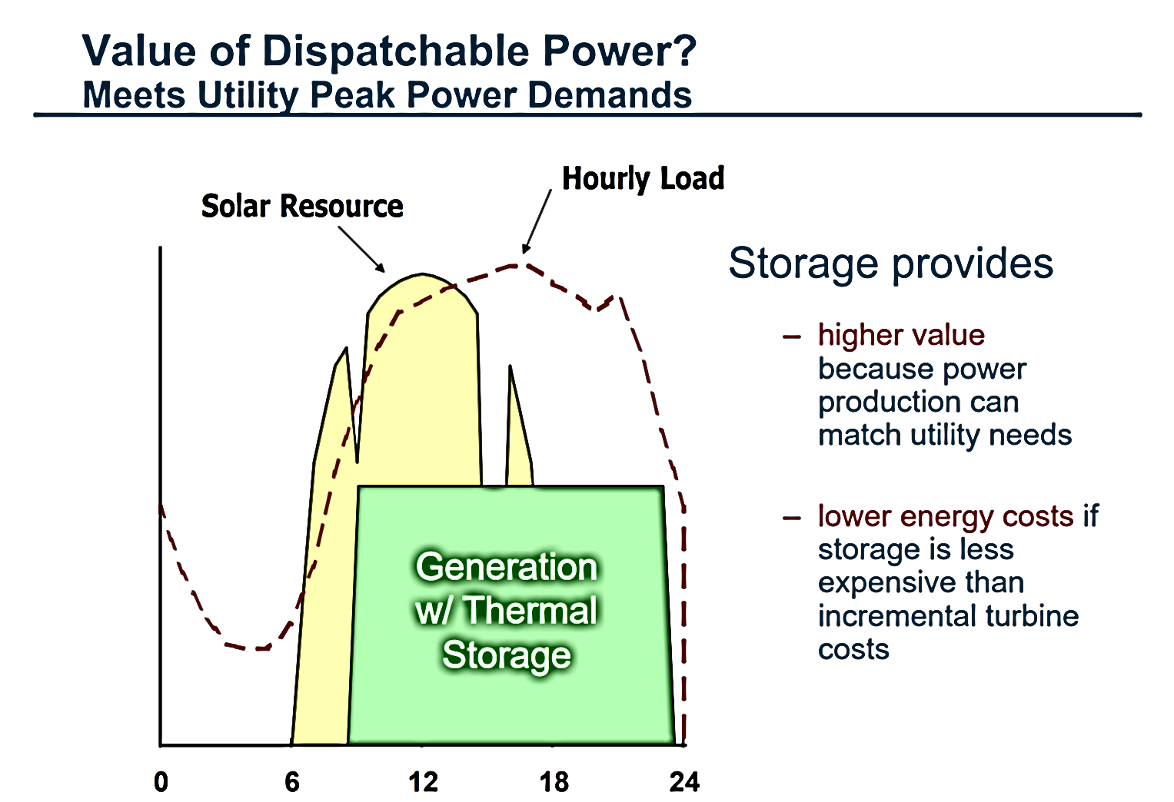

Slide 18

Background
Flat glass mirrors (so called primary reflectors) focus the sunlight onto an absorber tube filled with water. As a result, the water is heated up and evaporates .
Why we chose LFR over the more common PTC?
Primary Location - Phoenix 33.45 Latitude -111.98W Longitude
Constraints Chosen TES - 4 hrs vs 10 hrs Salt used : HiTec Solar Salt - KNO3:NaNO2:NaNO3 (53 :40: 7 %mass ratio)
2/11
GRAINGER ENGINEERING
Notes:
Flat glass mirrors (so called primary reflectors) focus the sunlight onto an absorber tube filled with water. As a result, the water is heated up and evaporates at 275°C and 55 bar. The saturated steam is directed to two turbines, driving a 15 MW generator each. Thus, the thermal energy is converted into electricity and fed into the grid. The steam from the turbines is condensed in air cooled condensers and recirculated to the solar field. Special developed cleaning robots clean the mirrors during the night and ensure an almost waterless cleaning. The grass underneath the mirror rows is regularly grazed by sheep; thereby avoiding the use of machines. Furthermore, does not use additional energy produced by gas or oil combustion but generates steam directly, not using thermal oil as heat transfer fluid. The result is 100 percent ecological power.
The main advantages of LFR are (1) simplicity, (2) robustness, (3) low wind load, (4) low capital cost, and (5) flexibility of design LFR is inherently superior to PTC for DSG due to higher reliability and safety (4)
HITEC molten salt shows better physicochemical properties than the binary solar salt (60 % NaNO3 + 40 % KNO3), due to its lower melting point which can improve the work temperature range in commercial solar plants.

Slide 19

Financial Parameters
NPV - the difference between the present value of cash inflows and cash outflows over a period of time.
IRR
LCOE is a metric that measures the costs over the entire project lifetime divided by total energy production over that time period.
3/11
GRAINGER ENGINEERING
Notes:
NPV is widely used for budgeting capital and allows investors to see if a project is profitable. When calculating NPV, we are looking to find today’s value of future payments as a general rule; projects with a negative NPV should be avoided.
Relies on the Discount Rate, which is the rate used to discount future cash flows in discounted cash flow. It also expresses the time value of money and can distinguish whether an investment project is financially viable or not.
IRR- The expected compound annual rate of return that will be earned on a project or investment. It is a metric used in financial analysis to estimate the profitability of potential investments. It is widely used for decisions concerning how to use cash during budget planning.
One drawback of the IRR is its limited use with modeling financing options that require little to no initial investment out of pocket. For example, the IRR will return an infinitely high value if the project has no or low initial investment needed. So in cases where there is no down payment or a low one, the calculation will not depict a reliable metric of the investment's profitability.
Lcoe Factors like the initial expenditure, financing costs (discount rate), electricity cost, operating expenses, and production will impact the LCOE.

Slide 20
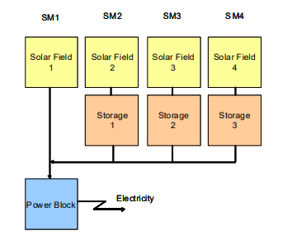
Solar Multiple
The size of the solar field, in conjunction with solar irradiance, determines the amount of thermal energy that will be available to the power block. The sizing of the solar field is important because the relative size of the solar field and power block will determine the capacity factor of the CSP plant and the extent to which thermal energy will be wasted.
5/11
GRAINGER ENGINEERING
Notes:
The configuration of a CSP plant is best described by the so called Solar Multiple (SM). For example a steam cycle power station with SM1 has one solar field just large enough to provide nominal turbine capacity under nominal irradiation conditions, e.g. at 800 W/m² on the collector aperture area. A CSP plant with a solar multiple SM2 would have a solar field twice as large and a thermal energy storage system large enough to store the energy produced by the second solar field during the day (Figure 4). Thus, one solar field will directly drive the turbine, while the other solar field will serve to fill the storage for night time operation. Storage capacity and collector field size can be increased to SM3 and SM4. Increasing solar fields further does not make sense, as during high irradiation periods they would increasingly produce unused surplus energy
Base case characteristics :
Solar multiple : 2.3
Net Output : 100 MWe
Field Aperture : 85000 m2
Thermal Storage : 8 hrs
Irradiation : 950 W/m2

Slide 21
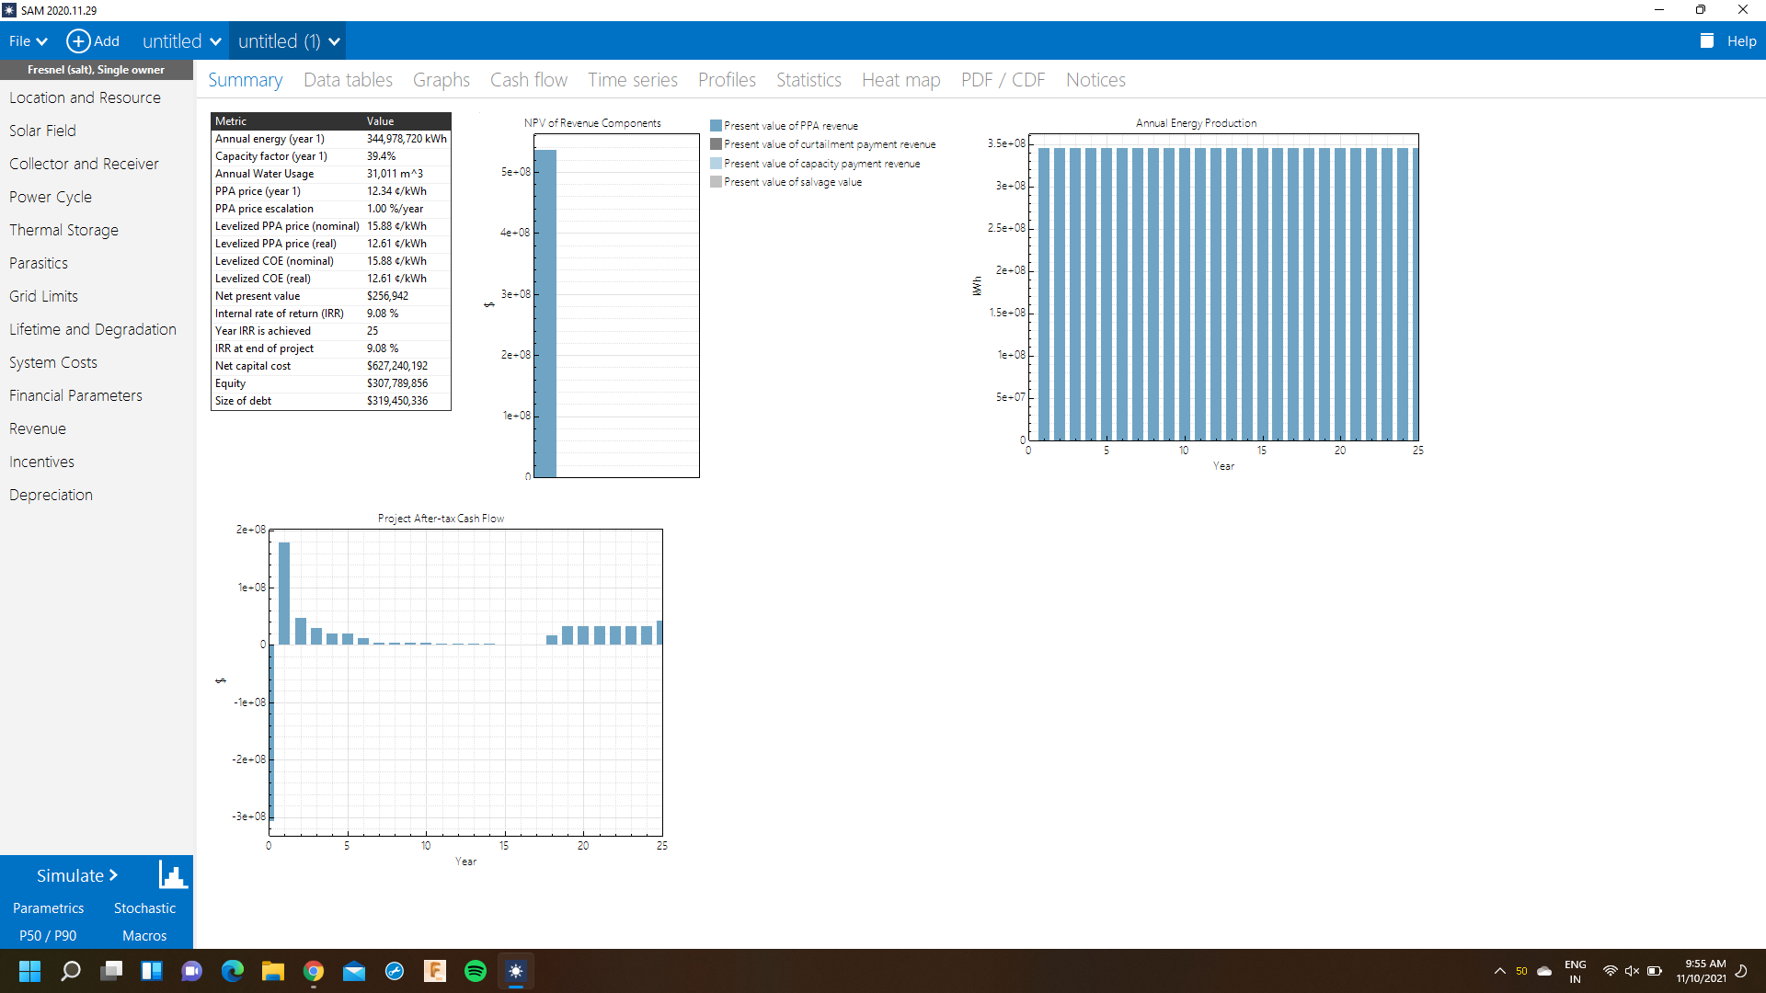
6 hours
4/4
GRAINGER ENGINEERING

Slide 22
4 hrs- LCOE: 12.74 c/kWh
NPV: $246,014
6 hrs- LCOE: 12.61c/kWh
NPV: $231,014
8 hrs- LCOE: 12.91c/kWh
NPV: $266,976
10 hrs- LCOE: 13.31c/kWh
NPV: $277,014
At IRR 9.08% over 25 yrs
6/11
GRAINGER ENGINEERING

Slide 23
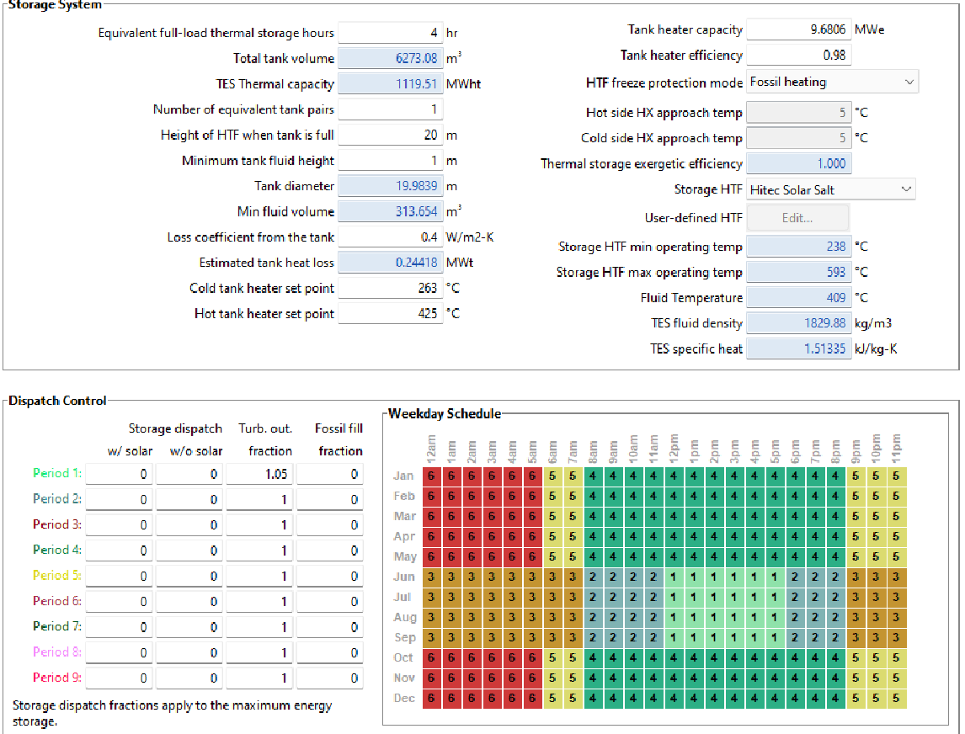
Design Problem
While Installing a TES with a CSP, how do the values of net present value, internal rate of return and LCOE change.
Identify the lowest possible combination of TES + CSP. Also, do the costs vary a lot?
Check how the values of these system change over various locations. Is Illinois the right place for CSP?
Compare how the size of the plants and storage affect the LCOE and capacity factor
GRAINGER ENGINEERING
Notes:
Production is nil during nightime. Expected night usage to surge in h future, with increased demand for charging and other electric appliances

Slide 24
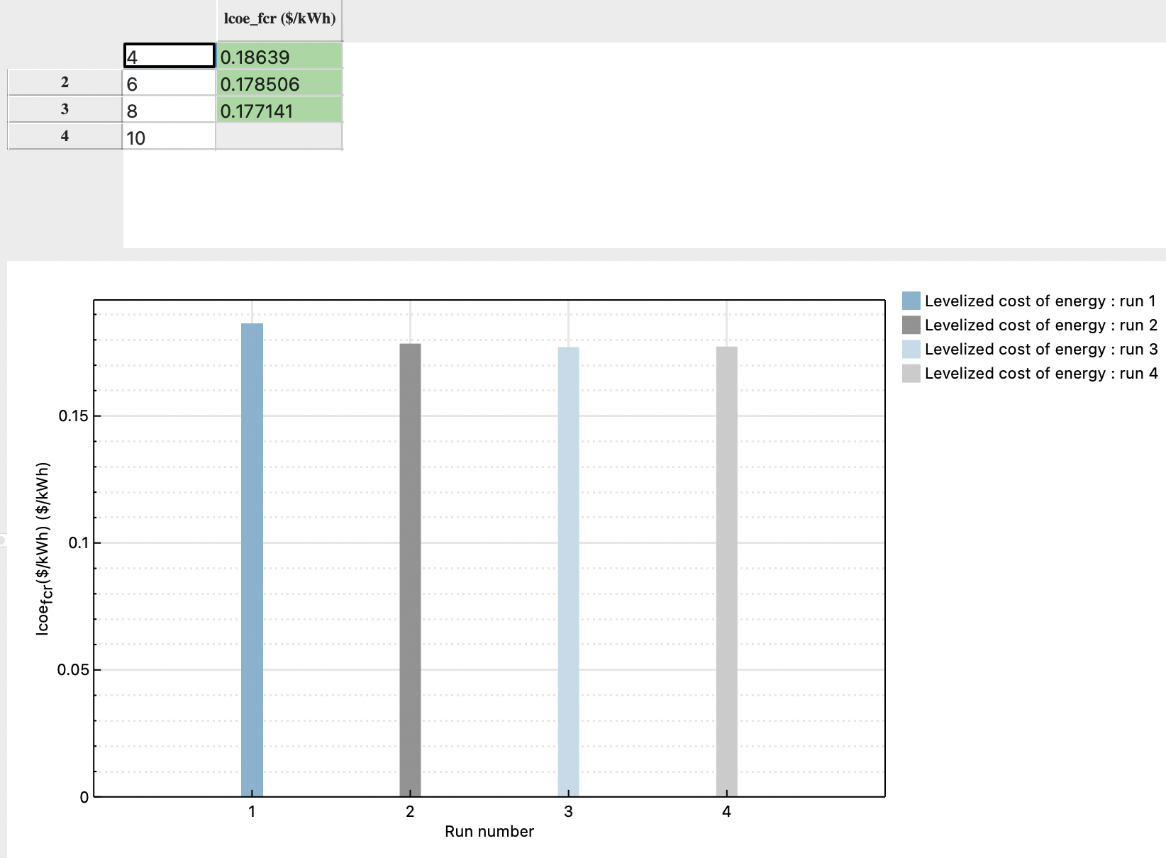
Comparison 1
LCOE v/s TES
Cheapest option is at 8 hrs
We see a trend where there’s a small drop in LCOE for 6,8 hrs and an increase in price for 10hrs
GRAINGER ENGINEERING

Slide 25
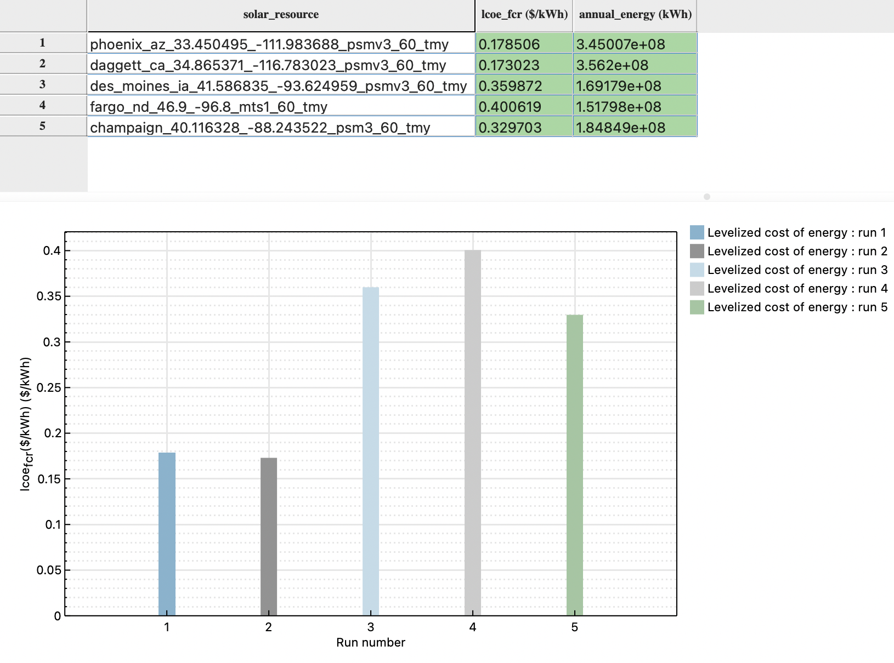
LCOE at TES = 6 at Different locations
-value of a CSP plant can vary significantly by location
-We can see the sheer variance in LCOE values even at cheapest combinations of battery storage - 8hrs
- Champaign is not suitable for Linear fresnel CSP plant - A plant in Dagget, CA produces 1.93x amount of energy for the same capacity and energy storage
GRAINGER ENGINEERING

Slide 26
Comparison 2: LCOE vs TES vs Capacity factor
Increased SM, particularly with the addition of energy storage can increase the utilization of the power block, thus increasing capacity factor, which acts to reduce the LCOE of the plant as a whole. the more often a plant runs, the more fuel or other operating costs it incurs and the more revenue it needs to bring in to break even.
However, increasing the SM and storage capacity also increases capital costs. This tradeoff between solar field size, energy storage, and capacity factor represents an optimization problem, and tools like SAM can be used to estimate the configuration with the lowest overall LCOE
The analysis indicates that the lowest overall LCOE would be for a plant with a high SM and many hours of storage. This configuration would likely have a very high capacity factor but produce a fairly flat output, requiring a large fraction of solar energy to be stored during the day.
We see that increasing the size of the solar field only yields noticeable profit increases if sufficient TES is available to shift the solar resource to periods with less available sunlight.
The ability to vary both SM and hours of storage is an important aspect of CSP plant design. Adding energy storage enables reduction in LCOE due largely to decreased spillage. However, the optimum CSP design should consider not only cost but also the value of energy and capacity CSP delivers to utilities and system operators
GRAINGER ENGINEERING

Slide 27
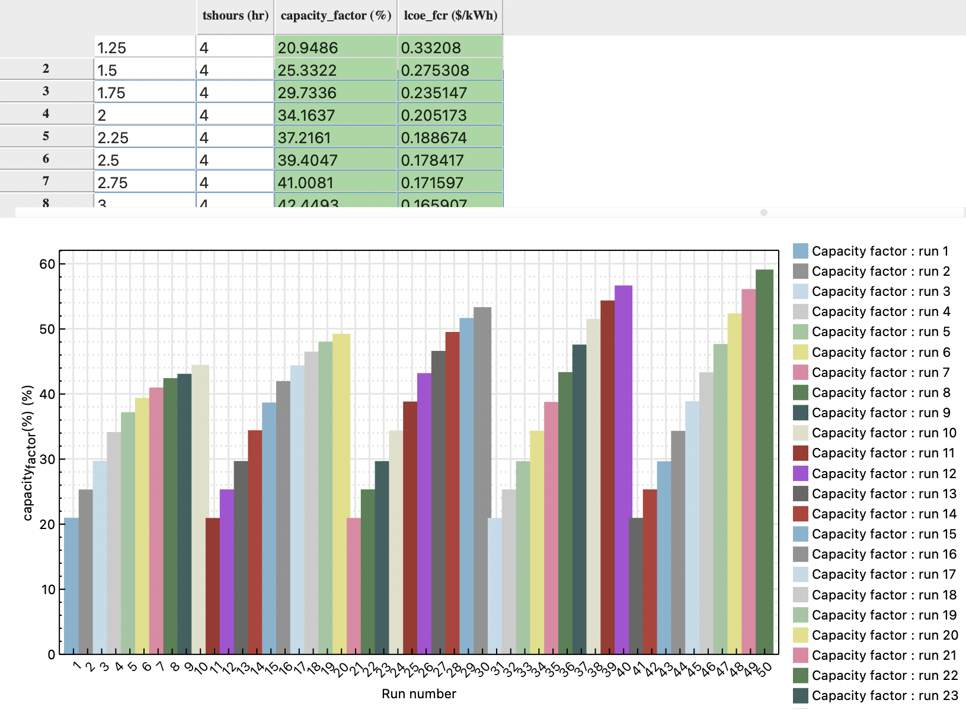
Results & Interpretation
Highest Capacity Factor : SM -3.5 & Storage 12 hrs- 59% we can get 42% CF at :
SM 3.25, hrs :4 SM 2.5, hrs :6
GRAINGER ENGINEERING

Slide 28
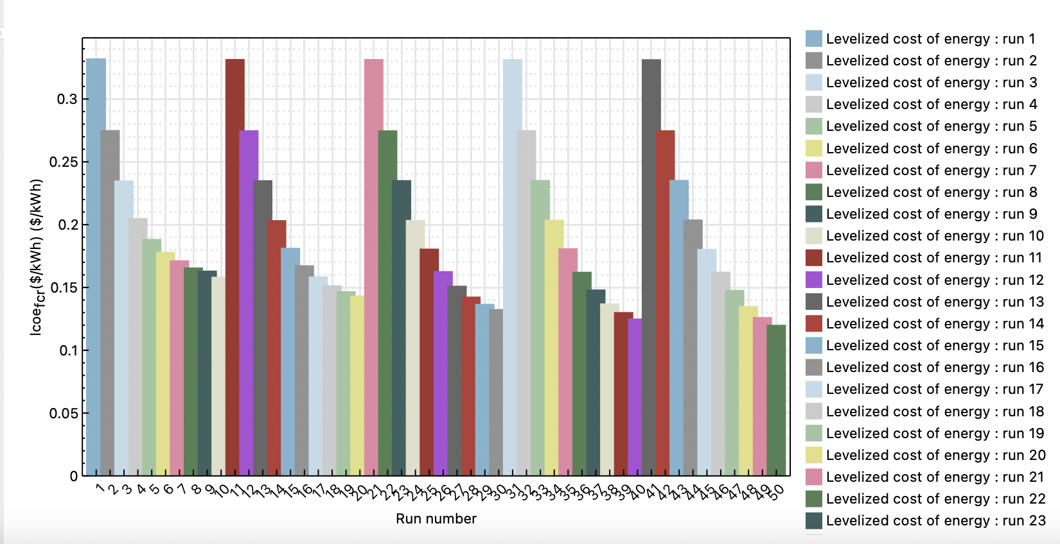
Results & Interpretation
Lowest LCOE numbers: SM -3.5, Storage -12 hrs LCOE : 12c/Kwh
GRAINGER ENGINEERING

Slide 29
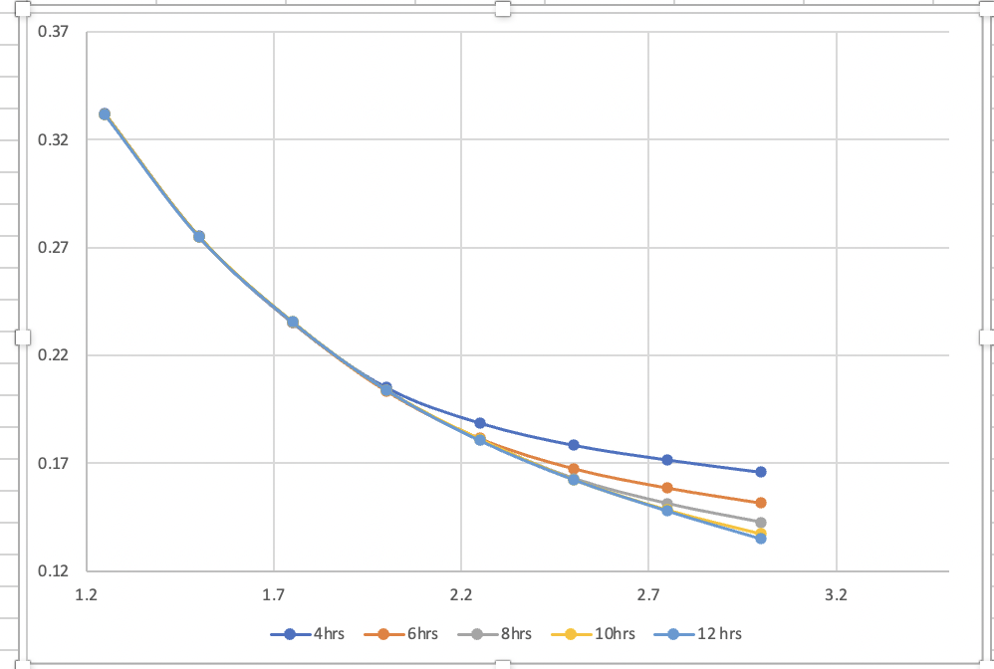
Results & Interpretation
We see while increasing SM, there’s noticeable profit only when there’s sufficient storage involved
GRAINGER ENGINEERING

Slide 30
Future scope(CSP+TES)
In conclusion, concentrated solar power plants/systems work on two basic principles – how much of the sun’s heat can the external mirrors capture and how much of the captured heat can the thermal energy storage system deliver for power generation.
Advanced optical materials are key
Reflective flexible coatings with ultra high reflectance and which are durable and easy to clean
Materials which have high heat capacities and good thermal conductance
Continued optimization of design to drive down capitol costs and increase efficiency
Clever heat transfer fluids which also double for thermal storage so plant can generate electricity at night
GRAINGER ENGINEERING

Slide 31
Future scope(Economics)
Quantify the value addition of the additional storage, we have observed that similar capacity factor can be obtained at various combinations of storage and size of the capacity. We can sell electricity more profitably with the availability of TES. How does that exactly change the economics? In high EV penetration scenarios, it will be more economical for plants to consider TES. The price of electricity will be fundamentally different. How does that affect the economics?
GRAINGER ENGINEERING

Slide 32
Questions?
GRAINGER ENGINEERING

Slide 33
References
https://sam.nrel.gov/financial-models/residential-and-commercial.html
https://www.nrel.gov/docs/fy15osti/64102.pdf
https://www.mdpi.com/1996-1073/12/12/2340/htm
https://www.sciencedirect.com/topics/engineering/linear-fresnel-reflector
Solar Advisor Model User Guide for Version 2.0
https://sam.nrel.gov/financial-models/lcoe-calculator.html
https://sci-hub.hkvisa.net/10.1016/B978-0-12-803022-6.00007-1
GRAINGER ENGINEERING

