Slide 1

Battery and hydrogen aircraft concepts
Created by: Robert Adamski
Professor Ragheb
NPRE 498

Slide 2
Carbon dioxide Aviation emissions
Commercial aviation CO­­₂ contribution: 2.5% globally
Contrails account for much more of aviation’s effects on the environment
Improved efficiency in aviation
CO₂ emissions down 50% since 1990
Rising air traffic

Slide 3
Battery powered electric aircrafts
More than 200 electric aircraft in development
30% increase in projects between 2018 and 2019
eCaravan
Developed by AeroTEC and magniX
Tested for a 30-minute flight
Much more affordable than conventional jet fuel
eVTOL Aircraft
Electric taxi concept
Improve carbon emissions while completely transforming the transportation industry

Slide 4
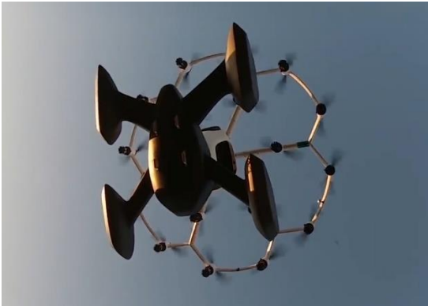
Hexa evtol aircraft
Simple sustainment footprints
Holds one passenger
Operate for 10-15 minutes, 10-15 miles
Easy to learn
No pilot license required
Useful to Air Force military missions
Plans to fully automate the aircraft

Slide 5
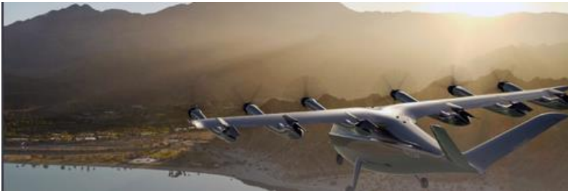
All-evtol aircraft
Contract with United Airlines
Transport customers zero emissions
4 passengers, 1 pilot
$3.30/mile, 60-mile range
Can travel up to 150 mph
Plans to decarbonize air travel
Hollywood to LAX trips
Production by 2023

Slide 6
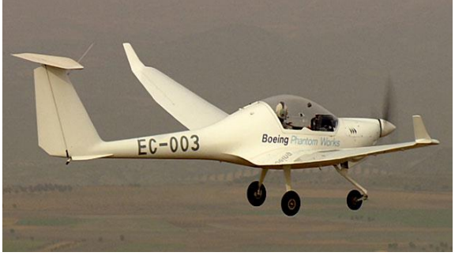
Brat Hydrogen fuel cell aircraft
Aircraft by Boeing Company Research and Technology (BRAT) division
Completed flight in Spain
Relied on Li-ion battery boost and a single Photon Exchange Membrane fuel cell
2-seat plane, similar to that of the Dimona motorized glider

Slide 7
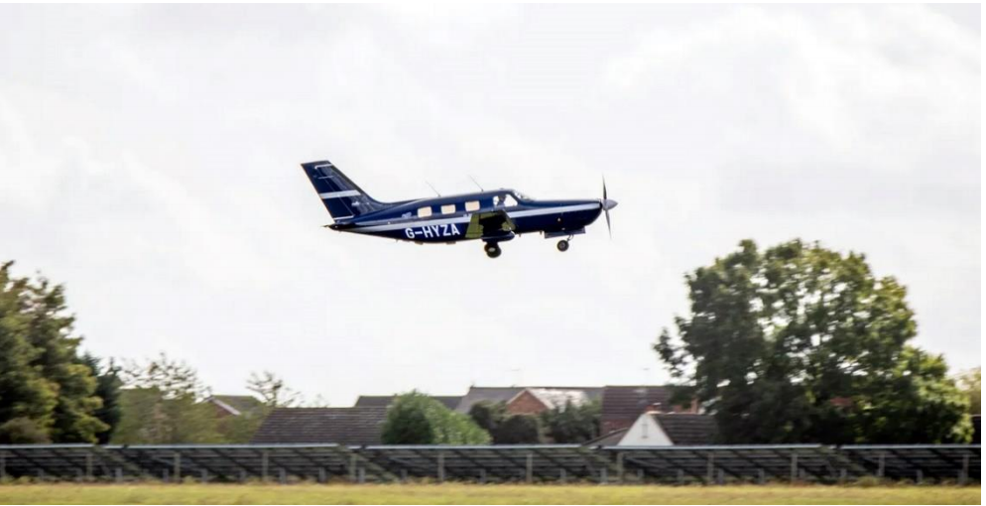
Hyflyer hydrogen fuel cell aircraft
6-seater Piper M-Class plane
Zero carbon emission
Researched and developed by ZeroAvia and British partners
2023 goal: 20 passengers, 350-nautical mile range
2026 goal: 80 passengers, 500-nautical mile range
2030 goal: 100+ passengers, achieving near commercial operation

Slide 8
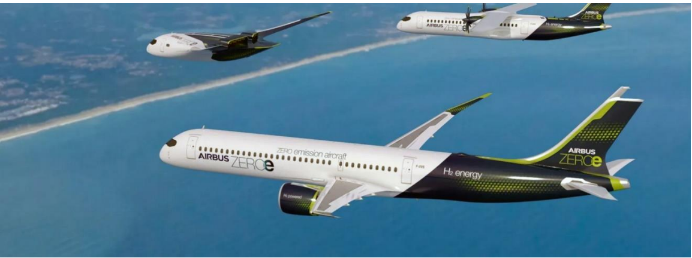
European airbus concept aircraft
3 designs
Turboprop driven
Turbofan driven
Blended-wing design (shown below)
All are hydrogen hybrid designs
Powered by gas-turbine engines, also burning hydrogen as fuel
Generate electricity using hydrogen fuel cells

Slide 9
Limitations of battery and hydrogen aircrafts
Battery powered aircraft
Batteries weighing 30 times more than current jet fuel intake
Battery’s weight remains on the aircraft after being drained
Kerosene used up through the flight process
Hydrogen powered aircraft
Higher energy by mass than jet fuel
Lower energy by volume than jet fuel
Hydrogen energy density 4 times smaller than jet fuel
Hydrogen storage tank 4 times larger than jet fuel counterpart
Producing hydrogen at scale can affect carbon footprint

Slide 10
Future of battery and hydrogen aircrafts
Battery powered aircraft to be used in military missions
eVTOL prospects to be a $1.5 trillion market by 2040
Air taxi hub by 2025
Unmanned Aerial Vehicles (UAVs)
Hydrogen-powered aircraft unlikely to be the main solution to carbon emissions by 2050
Passenger numbers to double by 2037

Slide 11
references
http://mragheb.com/NPRE%20498ES%20Energy%20Storage%20Systems/Battery%20and%20Fuel%20Cell%20Aircraft.pdf
https://www.bbc.com/future/article/20210401-the-worlds-first-commercial-hydrogen-plane
https://www.bbc.com/future/article/20200617-the-largest-electric-plane-ever-to-fly
https://www.airbus.com/newsroom/stories/hydrogen-aviation-understanding-challenges-to-widespread-adoption.html

