Slide 1
Redox Flow Batteries
& Regenerative Fuel Cells
Enabling renewable energy
Vanadium redox flow
Polysulfide/Bromine flow
Uranium (!!!) based
Zinc/Bromide (half redox flow)
All liquid regenerative fuel cells
Ongoing Projects here in UIUC

Slide 2
Redox flow battery (history)
Dated back to the 70’s with the 1973 oil crisis
Examples:
  Fe(III)/Fe(II) in liquid (solvated ionic) form
  Cr(III)/Cr(II) in liquid (solvated ionic) form

Slide 3
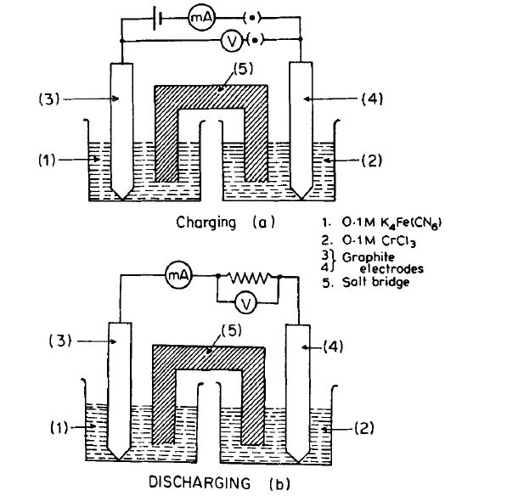
A Fe/Cr
Redox flow battery

Slide 4
The Vanadium Redox Pair
Anode (-)
V²⁺ ←→ V³⁺ + e-
Cathode (+)
V⁴⁺ ←→ V⁵⁺ + e-
Advantages:
no non-desired ionic mixture
No need for salt bridge

Slide 5
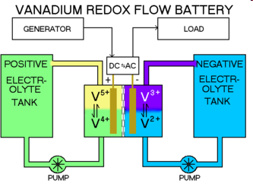
Vanadium Redox Battery
Schematic

Slide 6
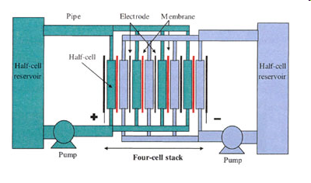
The VRB: the bipolar construction

Slide 7
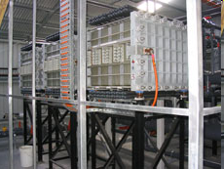
VRB: Real system

Slide 8
VRB: Performance
Cell voltage change vs time in a charge/discharge cycle,
current density was 40mA/cm2

Slide 9
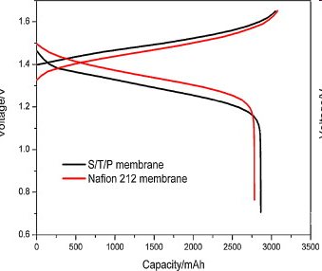
VRB: Performance
Cell voltage change in different membranes vs time in a charge/discharge cycle,
current density was 37.5mA/cm2

Slide 10
VRB: Issues
Disadvantage:
Cost of vanadium (cost > $100/kWhr)
Energy density (~30 Whr/kg)

Slide 11
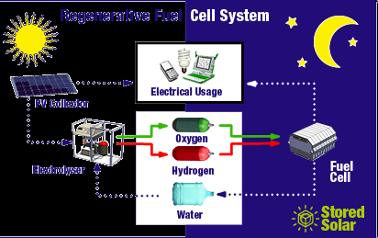
Regenerative Fuel Cells
Referring to a system or a single cell?
A Regenerative Fuel Cell System

Slide 12
Regenerative Fuel Cells
A regenerative Fuel Cell System in NASA Glenn Center
Fuel cell
Electrolyzer

Slide 13
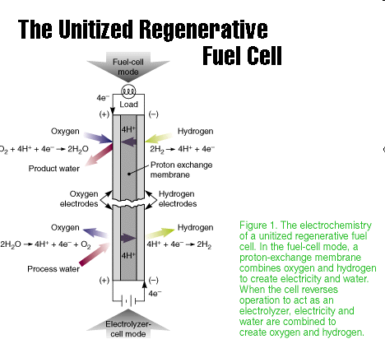
Regenerative Fuel Cells
A Single Cell

Slide 14
Regenerative Fuel Cells
But there is a big catch:
Hydrophobicity vs Hydrophilicity
Conflicting requirement in two modes for a gas phase product/reactant combination

Slide 15
Regenerative Fuel Cells
All liquid RFC
A bit like Redox flow battery
Potentially higher energy density
Kinetics is generally slower
Example, NaBH4/H2O2

Slide 16
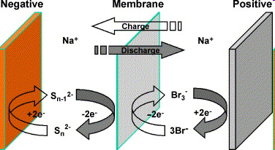
Polysulfide/Bromine Flow Battery
How it works?
3NaBr+(n−1) Na₂Sn → NaBr₃+nNa₂S_{n−1}, n=2−4

Slide 17
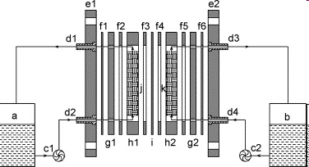
Polysulfide/Bromine Flow Battery
The structure of a PSB battery: (a) anolyte tank; (b) catholyte tank; (c1, c2) magnetic pump; (d1, d2, d3, d4) tie-in; (e1, e2) end plate; (f1, f2, f3, f4, f5, f6) gasket; (g1, g2) electrode plate; (h1, h2) flow frame; (i) cation exchange membrane; (j) negative electrode; (k) positive electrode.

Slide 18
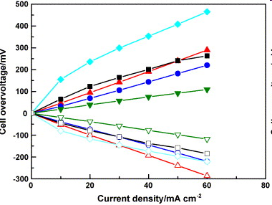
Polysulfide/Bromine Flow Battery
Polarization curves (at 50% SOC) with different material: (♦, ) GF; (■, □) CF; ( upright triangles ) ACE; (●, ○) Co-ACE; and ( , inverted triangles ) Co-GF.

Slide 19
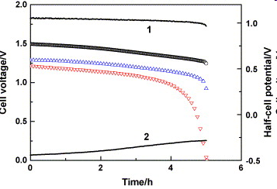
Polysulfide/Bromine Flow Battery
Discharge curves of ( u tri ) CF and ( inv tri ) ACE. (○) Cell open circuit voltage curve. (Line 1) positive half-cell potential and (line 2) negative half-cell potential.

Slide 20
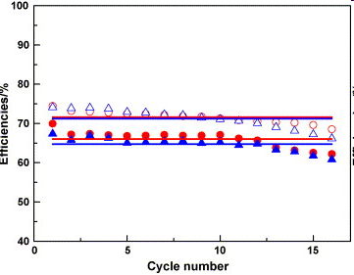
Polysulfide/Bromine Flow Battery

Slide 21
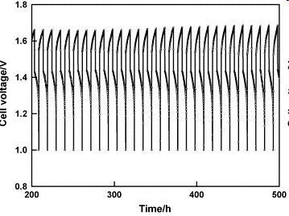
Polysulfide/Bromine Flow Battery

Slide 22
Polysulfide/Bromine Flow Battery
Advantages
  Low cost
  Fast kinetics
Disadvantages
  Cross-over
  Poor stability

