Slide 1
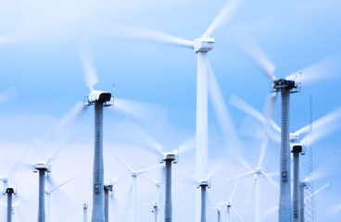
Wind Power Green Energy
Rabie Abu Saleem

Slide 2
Skeleton
Historical Development And Statistics
Wind Power Turbines
Wind Power Calculations
Wind Power and CO2 Emissions
Wind Power and Energy Storage
Wind Power and Smart Grid
Conclusion
References

Slide 3
Historical Development
and Statistics

Slide 4
Historical Development and Statistics
Historical Development
Wind power is old.
1891: First wind turbine by a Dane Poul la Cour.
1890s: First wind-electric systems in the US in.
1930s and 1940s: many were running in the US.
1941: largest system (1250 kW) built at Grandpa’s Knob in Vermont.

Slide 5
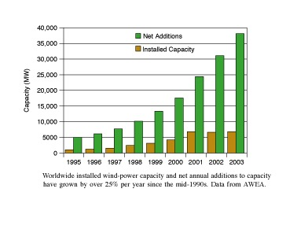
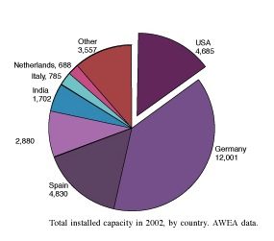
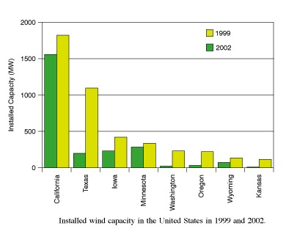
Historical Development and Statistics
Statistics
Global capacity growth
over 25% per year since the mid-1990s.

Slide 6
Wind Power Turbines
Vertical Axis Wind Turbines (VAWTs)
Horizontal Axis Wind Turbines (HAWTs)

Slide 7
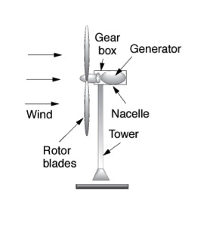
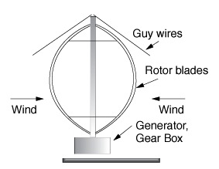
Types of Wind Power Turbines
Wind Power Turbines
Horizontal Axis Wind Turbine (HAWT)
Vertical Axis Wind Turbine (VAWT)

Slide 8
Horizontal Axis Wind Turbine (HAWT)
Wind Power Turbines
advantages:
increased efficiency.
smooth transfer of power from the rotor to the gearbox.
Higher power levels and smaller footprints on the ground.
Disadvantages:
require a yaw system
maintenance has to be done at the top.
require tall cranes for set-up.

Slide 9
Vertical Axis Wind Turbine (VAWT)
Wind Power Turbines
advantages:
generator and gearbox can be housed on the ground.
requires no yaw mechanism.
Disadvantages:
not much wind.
Little starting torque.
Repair requires taking the whole machine apart.
40% less efficient in energy production.

Slide 10
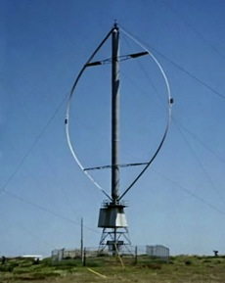
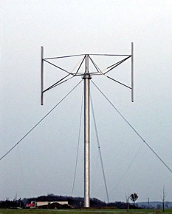
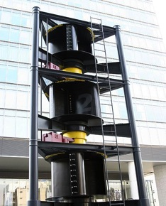
Vertical Axis Wind Turbine (VAWT)
Wind Power Turbines
Darrieus wind turbine
Giromills wind turbine
Savonius wind turbine

Slide 11
Wind Power Calculations
Power Calculation
Friction Effect
Average Power

Slide 12
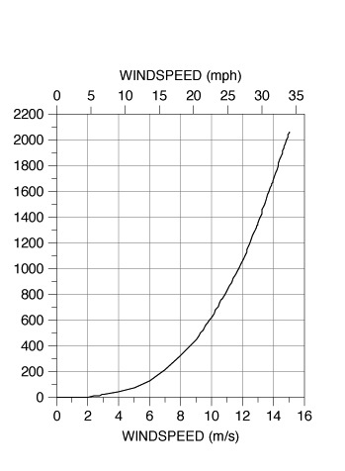
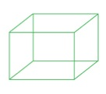
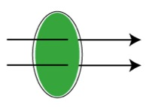
Power
Wind Power Calculations
m
v
A
v

Slide 13
Friction Effect
Wind Power Calculations
Friction Coefficient for Various Terrain Characteristics
Terrain Characteristics | Friction Coefficient α
Smooth hard ground, calm water | 0.10
Tall grass on level ground | 0.15
High crops, hedges and shrubs | 0.20
Wooded countryside, many trees | 0.25
Small town with trees and shrubs | 0.30
Large city with tall buildings | 0.40

Slide 14
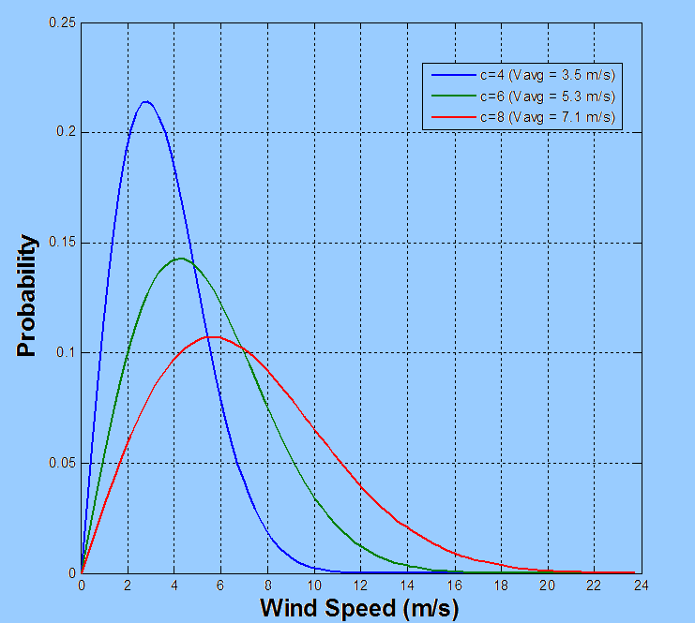
Average Power
Wind Power Calculations
Rayleigh probability density function:

Slide 15
Wind Power and CO2 Emissions
Windmills don’t decrease the CO2 emission, it can further increase it!!

Slide 16
Wind Power and CO2 Emissions
Balance the total supply with the total demand.
Studies:
2007: Wind power reduced CO2 emissions by over 28 million tons.
DOE: 20% of the electricity from wind energy by 2030 would cut CO2 emissions by over 7.6 billion tons. Natural gas used by 50%.
In Texas: Adding 3,000 (MW) of wind energy would reduce :
CO2 by about 5.5 million tons per year
sulfur dioxide by about 4,000 tons per year
nitrogen oxide by about 2,000 tons per year.
30 MW Kaheawa wind plant in Hawaii reduced oil imports by almost 10 million gallons per year.

Slide 17
Wind Power and Energy Storage
Energy Storage and Flexibility
Energy Storage Options
The UltraBattery Technology

Slide 18
Wind Power and Energy Storage
Energy Storage and Flexibility
Studied
storage valuable but not necessary
Less studied
storage increasingly valuable and at some point necessary
Past
Present
Near Future
Low Carbon Future
0%
1%
20%
100%
Fraction of Energy from Wind and Solar
Flexibility as an alternative.
recourses for flexibility :
Spinning reserves.
Non-spinning reserves.
Hydroelectric , natural gas.

Slide 19
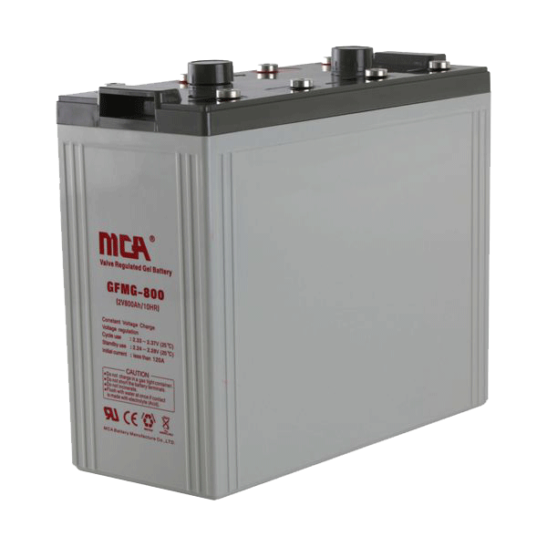
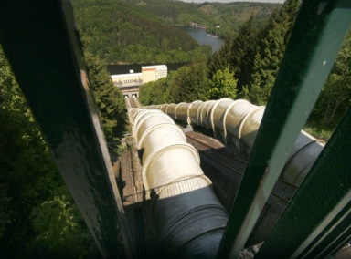
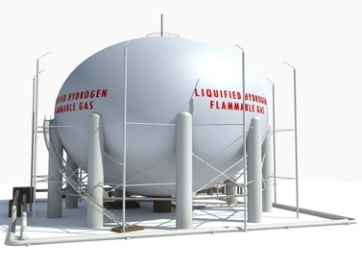
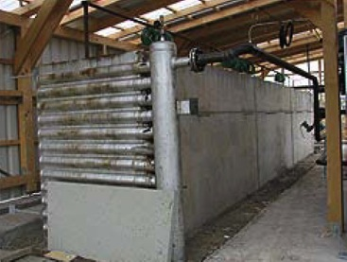
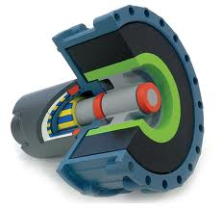
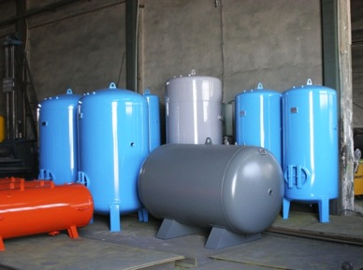
Energy Storage Options
Wind Power and Energy Storage
Existing already:
Hydroelectric reservoirs
gas pipelines
gas storage facilities
coal piles
Other options:
Hydrogen Production
Thermal Storage
Flywheel Energy Storage
Compressed Air Storage
Pumped Storage
Battery Storage

Slide 20
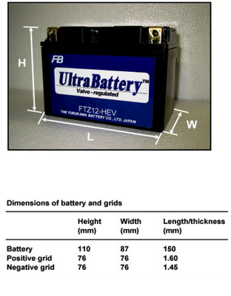
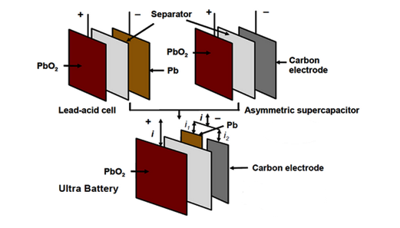
Wind Power and Energy Storage
The UltraBattery
Developed by CSIRO
Two technologies: supercapacitor and lead acid battery.
high charge–discharge rates and greater energy storage.

Slide 21
Wind Power and Energy Storage
The UltraBattery
Compared to Ni-Metal hydride batteries:
70% less expensive.
comparable performance:
fuel consumption
carbon-dioxide emissions
cycle life.
faster charge and discharge rates.
Challenges
Operational potential.
gassing rate
cycle-life
cost.
weight.
Notes:
Lpoidhjtoidttyhoixfmhx[ofpihj-x=

Slide 22
Wind Power and Smart Grid
The grid is not an electricity storage device, and adding windmills decreases the grid stability!!

Slide 23
Wind Power and Smart Grid
Electrical grid can be thought of as an energy storage system.
sources of flexibility for more stability.
smart grid.

Slide 24
Wind Power and Smart Grid
Smart Grid
Smart Devices
Use of two-way communication
Advanced sensors and control systems
* Many applications: Self Healing Networks

Slide 25
Self Healing Networks
Normal Feeder Configuration
Self Healing Networks – Intellirupters
Substation 1
N.O
Substation 2
1500 customers loss
Substation 1
N.O
Substation 2
750 customers saved

Slide 26
Conclusions
Wind energy is an old energy that is still undergoing huge development and capacity growth
Power produced by a wind turbine depends on its Type, its size, and its location.
Considering the total balance of supply and demand of energy, wind power contributes in decreasing the total emission of CO2
For the near future, storage of wind energy in valuable but not essential, for future clean energy it is essential.
Battery Storage technologies are the most promising with wind power.
Flexible resources and the smart grid can help reducing the problem of grid instability.

Slide 27
Questions
?

Slide 28
References
Masters G. “Renewable and Efficient Electric Power Systems”. A JOHN WILEY & SONS, INC., PUBLICATION.(2004) p307-379
“UltraBattery”. The Commonwealth Scientific and Industrial Research Organisation(CSIRO). Retreived on December 2 2011 from: http://www.csiropedia.csiro.au/pages/viewpage.action?pageId=426226
Ragheb M., Notes on “Energy Storage Options”. Retrieved on December 1 2011 from: https://netfiles.uiuc.edu/mragheb/www/NPRE%20498ES%20Energy%20Storage%20Systems/Energy%20Storage%20Options.pdf
Basics about Wind Energy. American Wind Energy Association, Retreived on November 29 2001 from: http://www.awea.org/
Rousan T. A talk about “Distribution Automation & Smart Grid Technologies”, American Association for Arab Engineers and Architects. November 2001.
http://www.newenergywatch.com/2006/11/vawt_versus_haw.html
http://www.nrel.gov/wind/systemsintegration/energy_storage.html

