Slide 1

Chemical and Thermal Energy Storage in conjunction with nuclear power generation
Ousmane Ndiaye
Npre 498

Slide 2
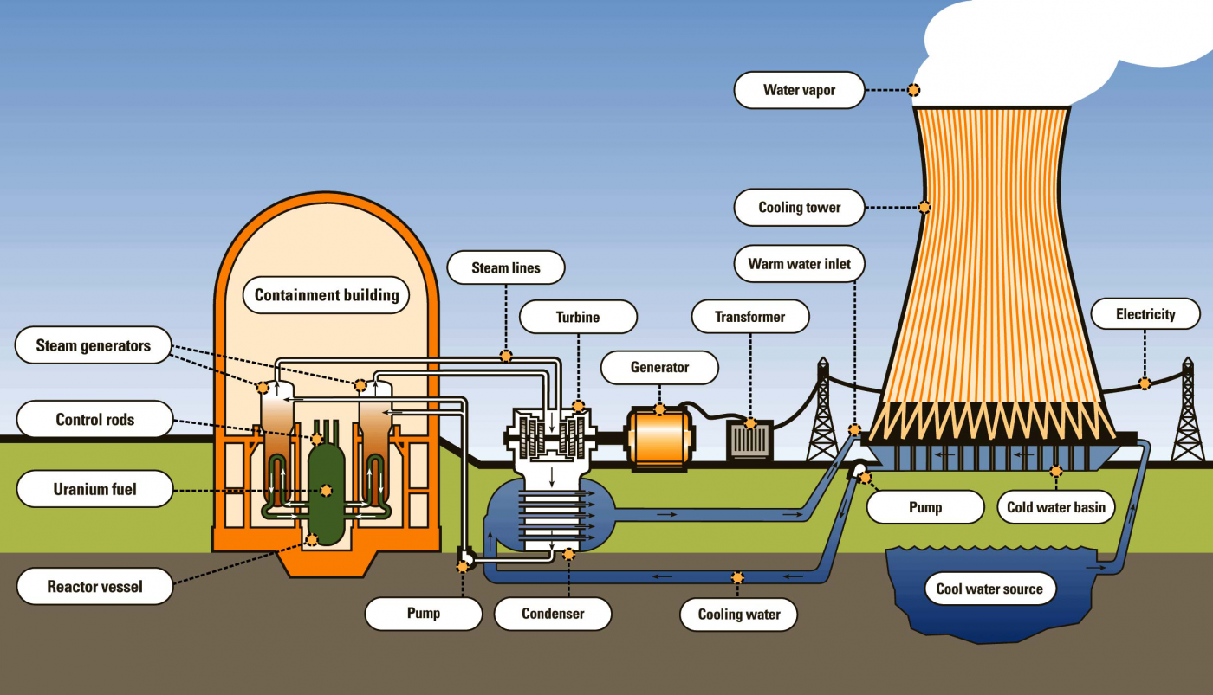
what is nuclear power?
The splitting or fusion of atom nuclei which produce steam to turn a turbine.
A clean and efficient that produces a magnitude 500–2000 MW peak output.
A base power load.
A diagram of the different components of nuclear power plant[1].
Notes:
In this presentation I will talk about different forms of chemical and thermal energy sources and then see which ones could work inconjuction with nuclear power. For some Basic of Nuclear Power , The typically Nuclear power plant that is all over the world is Fission power plants where nuclie are spilt realizing large amounts of energy. The main type of fuel of uranium fuel pellets which are located in the core. The energy released leads heating the water and turing it to steam which then turning the turbine which power the generator. There over 93 nuclear reactors in United states with the smallest one being R.E. Ginna Nuclear Power Plant in New York which has 582 MW capticty for daily generation it will generate 13,968 megawatthours (MWh). Nuclear Power Pants are based load energy sources because they generally run at close to maximum output (100% of rated power) continuously.

Slide 3
advantages and disadvantages of nuclear power
Low Cost of Operation
Reliable Source of Energy
Stable Base Load Energy
Low Pollution
Sufficient Fuel Availability
High Energy Density
Expensive to Build
Produces Radioactive Waste
Impact on the Environment
Accidents
Security Threat
Limited Fuel Supply
Notes:
Here are some of the pro and cons of nuclear power plants . One big issue for ncuelar power plants is that cost of building the plants they take large amount of capital and almost over budget but once finally built the cost of operation is signinfalty less. The large cost of building a power pants found is roughly $6 billion and $9 billion for each 1,100 MW plant. One big con is the production of radiativie istopes that take millions or years to decay and lead to health issue is not mange well. Nuclear power plants need large supply of water for cooling to avoid going super critical which can lead to meltdown and accidents. Nuclear Power plants can be security threat where in case of war they can be valuable locations for a country. For example There was big concern when That Russia would destroy or launch missile at Urkriane Nuclear power plants which would put millions in danger. And finally Nuclear power plants limited terms of fuel supply of uriuam where at the current rate of compsumtion we would run out uriruam in 80 years. On to more the positives it a stable base load where it can help countriy control the amount of electricity consumption for example France energy prodile over 70 percent nuclear and they are able to sell some of that energy to neably nations when elelctricity cost are high . Uruainm has a high energy density where one fuel pellet produces the same amount of 1 ton coal or 149 gallons of oil.

Slide 4
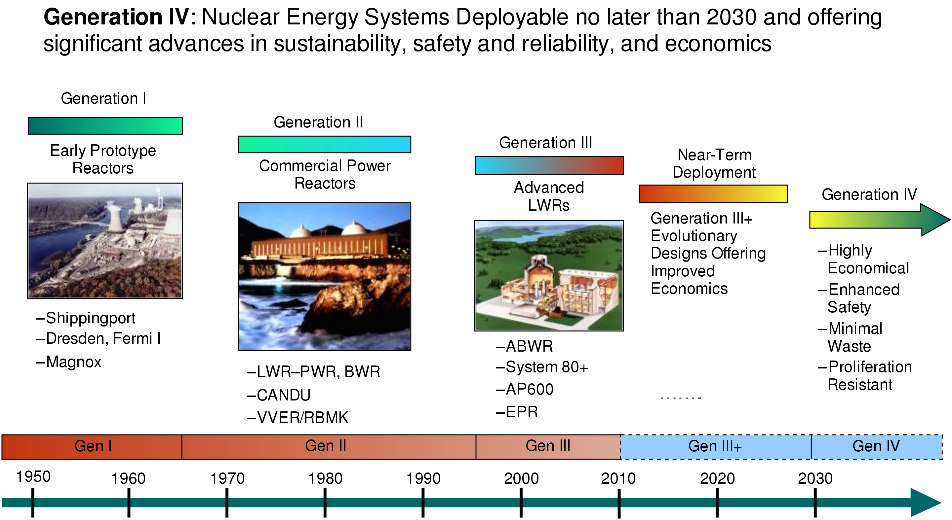
Figure 2 shows timeline of the progression of nuclear powerplant [3].
Notes:
These images shows the rpgessor of nuclear power from the first class of nuclear reactros generations 1 to general four . Generation four are the future reactros that are being designed to be more econeomical feasible, safer and produce less waste. Generations four have seen the short coming of generation 2 and 3 and are sceitnistn and ncuelar community push help fix the image of nuclear power plants.

Slide 5
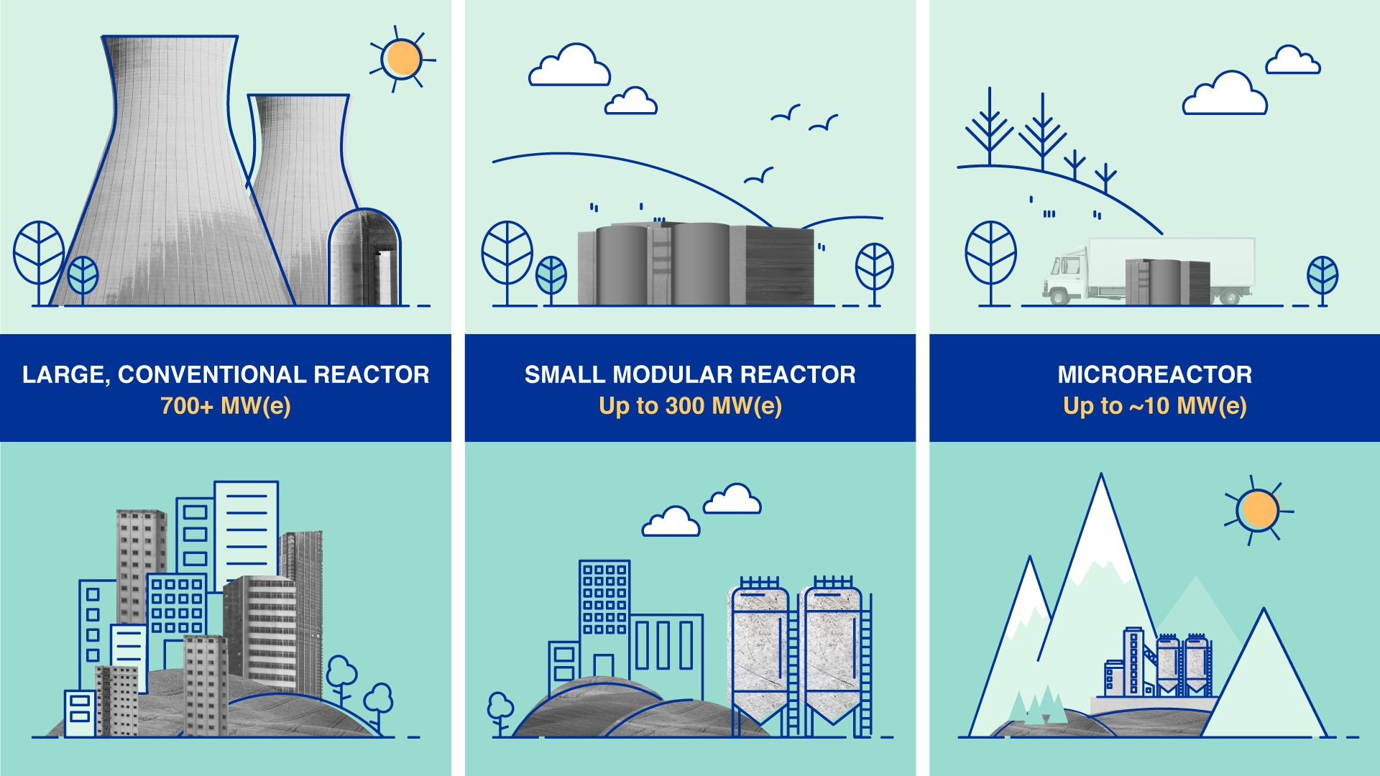
future generation of nuclear reactors
Small Nuclear Power Reactors
LOWER CAPITAL INVESTMENT
GREATER EFFICIENCY
SITING FLEXIBILITY
ECONOMIC DEVELOPMENT
SAFEGUARDS & SECURITY
Figure 3 shows the difference size of reactors[4].
Notes:
One exicitng aspect of future design is small modle reactros which would help the high investment cost , they would be more efficient and give flebility and control of supply of power. SMR and micro reactros compaes have been launched all over world for example Radiant in Los Angles are desgining micro reactros that fit into a truck and be driven into small community for power generated. Terra Power which was founded by bill Gates are desgiining a small modeule reactros located Washington state.

Slide 6
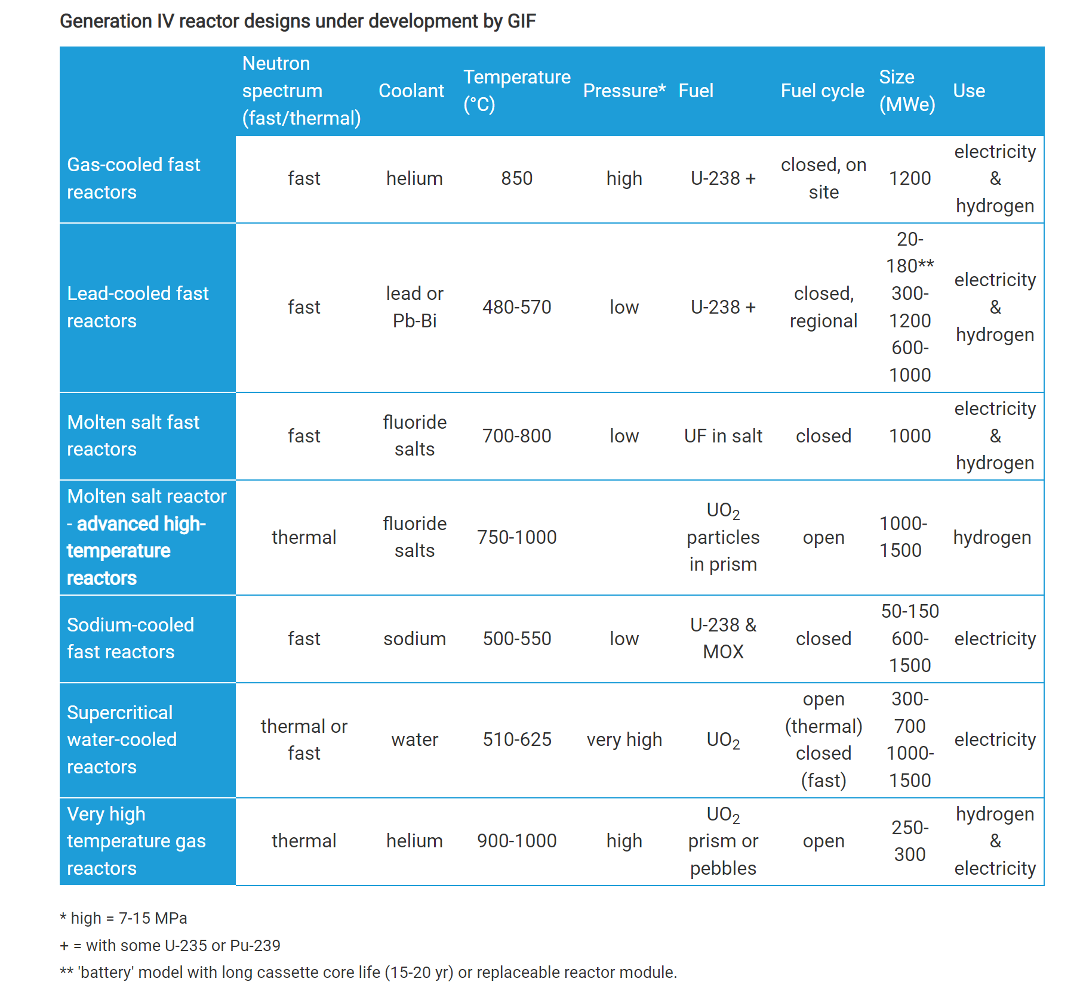
Generation IV Reactors
Figure 4 shows parameters of generation IV reactors[5].
Notes:
This chart shows the pamaters some common generations four reactros such as the coolant, the temperature range, fuel , and the size.

Slide 7
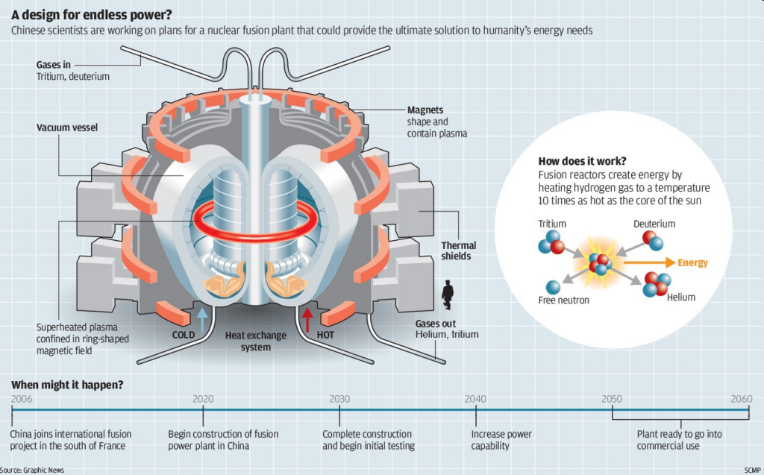
Figure 5 shows the breakdown of Fusion power plant[6]
Notes:
All of those nucelar power plants were fission now a poromsing tecnhnonly that been in the work since the 1980 is fusion power plants . Instead of spilling of nucli they would be comgning the ncuil to poroduce small element such as heium. This would reproduce more energy. The carbon emission would be lower and would a reneble source. However they are alsoways being discussed as 20 years out but more releilxist projections have the first power plants done and ready for commerilziation around 2080 . So many of us will be able to see the large commerlization of fusion power plants.

Slide 8
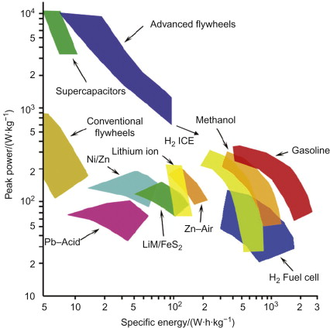
energy storage and why it can be beneficial ?
is the capture of energy produced at one time for use at a later time.
Improve Reliability & Resilience
Integrate Diverse Resources
Reduce Environmental Impacts
Figure 6 the ragone plot for different energy storage technologies[7]
Notes:
By taking this class we studied that energy storage is the capture of energy produce and stored later for usage . This would flexibity from high energy cost and help establish energy sectruity . This chart on the right is peak power vs specific energy for different forms of energy stoage discussed in this class .

Slide 9
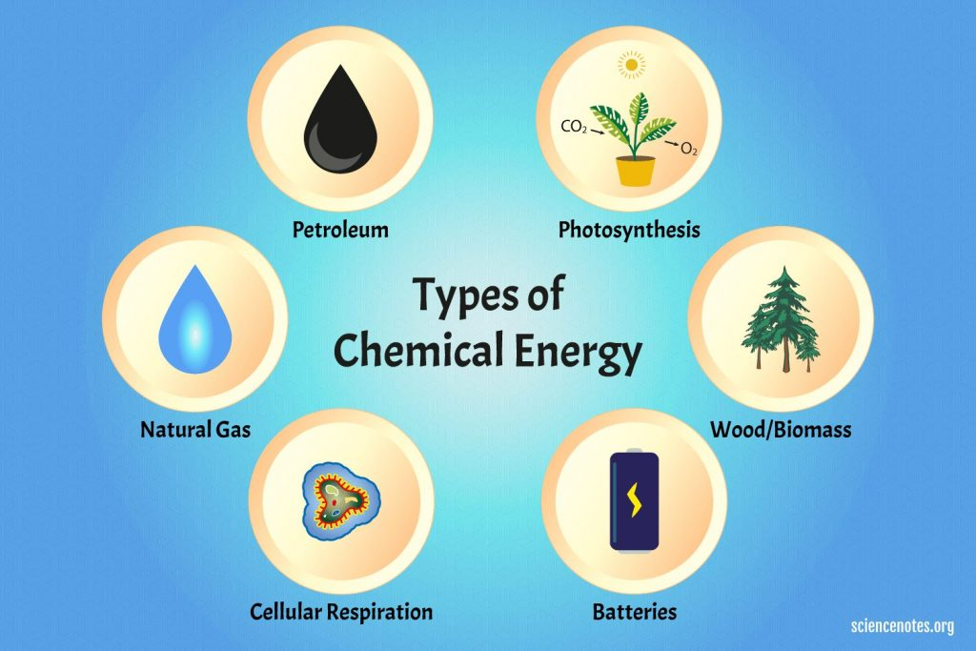
Chemical Energy storage
storing energy in chemical bonds
Petroleum, Coal, and Natural gas.
Biomass like wood
Gases such as hydrogen
Figure 7 shows different forms of chemical energy[8].
Notes:
On our first class of energy storage .Chemical energy which stores energy in chemical bonds . Here are some examples of chemical energy but for the scope of this paper desngied hydrogen because it clean and efficient behavior compared to the other sources such as petroleum , and natural gas.

Slide 10
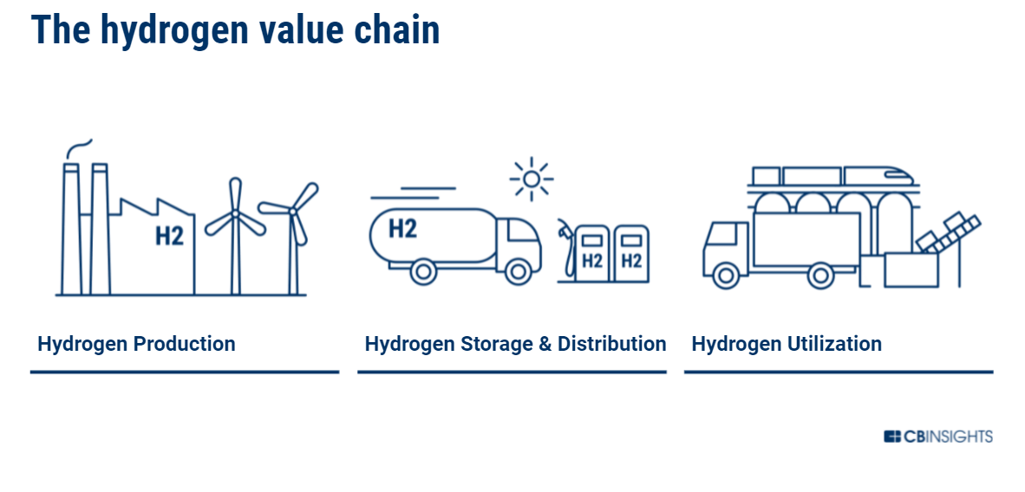
hydrogen storage
High specific energy
Clean energy source
Very abundant source
Will be affordable in future.
Figure 8 the hydrogen value chain diagram[9].
Notes:
Hyrogen has a high specific energy which means it has high amount of energy alailbe per unit mass.It is a clean energy sources and very abdyudent since it is the most adbdunt element in the uriersse. It is projected that the it would more aforable due to more methods of productions and the supply can reach the demand of all it usages. The image on the left shows the value chain for hydrogen as it produced , sotaged and disutibed into the different usages it can have.

Slide 11
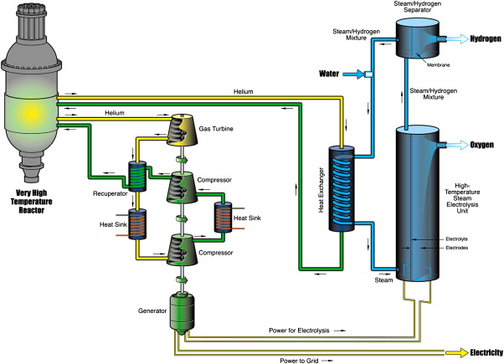
hydrogen storage
Current electrolysis technologies generally operate at relatively low temperatures
Can be used with current nuclear technology by diverting energy to run these processes
High temp electrolysis (700-900C) is currently being researched
Next generation nuclear power plants will be particularly useful for this technology
Figure 9 The working of High temperature electrolysis[10].
Notes:
The key method of producing hydrogen is electrooysis which beascailly take steam separate the oxygen and hydrogen form the water moleucles. Low and high temperature can both rpdocue hydrogen but high temperature electrolyisis is considered to be the future. In the picture on the right see a example of high temeprautre elelctroyis with a Very High Tmerpature reactros which is a generation four reactrors. So Hydorgen is belived to a energy storage for ncuealr power plants.

Slide 12
hydrogen storage
Tradeoffs :
Durability of the system components
high investment costs
Significant Land and Water Impact
Hazardous Materials
Short-Term Safety Concerns
Notes:
Here are some of the trade off that associated for hydrogen production. The harzdous material are the by producted such as the greenhouse gases like CO2 and CO which are not good for the enviroement. Hydorgen stoage would require siginfant land and would need large amount of water and there are some short term safety conersn such as being very flammable and easy to ignate and light and orderless.

Slide 13

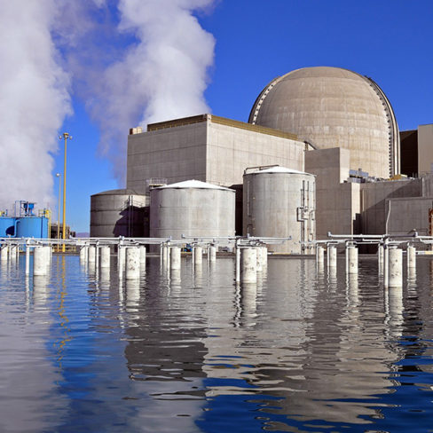

hydrogen storage
Uniper and Fortum (Pink Hydrogen) Application
The Oskarshamn Nuclear Power Plant made an agreement in January 2022 to supply commercial pink hydrogen.
PNW Hydrogen LLC
An Arizona company that plans on using nuclear power to produce clean hydrogen.
Large recipient of 20 million award from the DOE to produce clean hydrogen[11].
Left: Figure 10 shows one of PNW hydrogen plant.[12].
Upper Right: Figure 11 shows the logo of Unpier[13].
Lower Right: Figure 12 shows the logo of Fortum[14].
Notes:
Here are some examples of hydrogen being produced from nuclear power. So industry Pink Hydogren is hydogren produced from the nucelar power and Uniper and Fortum which are Germany energy companiens which are using this sweedish nuclear power to start producing hydrogen to. Thye started in recent in 2022. Another example is here in the sttes where PNW Hydrogen an arzonia company who rexcied money DOE to produce hdyrgoen from ncuelar power plants. The future of hydogren produce from nuclear power is bright and seem to have amny opportiunies.

Slide 14
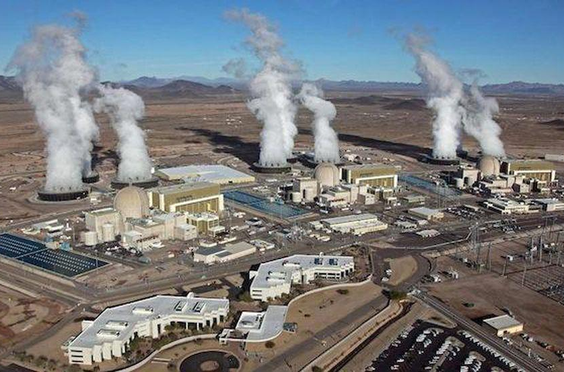

hydrogen storage
The APS (Arizona Public Service)
project starting 2022 will be at the Palo Verde Generating Station near Phoenix, Arizona.
FirstEnergy Solutions (FES)
DOE rewarded $9 million in federal funding for a $11.4-million project, a light water reactor (LWR) hybrid energy system In Ohio.
Top: Figure 13 shows one of APS built near Phoenix[15].
Bottom: Figure 14 the logo for Frist Energy[16].
Notes:
Here are more examples future projects as the Arizona public service trying to build some hydrogen production plants ner phoenix and first energy trying to similar things Ohio.

Slide 15
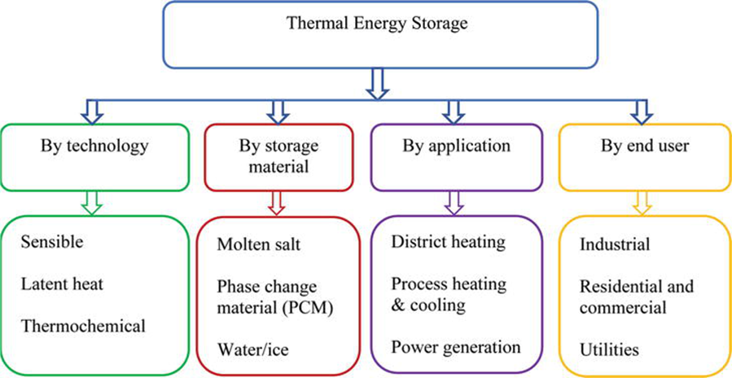
thermal energy Storage
Sensible Thermal Energy Storage
Underground Thermal Energy Storage
Hot and Cold-Water Storage
Solid Media Storage
Latent Thermal Energy Storage
Thermochemicals
Molten Salts
Liquid Air
Phase Change Materials
Figure15 classification of thermal energy storage systems[22].
Notes:
Here is a list thermal energy systems that we will discuss. They are broken into into main groups, sensible and latent and the mafferecne would be if a phase change occus. Phase changes will occus in the Lantent thermal energy s systems and not in the sensible energy systems.

Slide 16

Sensible thermal energy Storage
Sensible Thermal Energy Storage
Prevent a phase change of the storage medium.
Use water, rocks, concrete to minimize environmental impact.
somewhat low energy densities
Minimal environment impacts.
Figure15 classification of thermal energy storage systems[22].
Notes:
Sensibel termal energy stoage repvent a phase change they use water , concrete and enviroemntal impacts . One down fall they have lower energy densities compared to latent systems.

Slide 17
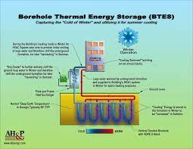
Sensible thermal energy Storage
Underground Thermal Energy Storage
Stores energy by pumping heat into underground storage space.
Examples of underground storage :boreholes, aquifers, and caverns or pits.
Storage medium is Water.
Installations have been limited due to high investment costs
Common in Netherlands, Sweden, German, and Canada
Figure16 diagram of Borehole thermal energy storage system [17].
Notes:
One very common sensible system is Underground thermal energy storage where they pump heat into undergroujnd storage spaces the main medium is water and some example underground spaces is boreholes , aquifers , and caverns. The image on the right shows borehole example which is a deep, narrow hole made in the ground. Underground thermal energy storage systems are ideally suited for seasonal storage . And they are common Netherlands, Sweden, German, and Canada

Slide 18
Sensible thermal energy Storage
Underground Thermal Energy Storage
High investment costs due to geological requirements .
Popular in Europe but due to U.S The regulatory barrier not widespread in the States.
Mainly used for seasonal thermal energy storage and district heating.
Is not able to assist with the integration with generating renewable energy sources.
The number of future are increasing by a factor 10 .
An increase in knowledge of this method will be a byproduct of geothermal energy production opportunities.

Slide 19
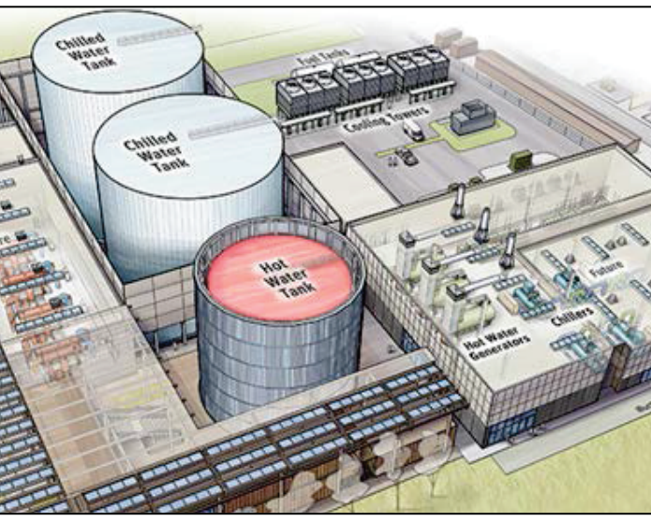
Sensible thermal energy Storage
Hot and Cold-Water Storage
Most common form of thermal energy storage.
Used to meet energy demand for the heating and cooling of residential and commercial buildings to control cost.
the device either chills or transfers heat to the water and then stored insulated tank
Figure 17. Example of a hot and cold energy system[21].

Slide 20
Sensible thermal energy Storage
Hot and Cold-Water Storage
Are dependent on the size of tanks
Environmental impacts are minimal .
Faces regulatory barriers that must be overcome.
The hot and cold system has different technology systems that are compatible with many different applications
There is only be demonstration-scale of integration with power plants.
there are huge demand of opportunities for further research and development around the globe.

Slide 21
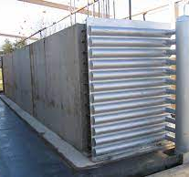
Sensible thermal energy Storage
Solid Media Storage
high-temperature applications
Mainly stored in concrete, bricks, and rocks.
are more widely available and relatively inexpensive
Have lower energy densities compared to liquids
Figure 18 Example of a concrete thermal energy storage module[18].

Slide 22
Sensible thermal energy Storage
Solid Media Storage
simple as a standard heat exchanger
Geothermal energy systems have environmental impacts
More research into the environmental impact of geothermal heat storage is encouraged due to unknown long-term risks.
Claims more market opportunities than Hot and Cold systems.
concrete design is the closest to commercialization
Research into a design where thermal energy generated by a power plant is stored the solid storage medium is being encouraged.

Slide 23
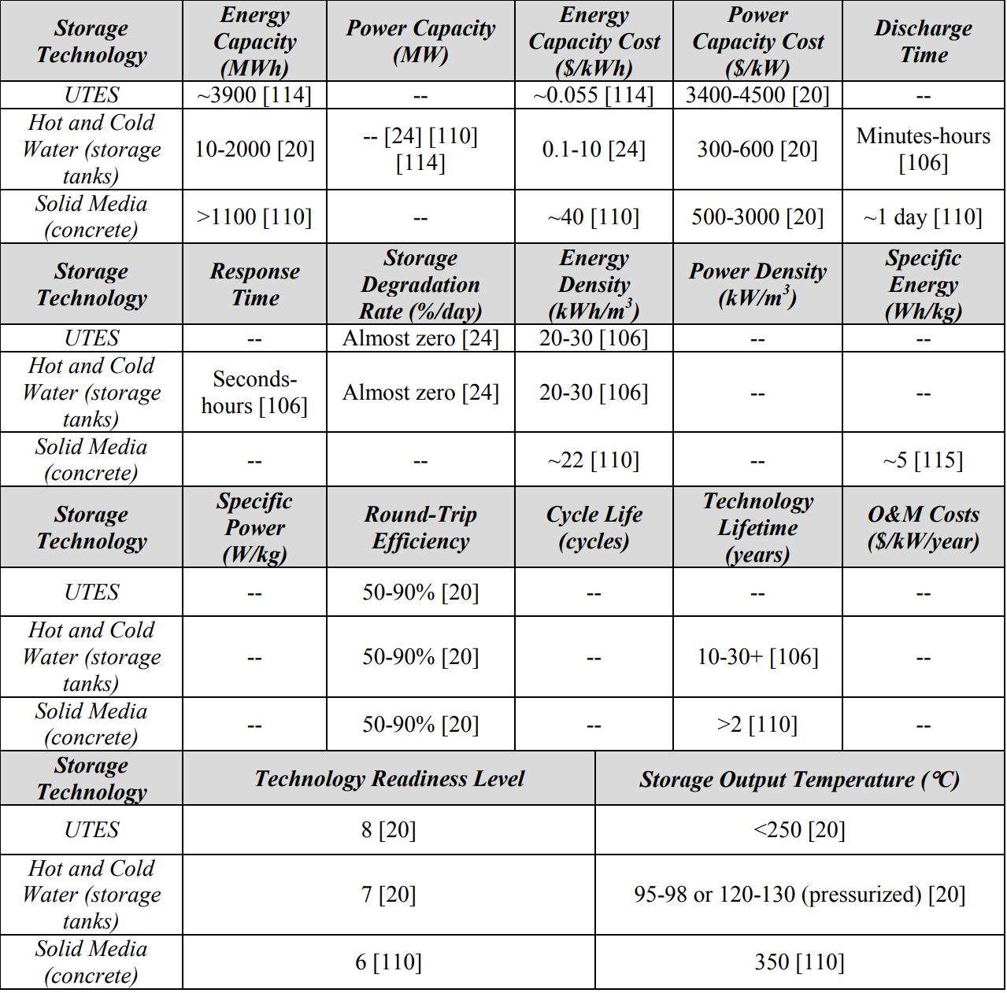
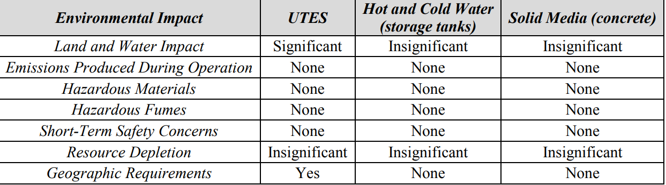
Sensible thermal energy Storage
Left Figure 19 shows the performance parameters for Sensible thermal energy storage system[21].
Right. Figure 20 shows the environmental aspect Sensible thermal energy storage system[21].

Slide 24
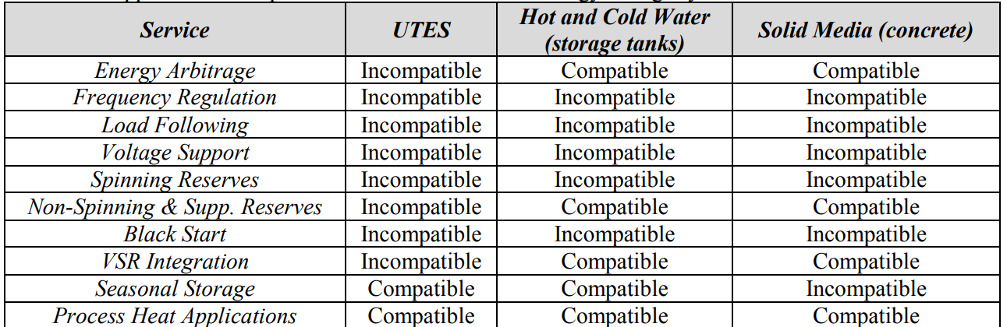
Sensible Thermal Energy Storage
Figure 21 shows the compatibility of certain applications of Sensible thermal energy storage system[21].

Slide 25
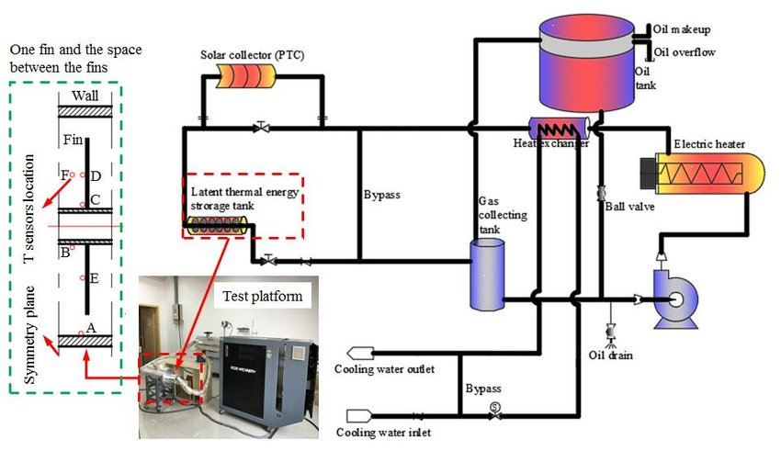
Latent Thermal Energy Storage
Latent thermal energy storage
Uses phase change of the storage medium.
More specific energy
Energy can be release at constant temperature.
More expensive than Sensible energy storage
Industrial heat process applications.
Figure 22 the interworking of latent heat thermal energy storage experimental platform [23].

Slide 26
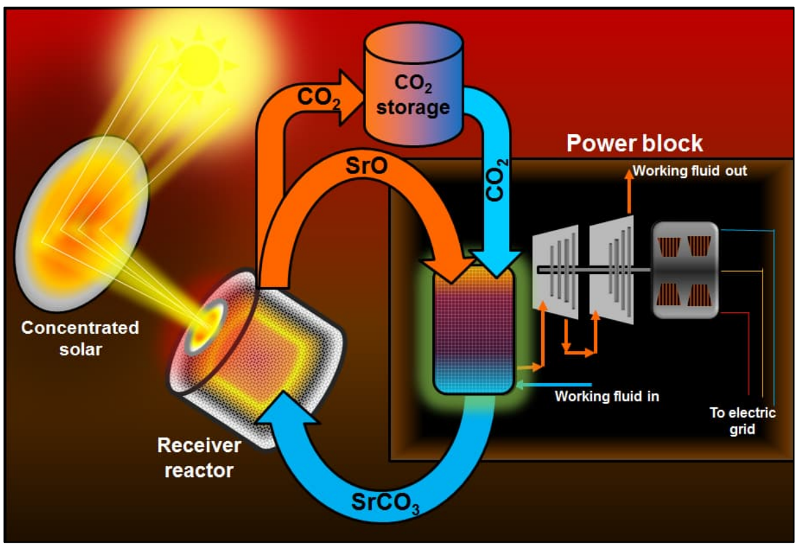
Latent Thermal Energy Storage
Thermochemical
better energy density and less likely for any energy leakage throughout duration
Energy stored in endothermic reactions and released in exothermic reactions
Not economically feasible
Can make integrating renewable energy sources into the grid more efficient.
Some thermochemical materials can degrade into toxic and corrosive substances.
Figure 23. A diagram of thermochemical energy storage[21].
Notes:
Typically, thermochemical energy storage refers to two main processes, thermochemical reactions and sorption processes. Thermal adsorption reactions can be used to store heat or cold in the bonding of a substance to another solid or liquid. A common sorption process used in TCS systems is the adsorption of water vapor to silica gel or zeolites

Slide 27
Latent Thermal Energy Storage
Thermochemical
capable of storing thermal energy in a compact space.
systems have the potential to fill is the transportation of stored energy
offer seasonal energy storage services
DOE programs are funding further development of TCS systems
One of the furthest from commercialization.
Currently at the forefront of research and development into energy storage technologies.

Slide 28
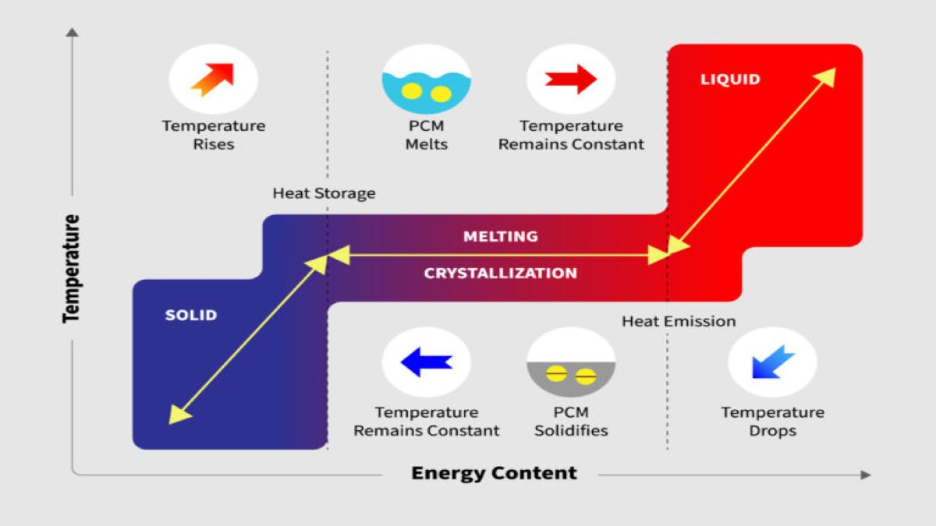
Latent Thermal Energy Storage
Phase Change Materials
absorb and release heat isothermally throughout the phase change process
can store 5–14 times energy density than sensible energy storage
Materials can be expensive and rare
liquid air and molten salts are common examples
Figure24. Comparison of energy content of liquids ,solids and phase changing materials [20].

Slide 29
Latent Thermal Energy Storage
Phase Change Materials
the performance parameters can vary widely depending on the chemical properties of the material involved.
Paraffins and petroleum-based PCMs are known to be toxic to plants and wildlife
Salt hydrates can be corrosive surrounding ecosystems.
Many inconsistencies between what the regulations allow and the capabilities of PCMs.
Potential applications range from daily to seasonal usage base on the chemical properties.
significant research and development need to done before moving to commercialization .

Slide 30
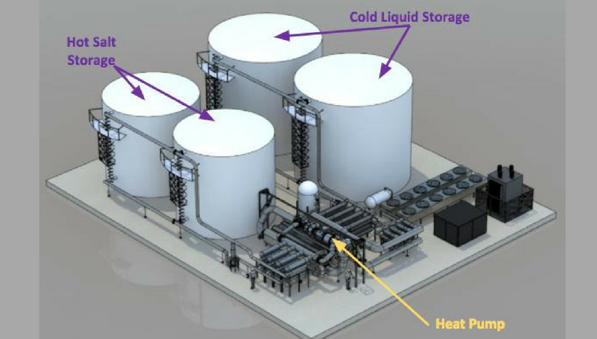
Latent Thermal Energy Storage
Molten Salts
Solid at room temperature but become liquid due to thermal energy transfer.
60% sodium nitrate and 40% potassium nitrate.
helps a power plant to generate electricity during peak demand periods
relatively low-cost and efficient storage medium
environmental impacts are significant.
Figure 25. A diagram of molten salt energy storage[21].

Slide 31
Latent Thermal Energy Storage
Molten Salts
impacts come from the emissions produced during the transportation of materials
the possibility of toxic compounds being produced if the used material is landfilled.
significant opportunity for the development of molten salt energy storage systems
many methods for improving the efficiency and storage capacity of molten salts have been considered.

Slide 32
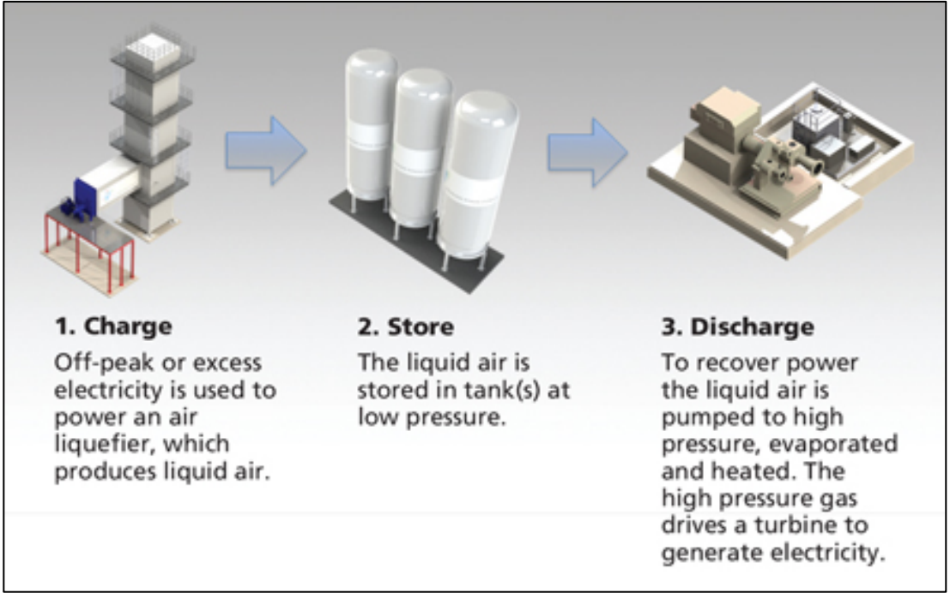
Latent Thermal Energy Storage
Liquid Air
efficient and cost-effective energy storage method because of the combability with current infrastructure
Refrigerating and then liquefying air to be stored in insulated tanks.
Similar to Compressed air storage but does not require the geographic requirements.
Figure 26. A diagram of Liquid Air process[21].

Slide 33
Latent Thermal Energy Storage
Liquid Air
On larger scale, where the economics, self-discharge rate, and efficiency all improve.
Minimal environmental impact.
Relatively new technology and can on the scene in 2011 in United Kingdom.
One factor that could accelerate the development of this technology advancing components to move pass using natural gas

Slide 34
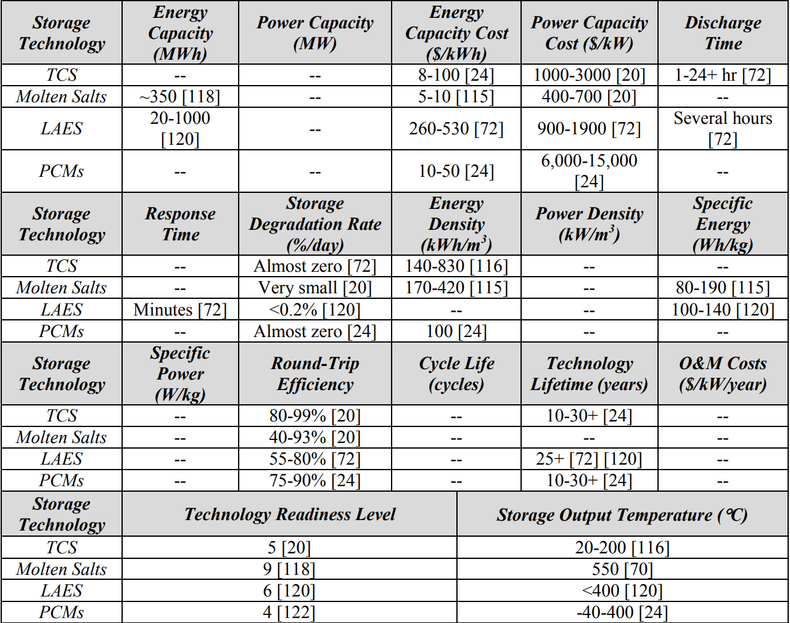
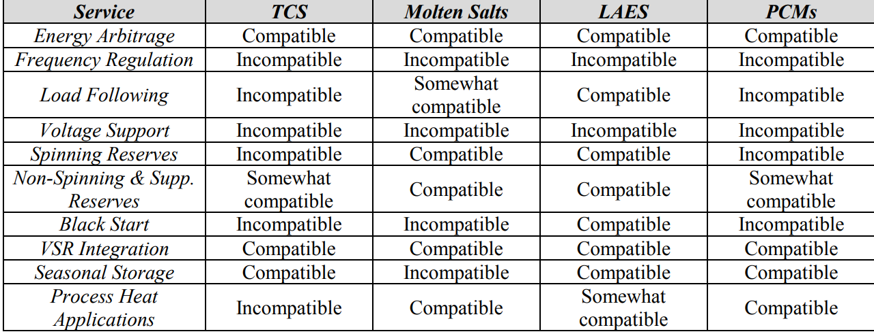
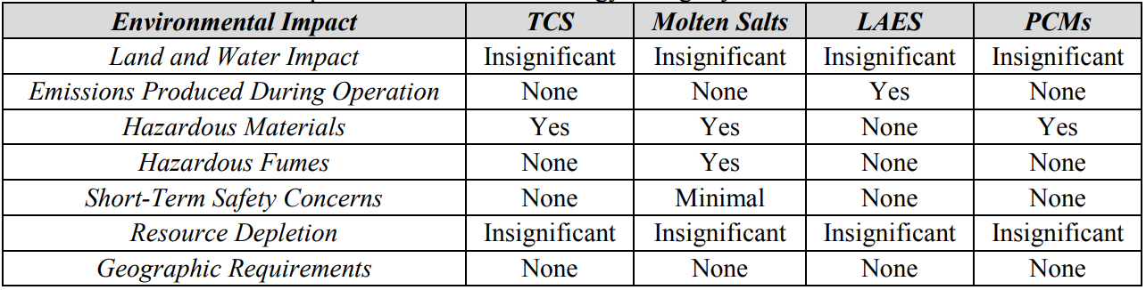
Latent Thermal Energy Storage
Upper Left Figure 26.shows the performance parameters for latent thermal energy storage system[21].
Lower Right. Figure 27 shows the environmental aspect latent thermal energy storage system[21].
Upper Right Figure 28. shows the compatibility of certain applications of Latent thermal energy storage system[21].

Slide 35
compatible with Nuclear Power
Main factors that determine capability is the reactor type and geological formations around the power plant
Many reactors are being built with energy storage being used to help with flexibility to the grid.
hydrogen production, thermochemical processes, and molten salt thermal energy storage are the most applicable to current and future nuclear power designs
Honorable mentions include flywheel and pumped storage which would be desired for energy storage with nuclear power.

Slide 36
References
1. What are the different components of a nuclear power plant? Foro Nuclear. (2020, November 25). Retrieved April 22, 2022, from https://www.foronuclear.org/en/updates/in-depth/what-are-the-different-components-of-a-nuclear-power-plant/
2. The Pros & Cons of Nuclear Energy: Is It Safe? Spring Power & Gas. (2019, April 30). Retrieved April 22, 2022, from https://springpowerandgas.us/the-pros-cons-of-nuclear-energy-is-it-safe/
3. Wikimedia Foundation. (2022, March 4). History of nuclear power. Wikipedia. Retrieved April 22, 2022, from https://en.wikipedia.org/wiki/History_of_nuclear_power
4. IAEA. (2021, November 4). What are small modular reactors (smrs)? IAEA. Retrieved April 22, 2022, from https://www.iaea.org/newscenter/news/what-are-small-modular-reactors-smrs
5. Generation IV Nuclear Reactors: WNA - World Nuclear Association. (n.d.). Retrieved April 22, 2022, from https://world-nuclear.org/information-library/nuclear-fuel-cycle/nuclear-power-reactors/generation-iv-nuclear-reactors.aspx
6. Yurman, D., Energy and Environmental Review: September 20, AWED Newsletter: Covering COVID to Climate, 20, S., 20, M. B. N. S., Bush, J., Rowland, B., Meeten, N., & Perrio, M. (2021, September 16). Nuclear fusion: U.S. and China Race to build world's first commercial plant. Energy Post. Retrieved April 22, 2022, from https://energypost.eu/nuclear-fusion-u-s-and-china-race-to-build-worlds-first-commercial-plant/
7. Ragone plot for comparing the energy storage technologies ... (n.d.). Retrieved April 22, 2022, from https://www.researchgate.net/figure/Ragone-plot-for-comparing-the-energy-storage-technologies-and-their-power-density-versus_fig6_221909845
8. Helmenstine, A., & Helmenstine, A. (2021, December 4). What is chemical energy? definition and examples. Science Notes and Projects. Retrieved April 22, 2022, from https://sciencenotes.org/what-is-chemical-energy-definition-and-examples/

Slide 37
References
9. CB Insights. (2021, September 17). How hydrogen will help industrials meet decarbonization goals and leave fossil fuels behind. CB Insights Research. Retrieved April 22, 2022, from https://www.cbinsights.com/research/hydrogen-industrials-decarbonization-clean-energy/
O'Brien, J. E., McKellar, M. G., Harvego, E. A., & Stoots, C. M. (2009, October 1). High-temperature electrolysis for large-scale hydrogen and syngas production from Nuclear Energy – Summary of system simulation and economic analyses. International Journal of Hydrogen Energy. Retrieved April 22, 2022, from https://www.sciencedirect.com/science/article/pii/S0360319909013809
10.Doe announces $20 million to produce clean hydrogen from nuclear power. Energy.gov. (n.d.). Retrieved April 22, 2022, from https://www.energy.gov/articles/doe-announces-20-million-produce-clean-hydrogen-nuclear-power
11.Sep 11, 2019 by S. P. (2019, September 11). Three more nuclear plant owners will demonstrate hydrogen production. POWER Magazine. Retrieved April 22, 2022, from https://www.powermag.com/three-more-nuclear-plant-owners-will-demonstrate-hydrogen-production/
12.Mullin, R., Cook, A. D., Soapbox, S., Yoder, M., McFarland, S., & Jr., R. H. (2021, October 7). Items tagged with 'PNW Hydrogen LLC'. RTO Insider RSS. Retrieved April 22, 2022, from https://www.rtoinsider.com/keywords/5460-pnw-hydrogen-llc
13.Wikimedia Foundation. (2022, March 9). Uniper. Wikipedia. Retrieved April 22, 2022, from https://en.wikipedia.org/wiki/Uniper
14.Fortum's subsidiary Uniper takes precautionary financing measures including credit facilities from KFW Bank and Fortum to secure liquidity in extremely volatile markets. Fortum. (n.d.). Retrieved April 22, 2022, from https://www.fortum.com/media/2022/01/fortums-subsidiary-uniper-takes-precautionary-financing-measures-including-credit-facilities-kfw-bank-and-fortum-secure-liquidity-extremely-volatile-markets
15.Alamalhodaei, A. (2020, June 26). APS, Xcel explore producing hydrogen from nuclear plant. NewsData, LLC. Retrieved April 22, 2022, from https://www.newsdata.com/california_energy_markets/southwest/aps-xcel-explore-producing-hydrogen-from-nuclear-plant/article_21973976-b7da-11ea-98fd-abf548c1b72e.html

Slide 38
References
16.Corp., F. E. (2018, August 27). Firstenergy enters definitive settlement agreement with key parties in Fes bankruptcy proceedings. FirstEnergy Enters Definitive Settlement Agreement with Key Parties in FES Bankruptcy Proceedings. Retrieved April 22, 2022, from https://www.prnewswire.com/news-releases/firstenergy-enters-definitive-settlement-agreement-with-key-parties-in-fes-bankruptcy-proceedings-300702910.html
17.Houston, TX Underground Thermal Energy Storage (utes). (n.d.). Retrieved April 22, 2022, from https://www.energy.gov/sites/prod/files/2015/11/f27/fupwg_fall2015_hammock.pdf
18. Concrete storage for solar thermal power ... - stratosolar. (n.d.). Retrieved April 22, 2022, from http://www.stratosolar.com/uploads/5/6/7/1/5671050/26_2008_ires_iii_concrete_storage_laing_et_al.pdf
19.Duan, D. (2018, July 26). Molten salt-the "seasoning" renewable energy desperately needs: Chemistry and physics. Labroots. Retrieved April 22, 2022, from https://www.labroots.com/trending/chemistry-and-physics/12212/molten-salt-the-seasoning-renewable-energy-desperately
20.Phase change material (PCM). Thermtest Inc. (2022, February 3). Retrieved April 22, 2022, from https://thermtest.com/phase-change-material-pcm
21.Coleman, J. L., Bragg-Sitton, S. M., & Dufek, E. J. (2017, June 1). An evaluation of Energy Storage Options for Nuclear Power. An Evaluation of Energy Storage Options for Nuclear Power (Technical Report) | OSTI.GOV. Retrieved April 22, 2022, from https://www.osti.gov/servlets/purl/1372488
22. Hailu, G. (2018, November 5). Chapter: Seasonal Solar Thermal Energy Storage. IntechOpen. Retrieved April 23, 2022, from https://www.intechopen.com/chapters/63027
23. Effect of Phase Transition Temperature and Thermal Conductivity on the Performance of Latent Heat Storage System - Scientific Figure on ResearchGate. Available from: https://www.researchgate.net/figure/Structure-diagram-of-latent-heat-thermal-energy-storage-experimental-platform-15_fig1_323158686 [accessed 24 Apr, 2022]

