Slide 1

Practical Hydrogen Fuel Development: A Non-Nuclear Feasibility Study
¹A. Groll,
¹Department of Nuclear Plasma and Radiological Engineering,
University of Illinois at Urbana-Champaign
Contact: groll1@Illinois.edu
Conference
Date
Nuclear, Plasma, and Radiological Eng.
University of Illinois
April 1st, 2016
ANS Student Conference 2016

Slide 2
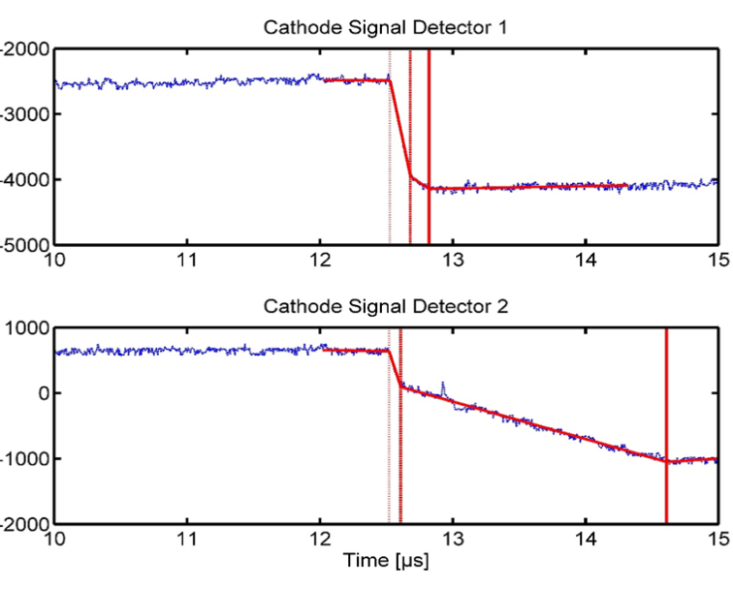
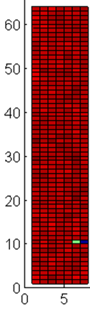
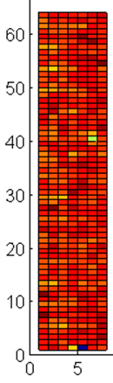
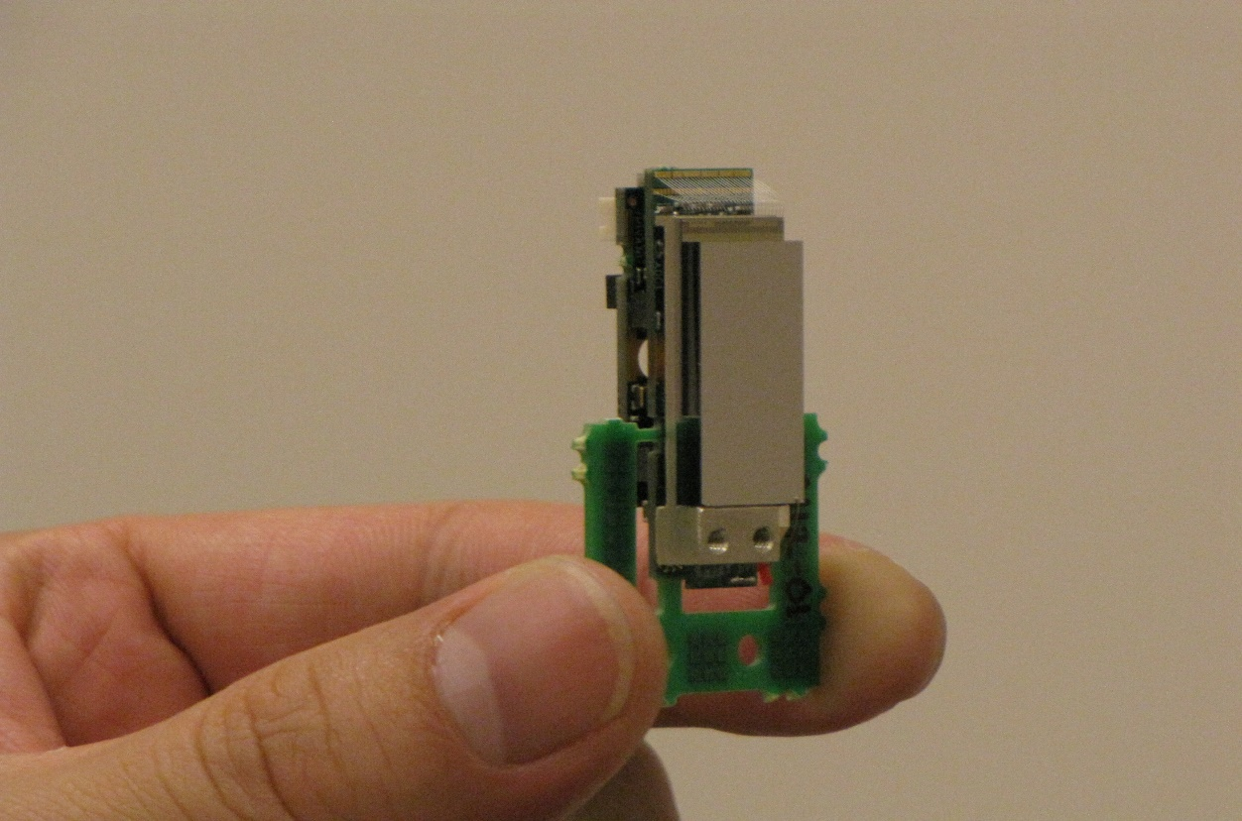

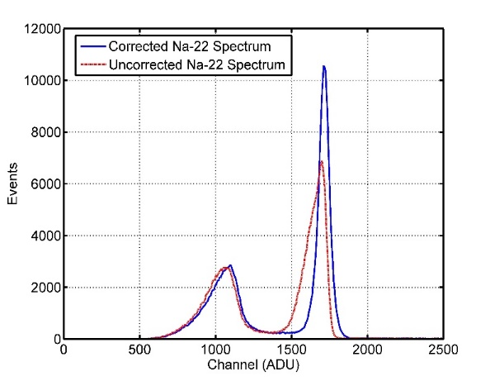
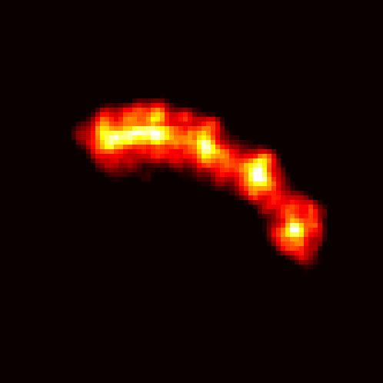
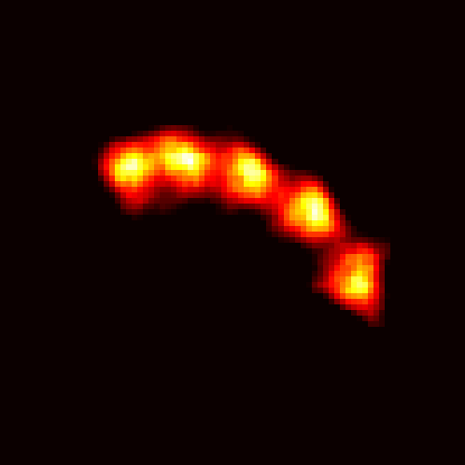
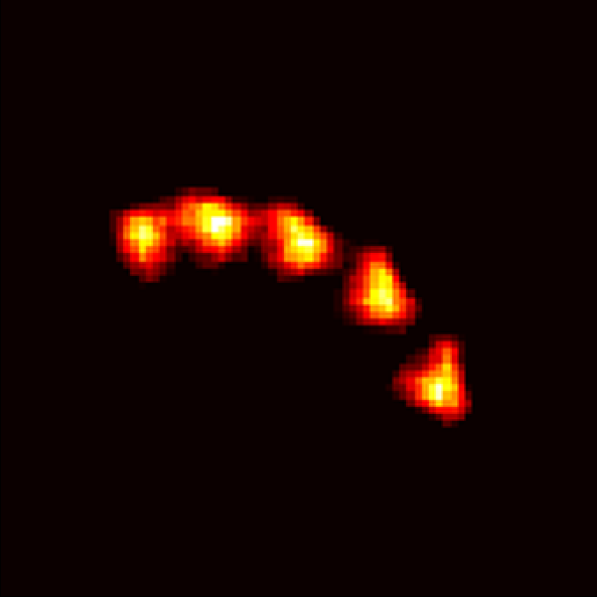
Short Bio - Hybrid Pixel-Waveform (HPWF) CdTe
Compact CdTe Detectors
Hybrid Pixel-Waveform (HPWF) Method
Electron and hole drift begin
[ADU]
Electrons arrive at anode
Holes arrive at cathode
2.2 cm
Super-compact PCBs
Electron Amplitude
[ADU]
Hole Amplitude
Fig. 1. Super-compact CdTe detectors for imaging
Fig. 2. Cathode signal and pixelated anode acquired from HPWF detectors
Combining the cathode waveform and pixel information for each interaction yields:
Depth of interaction (DOI) information from the cathode waveform
Improved energy resolution using the induced cathode waveform amplitude
Improved timing resolution from using the initial bending point of the cathode waveform
Simplified readout circuitry due to the reduced burden of extracting critical information from the anode
Energy Resolution
Point Source Resolution
(A)
(B)
(C)
400 µm
5% Energy Resolution
300 µm
Fig. 4. (A) Raw data reconstruction of Na-22 point source at multiple positions. (B) Reconstructed point source data with DOI correction. (C) Reconstructed data with DOI and positron range correction. Preliminary work indicates that’s sub 500-µm resolution is possible.
Fig. 3. Raw energy spectrum and DOI corrected energy spectrum
Nuclear, Plasma, and Radiological Eng.
University of Illinois
April 8th 2016
498 ES – Energy Presentation

Slide 3
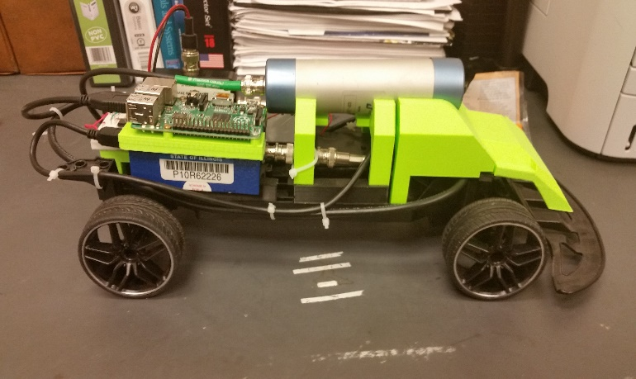
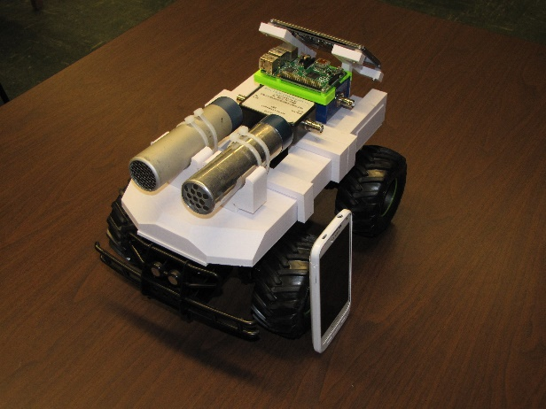
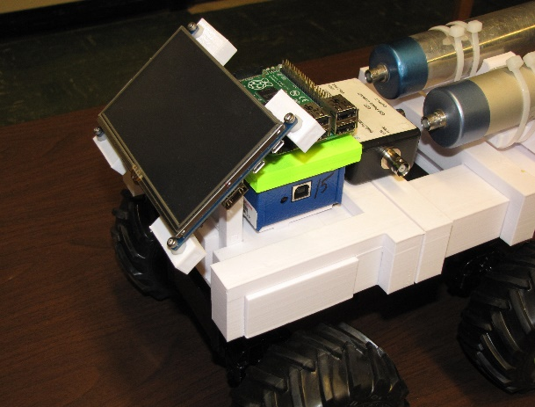
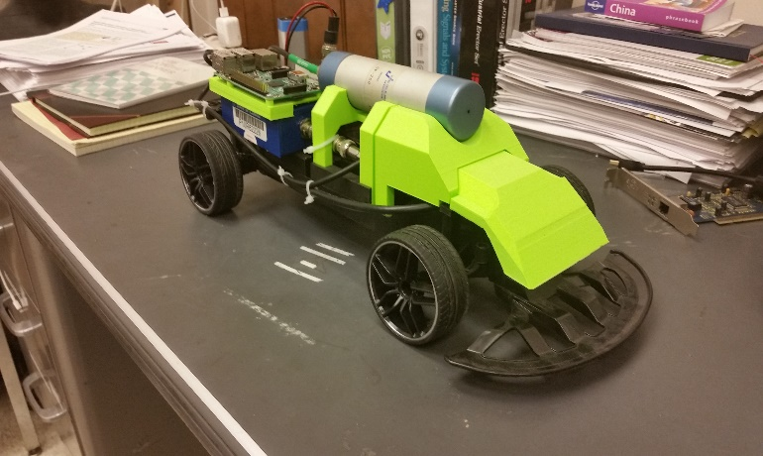

Short Bio – First and Second Generation Radiation Cars
Mark I – Geiger Car
Mark II – Geiger/NaI Chassis
(5A)
(6A)
(6B)
Side View
(5B)
(6C)
(B)
(C)
400 µm
Front View
300 µm
Fig. 5. (A) First generation detector car with Geiger tube and buzzer for indicating detection. (B) Front view of the car.
Fig. 6 (A,B,C) Multiple views of the second generation car designed within the last few weeks. Approximately twice as tall as the previous generation.
Nuclear, Plasma, and Radiological Eng.
University of Illinois
April 8th 2016
498 ES – Energy Presentation

Slide 4
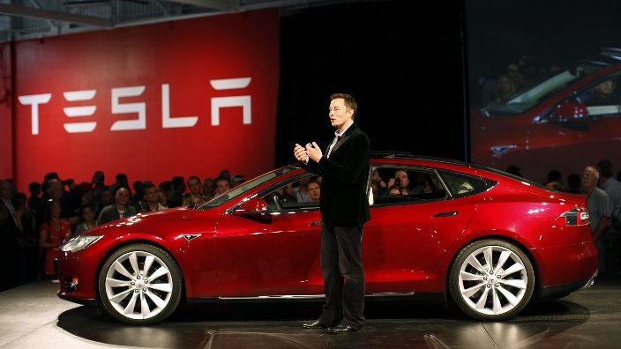
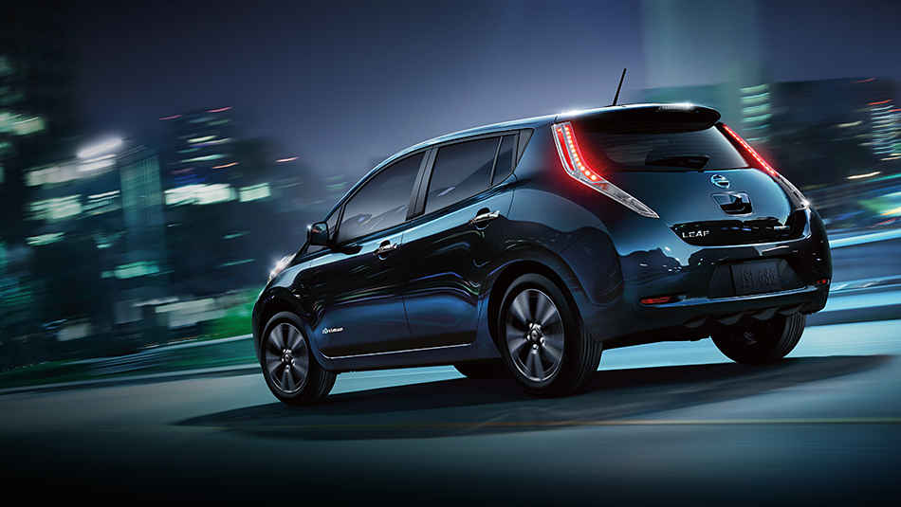
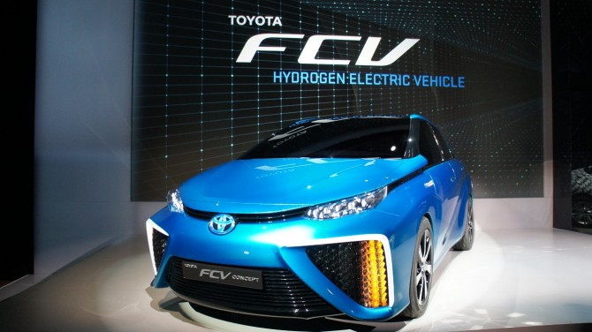
Motivation of Work – Carbon Dioxide and Current Infrastructure
How we develop a infrastructure friendly fuel?
(7A)
Understanding the composition of our infrastructure
Identifying trends in the current energy infrastructure
How easy is the technology at hand?
(7B)
Reducing or Mediating greenhouse gases
Interpreting the current science and engineering for hydrogen and carbon dioxide
Coupling fossil fuels, natural gas and renewables
(7C)
Fig. 7. (A) Elon Musk showing off his current Tesla car. (B) The compact Nissan leaf, an electric vehicle. (C) The Toyota hydrogen electrical vehicle
Nuclear, Plasma, and Radiological Eng.
University of Illinois
April 8th 2016
498 ES – Energy Presentation

Slide 5
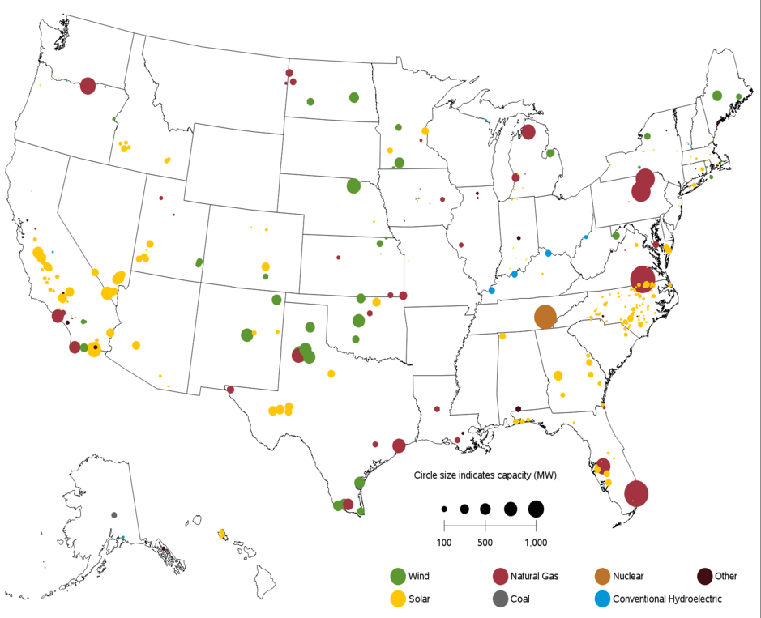
Introduction – Our Energy Infrastructure
U.S. Energy Production
MW Capacity Growth for 2016 and 2017
Nuclear Faction:
Only 20% of all energy production is nuclear
(8A)
Major Carbon Produces:
67% of electricity generated comes from fossil fuels
Fig. 8. (A) Anticipated capacity growth for the 2016 year and the 2017 year including from what utilities we expect to see this growth. (B) The current partitioning of all U.S. electricity generation. Nuclear is only 20% of the picture.
(8B)
Nuclear, Plasma, and Radiological Eng.
University of Illinois
April 8th 2016
498 ES – Energy Presentation

Slide 6
Trends in Energy – Nuclear In Review
What’s Happening?
Current Trending for Nuclear Sites
Nuclear Growth:
EIA reports show minimal nuclear growth over the last 25 years
(9A)
Energy Capacity:
The current operating power plants are operating at 92% capacity
Development Rate:
The nuclear industry is simply far to too slow in developing
(9B)
Fig. 9. (A) The growth of the number of U.S. nuclear power plants since 1957. Currently 99 reactors are operation for electricity production. (B) Net generation of all operational units within the United State. Current operational capacity is at 92%.
Nuclear, Plasma, and Radiological Eng.
University of Illinois
April 8th 2016
498 ES – Energy Presentation

Slide 7
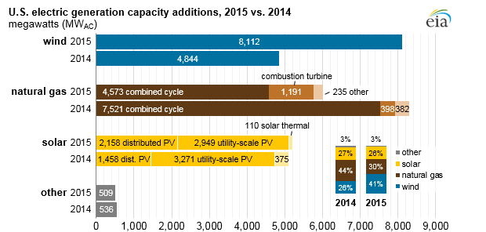
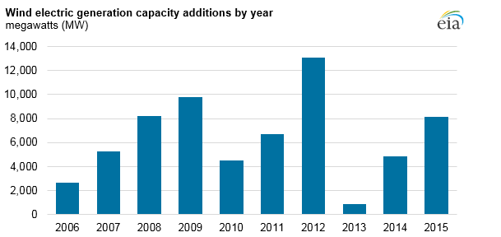
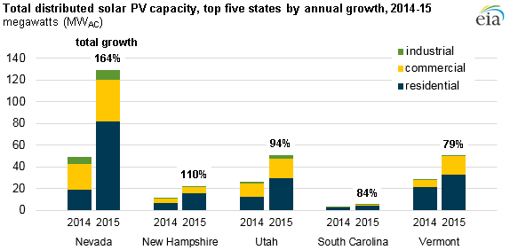
Trends in Energy – Sector Growth
U.S. Generation Capacity Additions
Trends in Electricity
(10B)
(10A)
Growth is currently dominated by wind, natural gas, and solar power
(10C)
What is growing?:
Wind is dominating while natural gas and solar power are moving forward quickly as well
Fig. 10. (A) Additional capacity growth in wind, natural gas, and solar from 2014 to 2015. (B) The development of wind energy capacity from 2006 to 2015. (C) Growth of photovoltaic capacity for the 2014 to 2015 year.
Nuclear, Plasma, and Radiological Eng.
University of Illinois
April 8th 2016
498 ES – Energy Presentation

Slide 8
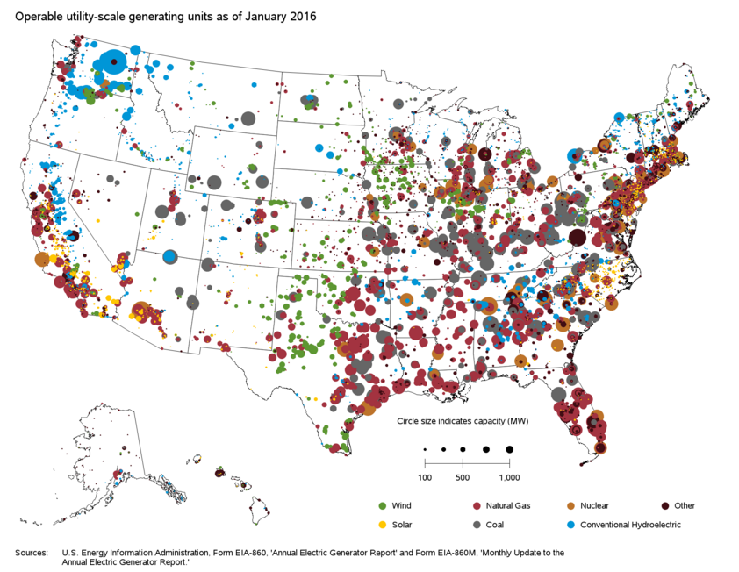
Trends in Energy – Our Current Energy Distribution
U.S. Generation Capacity as of January 2016
(11A)
Fig. 11. (A) The current U.S. distribution of generation capacity for the selected sources of energy. Natural gas, solar, and wind are becoming dominant with hydroelectric showing strength in the northwest.
Nuclear, Plasma, and Radiological Eng.
University of Illinois
April 8th 2016
498 ES – Energy Presentation

Slide 9
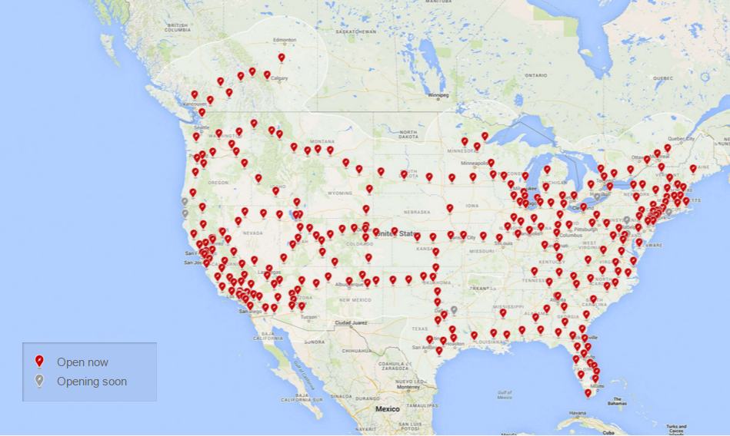
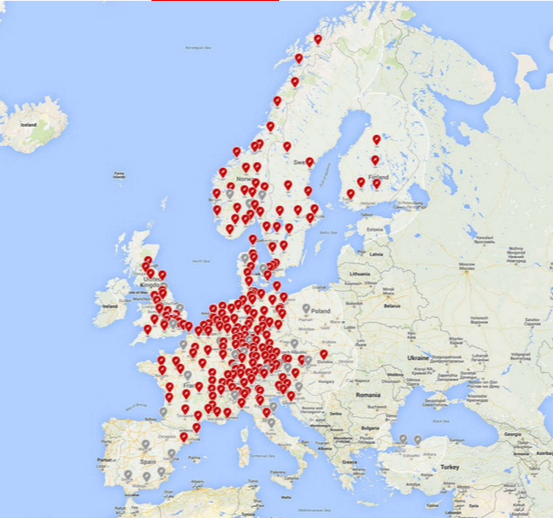
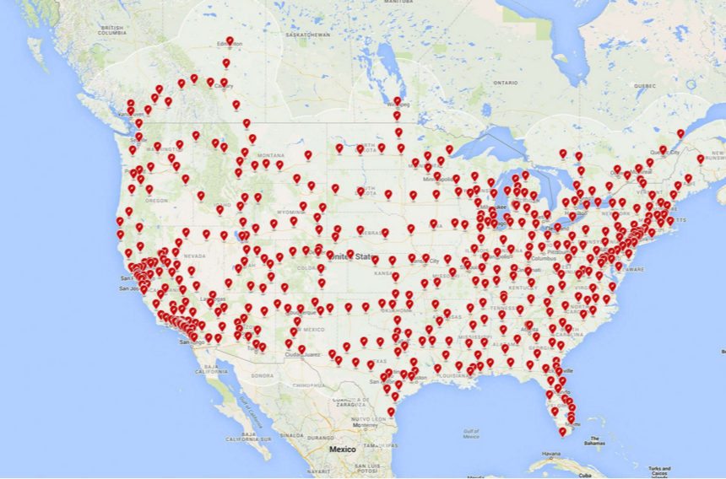
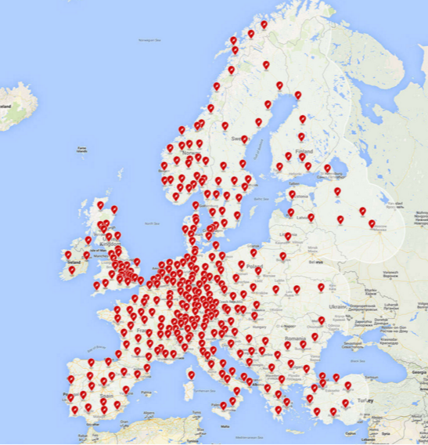
Trends in Energy – Tesla Growth
Musk on Nuclear
The Massive Massive Growth (Over 3 years)
“I'm quite confident that solar power will be the single largest source of electrical energy for humanity in the future. It will be combined with other things, of course, such as hydro power, geothermal, and I actually think nuclear is not a terrible option, so long as you're not located in a place that's susceptible to natural disasters. That, also I think, defies common sense. So long as there are not huge earthquakes or weather systems that have names coming at you, then I think nuclear can be a sensible option. There are much safer and better ways of generating nuclear energy - I'm talking fission here - than existed in the past when nuclear reactors first came out. At some point in the future it would be nice to make fusion work, of course. That'd be quite good, but in the mean time I think indirect fusion, being solar power, is a good thing to do.” – Elon Musk
(12A)
(13A)
(12B)
(13B)
Fig. 12. (A) Current supercharging stations in the U.S. (B) 2016 anticipated growth in the U.S. (C) Current supercharging stations in the Europe. (D) Anticipated growth of supercharging stations in Europe by 2016.
Nuclear, Plasma, and Radiological Eng.
University of Illinois
April 8th 2016
498 ES – Energy Presentation

Slide 10
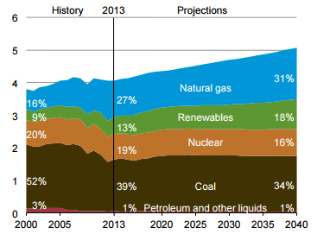
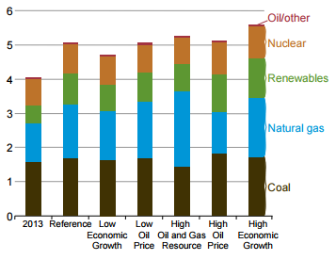
What statement is being made?
Nuclear Infrastructure Really Isn’t Growing
EIA Outlooks
Nuclear has high energy yield but no current true resolution to waste
Nuclear has far more regulatory constraints due to the production of radioactive material
Poor public perception, which is improving, but still has many hurdles to overcome
Technological developments and implementation of nuclear power is outrun by other energy acquisition methods
It’s very expensive, the economics challenge
(13A)
(13B)
While nuclear is a smart option for high energy density and is very safe, its simply not moving anywhere in U.S. infrastructure
Fig. 13. (A) The anticipated projections for energy composition to 2014. (B) The anticipated growth given different conditions.
Nuclear, Plasma, and Radiological Eng.
University of Illinois
April 8th 2016
498 ES – Energy Presentation

Slide 11
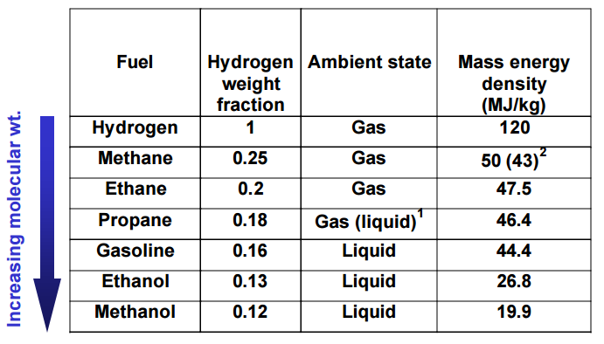
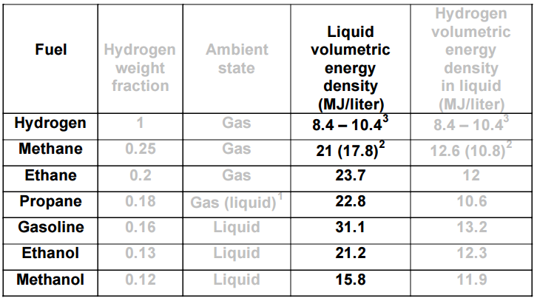


Moving Forward With EIA Trends – The Goal
The Goals for Hydrogen
Various Different Fuels
Develop a fuel which is not intended to be burned
Fuel which can be produced from capturing carbon dioxide
Emit hydrogen from the intermediate carrier
(14A)
Methanol Production Chemistry
(14B)
Fig. 14. (A) Specific energy for various hydrocarbon compositions (B) Energy density for given liquid volumes of selected hydrocarbon compositions.
Nuclear, Plasma, and Radiological Eng.
University of Illinois
April 8th 2016
498 ES – Energy Presentation

Slide 12
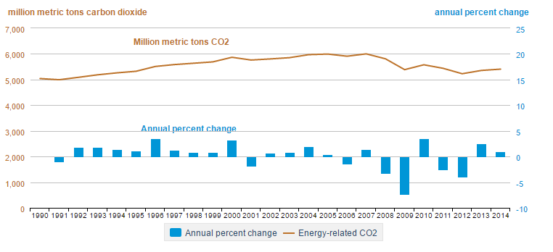
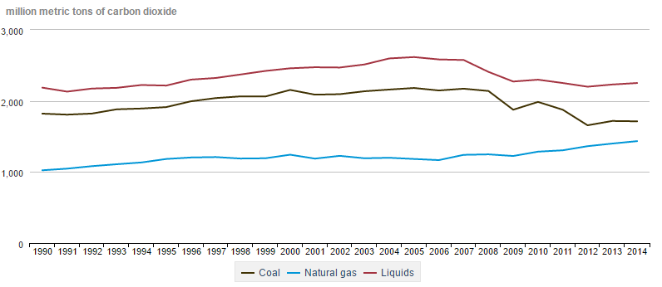
Moving Forward With EIA Trends – Ingredient 1
Energy Related Carbon Dioxide Production
Future Trends
(15A)
Carbon Dioxide:
The objective is reduce carbon dioxide as much as possible
Natural Gas Growth:
The only growing carbon dioxide producer
(15B)
Coal and Liquids:
Slowly dropping but still relevant producers of carbon dioxide
Fig. 15. (A) The total amount of carbon dioxide produced from 1990 to 2014 with annual percentage change. (B) The production of carbon dioxide from various sources such as coal, natural gas, and liquids from 1990 to 2014.
Nuclear, Plasma, and Radiological Eng.
University of Illinois
April 8th 2016
498 ES – Energy Presentation

Slide 13
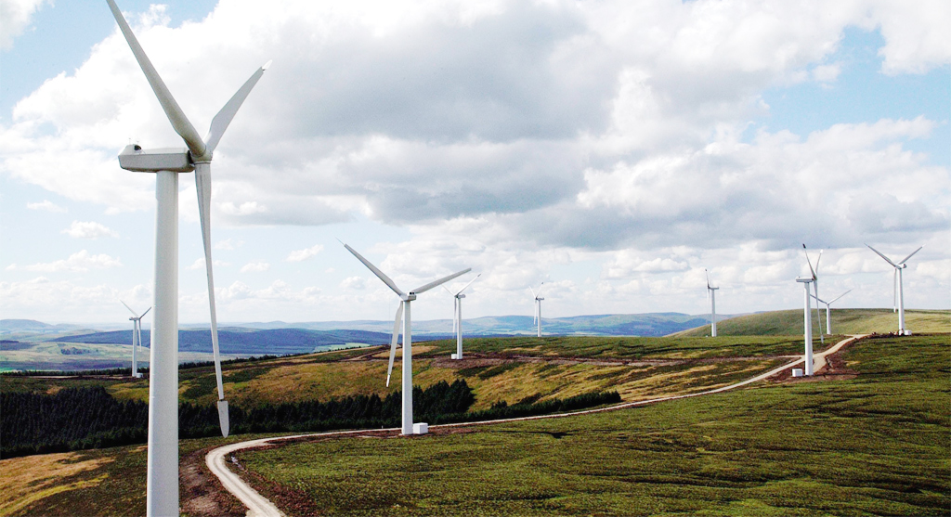
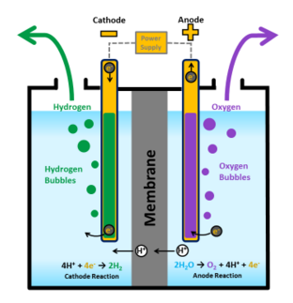
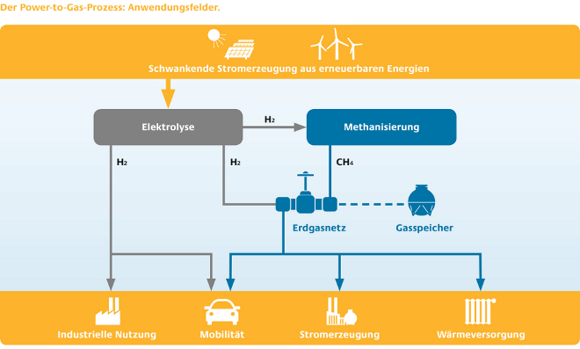

Moving Forward With EIA Trends – Renewable Ingredient
Extracting Hydrogen from the #1 Renewable
Storing Wind Energy
(16A)
(16B)
Electrolysis Anode and Cathode Eq.
(16C)
Fig. 16. (A) Wind turbines that generate wind power. (B) Electrolysis used for hydrogen and oxygen production. (C) Schematic of potential energy usage from wind based generation.
Nuclear, Plasma, and Radiological Eng.
University of Illinois
April 8th 2016
498 ES – Energy Presentation

Slide 14
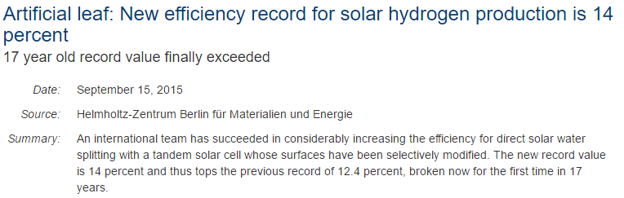
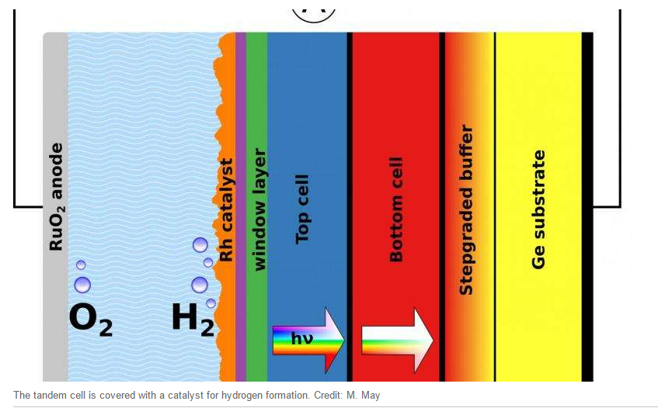
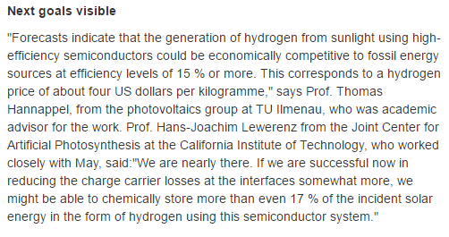
Moving Forward With EIA Trends – Renewable Ingredient
Solar Based Hydrogen Production – Efficiency Improvement
(17A)
Fig. 17. (A) The efficiency of hydrogen production from solar has not changed dramatically over the last 17 years. Recently the record of 12.4 % has appeared to be broken. Currently 14% is now achievable. The next goals focus on improving efficiency to 17%.
Nuclear, Plasma, and Radiological Eng.
University of Illinois
April 8th 2016
498 ES – Energy Presentation

Slide 15
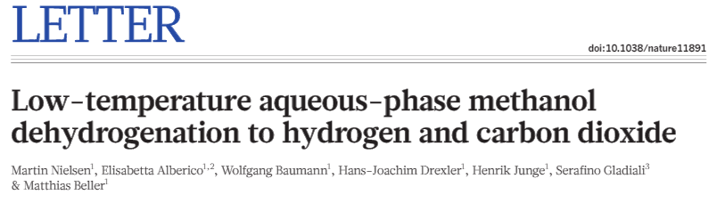
Moving Forward With EIA Trends – The Ingredients
Nature Paper – Methanol Usage
A Hydrogen Fuel – Methanol as the Carrier
Methanol has a low specific energy
Hydrogen has a very high specific energy
We use methanol as an intermediate store of hydrogen for future use
Nuclear, Plasma, and Radiological Eng.
University of Illinois
April 8th 2016
498 ES – Energy Presentation

Slide 16
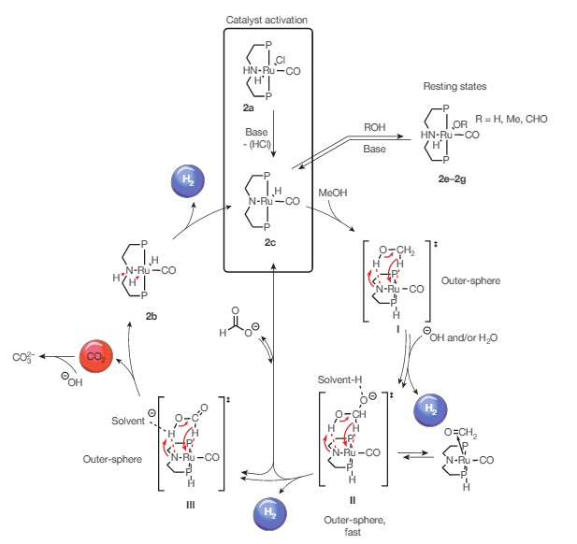
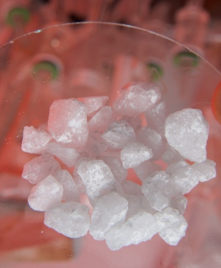
Moving Forward With EIA Trends – Methanol Dehydrogenation
Energy Related Hydrogen Emission
Rubidium Catalyst
(18A)
(18B)
Fig. 18. (A) Rubidium based methanol dehydrogenation which improves the pressure and temperature at which hydrogen can be released. (B) The rubidium catalyst which makes this process possible.
Nuclear, Plasma, and Radiological Eng.
University of Illinois
April 8th 2016
498 ES – Energy Presentation

Slide 17
References
Identify the Contributing Articles
United States Government Energy Information Agency (EIA)
  Specifically the 2015 outlook publication
Nature Letters (Look up the impact factor of Nature)
Car companies Tesla, Nissan and Toyota
Nuclear, Plasma, and Radiological Eng.
University of Illinois
April 8th 2016
498 ES – Energy Presentation

