Slide 1
Microgrids for Distributed Generation in Developing Countries
Nicholas Rivera

Slide 2
Agenda
Perspective
Microgrids
Distributed Generation
Rural Electrification
Case Study
Takeaways

Slide 3
Putting things into perspective
Over 1.2 Billion people do not have access to electricity
  550M in Africa
  300M in India
Current approach is to extend central grid
  Can be inefficient due to lack of capital and stresses to grid
Multiple models to consider
  For-Profit
  Partially-Subsidized
  Fully Subsidized

Slide 4
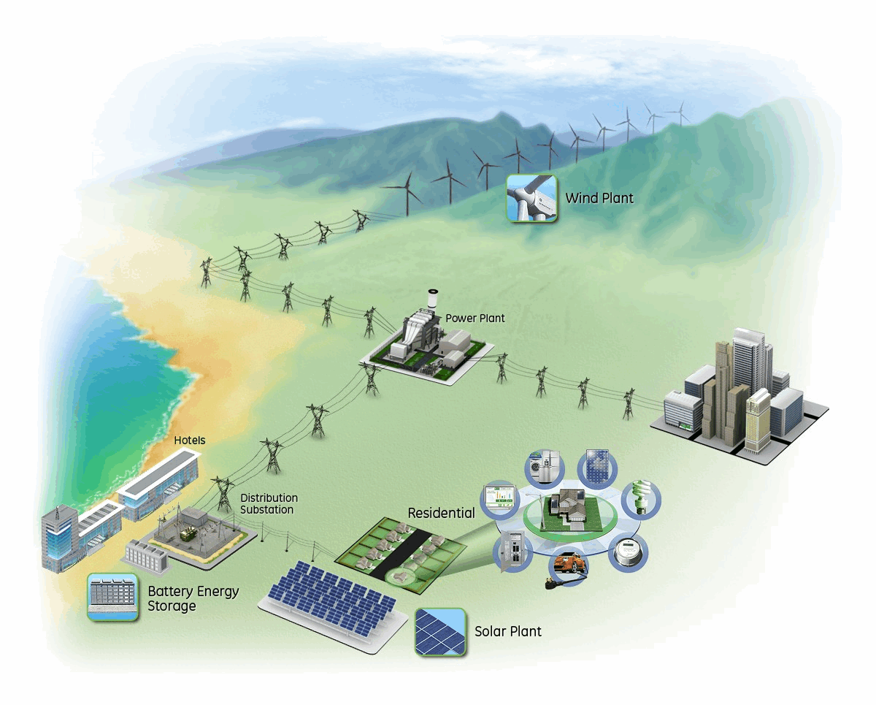
What is a Microgrid?
Localized vs. vast
Achieve local goals
  Reliability
  Carbon emission reduction
  Diverse energy portfolio
  Less transmission losses
Function independently of, but still network with, the larger grid

Slide 5
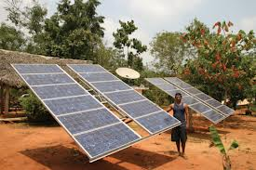
Distributed Generation
Microgrids employ
  Diesel (most common)
  Solar photovoltaics
  Hydro
  Biomass
  Wind-diesel
  PV-diesel
Often smaller scale/modular
Can help prevent local blackouts/brownouts

Slide 6

Rural Electrification - Benefits
Replace low quality energy sources with cheaper, more efficient sources
Electric lighting vs. kerosene lamps
Improved health due to less reliance on biomass fuel
Increased local education
Wage improvement
Increased potential for demand side management

Slide 7
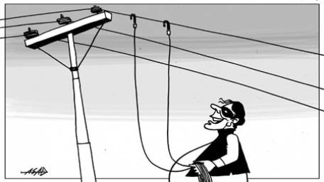
Rural Electrification - Challenges
Lack of technical and business skills
Difficulty limiting individual consumption
Theft
Community involvement needed throughout process
Penalty enforcement

Slide 8
Case Study: West Bengal Renewable Energy Development Agency (WBREDA)
State agency tasked with implementing renewable energy
Installed over 20 microgrids since 1993
  18 PV
  3 biomass
  1 biomass/PV hybrid
  1 wind/diesel hybrid
WBREDA and municipal government split ownership of grids
In some of the microgrid communities, beneficiary committees have assumed responsibilities of monitoring usage and enforcing penalties

Slide 9
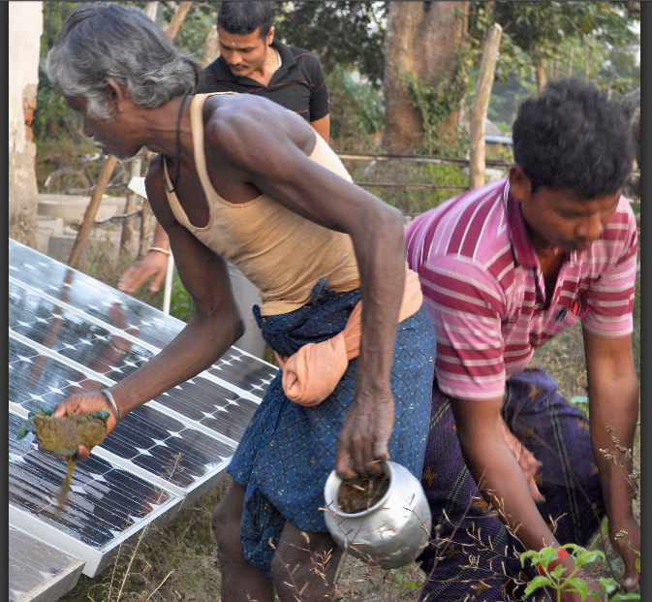
WBREDA: Economics
100% government subsidized microgrids
Tariffs collected fund O&M expenses
  Salaries of maintenance contractor, linemen, spare parts
Although existent for multiple years, there has been a price decrease from $12,000/kW installed to $4500/kW installed
  It is speculated that as of 2013, unit costs declined to $1800/kW installed
Individuals pay for a fixed amount of energy
  Unit cost can vary by usage

Slide 10
WBREDA: Challenges
Electrification allowed for some individuals to obtain higher incomes
In general, higher disposable income correlates to higher electricity consumption
Increase in energy intensive appliance use
Effort to control usage using current limiters
  Quickly rendered useless
Performance may decrease or zero out upon the arrival and integration of the central grid

Slide 11
Key Takeaways
Microgrids can solve localized energy challenges
When paired with distributed generation, consumers can be more active in selecting their energy sources
Rural electrification can increase quality of life, public health, and financial stability (due to job creation)
Despite benefits, there are always challenges to address

Slide 12
References
Department of Energy. "Energy.gov." Distributed Energy. N.p., n.d. Web. 19 Nov. 2014.
Galvin Power. "What Are Smart Microgrids?" Home. N.p., n.d. Web. 19 Nov. 2014.
Schnitzer, Daniel, Deepa S. Lounsbury, Juan P. Carvallo, Ranjit Deshmukh, Jay Apt, and Daniel M. Kammen. Microgrids for Rural Electrification. Rep. United Nations Foundation, n.d. Web. Feb. 2014.

