Slide 1
Lead-Acid Battery 'Regeneration' with bacteriophages to Improve Battery life and reduce waste
Melixa Rivera-Sustache
NPRE 498
Prof. M. Ragheb
Fall 2014

Slide 2
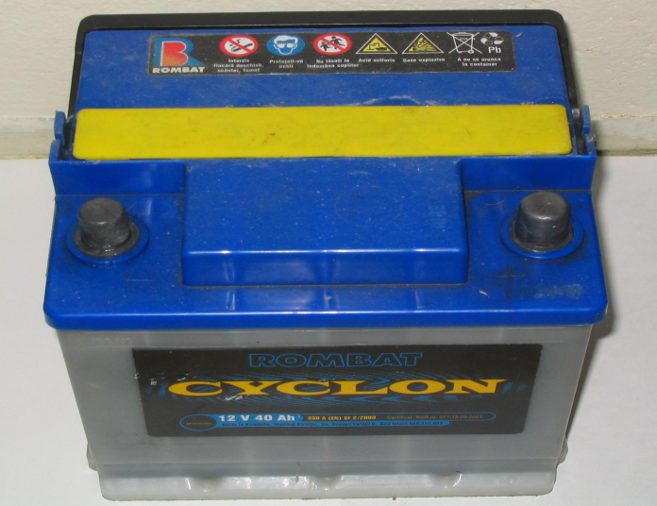
Lead Acid Batteries
Lead acid batteries continue to be one of the most widely used rechargeable batteries with 70% of the worldwide secondary battery market ($36 billions) in 2008. [1]
They have a relatively short life cycle (~500 cycles) and must be replaced frequently resulting in increased replacement costs.

Slide 3
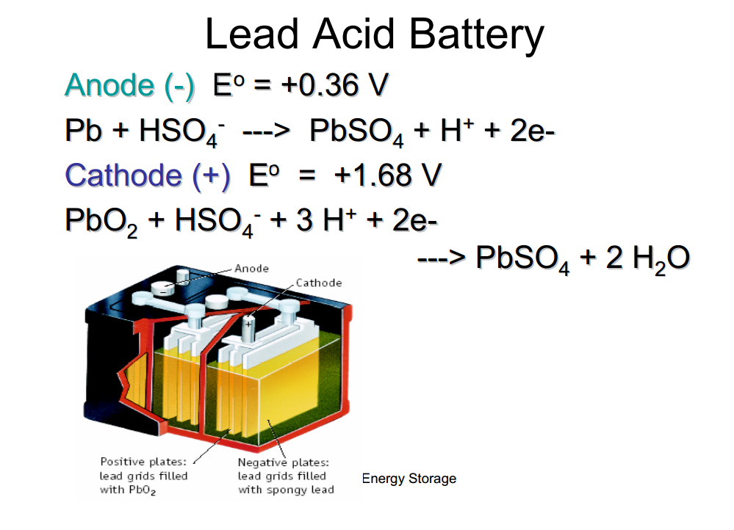
The Electrochemistry
Negative plate reaction:
Resource: www.mragheb.com

Slide 4
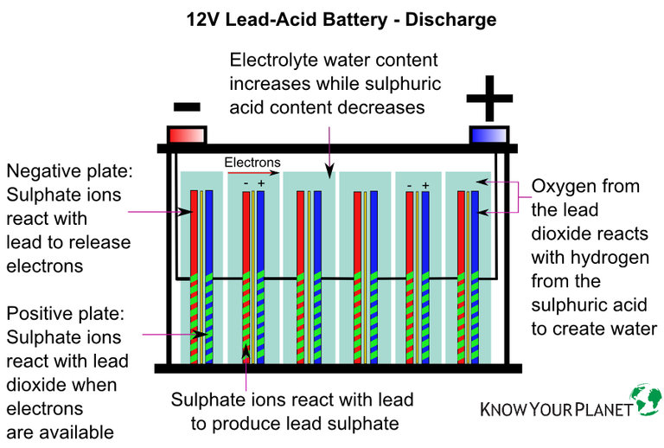
How do they work ?

Slide 5
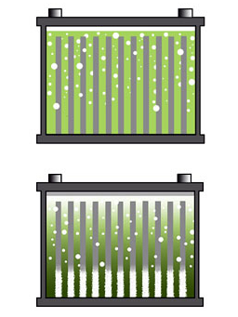
Issues with Lead Acid Batteries
Lead-acid batteries designed for starting automotive engines are not designed for deep discharge. Repeated deep discharges will result in capacity loss and ultimately in premature failure, as the electrodes disintegrate due to mechanical stresses that arise from cycling.
Stratification
A light acid limits plate activation, promotes corrosion and reduces performance.
High acid concentration on the bottom, on the other hand, artificially raises the open circuit voltage. The battery appears fully charged but provides a low CCA.
High acid concentration also promotes sulfation and decreases the already low conductivity further.
http://batteryuniversity.com/learn/article/what_causes_car_batteries_to_fail

Slide 6
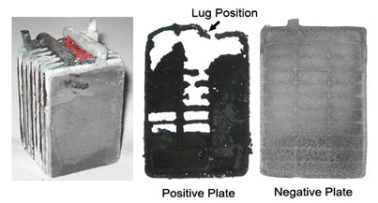
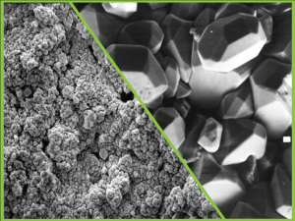
Sulfation
Sulfation occurs when a lead acid battery is deprived of a full charge (prolonged charge deprivation).
This is common with starter batteries in cars driven in the city.
Solar cells and wind turbines do not always provide sufficient charge.
www.hydrabatteriessolutions.com

Slide 7
Types of Sulfation
Reversible (or soft sulfation), and Permanent (or hard sulfation)
Existing Reversible Sulfation Process:
Applying an increased over potential to a fully charged battery between 2.50 and 2.66V per cell in the form of a regulated current 200mA for 24 hours.
Permanent Sulfation, no current methods availabe to breakup the “hard sulfation” thus recycling methods are currently applied.

Slide 8
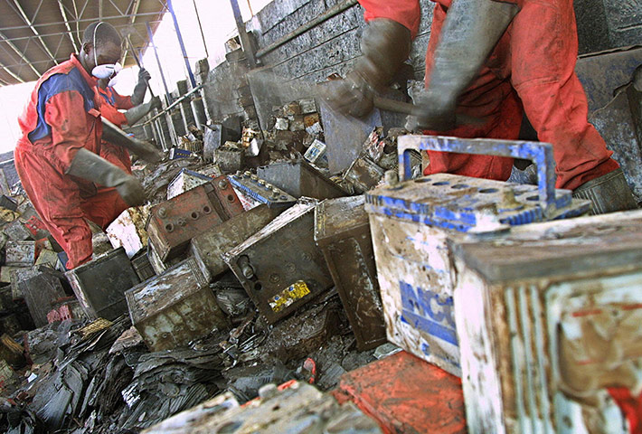
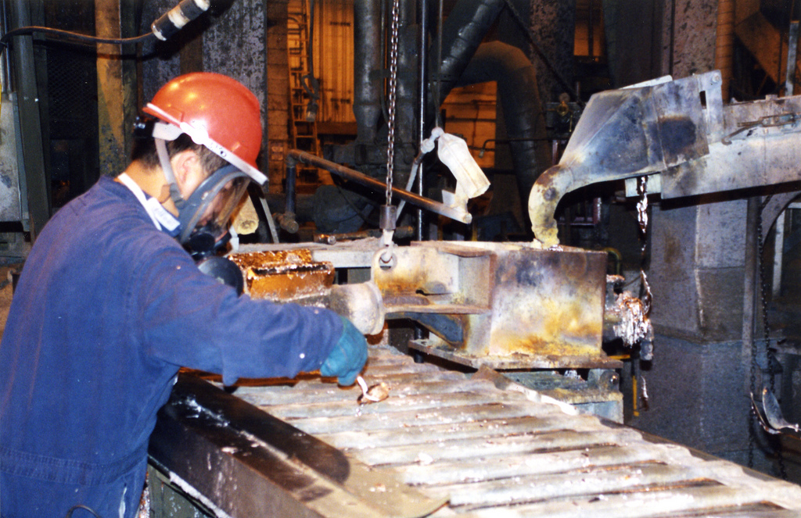
Recycling Lead Acid Batteries
Once the lead acid battery ceases to be effective, it is unusable and deemed a used lead acid battery (ULAB), which is classified as a hazardous waste.

Slide 9
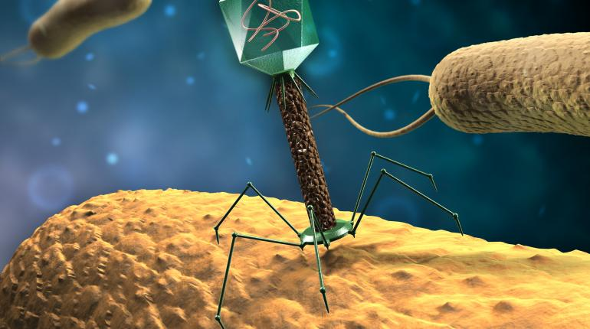
Potential Solution for Hard Sulfation
Use bacteriophages for sulfate regeneration.
A bacteriophage is a virus
that infects and replicates within a bacterium. The term is derived from 'bacteria' and the Greek φαγεῖν phagein "to devour".

Slide 10
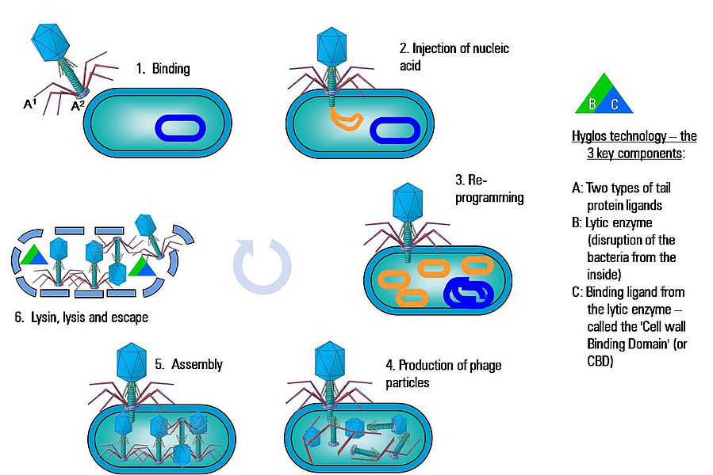
Phage Cycle
https://www.youtube.com/watch?v=ehbZpo8oXSs

Slide 11
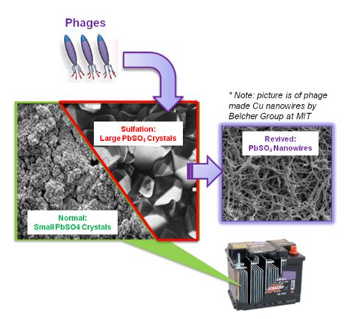
Main Idea
The phage would break up the hard sulfation by dissolving the PbSO₄ and re-depositing the PbSO4 into phage based material structures that are more electrically conductive and have higher surface area and porosity.

Slide 12
What’s currently done with M13 Bacteriophage (MIT research)
M13 bacteriophage is attracted to inorganic materials.
Each virus can be coated with gold and cobalt oxide and that transforms it into a scrap of nanowire. When combined the viruses in chain-like fashion, they form a film that can act as anode or the part of a battery that carries a negative ionic charge.

Slide 13
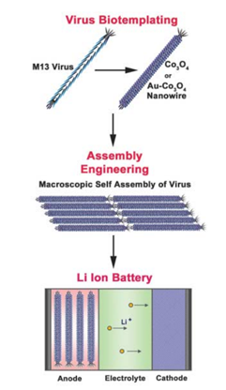
Li-ion Battery M13 Anode
The virus essentially acts as a “biological scaffold”.

Slide 14
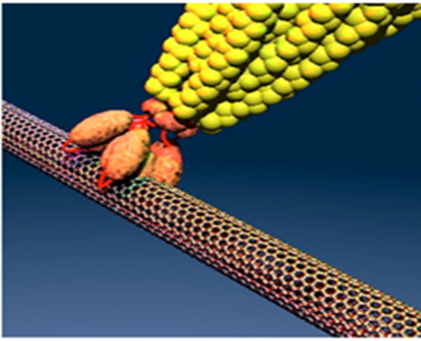
M13 cathode
MIT team have used viruses that would be attracted to iron phosphate and carbon nanotubes (cylindrical carbon molecules frequently used in nanotechnology). This way they have created a highly conductive substance whose weight is negligible. [9]

Slide 15
Today
A virus-battery prototype M.I.T. built exists as a coin cell, similar to the ones found in watches and calculators, and they’ve used it to turn on some small lights in the lab. In terms of energy storage, a third of an ounce (10 grams) of the viral battery material could power an iPod for 40 hours, according to Belcher.
MIT team believe the technology would be more suited for making big, high performance batteries for hybrid cars and the like rather than to fuel small electronic devices. But they acknowledge it will be a challenge to scale up the technique to build batteries large enough to power big machines. “Cell phones are not too hard size-wise,” says Belcher. “But getting up to kilograms [for car batteries], that’s harder.”
Belcher also notes that a viral battery used to power, say, a hybrid car “would not need any more mass than current batteries, and you’d actually get a bit more power.”

Slide 16
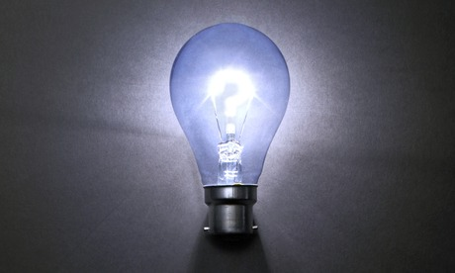
Questions?

Slide 17
References
http://batteryuniversity.com/learn/article/what_causes_car_batteries_to_fail
http://batteryuniversity.com/learn/article/sulfation_and_how_to_prevent_it
http://www.barkeraircraft.com/files/Pulse3_web_layout_.pdf
https://microbewiki.kenyon.edu/index.php/Virus_Selection_for_Lithium_Ion_Battery_Formation
http://batteryuniversity.com/learn/article/types_of_lithium_ion
http://www.alternative-energy-news.info/mit-completes-virus-built-nanomachine-battery/
http://www.scientificamerican.com/podcast/episode/viruses-make-a-battery-09-04-06/
http://www.worstpolluted.org/projects_reports/display/65
http://www.scientificamerican.com/blog/post/virus-battery-sick-power-2009-04-02/?id=virus-battery-sick-power-2009-04-02

