Slide 1
Sulfur-Iodine Thermochemical Rxn.
1. 2H₂O_{(l)} + SO_{2(g)} + I_{2(l)}→ H₂SO_{4(l)} + 2HI_{(l)} 120°C
Bunsen Reaction
2a. H₂SO_{4(l)} → H₂O_{(g)} + SO_{3(g)} ~850°C
2b. SO_{3(g)} → SO_{2(g)} + 0.5O_{2(g)} ~500°C
3. 2HI (g) → I_{2(l)} + H_{2(g)} ~400°C

Slide 2
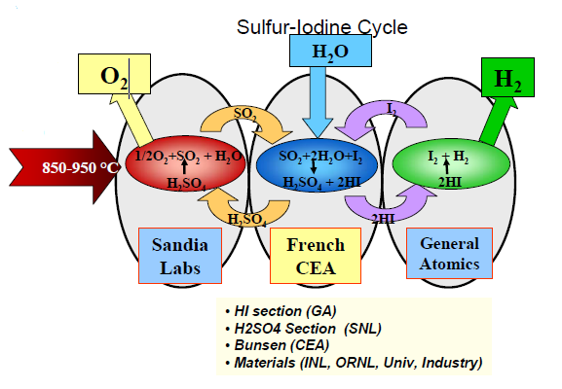

Slide 3
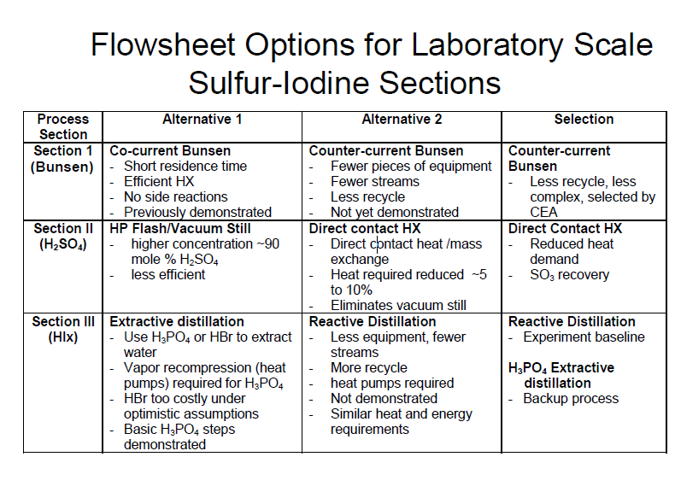

Slide 4
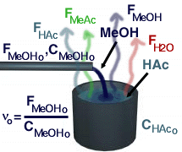

Reactive Distillation
Equilibrium of reversible reaction highly temperature dependent
A + B  C + D
Using L’Chatlier’s Principle:
A + B  C + D
Heating mixture and extracting product will push reaction to right

Slide 5
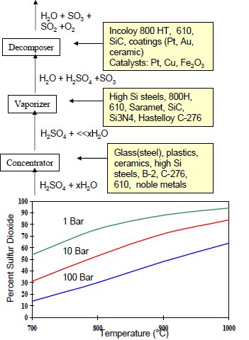
Vacuum Distillation
Each stage considered for the sulfur process (DOE) 
Low pressures (compared to the bunsen reactor) allows for high distillation
Note materials consideration
http://www.hydrogen.energy.gov/pdfs/review05/pd27_pickard.pdf

Slide 6
Materials
Corrosive environment – H₂SO₄ , HI, H₃PO₄
High temperature
Closed system – three part reaction
Iodine section may generate residual solids

Slide 7
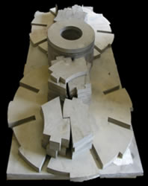
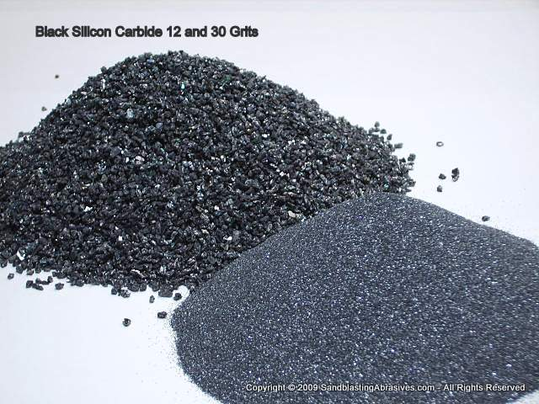
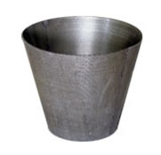
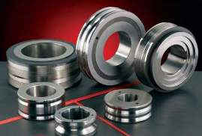
Incoloy 800H:
Nickel-iron-chromium alloy, high strength, resistant to oxidation and carburization, temperatures above 1100°F
Pt, Au, SiC coating
Very unreactive, ceramics and other polymer coatings a consideration
Pt, Cu, Fe₂O₃
Catalysts, Cu and Fe₂O₃ cheap
Hastelloy C-276 (B-2)
Nickel-moly-chromium superalloy with resistance to corrosion and oxidation
Saramet
“Sulphuric acid resistant alloy metal”; due to high Si content – a.k.a. Si steels, with chromium and nickel balance

Slide 8
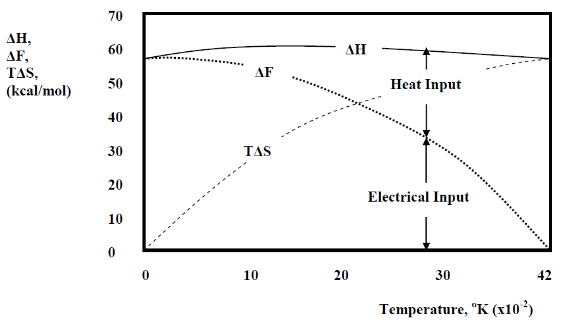
Against other methods
Steam reforming – CH₄ + H₂O → CO + 3 H₂
CO + H₂O → CO₂ + H₂
Doesn’t cut out carbon emission
High or low temp electrolysis: H2O → O₂ + H₂
Needs extremely high temperatures for efficiencies ~45%
Others - methanol:
CO₂ + 3H₂ → CH₃OH + H₂0
- dimethyl ether CH₃OCH₃
- Ammonia NH₃

Slide 9
DOE Hydrogen Program
2002 – 2008 (report in 2005 states 25% progress towards objectives)
Funding – $4.2M
Sandia Labs – H₂SO₄ reactor
CEA (Commissariat à l'énergie atomique) – Bunsen reactor
General Atomics (Japan) – Iodine Reactor/H₂ extractor

Slide 10
Very High Temperature Reactor (VHTR)
“To produce hydrogen economically, a reactor must operate at extremely high temperatures. Thus the VHTR has been selected for future hydrogen production plants. ‘The VHTR has the highest priority among the U.S. reactor concepts,’ [Bill] Corwin says, ‘because it fits into the President's plan for the hydrogen economy.’”
-”Can the Next Generation Take the Heat?” ORNL Review. http://www.ornl.gov/info/ornlreview/v37_1_04/article_02.shtml. 30 Nov 2010.
Current R&D – DRAGON, Peach Bottom
ONRL – NGNP design: graphite moderated
Metal-cooled fast reactors
Gas-cooled reactors: pebble bed
Numerous other designs, narrowed down by the DOE in the past two years
Deployment anticipated 2025
Varied fuel types and coatings – if outlet 900°C, fuel needs 1300°C

Slide 11
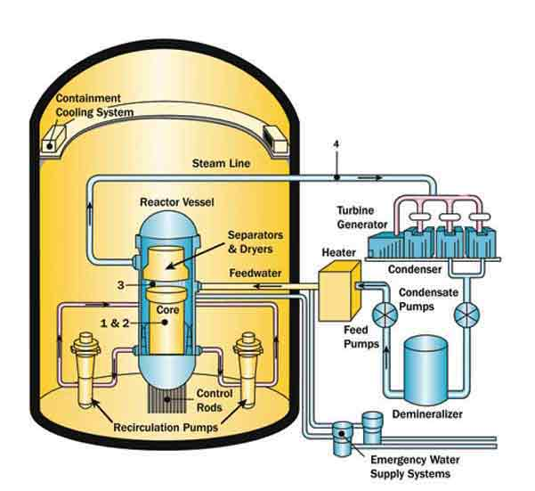
Boiling Water Reactor (BWR)
Constrained by coolant
Low fuel temperature (compare PWR)
Larger pressure vessel – higher cost
PWRs: ~10% higher performance, increased temperature, but also has a ceiling

Slide 12
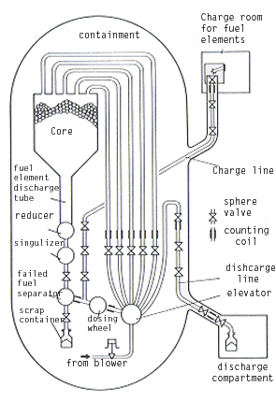
Pebble Bed Reactor
Helium coolant: low density – collisions minimized
High flow for low specific heat capacity
Significant lethargy – slow neutrons (though graphite requires more collisions)
300,000 pebbles, 350 discarded daily
Involved fuel handling process

Slide 13
Sodium-Cooled Fast Reactor (SFR)
Closed fuel cycle
Two lines of flow – HX between Pb and H₂O
Fertile uranium, plutonium, and other actinides
Operates near ambient pressure
Difficulties with VHTR: Na melting point – 98°C
(At ambient pressure) Na boiling point – 883°C
Na highly reactive and corrosive

Slide 14
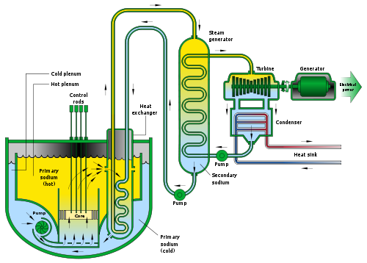
Sodium-Cooled Fast Reactor

Slide 15
Lead-Cooled Fast Reactor (LFR)
Lead/Bismuth coolant
Very similar to SFR – closed system liquid metal
Replaceable fuel module, designed to run 15-20 years
Designed to meet the needs of a small grid
Following design features U-Tube HX
Another Gen. IV design replaces liquid metal with helium, maintaining similar design but with varied HX

Slide 16
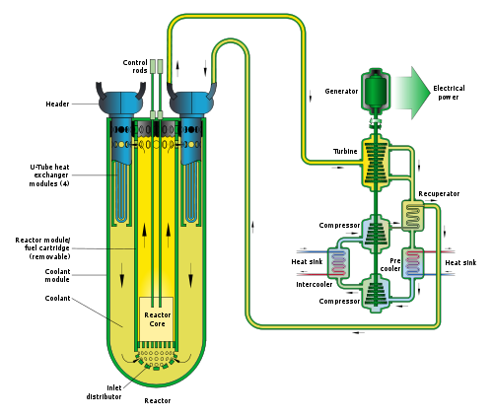
Lead-Cooled Fast Reactor

Slide 17
Advantages
Only liquid and vapor for fluid cycle
Sulfur and iodine components remain in system, H₂ and O₂ distilled out
Chemicals relatively cheap (HBr out of consideration)
Existing R&D – actualization is not too far off
Functional with intermittent renewables or unused heat of gen. IV reactors
No carbon footprint
Ƞ ~ 50%, beats HT electrolysis

Slide 18
Disadvantages
Three components, cumbersome setup
Full cycle has not been perfected
Corrosive intermediates (HI, H₂SO₄, H₃PO₄)
High materials cost
Much R&D still necessary
Must wait on nuclear technology to advance – subject to public opinion, economy, legislature
Large scale necessary for satisfactory efficiencies (investment)

Slide 19
References
“Boiling Water Reactors”. Nuclear Regulatory Commission. Oct 1 2008. <http://www.nrc.gov/reactors/bwrs.html>. 30 Nov 2010.
“Can The Next Generation Take The Heat?” Oak Ridge National Lab Review. Volume 37, Number 1, 2004. <http://www.ornl.gov/info/ornlreview/v37_1_04/article_02.shtml>. 30 Nov 2010.
Mashue, Timothy; Folger, H. S. “Reactive Distillation”. University of Michigan. 1998. <http://www.engin.umich.edu/~cre/web_mod/distill/>. 10 Nov 2010.
Mathias, Paul M.; Brown, L. C. “Thermodynamics of the Sulfur-Iodine Cycle for Thermochemical Hydrogen Production”. Society of Chemical Engineers, 68th annual meeting. 23 Mar 2003. <http://www.aspentech.com/publication_files/TP51.pdf>. 30 Nov 2010.
“Modular Pebble Bed Reactor”. MIT Department of Nuclear Science and Engineering. <http://web.mit.edu/pebble-bed/>. 30 Nov 2010.
Ogawa, Masuro; Lensa, W. v. “Very High Temperature Gas Cooled Reactor (VHTR)”. Generation IV R&D Scope Meeting. 25 Jun 2002. <http://gif.inel.gov/roadmap/pdfs/p_grns_june_25-27_presentation_gp32-00.pdf>. 30 Nov 2010.
Pickard, Paul. “2005 Hydrogen Program Review: Sulfur-Iodine Thermochemical Cycle”. Sandia National Labs; U.S. Department of Energy. May 25 2005. <http://www.hydrogen.energy.gov/pdfs/review05/pd27_pickard.pdf>. 30 Nov 2010.
Ragheb, Magdi. “HIGH TEMPERATURE WATER ELECTROLYSIS FOR HYDROGEN PRODUCTION”. University of Illinois – Champaign-Urbana. 19 Oct 2010. <https://netfiles.uiuc.edu/mragheb/www/NPRE%20498ES%20Energy%20Storage%20Systems/High%20Temperature%20Water%20Electrolysis%20for%20Hydrogen%20Production.pdf>. 30 Nov 2010.
Sponseller, Mike. “Lead-Cooled Fast Reactor (LFR)”. Idaho National Laboratory. <http://www.inl.gov/research/lead-cooled-fast-reactor/>. 30 Nov 2010.
Sponseller, Mike. “Sodium-Cooled Fast Reactor (SFR)”. Idaho National Laboratory. <http://www.inl.gov/research/sodium-cooled-fast-reactor/>. 30 Nov 2010.

