Slide 1
Factors and Feasibility of obama energy plan with regards to renewables
James Babiarz
NPRE 498ES

Slide 2
Target Goal
By the year 2025 renewable energy with account for 25% of all energy produced in the United States

Slide 3
Power Overview
Table 1.1 Primary Energy Overview, 1989-2009
(Billion Btu)
Year | Production
 | Fossil | Electric | Renewable | Total |  | Net Imports ¹
 | Fuels ² | Power | Energy ³ |  | Total ⁵ | Total | Total Produced and Imported | Change over previous year
1990 | 58,559,602 | 6,104,350 | 6,206,027 | 70,869,979 | 18,817,264 | 14,064,785 | 84,934,764 | xxxx
1991 | 57,871,727 | 6,422,132 | 6,237,473 | 70,531,332 | 18,334,826 | 13,193,866 | 83,725,198 | -1.424111804
1992 | 57,655,059 | 6,479,206 | 5,992,172 | 70,126,437 | 19,372,208 | 14,435,270 | 84,561,707 | 0.999112597
1993 | 55,822,084 | 6,410,499 | 6,261,220 | 68,493,804 | 21,272,544 | 17,014,176 | 85,507,980 | 1.119032519
1994 | 58,043,637 | 6,693,877 | 6,153,209 | 70,890,723 | 22,389,924 | 18,328,779 | 89,219,502 | 4.340556285
1995 | 57,540,133 | 7,075,436 | 6,700,769 | 71,316,338 | 22,260,469 | 17,749,599 | 89,065,937 | -0.172120441
1996 | 58,387,225 | 7,086,674 | 7,164,759 | 72,638,657 | 23,701,776 | 19,068,516 | 91,707,173 | 2.965483875
1997 | 58,856,635 | 6,596,992 | 7,177,141 | 72,630,769 | 25,215,350 | 20,701,363 | 93,332,132 | 1.771899566
1998 | 59,314,068 | 7,067,809 | 6,654,925 | 73,036,802 | 26,580,676 | 22,281,476 | 95,318,278 | 2.128040962
1999 | 57,614,483 | 7,610,256 | 6,678,315 | 71,903,053 | 27,252,257 | 23,537,258 | 95,440,311 | 0.128026862
2000 | 57,366,013 | 7,862,349 | 6,257,018 | 71,485,380 | 28,972,779 | 24,966,904 | 96,452,284 | 1.060320308
2001 | 58,541,347 | 8,028,853 | 5,312,354 | 71,882,553 | 30,156,633 | 26,386,189 | 98,268,742 | 1.883271111
2002 | 56,893,563 | 8,145,429 | 5,892,458 | 70,931,450 | 29,407,132 | 25,738,702 | 96,670,152 | -1.626753297
2003 | 56,099,243 | 7,958,858 | 6,138,713 | 70,196,814 | 31,060,518 | 27,006,897 | 97,203,711 | 0.551937686
2004 | 55,895,355 | 8,221,985 | 6,235,014 | 70,352,355 | 33,543,175 | 29,109,865 | 99,462,220 | 2.323480222
2005 | 55,037,660 | 8,160,810 | 6,393,401 | 69,591,871 | 34,709,920 | 30,148,981 | 99,740,852 | 0.280138529
2006 | 55,968,153 | 8,215,414 | 6,773,640 | 70,957,207 | 34,673,006 | 29,805,026 | 100,762,233 | 1.024034766
2007 | 56,447,084 | 8,455,364 | 6,705,528 | 71,607,975 | 34,685,121 | 29,237,533 | 100,845,508 | 0.082645052
2008 | 57,613,054 | 8,427,297 | 7,380,966 | 73,421,316 | 32,951,874 | 25,936,025 | 99,357,341 | -1.475689924
2009^{P} | 56,859,891 | 8,349,279 | 7,760,850 | 72,970,019 | 29,781,081 | 22,849,185 | 95,819,204 | -3.56102223

Slide 4
Power Overview continued
Varying changes in power produced per year
Recent rapid growth in renewable energy
Recent decrease in imported energy (mostly petroleum)

Slide 5
Power Goals
Over 19 years the average rate of Power change is .6525%
Applied until 2025 this would require around 2000GW of renewable energy at 25%.

Slide 6
Perspective
The world produced 1230 GWe of renewable energy in 2009
If renewable energy increase at the an average rate of 7% it will cover 9.3% of the US production in 2025
If we can double that to 14% per year we can meet the goal of 25% by 2025

Slide 7
Factors not inclduded
Estimating Power for the next 20 years is not as easy and applying on average of growth rates
  Economic Factors
  Technology Factors
  Replacements of Facilities
  Environmental Restrictions
  Population growth

Slide 8
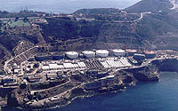
Wastewater Treatment
Point Loma, San Diego CA
4.5 MW plant
Powered by waste of 2.2 Million people
Keeping the same people to power ratio we can generate 687 MW nation wide
Reduces emissions

Slide 9
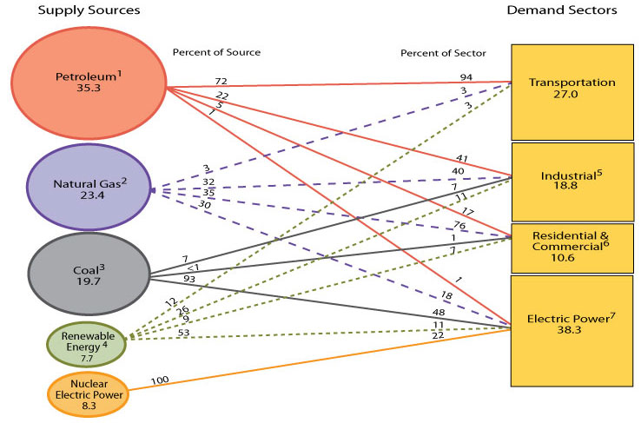
Transportation
Transportation accounts for 27% of the Nations Power consumption

Slide 10
Transportation Continued
60% of transportation energy is light cars and trucks
“The Billion Ton Review” by ORNL suggests 30% biofuels by 2030 is feasible
30% of the estimated required transportation energy would be 648GW in 2025
An increase of 10% efficiency by 2025 would also save 216GW

Slide 11

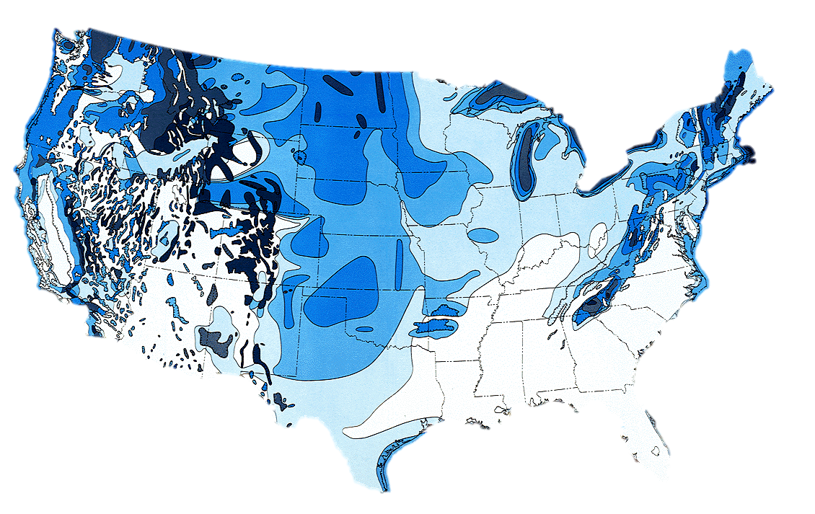
Wind Power
200,000 10MW turbines at 35% efficiency
Span 16,700 square miles
Would account for 700 GW of power

Slide 12
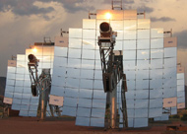
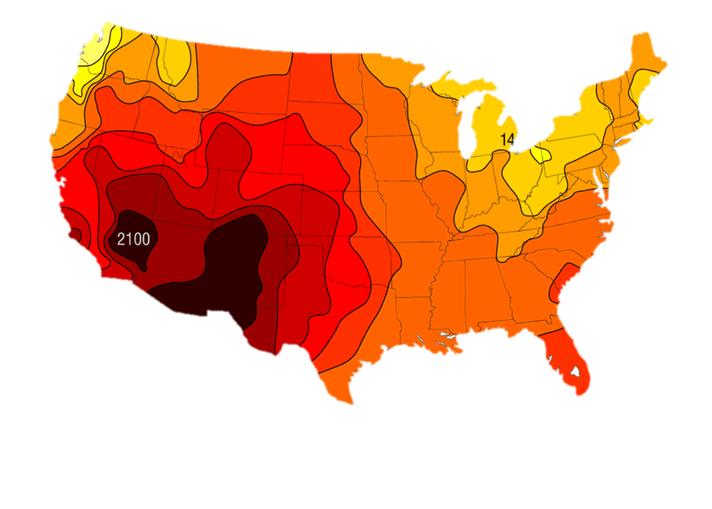
Solar Thermal
348 GW required to meet remainder of 2000 GW goal
Requires 5,875 sq. feet approximately 1/5th of the Mojave dessert

Slide 13
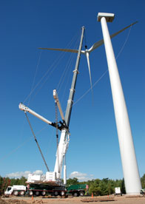
Problems
Production
Energy Storage
Energy Transmission
Construction
COST!!

Slide 14
Easy Solution!!
Conservation is the Key!!!
If the total energy produced in the US reduced by 10% from 2009
  541GW would be the new target (almost 25% less)
    175 GW from bio fuels
    300 GW from wind power
    66 GW from Solar energy farm

