Slide 1
Metal-Air batteries
NPRE 498 Energy Storage Systems
Garrett Gusloff
11/21/2014

Slide 2
Outline of discussion
Introduction
Where do they fit?
Characteristics of metal-air batteries
Performance
Zinc-Air batteries
Characteristics
Chemistry involved
types
Lithium-Air batteries
Characteristics
Reusability
Challenges
Conclusion

Slide 3
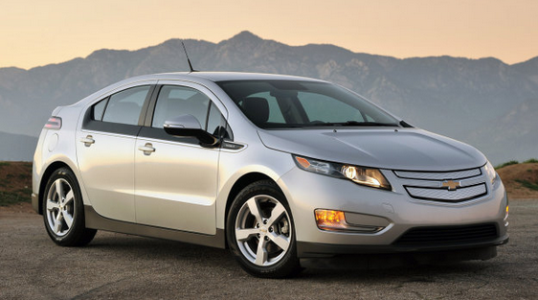
Where batteries fit
Every day technology is advancing and new electrical devices are being invented. These devices require high energy density and high power density source devices to power them.
Technology like electric cars have shown the Li-ion batteries have the ability to meet these demands.

Slide 4
Characteristics of Metal-air Batteries
Major advantages:
High energy density
Can store more energy than similar Li-ion batteries
Flat discharge voltage
Long dry storage or “shelf life”
In terms of the metal used
  Non toxic
  Low cost
Major disadvantages:
Once open to the air, limited lifetime
Limited power density
Limited temperature range during operation
Some of the metals are highly reactive in water

Slide 5
Metal-Air Battery Properties
Metal-Air batteries are usually divided into aqueous and non-aqueous categories.
They can also be divided into categories as primary, secondary, or ‘refuelable’.
Several metals considered:
Metal-Air Battery | Calculated open-circuit Voltage (V) | Theoretical Specific energy (Wh/kg)
 |  | With Oxygen | Without Oxygen
Al-O2 | 1.20 | 4300 | 8140
Ca-O2 | 3.21 | 2990 | 4180
Li-O2 | 2.91 | 5210 | 11140
Mg-O2 | 2.93 | 2789 | 6462
Na-O2 | 2.30 | 1677 | 2260
Zn-O2 | 1.65 | 1090 | 1350

Slide 6
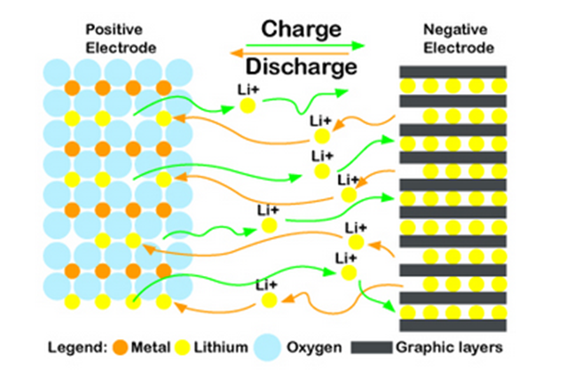

Zn-Air Batteries
Brief History: Zinc was the first metal that was used for a metal-air battery. It was the most stable in water and alkaline electrolytes without significant corrosion.
Chemistry behind the zinc-Air battery:
Catalytic active layer:
$O_{2}+2H_{2}O+4e^{−}→4OH^{−}$ (Oxygen Reduction Reaction)
Gas Diffusion layer:
$Zn→Zn^{2+}+2e^{−}$
$Zn^{2}+4OH^{−}→Zn{\left(OH\right)}_{4}^{2−}$
$Zn{\left(OH\right)}_{4}^{2−}→ZnO+H_{2}O+2OH^{−}$

Slide 7

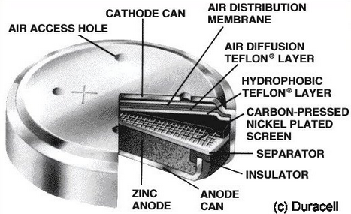
Types of Zn-Air Batteries
Primary zinc-Air batteries have many uses and have been in the real world for many years.
  At the beginning they were larger batteries used to power ocean navigational units as well as railroad signaling systems.
  Later, they were developed to be smaller and power electronics and small mechanical devices.
Rechargeable zinc-air battery technology, does it exist?
  Not yet. Non-uniform zinc deposition paired with limited solubility of the reaction products limits the rechargeability of the system.
  HOWEVER, they are refuelable!

Slide 8
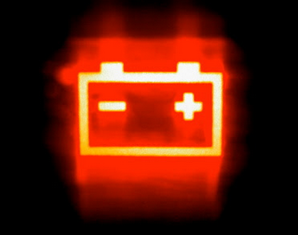


Lithium-Air Batteries
Why Li-Air batteries?
  Extremely high specific capacity
    $3842 mAhg^{−1} vs. 815 mAhg^{−1}$ (Li-air vs. Zn-air anode material)
  The Couples Open-Circuit Voltage
    $2.91 V vs. 1.65 V$ ( Li-air vs. Zn-air)
  Li-Air batteries ARE electrically rechargeable! This is a huge advantage to other metal-air battery systems.
  It is important to note that Li-air batteries are still in the development stage, their experimental parameters still fall short.

Slide 9


Li-Air Battery Rechargeability
Looking at the anode and cathode reactions:
  Anode - $Li^{s}→Li^{+}+e^{−}$
  Cathode reaction - $Li^{+}+\frac{1}{2}O_{2}+e^{−}→\frac{1}{2}Li_{2}O_{2}$
  It was determined in 2006 by Bruce et al. that Li2O2 is formed on charging. This results in a chargeable material.
  It decomposes according to the following reaction:
    $Li_{2}O_{2}→O_{2}+2Li^{+}+2e^{−}$

Slide 10
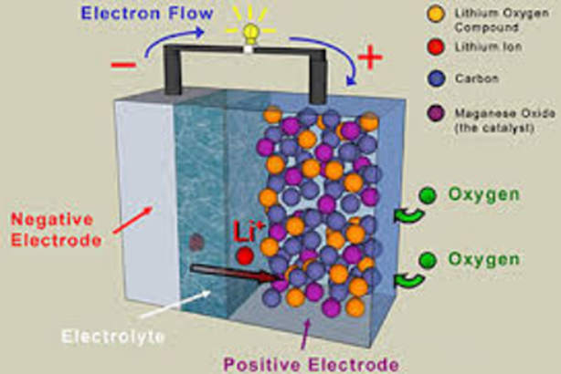
Lithium-Air Battery Cathode and Anode
Cathode reaction delivers almost all of the energy. This happens because most of the cell voltage drop occurs at the air cathode.
It has been theorized that the non-aqueous Li-air energy falls sort of the theoretical values. This is because the discharge terminated before all of the pores were filled with Lithium Oxide.
  This can in fact, be neutralized by the development of new cathodes, developing catalysts that can change the lithium-oxide deposits, or by additives that improve the solubility of the system.

Slide 11
Final Comparison
Zn-Air | Li-Air
Stable in moisture | Not stable outside in moisture
Zinc metal and aqueous electrolytes are inexpensive | Lithium and non-aqueous electrolytes are very expensive
Industry is already applying this technology | The technology is not quite there yet, more research is needed.
Poor reversibility | Reversible reactions
Low operating potential | Highest operation potential

Slide 12
Conclusion
Metal Air batteries offer huge benefits if their power can be harnessed and controlled in the proper way. They can be very useful in many different industrial applications if they are developed properly.
It is very important to continue the research on these types of systems. They going to be key in the future and they need to be explored more and more!

Slide 13
References
"Lithium Battery." Wikipedia. Wikimedia Foundation, 19 Nov. 2014. Web. 20 Nov. 2014.
"Zinc-air Battery Company Claims Novel Electrolyte Will Do The Trick (CT Exclusive)." CleanTechnica. N.p., n.d. Web. 20 Nov. 2014.
W. Qu, 'The Development of Materials and Components for Metal-air Battery Applications at NRC', 2014.
"What’s a Metal Air Battery and Why Is Tesla Interested in It?" Gigaom. N.p., n.d. Web. 20 Nov. 2014.
"New Metal-Air Battery Drives Car 1800Km Without Recharge." IFLScience. N.p., n.d. Web. 20 Nov. 2014.

