Slide 1
Decentralized Energy Production in Rural Areas – Focus on Anaerobic Digestion
Rubens Bragagnollo Filho
MSc Bioenergy
NPRE 498 – Energy Storage Systems
Email: bragagn2@illinois.edu

Slide 2
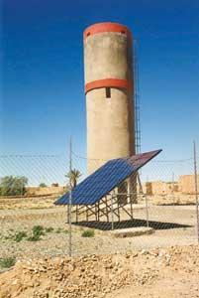
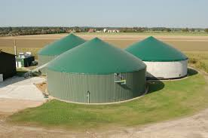
Renewable energy in rural areas
  Wind
  Solar → Water supply
  Biomass → Anaerobic Digestion

Slide 3
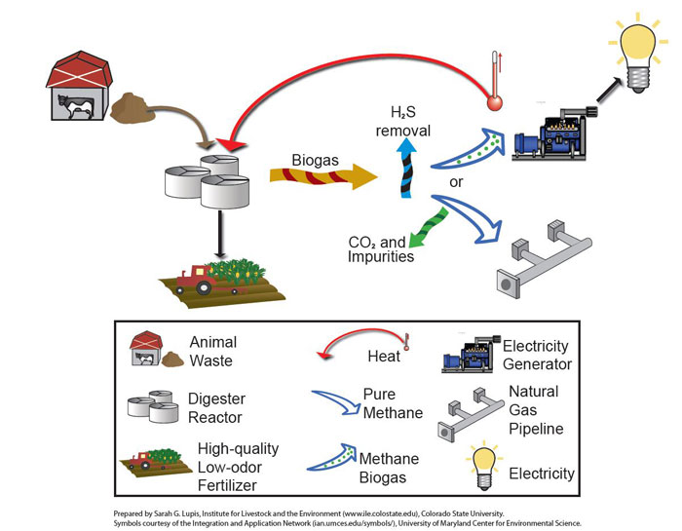
Anaerobic Digestion

Slide 4
Why Anaerobic Digestion?
Commercialized technology
Less odor
Pollution Control
Electricity/heat production → Revenue
Byproducts → Fertilizer and bedding material
GHG reduction
CAFOs: Over 1 million farms → ~ 9 million AU
Co-digestion → Food Waste

Slide 5
Production Assumptions
Production Measure | Units | Per cow per day | Per cow per year
Methane Weight | (lbs) | 1.37 | 500
Energy Value | (thousand BTU) | 30.9 | 11,279
Electricity | (KWh) | 2 | 730
Biomethane | (cubic feet) | 27.8 | 10,150
Digestate | (lbs) | 144 | 52,560
Carbon reduction for GHG credits | (kg/ CO₂ equivalent) | 20.4 | 7,450

Slide 6
Electricity Generation Potential
Animal Sector | Candidate Farms | MW | MWh/year | MMBtu/ year
Swine | 5,596 | 804 | 6,341,527 | 21,643,632
Diary | 2,645 | 863 | 6,802,914 | 23,218,346
Total | 8,241 | 1,667 | 13,144,441 | 44,861,978
About 200 systems operating currently

Slide 7
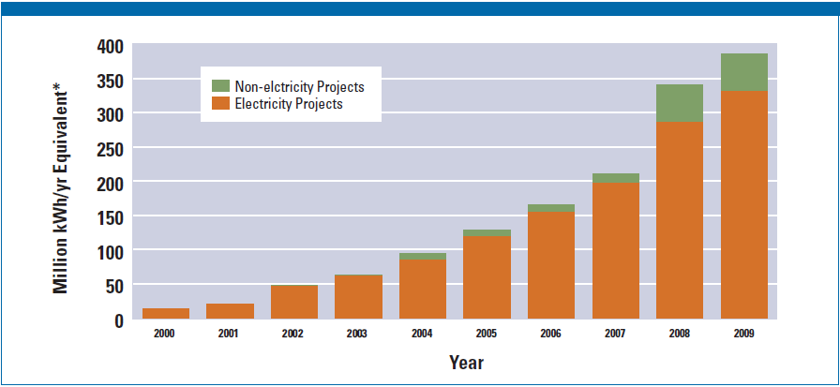
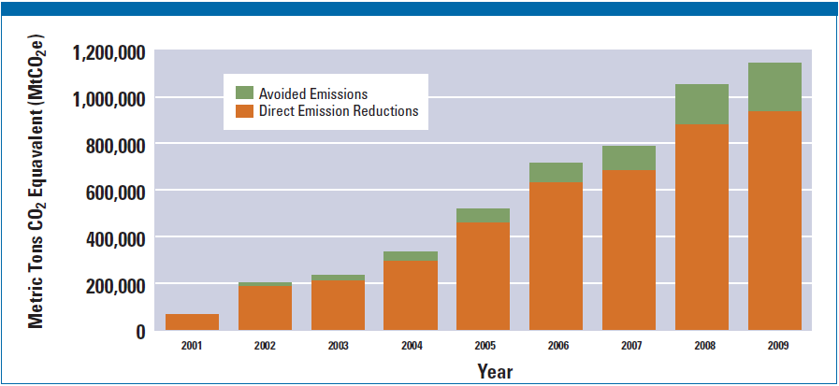

Slide 8
Study cases – Barker (2001)
National average on-site electrical usage: 550 kW/cow/year
Typical retail energy cost: $0.12 kWh → $66 per cow per year
A cow can generate: 876 kWh/cow/year → Surplus of energy
$ 39 per cow per year

Slide 9
Study cases – Wang et al. (2011)
Price premium of $0.04 kWh
Costumers volunteer to pay it (25, 50 or 100%)
1212 cows → 5,295 kWh per day → $958 revenue
Total revenue: $1,263 per day
By products: 26% of revenue
Bedding material 50% cheaper
Return on equity = 14.13% → Aprox. 8 years payback

Slide 10
Economics
Capital costs: Ranging from $2,785 to 15,422 $/kW
Natural gas prices are not expected to rise much
Electricity prices now at $0.12 per Kwh
Projects Financing
  USDA, Rural Energy for America, NRCS, etc.

Slide 11
Challenges
Power Purchase Agreement (PPA) – Utilities vs. Operator
  Buy-all-sell-all; surplus sale; net metering
Logistics:
  Co-digestion → Waste management
  Manure transportation: trucking vs. pipeline
  Community and centralized digesters
  Farming density and intensity
Biogas injection into natural gas pipelines
  Standardization
  PG&E (2010)

Slide 12
Questions?

Slide 13
References
http://www.nrcs.usda.gov/wps/portal/nrcs/detail/national/technical/nra/nri/?&cid=nrcs143_014121 , accessed November 12th, 2014.
U.S. Economics and Statistics Administration – ESA. (2011). Economic feasibility of dairy manure digester and co-digester facilities in the Central Valley of California. Sacramento, CA. ESA publishing: 209481
http://www.epa.gov/agstar/tools/financing/index.html , accessed November 13th, 2014.
http://www.epa.gov/agstar/documents/digester_status_report2010.pdf , accessed November 14th, 2014.

