Slide 1
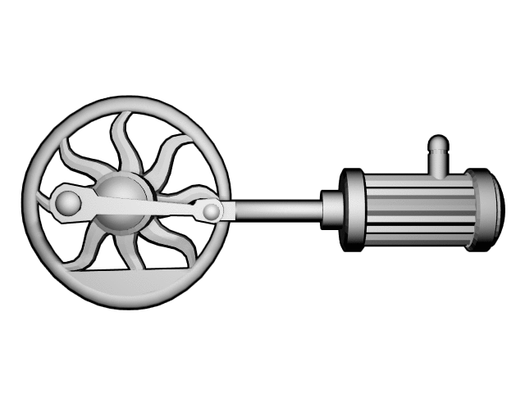
Advanced Application of Flywheels
Cory Markham

Slide 2
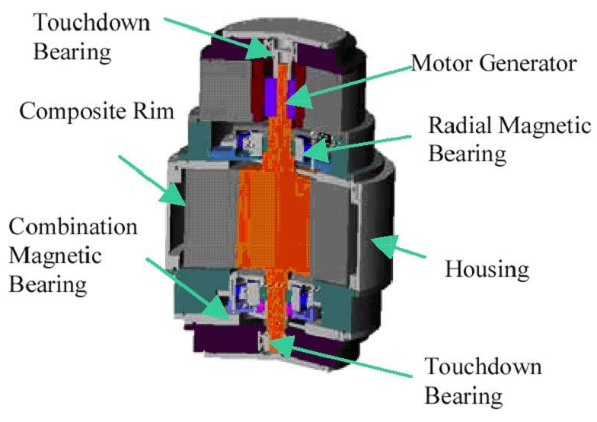
Components of a flywheel energy storage system
Rotor: spinning mass that stores energy
Bearings: pivots on which the rotor rests
Motor-generator: converts mechanical energy into electrical energy or vise versa
Power electronics: inverter and rectifier that convert raw electrical power into conditioned electrical power
Controls/instrumentation: monitors and controls the flywheel system to ensure that the system is running at the given parameters
Housing: Containment around the flywheel system. Can also be used to maintain a vacuum.

Slide 3

Background of Flywheel
Storage of kinetic energy
  $E_{Kinetic}=\frac{1}{2}Iw^{2}, where I=\frac{1}{2}m(r_{1}^{2}+r_{2}^{2})$
Past application have used standard mechanical bearing that have high losses due to friction.
Boeing will combat loss using the patented high-temperature superconducting (HTS) magnetic non contact bearing system.

Slide 4
Background Continued
Advantages
  Fast power response
  High cycle life
  Short recharge time
  High specific energy
Disadvantages
  Complex low loss bearings
  Fatigue limits
  Short discharge time
  Current material limits of 800m/s tip speed

Slide 5
Boeing ARPA-E Flywheel Project
Use a combination of advanced fiber technology and HTS bearing to develop a low cost and high efficiency flywheel energy storage system.
Their goal is have a high enough rotor speed that will have a projected energy value of $100/kW-h
Material prototypes will produce 7kWh for scaling purposes up to a utility size flywheel (100kW-h)
Their vision is to develop an array of the 100kW-h flywheels in an array to allow for a storage capacity of 2 MW-h fro utility applications

Slide 6
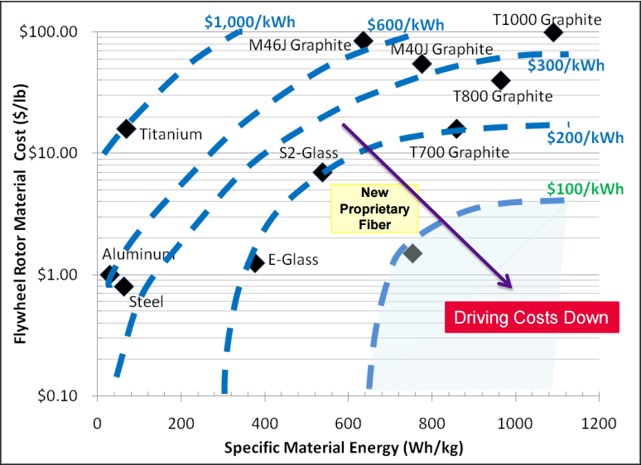

Slide 7
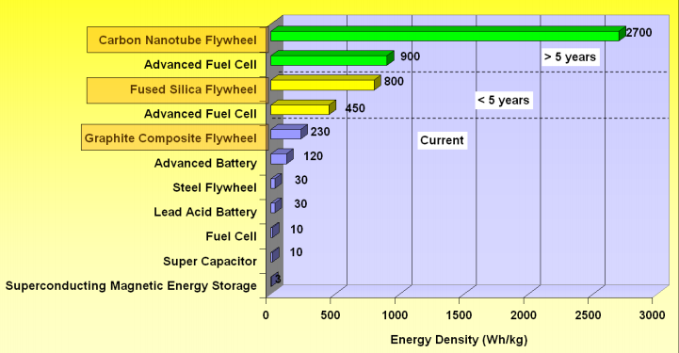

Slide 8
Other Applications of Flywheel for space crafts
Reaction wheel: used primarily by spacecraft for attitude control without using fuel for rockets or other reaction devices. This is accomplished by equipping the spacecraft with an electric motor attached to a flywheel which, when its rotation speed is changed, causes the spacecraft to begin to counter-rotate proportionately.
Momentum wheel: operates it at a constant (or near-constant) rotation speed, in order to imbue a satellite with a large amount of stored angular momentum. Doing so alters the spacecraft's rotational dynamics so that disturbance torques perpendicular to one axis of the satellite
Control moment gyro (CMG): Applying a constant torque to the on the mounted wheel causes the spacecraft to develop a constant angular velocity about a perpendicular axis. CMGs are generally able to produce larger sustained torques than RWs and are preferentially used in larger spacecraft, including Skylab and the International Space Station.

Slide 9


Slide 10
Aviation design
The Electromagnetic Aircraft Launch System (EMALS) is designed to replace steam catapult system currently used on U.S. Navy aircraft carriers.
Gerald R. Ford (CVN 78) is the first carrier to use EMALS. John F. Kennedy (CVN 79) is the next carrier scheduled to install and use EMALS.
Four rotors will store 121 MJ at 6400 rpm. They can store 122 MJ in 45 secs and release it in 2–3 seconds. The flywheel energy densities are 28 kJ/kg; including the stators and cases this comes down to 18.1 kJ/kg, excluding the torque frame.

Slide 11
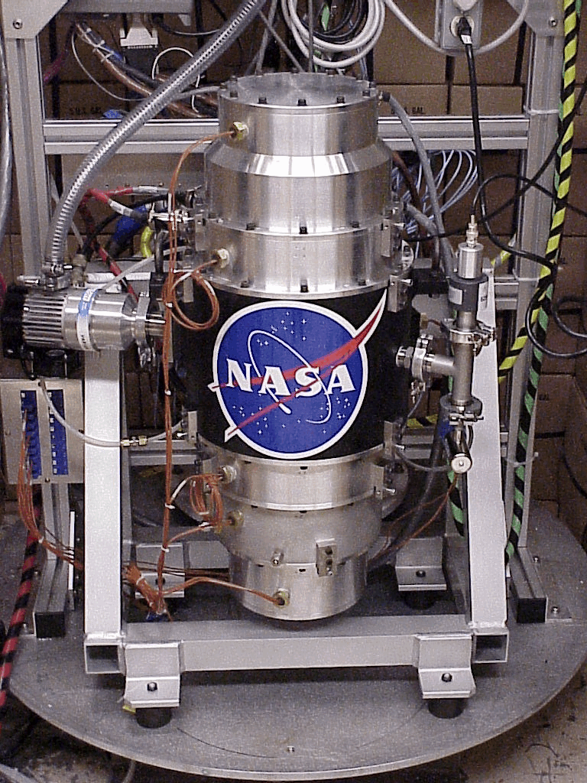
NASA uses Flywheels
it used a carbon fiber rim with a titanium hub designed to spin at 60,000 rpm, mounted on magnetic bearings.
Storage was 525 W-hr and could be charged/discharged at 1 kW.
Demonstrations were conducted at Glenn to show simultaneous energy storage and momentum control using two high-speed magnetically levitated flywheels.

Slide 13
Bibliography
https://upload.wikimedia.org/wikipedia/commons/f/f5/Blender3D_KolbenZylinderAnimation.gif
http://large.stanford.edu/courses/2010/ph240/haefele1/
http://www.climatetechwiki.org/technology/jiqweb-es-fw
http://www.grc.nasa.gov/WWW/portal/pdf/flywheel.pdf
https://www.uaf.edu/files/acep/BoeingFlywheelOverview_06_20_2012.pdf
https://www.quora.com/How-is-Flywheel-used-in-spacecraft-navigation-and-guidance-system
http://www.ga.com/emals

