Slide 1
Gravitational Potential Energy Storage
Byron Mui

Slide 2
Overview
Storing/Releasing of energy via changing the altitude of mass
Stored Gravitational Potential Energy
Released via Kinetic Energy
Load Balancing
Reduce Intermittence

Slide 3
Mass Type
Gravitational Potential Energy Storage with Solid Masses
Pumped-Storage Hydroelectricity
Compressed Air Storage

Slide 4
Solid Mass Transport Type
Mountainside Energy Storage
Rail Energy Storage (ARES)
Ski Lift-Style Energy Storage (Energy Cache)
Winch Energy Storage
High Altitude Energy Storage (Stratosolar)
Ocean Energy Storage (Sink Float Solutions)

Slide 5
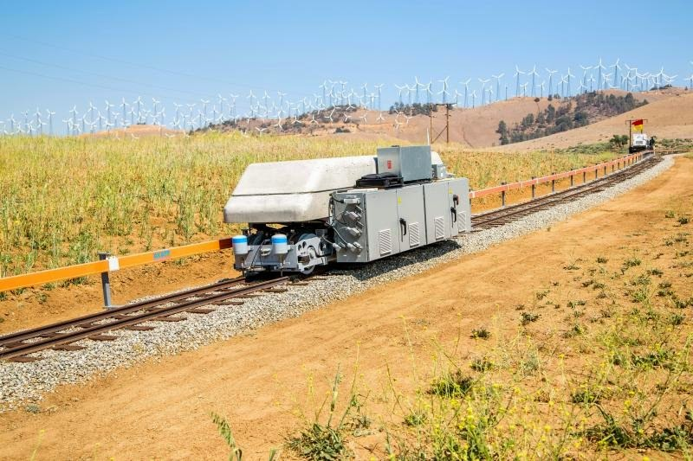
Rail Energy Storage
Advanced Rail Energy Storage (ARES)
Uses motors powered by excess power from the grid to drive uphill
Motors become generators as cars move downhill, generating needed energy back to grid
Notes:
https://vimeo.com/39364772

Slide 6
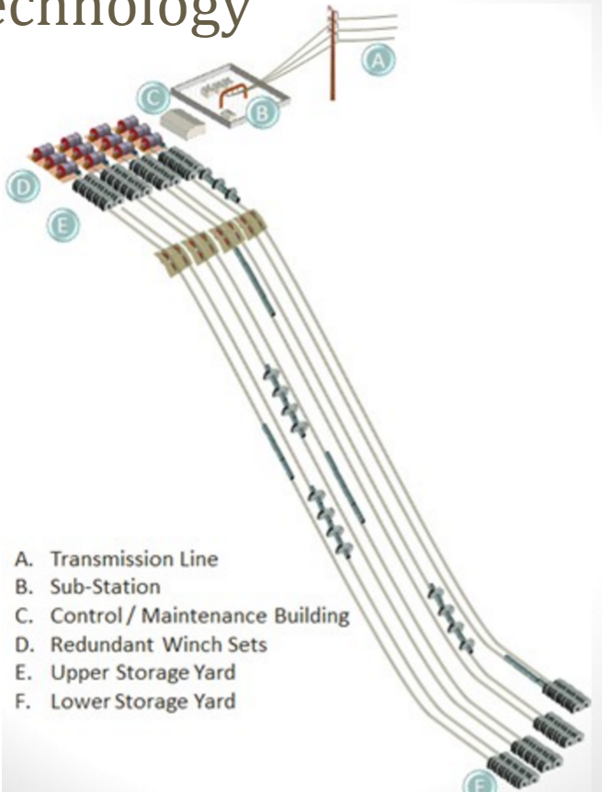

Slide 7


Slide 8
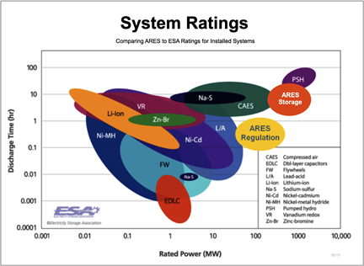

Slide 9
Rail Energy Storage Features
Extensive Sight Options
Favorable in arid regions
Scalability
Facilities ranging from 100MW w/200MWh capacity to 2-3GW w/16-24GWh capacity
78.3% Storage Efficiency
+86% efficiency for fast response Regulation Energy Management
Variable Output at Constant Efficiency
No System pressure loss during discharge
Lower Capital Cost
~60% of equivalent pumped-hydro facility
Issues
Noise

Slide 10
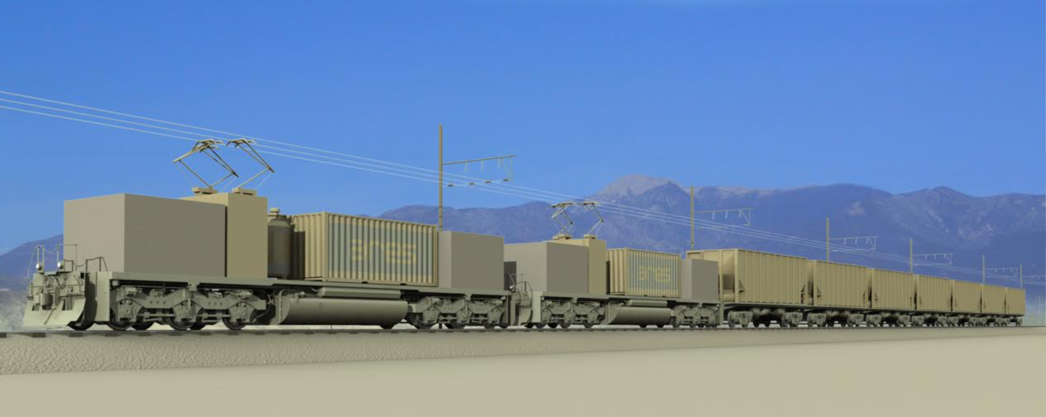
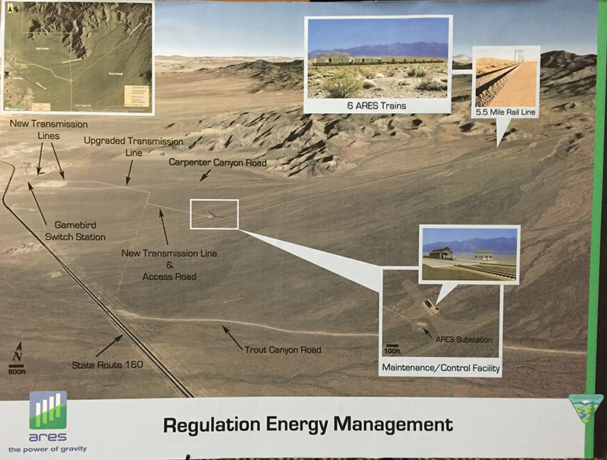
ARES Nevada
First Commercial Regulation Facility
Specifications
Charging Capacity | 57MW
Discharging Capacity | 44MW
Storage Duration | 15 min
Elevation Differential | 2,000 ft
Average Grade | 6.9%
Maximum Grade | 8.0%
Downhill Speed | 5-19 mph
Track Length | 5.5 mi
Size | 72 acres
Ramp Rate | 300 MW/min
Lifetime | 40 years
On-Line Date | September 2019

Slide 11
Ski Lift-Style Energy Storage
Energy Cache
Lift-based transport of gravel-filled hoppers
https://youtu.be/G3nz_kU604s
Cost estimated at ~60% of pumped storage hydroelectricity
No news of further development since 2013

Slide 12
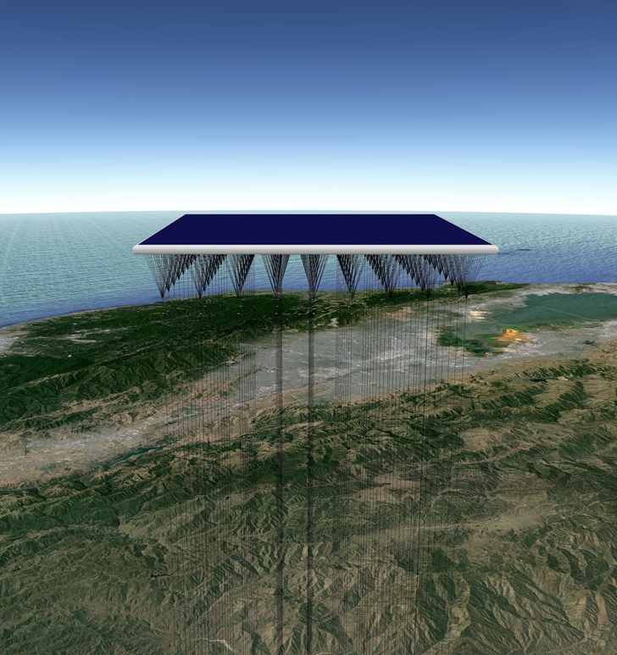
High Altitude Energy Storage
Stratosolar
Raise/Lower small masses via electric winches supported by buoyant platforms at 20 km altitude (stratosphere)
Energy Source from Photovoltaic Solar Energy on top of platforms
Specific Energy: 54 Wh of energy per kilogram of weight over 20 km.
Each platform to hold hundreds of metric tons of small masses
Notes:
Intermittence much less than solar on ground, as stratosphere has very calm weather and high sun visibility (3x)

Slide 13
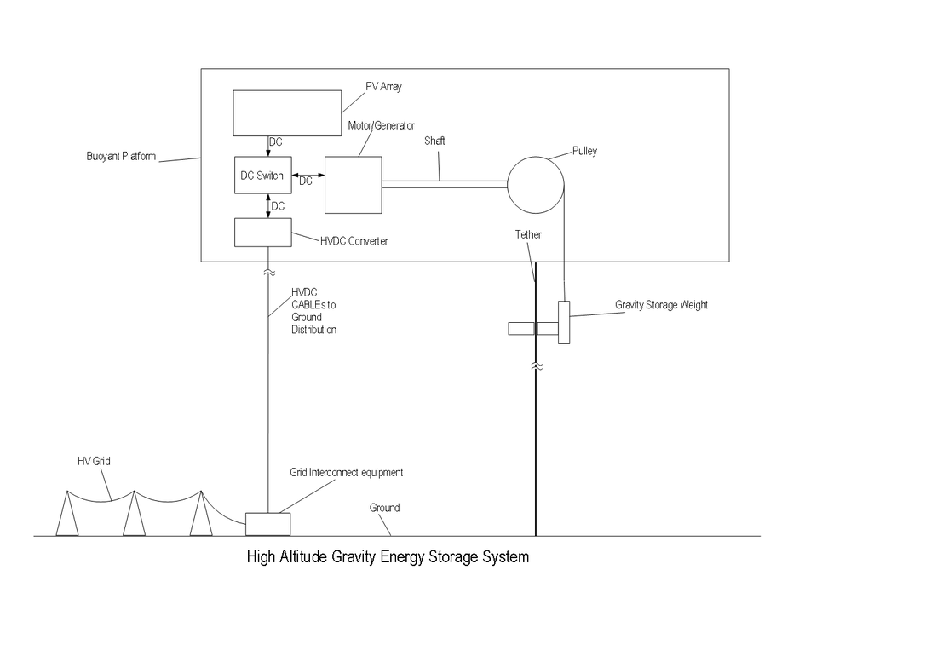

Slide 14
High Altitude Energy Storage Features
Lifetime: 15,000 daily cycles, 30 year life
Capital cost of $125/kWh ($1/W) initially
85% round-trip Efficiency
Scalability from 1MW to GWs
Issues
Tethers suspect to weather conditions and airspace
Platforms need to account for 50 m/s winds max
No physical prototype

Slide 15
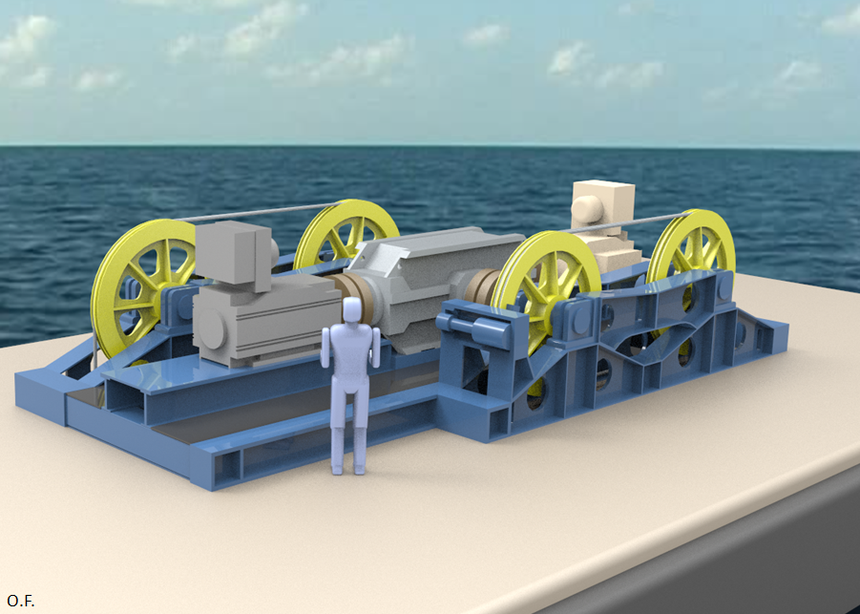
Ocean Energy Storage
Sink Float Solutions
Utilize ocean elevation and raise/lower solid masses via winches supported by ocean barges
https://youtu.be/EzdQAnDJjfg?t=1m43s

Slide 16
Ocean Energy Storage Features
Offshore Energy Storage
Energy Efficiency: >80% total roundtrip
Low investment cost
20 times cheaper than batteries
10 times cheaper than pumped storage hydroelectricity
Capital Costs
$25/kWh for 4000 m depth
$50/kWh for 2000 m depth
Issues
Concept Phase
No physical prototype

Slide 17
References
http://www.aresnorthamerica.com/
Challenges of Storage Development - Advanced Rail Energy Storage (ARES) Prepared for Bulk Storage Conference, Sacramento November 20, 2015 1. http://slideplayer.com/slide/9319746/
http://www.basinandrangewatch.org/Rail-Storage-Pahrump.html
http://www.energystoragenews.com/Mountain%20Side%20Energy%20Storage.htm
http://www.stratosolar.com/
http://sinkfloatsolutions.com/?page_id=1005

