Slide 1

NPRE 498 Printable Solar Cells
Atharva Rajadnya

Slide 2
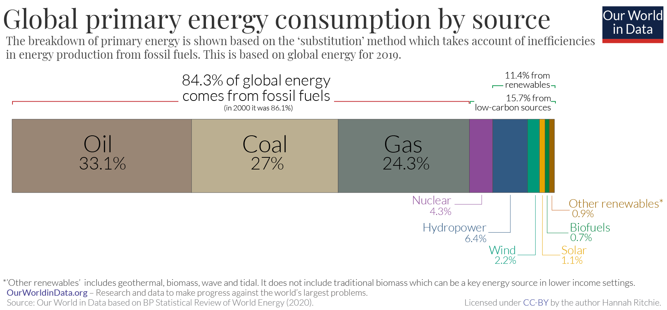
Energy Consumption

Slide 3
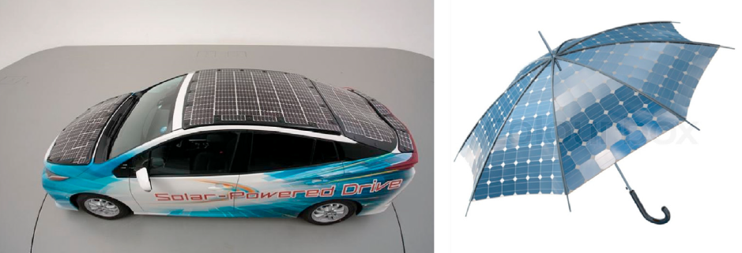
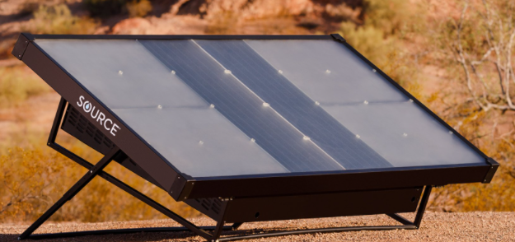
Renewable Energy - Solar Energy
Sunlight - Most promising source of clean energy.
Solar cells have been researched since a long time. Average price per watt for PV panel has dropped from ~$100 in 1975 to ~$1.5 today.
Thin-film cells are easily molded into various shapes and sizes based on the need of a specific application.

Slide 4
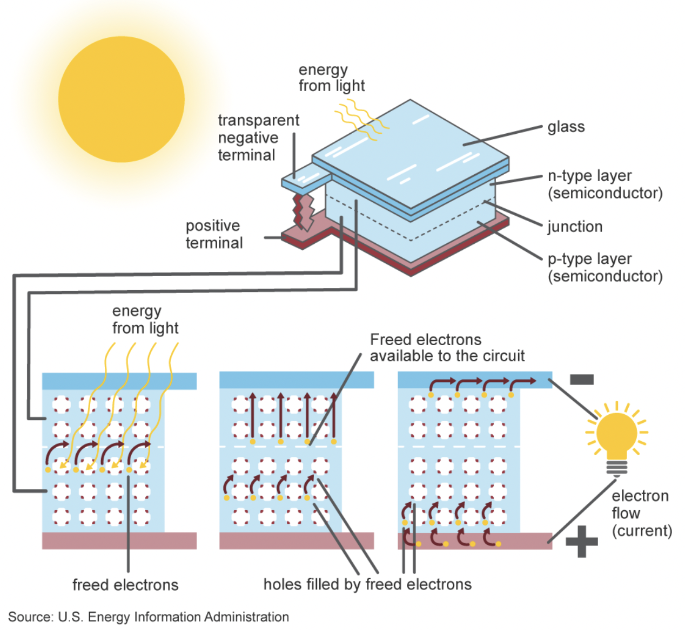
Inside a Photovoltaic Cell
A photovoltaic (PV) cell, commonly called a solar cell, is a nonmechanical device that converts sunlight directly into electricity.
Some PV cells can convert artificial light into electricity.

Slide 5
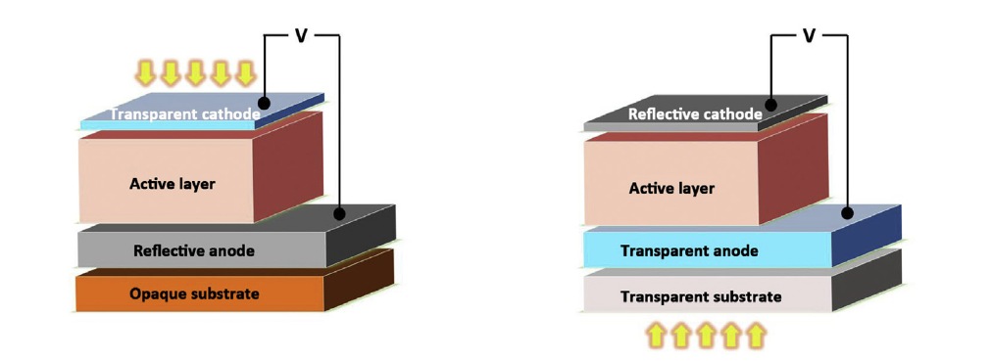
Cell Construction
Schematic structure of solar cells comprising various functional materials: a flexible substrate, two electrodes, and an active layer. The direction of light entry to the active layer determines the optical requirement for the substrate and the electrodes.
Notes:
Active materials – organic, inorganic, hybrid

Slide 6
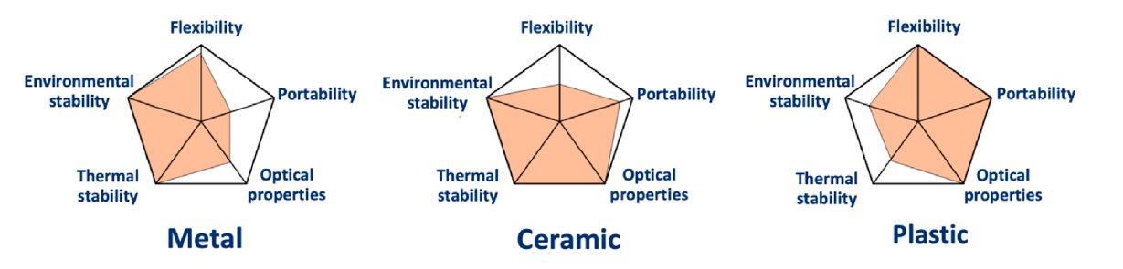
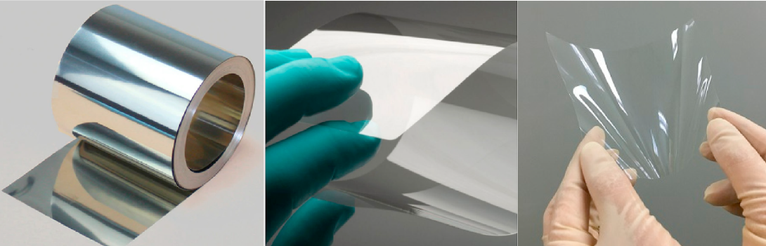
Qualitative Summary: Types of Substrates
Notes:
Plastic – high permeability to o2 and moisture. Hence coated on both sides by barrier layers (al2o3)

Slide 7
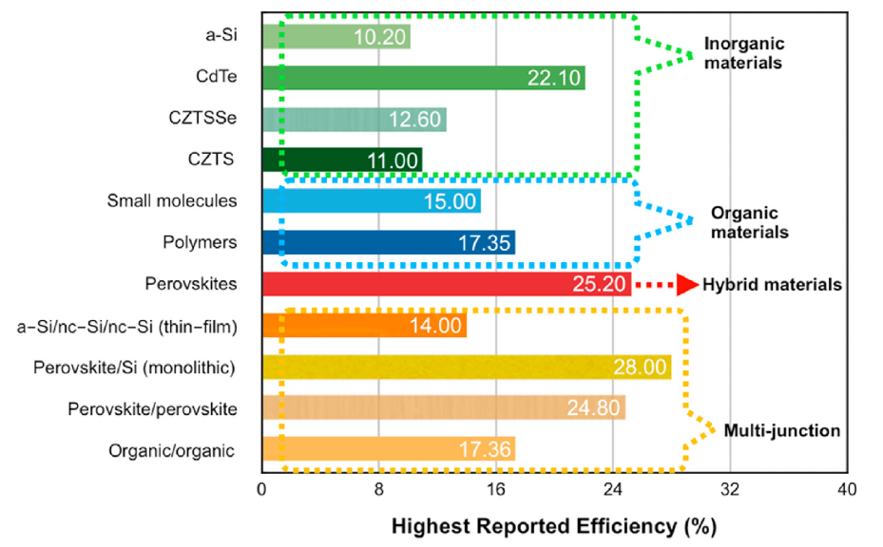
Efficiencies: Active Layer Materials
Notes:
PCE – power conversion efficiency
Perovskite – ABX3 (metal halides, 3D crystal structure), CZTSSe - copper zinc tin sulfide-selenide
TCO - transparent conducting oxide

Slide 8
Cell Manufacturing
Silicon Wafers
Pre-Check
Texturing
Acid Cleaning
Diffusion
Etching
Post Etching Washing
Anti-Reflective Coating
Contact Printing and Drying
Testing
Polysilicon Production
Ingot Production
Cell Fabrication
Module Assembly
Wafer Production

Slide 9
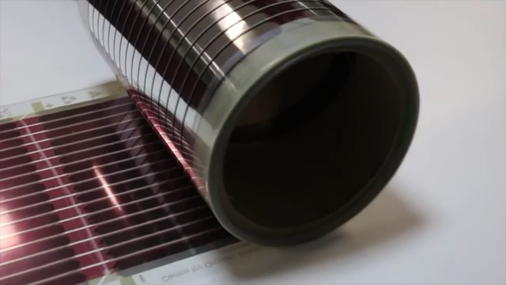
Printed Solar Cells: Concept
Notes:
10 AUD = 7.25 USD

Slide 10
Printed Solar Cells: History
1903 - Printed electronics, Albert Hanson, ‘printed wire’
1954 - First commercial solar cell, Bell Labs
2008 - First inkjet solar cell, Konarka Technologies
2011 - First CIGS cell, Oregon State University
2011 - First solar cell on paper, MIT
2014 - Olga Malinkiewicz, Perovskite sheets in Boston

Slide 11
Solar Cell Printing
Uses an inkjet printer to put down the semiconductor material and electrodes onto a solar cell substrate
Can be used for: Inorganic cells – CIGS, Organic cells – Polymers, Hybrid – Perovskite
Ink cartridges contain: a metal salt mixture, a polymer fullerene blend, a precursor of mixed organic and inorganic salts
Additives are added to affect viscosity and surface tension
Notes:
CIGS – Copper Indium Gallium Selenide

Slide 12
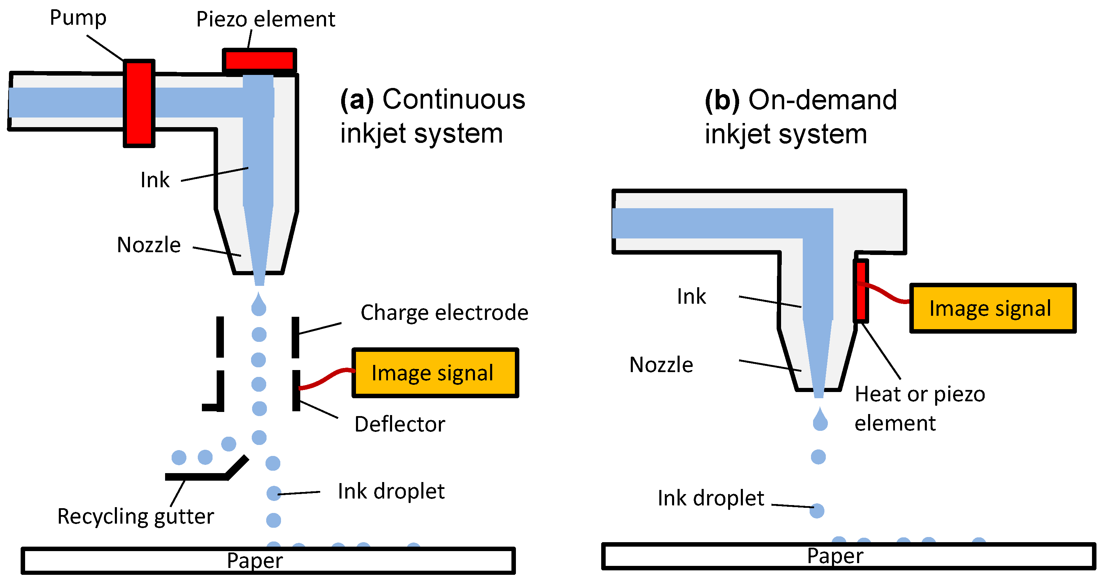
Inkjet Printing: Mechanism

Slide 13
Inkjet Printing: Advantages
Low cost of production (no vacuum needed)
Ink is a low-cost metal salt blend
Little waste compared to vapor phase deposition
Doesn’t involve the use of other harmful chemicals
Can create cells in any desired shape
Can create cells in any environment

Slide 14
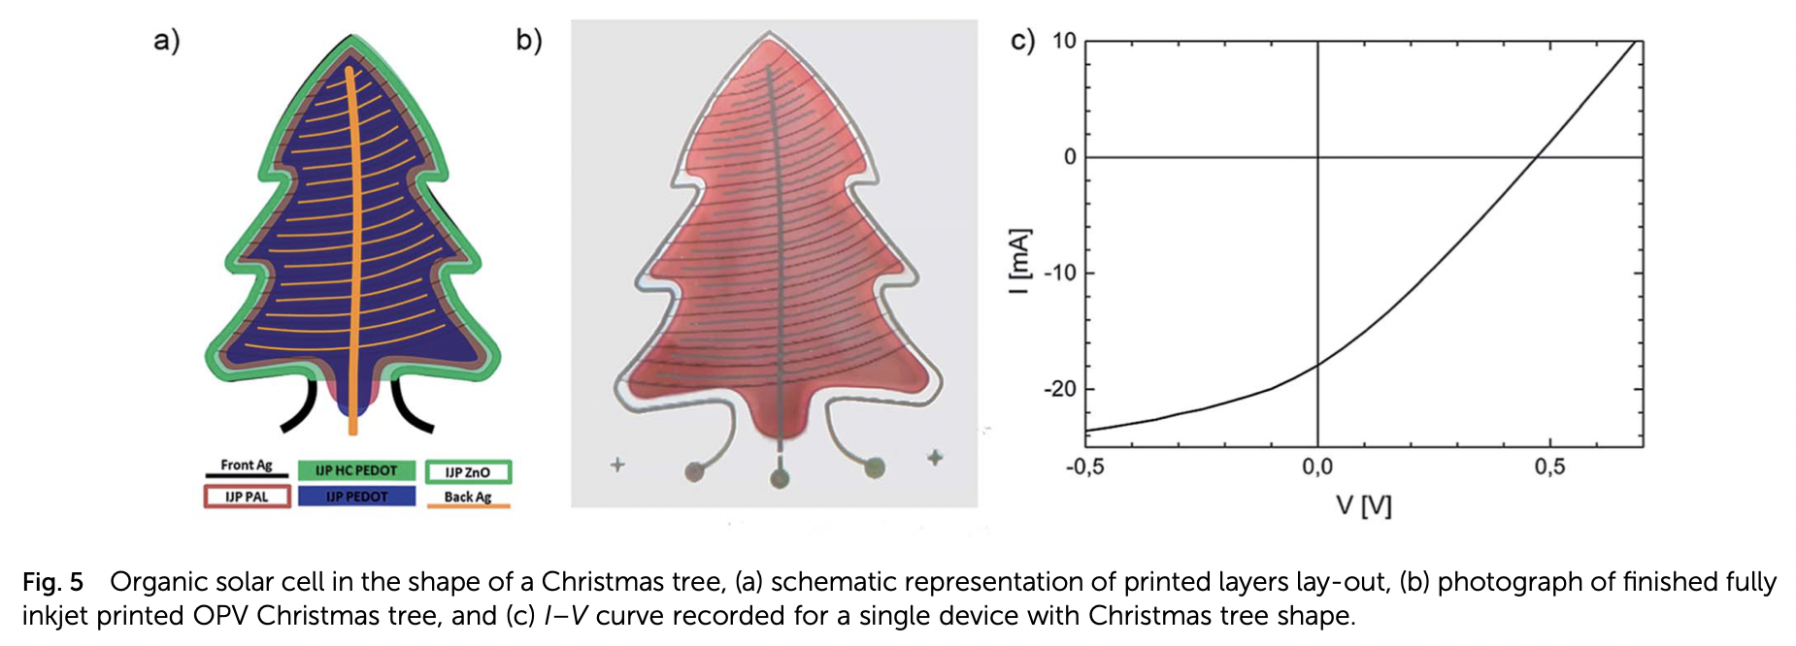
More Controlled Deposition

Slide 15
Inkjet Printing: Disadvantages
Low efficiency
Not Weather resistant
Availability of Indium
Primitive Technology
Notes:
Efficiency around 4%

Slide 16
Future Scope
Currently substrates cost more than the cell
With this technology, cells can be printed on paper
Paper thin cells can be placed anywhere like blinds, windows, etc.
Cells can also be directly 3D printed in the future

Slide 17
References
Office of Energy Efficiency and Renewable Energy - https://www.energy.gov/eere/solar/solar-photovoltaic-cell-basics
Environment and Energy Study Institute (EESI) - https://www.eesi.org/topics/fossil-fuels/description
Our world in data - https://ourworldindata.org/energy-mix?country=
Shirland F, Wolff G. Research on Solar-Energy Conversion Employing Cadmium Sulfide. 2. Clevand OH: Harshaw Chemical Co; 1962.
Vohl P, Perkins D, Ellis S, Addiss R, Hui W, Noel G. GaAs thin-film solar cells. IEEE Trans Electron Dev.
Williams E, Jones K, Griffiths A, et al. The electrophoresis of thin Film CdS/Cu2S solar cells. Sol Cell.
Okaniwa H, Nakatani K, Yano M, Asano M, Suzuki K. Preparation and properties of a-Si: H solar cells on organic polymer film substrate. Jpn J Appl Phys.
Dursch H. CDS/CUINSE/sub2/solar Cells with Titanium Foil Substrate. 1987.
Yano M, Suzuki K, Nakatani K, Okaniwa H. Roll-to-roll preparation of a hydrogenated amorphous silicon solar cell on a polymer film substrate. Thin Solid Films.
Ishizuka S, Yamada A, Matsubara K, Fons P, Sakurai K, Niki S. Alkali incorporation control in Cu (In, Ga) Se 2 thin films using silicate thin layers and applications in enhancing flexible solar cell efficiency. Appl Phys Lett.
Rance W, Burst J, Reese M, et al. In The use of Corning® Willow™ glass for flexible CdTe solar cells. In: 2013 IEEE 39th Photovoltaic Specialists Conference (PVSC). IEEE; 2013
Sino Voltaics - https://sinovoltaics.com/solar-basics/solar-cell-production-from-silicon-wafer-to-cell/

Slide 18
References (continued)
Bagher, A.M. Introduction to Organic Solar Cells. Sustain. Energy 2014, 2, 85–90.
Haque, A.; Rahman, M.A.; Ahsan, Q. Building integrated photovoltaic system: Cost effectiveness. In Proceedings of the 2012 7th International Conference on Electrical and Computer Engineering, Dhaka, Bangladesh, 20–22 December 2012; pp. 904–907.
Krebs, F.C. Fabrication and processing of polymer solar cells: A review of printing and coating techniques. Sol. Energy Mater. Sol. Cells 2009, 93, 394–412.
Søndergaard, R.R.; Hösel, M.; Krebs, F.C. Roll-to-Roll fabrication of large area functional organic materials. J. Polym. Sci. Part B Polym. Phys. 2013, 51, 16–34.
Aernouts, T.; Aleksandrov, T.; Girotto, C.; Genoe, J.; Poortmans, J. Polymer based organic solar cells using ink-jet printed active layers. Appl. Phys. Lett. 2008, 92, 033306.
Basaran, O.A.; Gao, H.; Bhat, P.P. Nonstandard inkjets. Ann. Rev. Fluid Mech. 2013, 45, 85–113.
Daly, R.; Harrington, T.S.; Martin, G.D.; Hutchings, I.M. Inkjet printing for pharmaceutics—A review of research and manufacturing. Int. J. Pharm. 2015, 494, 554–567. [CrossRef] [PubMed]
DeGans, B.J.; Duineveld, P.C.; Schubert, U.S. Inkjet printing of polymers: State of the art and future developments. Adv. Mater. 2004, 16, 203–213.

