Slide 1
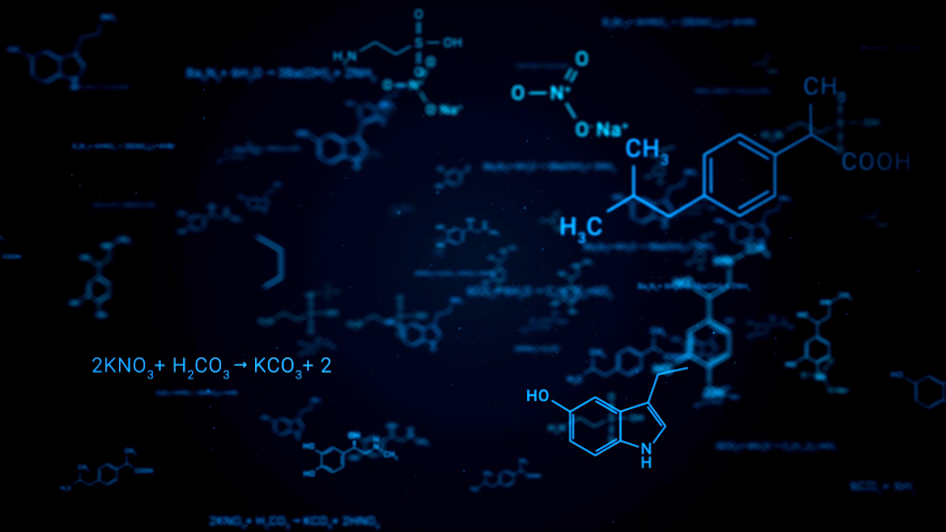
Topic: Sodium-Ion Batteries
Name: Ahmad A Kazan
Date: April 22nd, 2022

Slide 2

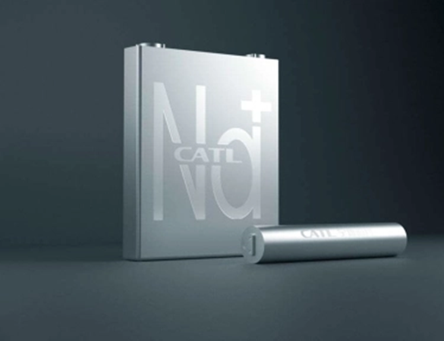
History
Development of Sodium-ion Battery (SIB) took place along with Lithium-ion Battery (LIB) in 1970s.
In 1990s; LIB had more commercial promise, interest in SIB declined.
In 2010s; SIB gained interest again, due to demand and cost of LIB.
Now, SIB have received academic and commercial interest.

Slide 3
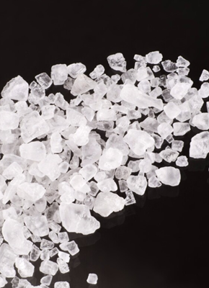
Background and Definition
SIB is a secondary type of battery, or a rechargeable battery.
Uses charging principle of intercalation and deintercalation.
Relies on the movement of sodium ions between the electrodes.
Analogous to the LIB but uses the sodium ions as charge carriers.
Very similar working principle and cell construction to LIB.
Note: Sodium and Lithium belong to same group in periodic table.

Slide 4
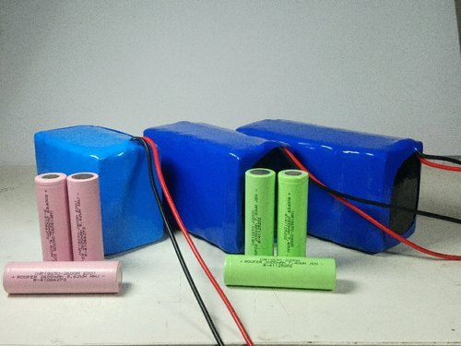
Motivation
Compared with LIB, SIBs have many advantages but also critical disadvantages.
Can currently be used in low-end energy storage, electric bicycles and others.
Difficult to use in high-end EVs, large-sized energy storage systems.
If SIBs are commercialized, will bring all around benefits.
Questions and objectives:
How fair is SIB from commercialization?
Can it replace the current mainstream LIBs?
How does a SIB work?

Slide 5
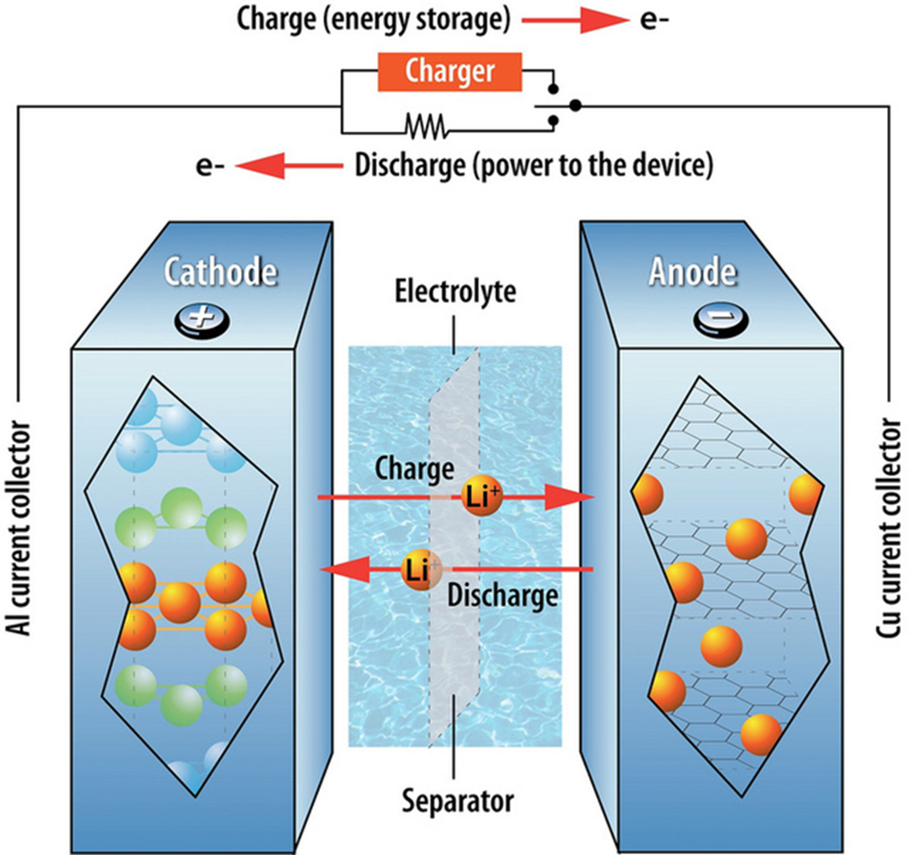
Process and Constituents
Consists of :
Positive Cathode based on sodium containing material.
Negative Anode
Liquid electrolyte that contains dissociated sodium salts.
Separator
Can use similar and different materials than LIBs.
Electrons that travel through electric circuit.
Convert electrical and chemical energy into each other.
Shuttling of ions between two electrodes with help of electrolyte.

Slide 6
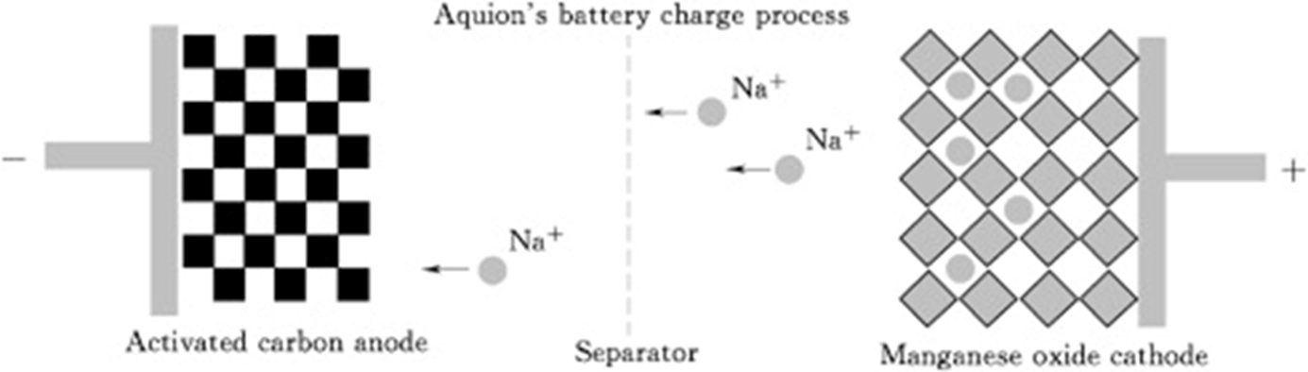
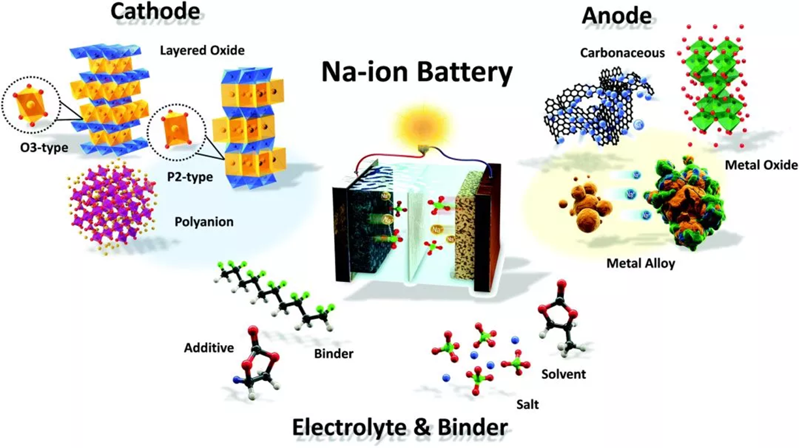
Materials
Anodes: Cannot use graphite, instead a disordered carbon that is non-crystalline and amorphous in structure is preferred (hard carbon or activated carbon).
Cathodes: Store sodium, sodium transition metal oxides used, less need for Co, Cr, Ni, V.
Electrolytes: Can use aqueous or non-aqueous electrolytes. Most common is hexafluorophosphate as salt is dissolved in these solvents. Can use same non-aqueous carbonate solvents as LIBs.
Notes:
graphite, cannot be used in sodium-ion batteries as it cannot store the larger sodium ion in appreciable quantities. Instead, a disordered carbon material non-crystalline and amorphous carbon structure (called "hard carbon") is the current preferred sodium-ion anode of choice. Hard carbon is clearly the most preferred anode due to its excellent combination of high capacity, lower working potentials and good cycling stability.
Similar to all lithium-ion cathodes, sodium-ion cathodes also store sodium via intercalation reaction mechanism. Owing to their high tap density, high operating potentials and high capacities, cathodes based on sodium transition metal oxides have received the greatest attention. From a desire to keep costs low, significant research has been geared towards avoiding or reducing costly elements such as Co, Cr, Ni or V in the oxides
Sodium-ion batteries can use aqueous as well as non-aqueous electrolytes. The limited electrochemical stability window of water, results in sodium-ion batteries of lower voltages and limited energy densities when aqueous electrolytes are used. To extend the voltage range of sodium-ion batteries, the same non-aqueous carbonate ester polar aprotic solvents used in lithium-ion electrolytes, such as ethylene carbonate, dimethyl carbonate, diethyl carbonate, propylene carbonate etc. can be used. The current most widely used non-aqueous electrolyte uses sodium hexafluorophosphate as the salt dissolved in a mixture of these solvents. Additionally, electrolyte additives can be used which can improve a host of performance metrics of the battery.

Slide 7
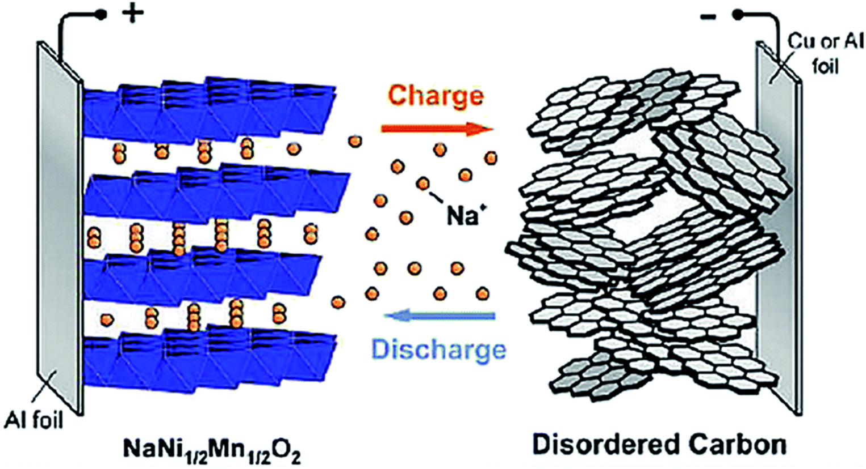
Working Principle
Step 1: Initial State; Cathode is sodium-ion source, Anode is sodium-free.
Step 2: SEI and CEI formation; Electrical energy used to induce migration of electrons. CEI forms at cathode, SEI at anode.
Step 3: Charging; sodium ions released from cathode and stored in anode. Cell voltage increases.
Step 4: Discharging; movement of electrons reversed. Cell voltage decreases.
Step 5: Stability; Electrolyte stability crucial for long life cycle.
Notes:
Step 1: Initial state; Sodium ion cell is assembled in a discharged state. Positive electrode is the sodium ion source of the cell and contains transferable sodium ions, whereas the negative electrode is sodium free. Suited cathodes are sodium transition metal oxides or Prussian blue analogs, and anode materials are typically disordered carbons or hard carbons.
Step 2: SEI and CEI formation; electrical energy is used to induc migration of electrons from the positive electrode to negative one via external circuit. Positive electrode releases sodium ions to the electrolyte to maintain charge neutrality. Ions transferred to negative electrode though electrolyte to be inserted in to the active material. Oxidation at positive electrode and reduction reaction at negative on takes place. Cell voltage increases as cell is charged. CEI forms at cathode and SEI at anode, which is crucial fro the functionality of the cell because it prevents continuous electrolyte degradation.
Step 3: Charge; Ongoing charging, more and more soidum ions released frfrom the cathode and stored in the anode via absorption and intercalation mechanaisms, the cell voltage increases until a predetermined end of charge voltage is reached.
Step 4: Dischagre; movement of eelctrons and sodium ions is reversed from negative to positive cathode. Oxidation takes place at the negative electrode and reduction takes place at the positive electrode. Cell voltage decreases tiull cell reaches a defined cut-off voltage.
Step 5: Rocking chair mechanism; High reversibility of the ongoing storage processes and high electrolyte stability are crucial for long life cycle.

Slide 8
Working Principle (cont.)
https://e-lyte-innovations.de/knowledge/working-principle-sodium-ion-battery/?msclkid=858a188ec27011ecaf58bc60f6b4b60e
(Follow the link to watch a video on the working principle of SIBs)
Source: E-LYTE Innovations

Slide 9
Comparison to Battery Technologies
SIBs have several advantages over competing battery technologies.
Have higher costs, lower energy density than LIBs.
Better safety, similar power delivery characteristics to LIBs.

Slide 10
Advantages
Abundant Reserves; Sodium is 6th richest element in earth’s crust. There has been increasingly tight supply of lithium resources.
Extremely uneven distribution of lithium reserves compared to the even distribution of sodium resources.
Raw material cost of SIBs are lower than LIBs. Aluminum can be used as current collector for both electrodes. Bill of material is 30% lower than that of LIBs.
Stabler and Safer. Can adapt to high and low temperatures without much energy attenuation. SIBs resist more impact and pressure.

Slide 11
Disadvantages Why can’t SIBs replace LIB’s?
Low Energy Density; Sodium has larger atomic mass. Sodium ions are harder to penetrate separator. This will affect performance, range, and reliability of EVs.
Shorter Battery cycle;
Low Performance Cost; SIBs consume more auxiliary materials.
 | SIBs | LIBs
Raw Material Cost ($/Wh) | 0.03-0.05 | 0.05-0.06
Life Cycle (times) | 1000-4000 | 6000-15000
Life Cycle Cost ($/kWh) | 0.008-0.05 | 0.003-0.006

Slide 12
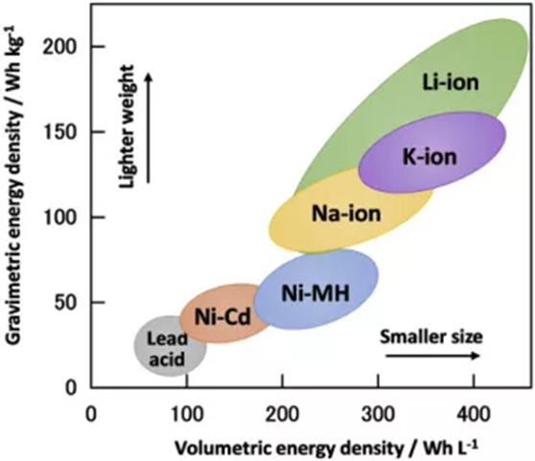

Slide 13
Comparisons
Category | Sodium-ion | Lithium-ion | Lead-acid
Cost/kWh | 40-80$ | 137$ on average | 100-300$
Energy Density | 250-375 Wh/L | 200-650 Wh/L | 80-90 Wh/L
Specific Energy | 75-165 Wh/kg | 120-260 Wh/kg | 35-40 Wh/kg
Cycles at 80% DoD | 100s-1000s | 3500 | 900
Safety | Low-risk | High-risk | Moderate-risk
Materials | Earth-abundant | Scarce | Toxic
Cycling Stability | High | High | Moderate
Temperature Range | -20 C – 60 C -30 C – 80 C | -20 C – 60 C 15 C – 35 C | -20 C – 60 C
Notes:
Cycling stability = significance of discharge?
The number of charge-discharge cycles a battery supports depends on multiple considerations, including depth of discharge, rate of discharge, rate of charge, and temperature. The values shown here reflect generally favorable conditions. Temperature affects charging behavior, capacity, and battery lifetime, and affects each of these differently, at different temperature ranges for each. The values given here are general ranges for battery operation.

Slide 14
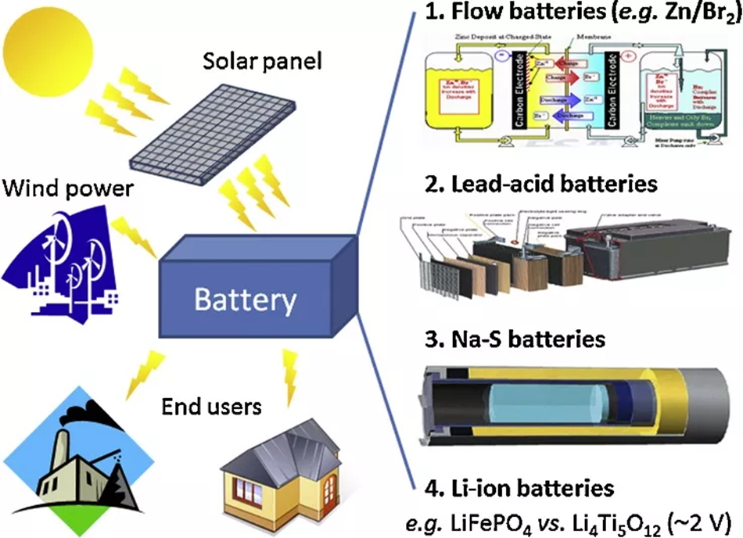
Current Applications
Difficult to apply to mainstream applications.
Has certain advantages in specific scenarios; where energy density or battery cycle are not high.
Small power batteries (electric bicycles/scooters), low-end energy storage.
In extreme temperature scenarios due to their good performance.
Lower capital cost projects.
Can be used in conjunction with LIBs in the power battery.

Slide 15
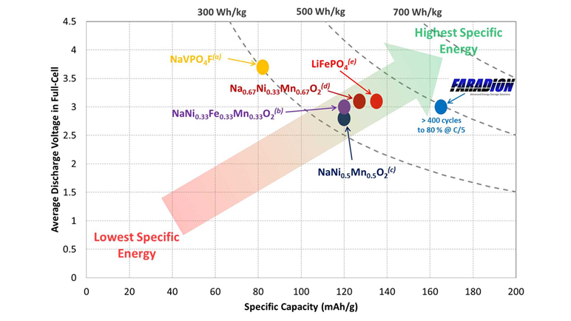
Companies at Work
Several companies around the world developing commercial SIBs.
Faradion Limited: Founded in 2011, use oxide cathodes, hard carbon anodes, liquid electrolyte. 150 Wh/kg specific energy. 1000 cycles at 80% DoD. E-bike and E-scooter applications.
CATL: Bringing SIBs by 2023. Use Prussian blue analogue for cathode, porous carbon for anode. Specific energy of 160 Wh/kg. Also plans to produce hybrid battery.
E-Lyte Innovations: Battery manufacturing of high power, high safety.
WSU: Making saltier SIB, preventing accumulation of salt crystals and a liquid electrolyte that has more room for sodium ions, so sodium keeps circulating. Great power density and 1,000 charging cycles before 80% DoD.

Slide 16
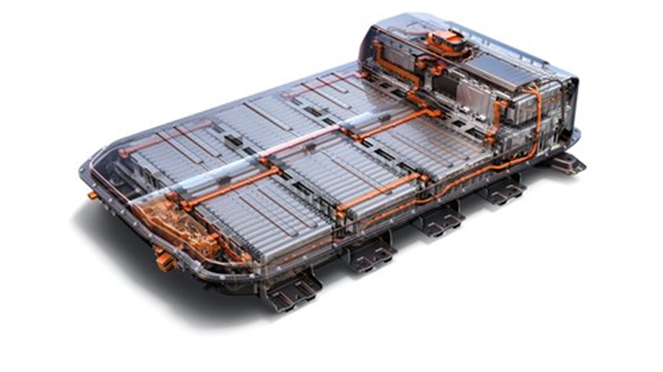
Sodium-ion Batteries in EV’s?
What we know: SIBs are cleaner, safer, cheaper to buy, chargers quicker, and performs better in extreme temperatures.
Lithium is expensive to mine, environmentally destructive, and becoming rare.
Higher battery costs → Higher EV costs → need to explore alternatives.
SIBs are non-flammable.; a major added bonus.
CATL: worlds biggest EV battery maker, has added SIBs. Reaches 80% capacity in 15 minutes. But can’t match energy density of LIBs.

Slide 17
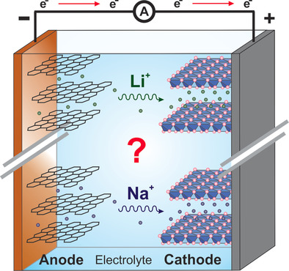
Possible Alternative?
CATL announced development of single system that features SIB and LIBs.
Would deliver energy densities of LIB combined with advantages of SIBs technology.
Need to develop high-performance, low-cost batteries.
CATL will continue developing standalone SIBs, goal of reaching 200 Wh/kg.
Notes:
This could provide the best of both worlds, delivering the higher energy density of lithium-ion batteries, along with the advantages of sodium-ion tech, such as great performance at low temperatures.

Slide 18
Discussion
Currently, it seems SIBs are best as a supplement and not a substitute.
Could see mass production of SIBs as early as 2023.
SIBs are just the beginning; we will see LIBs being replaced with different types of batteries in different applications.
The advantages and disadvantages seem to be balanced.

Slide 19
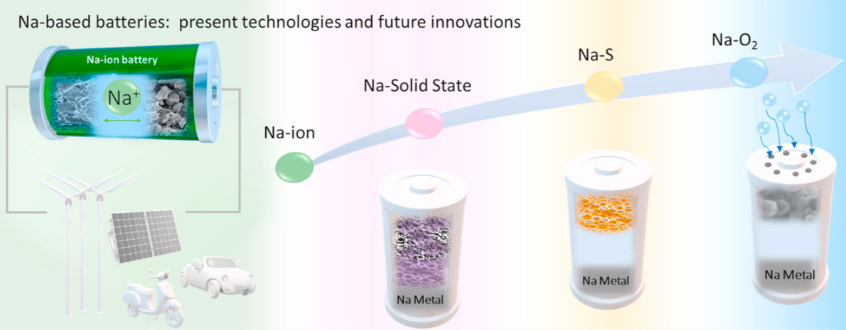
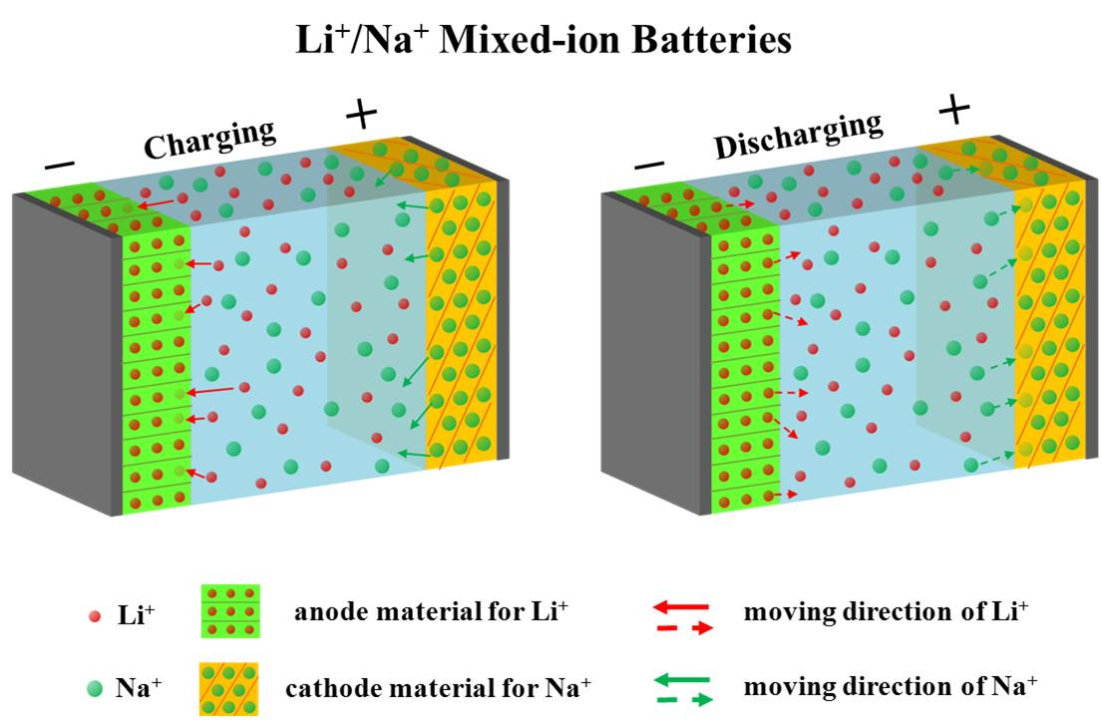
Further Work?
If cost of SIBs further reduced, will be favored in grid-storage and home energy storage.
Need to work on cost improvements, energy density, to one day replace any application where LIBs currently serve.
Potential for:
Lithium & Sodium Mixed Batteries.
Sodium Solid State Batteries.
Potassium-ion Batteries.

Slide 20
References
Zeng, H. (2021, November 16). What are sodium batteries, and can they replace lithium batteries? QH Tech. https://powerstationbattery.com/blogs/blog/sodium-ion-batteries
Nayak, P. K., Yang, L., Brehm, W., & Adelhelm, P. (2017). From Lithium-Ion to Sodium-Ion Batteries: Advantages, Challenges, and Surprises. Angewandte Chemie International Edition, 57(1), 102–120. https://doi.org/10.1002/anie.201703772
Abraham, K. M. (2020). How Comparable Are Sodium-Ion Batteries to Lithium-Ion Counterparts? ACS Energy Letters, 5(11), 3544–3547. https://doi.org/10.1021/acsenergylett.0c02181
Delbert, C. (2020, June 3). Scientists Just Built the Best Sodium Battery Ever. Popular Mechanics. https://www.popularmechanics.com/science/a32743665/best-sodium-ion-battery/
Lei Wang, JianxingHu, YajuanYu, KaiHuang and YuchenHua, Lithium-air, lithium-sulfur, and sodium-ion, which secondary battery category is more environmentally friendly and promising based on footprint family indicators? Journal of Cleaner Production, 2020, 276.
Xiao Chen, Yitian Bie, Fei Teng, Sodium battery positioning energy storage and lead-acid replacement, lithium battery is still the mainstream—New Energy Lithium Battery Series Report No. 5, Huaan Securities, 2021.
Houser, K. (2021, August 5). The world’s first sodium-ion battery for EVs has arrived. Freethink. https://www.freethink.com/technology/sodium-ion-battery
Working principle lithium-ion battery - E-Lyte Innovations GmbH (e-lyte-innovations.de)

Slide 21
Questions?

