Slide 1
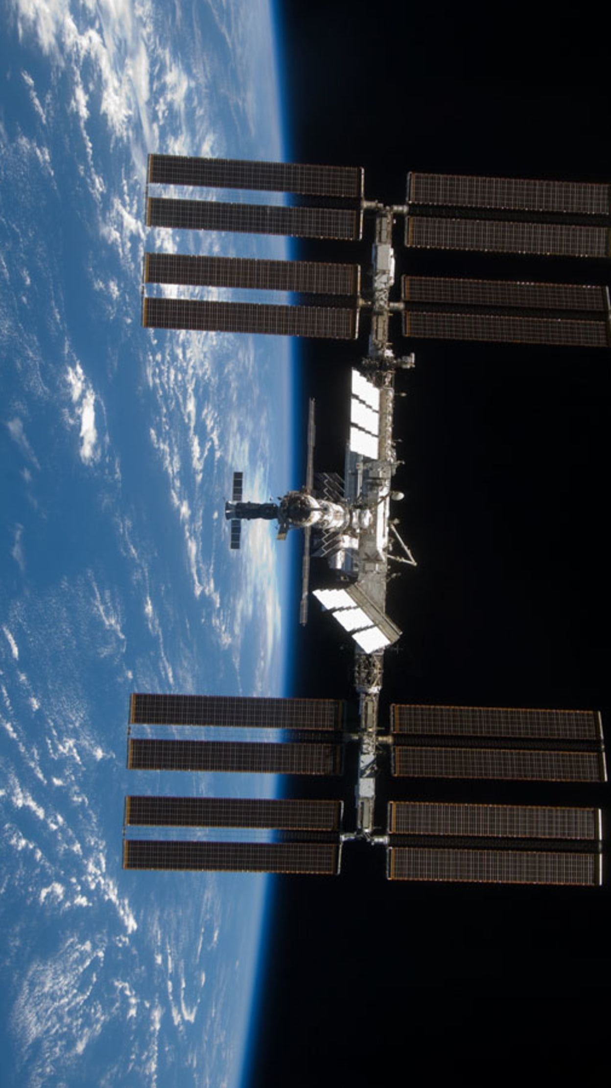
Energy Storage on the International Space Station and in Satellites
Author: Aaryaman Batra
Professor Ragheb
NPRE 498

Slide 2
Major Battery Limitations in Space
Must withstand load forces and vibrations of launch.
Must be able to operate over an extreme temperature range.
Cannot leak since it would damage vehicle/contaminate mission
Leaking can even cause a change in momentum and change trajectory

Slide 3
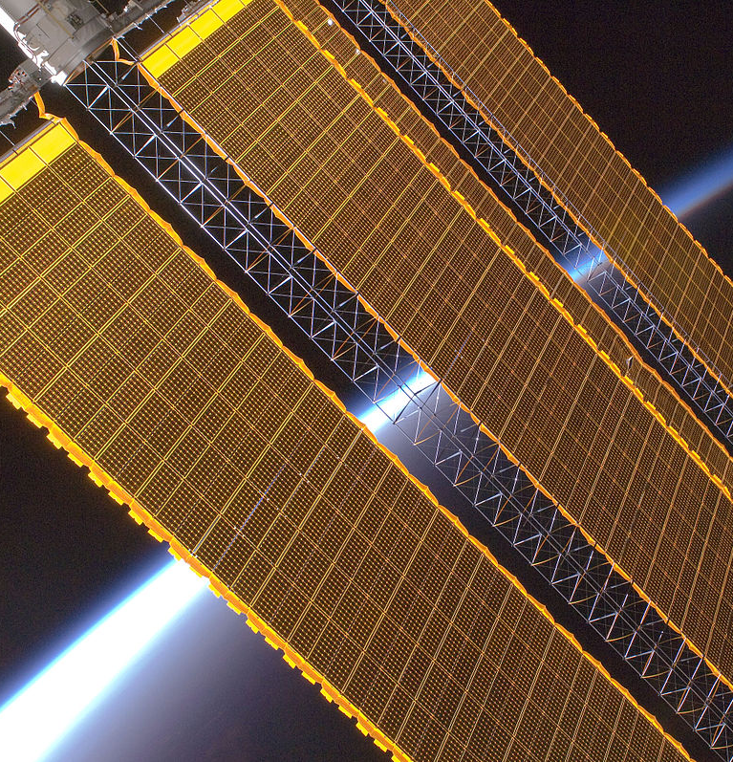
ISS Power Usage
The ISS uses 262,400 Solar cells to generate anywhere between 84 kW’s to 120 kW’s of power
Altogether the solar arrays can generate 240 kW’s of power in direct sunlight
Enough power to maintain operation of all life subsystems as well as power for research and science missions

Slide 4
ISS Power Storage
The solar arrays of the station are not always in direct sunlight.
Approximately 35 minutes of the 90-minute orbit period is in Earth’s shadow
Power storage was done in Nickel Hydrogen Batteries.
Ni-H2 batteries manufactured by Space Systems/Loral and Boeing
Batteries could exceed 38,000 discharge/charge cycles.
Each battery have a mass of 170 kgs

Slide 5
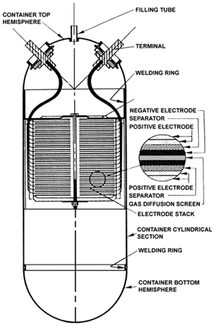
ISS Nickel Hydrogen Batteries
Desirable since they have higher life-cycles and can be used for a longer duration of time
Design life of 6.5 years
Initial batteries were replaced in 2009 and 2010 through space shuttle missions
Replaced by Lithium-Ion batteries between 2017 and 2021

Slide 6
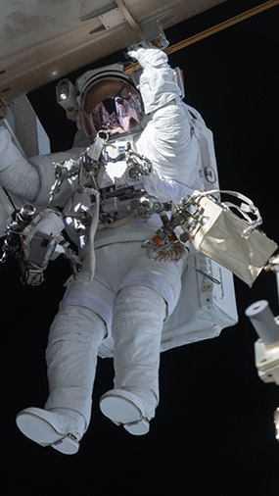
Battery Replacement with Lithium-Ion Batteries
Last Li-h2 battery replaced in February of this year by Illinois Alum Mike Hopkins
New Li-Ion Batteries can hold twice as much charge thus only half as many are required
Li-ion batteries usually have a lower design life, but ISS Li-ion batteries have been designed for 60,000 cycles and 10 years
Won't be replaced anymore since the ISS ends its lifecycle by 2028 unless extended

Slide 7
Benefits of Li-ion Batteries
Risks of Li-ion Batteries
Higher Power density
Longer life cycle
Slow degradation
Cheaper and easy to manufacture
Risk of explosion
Extreme fluctuation of temperature in space
High oxygen environment can create disastrous fire

Slide 8
Preventing fires from Li-Ion Batteries
Special casing for batteries in human missions made from steel tubes to contain explosion.
Enough separation in cells to prevent spreading of heat from one cell to another
Fortunately, have never had a fire due to battery failure

Slide 9
Flywheels as Batteries
Flywheels can be imagined as a rotating wheel. No air or frictional resistance thus the wheel doesn’t stop until the kinetic energy is lost.
Research is being conducted at the NASA Glenn Research center for improving efficiency and reliability
Magnetic bearings are used to prevent mechanical friction
Can also be used as a reaction wheel to adjust attitude of spacecraft through momentum dumping

Slide 10
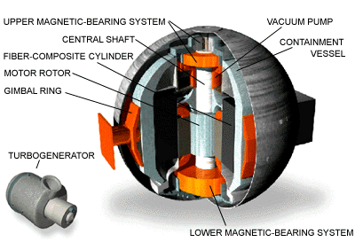
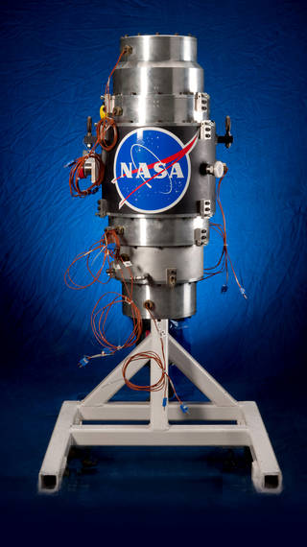
NASA Flywheels

Slide 11
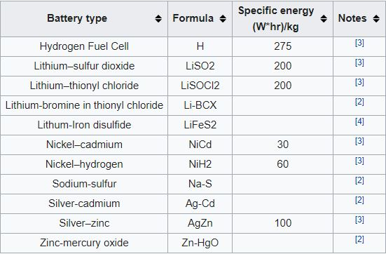
Satellite Batteries
Most common batteries used in spacecraft are Nickel-Cadmium batteries
Old technology batteries are still used since they have been tested on previous missions and are reliable.
Ni-Ca batteries are not rechargeable. Now being replaced by Li-ion Batteries
https://en.wikipedia.org/wiki/Batteries_in_space

Slide 12
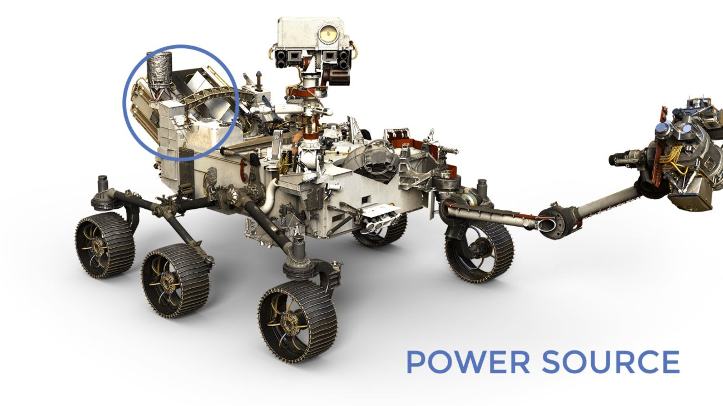
Power System on Perseverance

Slide 13
Perseverance Power System
The Perseverance rover used electrical power to move, communicate and conduct its scientific objectives on mars
Power is generated through the heat of plutonium's radioactive decay
Reactor is called Multi-mission Radioisotope Thermoelectric Generator(MMRTG)
Excess power from the MMRTG is stored in two lithium-ion Batteries
When peak power demand exceeds the MMRTG’s ability, power from storage is used

Slide 14
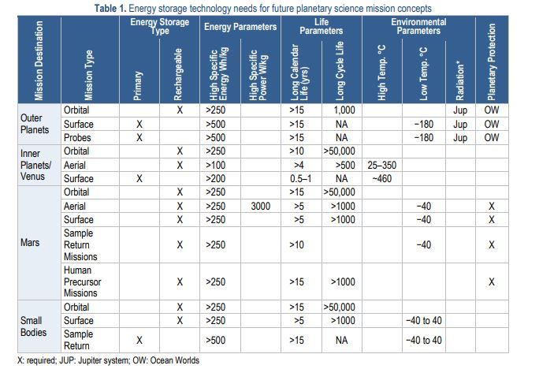
NASA/Jet Propulsion Laboratory-Caltech JPL D-101146

Slide 15
References
https://en.wikipedia.org/wiki/Batteries_in_space
https://www.nasa.gov/mission_pages/station/structure/elements/solar_arrays-about.html
https://www.nasa.gov/feature/spacewalkers-complete-multi-year-effort-to-upgrade-space-station-batteries
https://solarsystem.nasa.gov/resources/549/energy-storage-technologies-for-future-planetary-science-missions/
https://scitechdaily.com/nasa-astronauts-complete-four-year-effort-to-upgrade-the-batteries-of-the-international-space-stations-power-system/
https://mars.nasa.gov/mars2020/spacecraft/rover/electrical-power/
https://www.theverge.com/2018/8/17/17681422/nasa-lithium-ion-batteries-thermal-runaway-human-spaceflight

Slide 16
Thank you for listening
Any questions ?

